Slide 1


The Concorde
Team 2
Alex Xia | Arching Zhang | Santosh Srivatsa | Seshi Harianathan
OPIM 5270︱Hartford︱04/28/2016

Slide 2
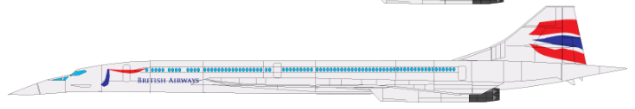
The Concorde - Outline
Background
What is Concorde
Scope and timing
Stakeholders
Description of failure
1
2
Analysis
Systematic Bias
Evidence
The
Concorde
Background
3
Conclusion
Influence of the Systematic Bias
4
Recommendations
Suggestions to mitigate the bias influence
Suggestions to the class

Slide 3

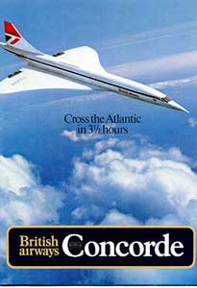
1
The Concorde - Background
What is Concorde
Concorde is a turbojet-powered supersonic passenger jet that was operated until 2003.
Concorde’s name means harmony or union, reflects the cooperation on the project between the United Kingdom and France.
Main Stakeholders: British and French governments
Scope: develop a long-range supersonic commercial aircraft focused on long distance, international travel.
Result: the final product failed because it was commercially unviable to operate on all air routes.
Source: Wikipedia – The Concorde: https://en.wikipedia.org/wiki/Concorde
Notes:
More on Goals:
By traveling close to Mach 2 for the majority of a flight’s duration, the Concorde was able to complete a transatlantic flight from Paris to New York in 3 hours, 45 minutes. Traditional subsonic aircraft completed the same journey in approximately 8 hours. (Concorde and Supersonic Civil Avaition, Saradhi Kumar, ICFAI Business School Case Development Centre)
Additionally, the Concorde provided a unique, cool flight experience. The Concorde’s cruising altitude was 56,000 feet, whereas traditional subsonic aircraft traveled below 40,000 feet. At this height, the curvature of the Earth was visible to passengers and the sky took on a dark blue, almost purple hue. These views were previously limited to military pilots and astronauts.
Lastly, when the Concorde traveled at supersonic speeds, passengers no longer heard the noise from the engines, contributing to a more peaceful in-flight environment.

Slide 4


1
The Concorde - Background
Project Timeline
1962
1975
1956
1969
2003
Development
Source: The Atlantic Monthly; January 1977; Supersonic Bust: The Story of the Concorde - 77.01; Volume 239, No. 1; page 72-81.
Notes:
Timeline:
1956 – Supersonic Transport Aircraft Committee (STAC) established to study the possibility of building a supersonic aircraft for service in commercial transport
1962 - By 1962, a formal agreement was reached between the two countries that agreed upon the aircraft specifications and divided responsibilities accordingly.
1957 – 1975 Development of the Concorde
British and French governments
Four independent companies - BAC and Sud Aviation (France) were responsible for building the frame of the aircraft and Bristol Siddeley (Britain) and SNECMA (France) were responsible for developing and producing the jet engines.
March 2, 1969 First Flight
20 aircraft were built including 6 prototypes and development aircraft. 14 aircraft entered service for 2 airlines
1976 – 2003 in service
November 26, 2003 - Retired

Slide 5
The Concorde - Outline
Background
1
Analysis
2
Systematic Bias
Evidence
Project Challenges
Project Costs
Stakeholder Actions
The
Concorde
Analysis
3
Conclusion
4
Recommendations

Slide 6




2
The Concorde - Analysis
Systematic Biases
Low
Medium
High
Extreme
Overconfidence
Confirmation Trap
Available Data
Sunk Cost
Sunk Cost
Conservatism
Escalation of Commitment
Selective Perception
Source: Barry Shore, PhD (2008). Project Culture and Systematic Biases in Project Failures. Project Management Journal.
Notes:
Selective Perception: This is also known as Frame Blindness. People have a way of looking at the world that fits into their preselected frameworks. They often fail to take into account data which contradicts their previously-chosen framework. One example of this, according to Dearborn and Simon, is when managers get promoted, their decisions they make may still be influenced by their previous roles. They have not adjusted their perception to their new roles.
Conservatism: As a project is executed, feedback is received and the project objectives may need to be revisited or the deliverables may need significant change. However, many project leaders may continue the project based on the original information, instead of taking the new feedback into consideration.
Escalation of Commitment: This is a bias that essentially leads to expending more project resources on resolving an issue. For example, throwing more money at a problem believing it will fix the issue, when really what you may need to do is reexamine the project altogether, or increase a different resource in order to meet the challenge.
The confirmation trap: Individuals tend to seek supportive information confirming what they think is true and neglect the search for opposing evidence.

Slide 7
2
The Concorde - Analysis
Evidence - 1956
Challenges
Costs were difficult to estimate at this stage.
Initial estimate costs would be in the range of £59 million to £95 million, depending on range, speed, and payload
Costs
Actions
Professor Henderson's more pessimistic formulation is ignored, STAC was off by a factor of around 15.
Scene 1 – 1956
Estimate (£)
Governments: Alex and Seshi
STAC: Santosh
Professor Henderson: Arching
£59m-95m
1956
1963
1966
1969
1975
Notes:
STAC – Supersonic Transport Aircraft Committee
STAC did say that costs were "difficult to estimate at this stage," but promptly overrode that caveat by stating that they would be in the range of £59 million to £95 million ($165 million to $266 million), depending on range, speed, and payload (At that time two versions were being considered: a Mach 1.2 plane carrying 100 people for 1500 miles, and a Mach 1.8 plane carrying 150 passengers from London to New York.) Even if the figure of £95 million ($266 million) is taken, and Professor Henderson's more pessimistic formulation is ignored, STAC was off by a factor of around 15.

Slide 8
2
The Concorde - Analysis
Evidence - 1963
first major design took place, discovered that the plane would fall short of New York by 500 miles
Challenges
Costs
First official costs reappraisal - £275 million
Britain made the most determined attempt to escape from the commitment but the government backed down because Britain might have to pay up to £200 million in damages
Actions
Scene 2 – 1963
Estimate (£)
£275m
Lead Engineer: Santosh
British Government: Alex
French Government: Seshi
£59m-95m
1956
1963
1966
1969
1975
Notes:
In 1963 it was discovered that the plane would fall short of New York by 500 miles; the first major design took place, and so did the first official reappraisal of costs, raised to £275 million, compared with the maximum estimateof £95 million. The STAC report had made. There was a further redesign in 1965: by 1966, the costs were given as £450 million ($1.26 billion). (http://www.theatlantic.com/past/docs/issues/77jan/gillman2.htm)
As work progressed, the very fine margins of original concept -- which Dietrich Kuchemann judged "just possible" -- became increasingly clear. The payload allowed for represented only 6 percent of the plane's overall weight -- compared with 12 percent for a Boeing 707 or a VC-10 -- and each time design snags increased the weight of other equipment, that percentage was further reduced. The original payload spoken of had been 150 passengers but this was soon reduced to 130; by 1968 it was found that this was no longer attainable and the fuselage, wings, and undercarriage had once more to be designed.
The most determined attempt Britain ever made to escape from its commitment came in 1964, when a Labour election victory ended the thirteen-year Conservative regime. The new aviation minister, Roy Jenkins, was dispatched to Paris to negotiate a withdrawal, but the French merely pointed to the terms of the agreement. The British attorney general said that Britain might have to pay up to £200 million ($560 million) in damages, and the government backed down. At several subsequent points both the British and the French governments wanted to end the project, but in view of the wording of the treaty, neither side could afford to let it appear that it was the one seeking cancellation, for the other would see a chance of recouping its own expenditure and would maintain that it, of course, wanted to carry on.

Slide 9
2
The Concorde - Analysis
Evidence – 1963-1969
All the technical challenges: Engine, Heating, Structural, Range, Radiation, Brakes and Undercarriage, Droop Nose
Challenges
Further redesigned took place: 1966 - £450 million
1969 - £730 million
Costs
Both the British and the French governments wanted to end the project, but didn’t happen due to potential lose for the one seeking cancellation
Actions
£730m
Scene 3 – 1963-1969
Estimate (£)
£450m
Lead Engineer: Santosh
British Government: Alex
French Government: Seshi
£275m
£59m-95m
1956
1963
1966
1969
1975
Notes:
In 1969, the cost £730 million ($1.75 billion); it rose to £1096 ($2.63 billion) by 1975. No one now mentions 150 even 130 passengers. British Airways hoped to fly into New York with 100. To Washington, because of the extra 200 miles, they cannot take more than eighty, and with Atlantic head winds some flights this winter have had a limit of seventy out of Bahrain, because of the heat, they can take off with only seventy-one.
Both the British and the French governments wanted to end the project, but didn’t happen due to potential lose for the one seeking cancellation
When Labour's rule ended in 1970, Edward Heath asked his government's "think tank" -- a body of unaffiliated intellectuals, headed by Lord Rothschild, and known formally as the Central Policy Review Staff -- to deliver a judgment on Concorde. When it came, it was simple enough. "Concorde," it began, "is a commercial disaster." But the report did accept that the plane carried considerable importance in terms of diplomacy and foreign relations. It could not recommend cancellation: that was a decision for government.

Slide 10
2
The Concorde - Analysis
Evidence - 1966
The British government's latest figures of development costs, shared between Britain and France are £1154 million
Total cost of £1460 million (production cost + losses sustained through operation)
£1154m
£730m
Estimate (£)
£450m
£275m
£59m-95m
1956
1963
1966
1969
1975
Notes:
Technically – Success
What about Financially? Commercially?
Hopefully they could make their money back.
The British government's latest figures of development costs, shared between Britain and France are £l154 million. To that must be added production costs and losses sustained through operating Concorde by British Airways and Air France bringing the total to around £1460 million.
Developing a supersonic transport system required tremendous resource allocation from the French and British governments as well as British Airways and Air France. The primary investments were made for Research and Development; in total four prototypes were designed costing £1.134 Billion which was split by the two governments. After carefully refining the prototypes the Concorde was put into production, which included a run of sixteen aircrafts. Of this production run, two aircrafts were used for testing and training and fourteen were put into service.

Slide 11


2
The Concorde - Analysis
Operation Costs
Virtually ordered to do so by the British government with guarantee to underwrite their losses
Price was a very favorable £23 million each V.S. £35 million
$1.35 million for new passenger facilities at Heathrow
$900,000 for an advertising campaign in Britain
Initially bought 4 aircrafts. The remaining 3 were given to them at huge discount
The Atlantic Monthly; January 1977; Supersonic Bust: The Story of the Concorde - 77.01; Volume 239, No. 1; page 72-81.
“The Concorde Saga”, Shirisha Regani, ICMR Center for Management Research
Notes:
>100 initial orders from 16 airlines
20 aircraft were built including 6 prototypes and development aircraft. 14 aircraft entered service for 2 airlines
The only two airlines to buy the planes remain the two respective national carriers, British Airways and Air France. British Airways was virtually ordered to do so by the British government; the price was a very favorable £23 million each, against the present selling price of £35 million ($56 million), and they extracted a guarantee from the government to underwrite their losses. In 1974 British Airways calculated that these losses could be as much as £25 million a year.
Of the fourteen aircrafts put into service, British Airways purchased five and Air France purchased four. To the demise of the British and French government viable buyers outside of British Airways and Air France could not be identified to purchase the remaining five aircrafts. As a result the aircrafts were given to British Airways and Air France for pennies on the dollar.
Expenditure continues: $1.35 million for new passenger facilities at Heathrow: $900,000 for an advertising campaign in Britain

Slide 12
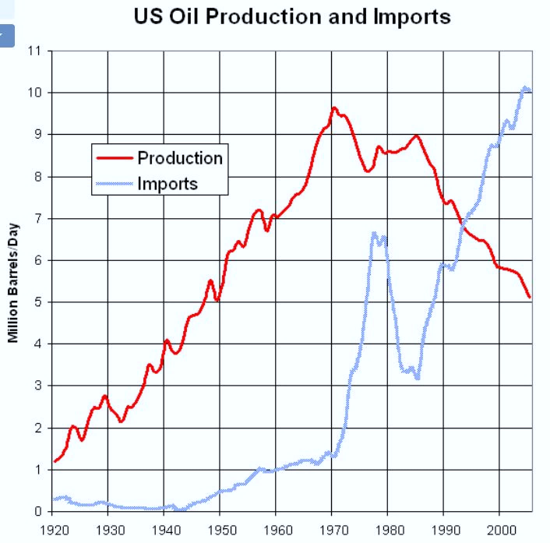
2
The Concorde - Analysis
Operation Costs
Expensive parts and maintenance
Specially trained pilots and crew
Fuel intensive
Notes:
The second challenge the countries faced was in the area of costs. Supersonic flight is significantly more fuel intensive than subsonic flight, given the drag and friction that results at high speed air travel. This meant that the Concorde burned over 4 times the amount of fuel per passenger, as compared to a traditional commercial airplane4. Given that fuel is a fixed per-flight cost, this already meant that flying the Concorde was going to be expensive.
Additionally, the Concorde needed unique parts and maintenance that were completely different from other types of aircraft. The Concorde’s parts suppliers thus were not able to achieve scale by manufacturing Concorde parts, which kept these parts expensive.
Concorde required specially trained pilots and crew, which added even more cost.

Slide 13


2
The Concorde - Analysis
Operation Profitability
In the 1970s the UK and French governments continued to take a cut of any airline profits. (80% for British Airways)
In 1984, British Airways paid British government to buy their Concorde’s outright. It has been reported that BA made a profit of £30-£50 million per year
They cited low passenger numbers following the 25 July 2000 crash, the slump in air travel following 9/11 and rising maintenance costs.
Notes:
In the 1970s the UK and French governments continued to take a cut of any airline profits. (80% for British Airways)
In the 1980s after posting large losses on their Concorde flights , British Airways paid a flat sum of £16.5 million in 1984 to the UK government to buy their Concorde’s outright.
It has been reported that BA made a profit of £30-£50 million per year and a total profit of £1.75 billion on costs of £1 billion during it’s service
They cited low passenger numbers following the 25 July 2000 crash, the slump in air travel following 9/11 and rising maintenance costs.
On 10 April 2003 British Airways and Air France simultaneously announced that they would retire the Concorde later that year.

Slide 14
The Concorde - Outline
Background
1
2
Analysis
The
Concorde
Conclusion
3
Conclusion
Influence of the Systematic Bias
4
Recommendations

Slide 15
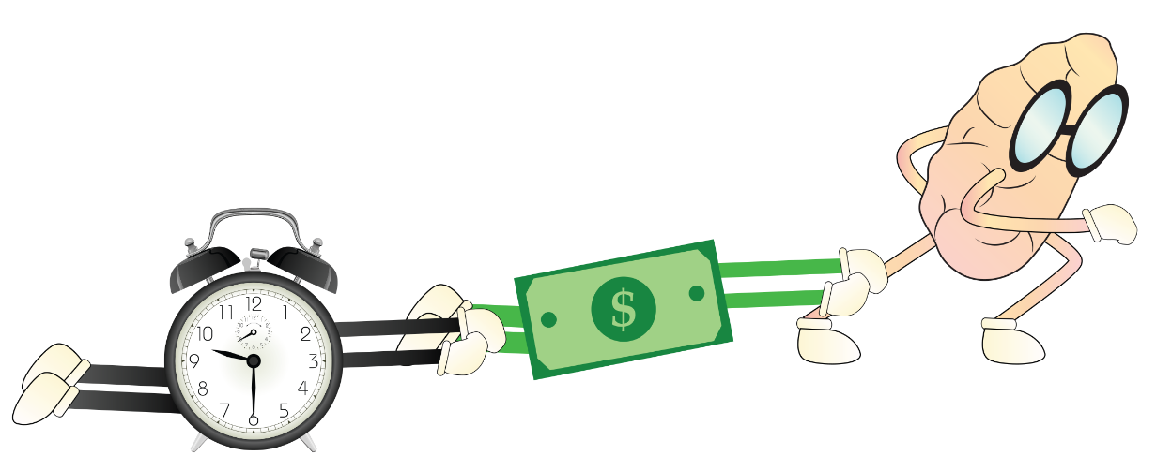
3
The Concorde - Conclusion
Conclusion
Sunk cost bias influenced the project at various stages:
1st major redesign, 2nd redesign, Operating stage, Maintenance
Both governments wanted to end the project several times but it didn’t happen because the more they invested in it, the harder it became for them to abandon it.
The emotional realization that the investment can’t be recovered created this irrational push to carry on down the road even though a poor outcome is inevitable.
Notes:
1&2. The project was predicted to be a failure early on; but everyone involved kept going. Their shared investment built a hefty psychological burden which outweighed their better judgments. After losing an incredible amount of money, effort and time, they didn’t want to just give up.

Slide 16
The Concorde - Outline
Background
1
2
Analysis
The
Creative Life
Recommendations
3
Conclusion
4
Recommendations
Suggestions to mitigate the bias influence
Suggestions to the class

Slide 17
4
The Concorde - Recommendations
Suggestions to Concorde Team
Launch the pre-emptive conversation.
Teams should think through the scenario when they can still think clearly, without sunk costs clouding their judgment.
Create constructive tension.
Actualize assumptions, generate alternatives
Actively monitor and control the project progress
Be aware of bias, evaluate status timely and avoid emotional decision
Include a stopping point in the contract
Source: Michael Roberto, Cutting Your Loses: How to Avoid the Sunk Cost Trap
Notes:
1&2. Leaders need to consider how they set the stage for the difficult conversation that will eventually take place if an organization must admit failure, cut its losses, and abandon a project. one must prepare carefully for that conversation about abandoning a mission and turning back. You cannot have the discussion with your team for the first time while staring at the finish line of the project. Instead, an effective leader brings the team together long before setting out on the journey. Prior to meeting with the team, the leader envisions a multitude of scenarios in which things go dramatically wrong, and he or she thinks through how and why the initial plan might have to be abandoned in favor of a quite different course of action. teams ought to have these conversations before they have incurred sizeable sunk costs. In other words, think through the scenario when you can still think clearly, without sunk costs clouding your judgment.
3. They could have assigned an unbiased outsider to help project teams evaluate their progress at a set of pre-determined milestones. This process worked most effectively when teams established a clear set of milestones and metrics at the outset of the project. Therefore, the unbiased outsider could employ relatively objective and mutually agreed-upon criteria for evaluating whether the team should continue forward. The unbiased outsider should be someone with substantial status within the organization. That status tended to insure that the outsider would be willing to speak candidly, and that the project team would be unlikely to dismiss their feedback and concerns.
4. Organizational leaders must ask their teams: “What must be true for us to conclude that we can turn around this failing project? What are we assuming about our capabilities, our customers, etc.? Are these assumptions valid?” Often, making these assumptions explicit exposes the improbability of a successful turnaround.
5&6. Actively monitor the project status timely, during the monitor process, be aware of the biases to stay on their course of action. While considering other options, evaluate the status quo as it was just another option, rather than the front-runner. Also, try to detach yourself emotionally from your past decisions. Be especially careful with things that worked at some point in the past as this is not a guarantee that they’ll work in your favor again.
7. The contract between two governments played a significant role during the decision making processes. They could have included a stopping point in the contract so that neither government needs to take the fault and pay the penalty by canceling the project.

Slide 18
4
Suggestions to the Class
I like to practice what I call “zero-based thinking”. Forget about the past and consider this very moment as your “point-zero” in time
I like to play the game Farmville: a commitment to a virtual life form. Your neglect has consequences. If you don’t return, your investments die and you will feel like you wasted your time, money and effort.
I found these articles very helpful and interesting. Certainly made me think why humans care about sunk costs while animals don’t.
“The Sunk Cost and Concorde Effects: Are Humans Less Rational than Lower Animals?” by Arkes, Hal R., and Peter Ayton.
“Why Humans Care About Sunk Costs While Animals Don’t.” by Höffler, Felix.
Notes:
Sunk costs drive wars, push up prices in auctions and keep failed political policies alive. The fallacy makes you finish the meal when you are already full. It fills your home with things you no longer want or use. Every garage sale is a funeral for someone’s sunk costs.
When you lose something permanently, it hurts. The drive to mitigate this negative emotion leads to strange behaviors. Have you ever gone to see a movie only to realize within 15 minutes or so you are watching one of the worst films ever made, but you sat through it anyway? You didn’t want to waste the money, so you slid back in your chair and suffered. What about that time you made it back home with a bag of chips, and after the first bite you hated it, but you ate them anyway not wanting to waste both money and food? If you’ve experienced a version of any of these, congratulations, you fell victim to the sunk cost fallacy.
1. I like to practice what I call “zero-based thinking”. Forget about the past and consider this very moment as your “point-zero” in time: act like all you have is the present. I often do this by pretending that I just woke up with some sort of amnesia. I imagine myself in my current situation, but without any knowledge of how I got there. This way, it’s much easier to focus on my current situation, instead of clinging to past decisions that would drag me down.
2. Play the game Farmville: Farmville is a commitment to a virtual life form. Your neglect has consequences. If you don’t return, your investments die and you will feel like you wasted your time, money and effort. You must return, sometimes days later, to reap the reward of the time and virtual money you are spending now. If you don’t, not only do you not get rewarded, you lose your investments.
3.
Ariely, D. (2009). Predictably irrational, revised and expanded edition: The hidden forces that shape our decisions. Harper. (Amazon link)
Arkes, Hal R., and Peter Ayton. “The Sunk Cost and Concorde Effects: Are Humans Less Rational than Lower Animals?” Psychological Bulletin 125.5 (1999): 591-600. Print. (pdf)
Höffler, Felix. “Why Humans Care About Sunk Costs While (Lower) Animals Don’t.” The Max Planck Institute for Research on Collective Goods, 31 Mar. 2008. Web. Mar. 2011. (pdf)

Slide 19

The Concorde
THANK YOU!
Team 2
Alex Xia | Arching Zhang | Santosh Srivatsa | Seshi Harianathan
OPIM 5270︱Hartford︱04/28/2016

