Slide 1
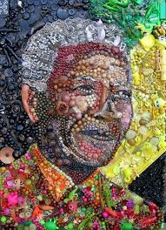
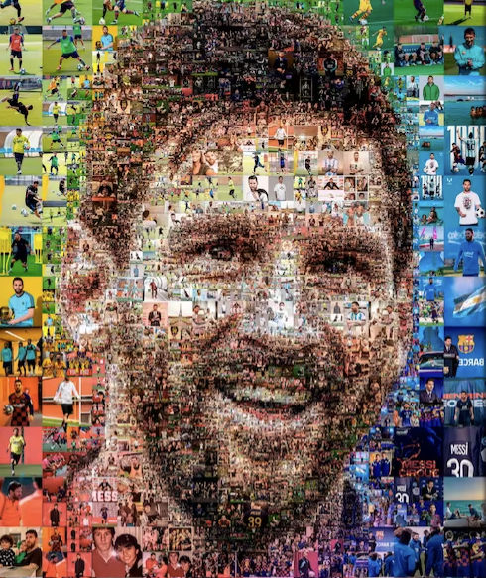
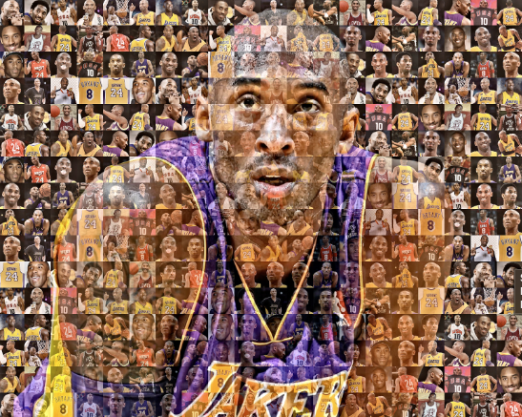
PIXEL IT

Slide 2



Purpose
Main Benefits
Greater access
A digital art auction gallery that combines contributor images and AI-gererated works, and provides a platform for bidding and claiming verifiable ownership of the artifacts
Easier search
Time & carbon saver

Slide 3



The usual suspects are back in action…
Alejandra
Torres
Edward
Arnold
Session
Mwamufiya

Slide 4

An approach compartmentalized and linked…
STEP B
01
03
Generate sample accounts to launch and participate on the platform.
STEP D
START
Pinata
Remix
Time-permitting, create a visual interface to interact with the platform on a web interface.
STEP A
02
04
Obtain a tokenized URI for digital art works to be used on the bidding platform.
STEP C
FINISH
Leverage and optimize Solidity code for an NFT auction that implements OpenZeppelin libraries.
Ganache
StreamLit

Slide 5
Win some, lose some…
PROS & CONS
Winning Team
Library Versioning
We have worked well together in the past, and leveraged that dynamic.
Ganache doesn’t work with the latest Solidity compilers, so finding the right versions of libraries was complex.
Code Reuse
Web3 Knowledge
Sampled auction solutions in Solidity, and settled on one that best fit our needs.
Our abilities were limited in developing a web3 interface to interact with the platform via StreamLit.
Great Support
We navigated around our limitations!
Time Zone Difference
Kevin Lee got us unstuck, and was very helpful in navigating versioning and other issues.
The team overlapped multiple time zones during most of the project, so intermediary touchpoints were limited.

Slide 6
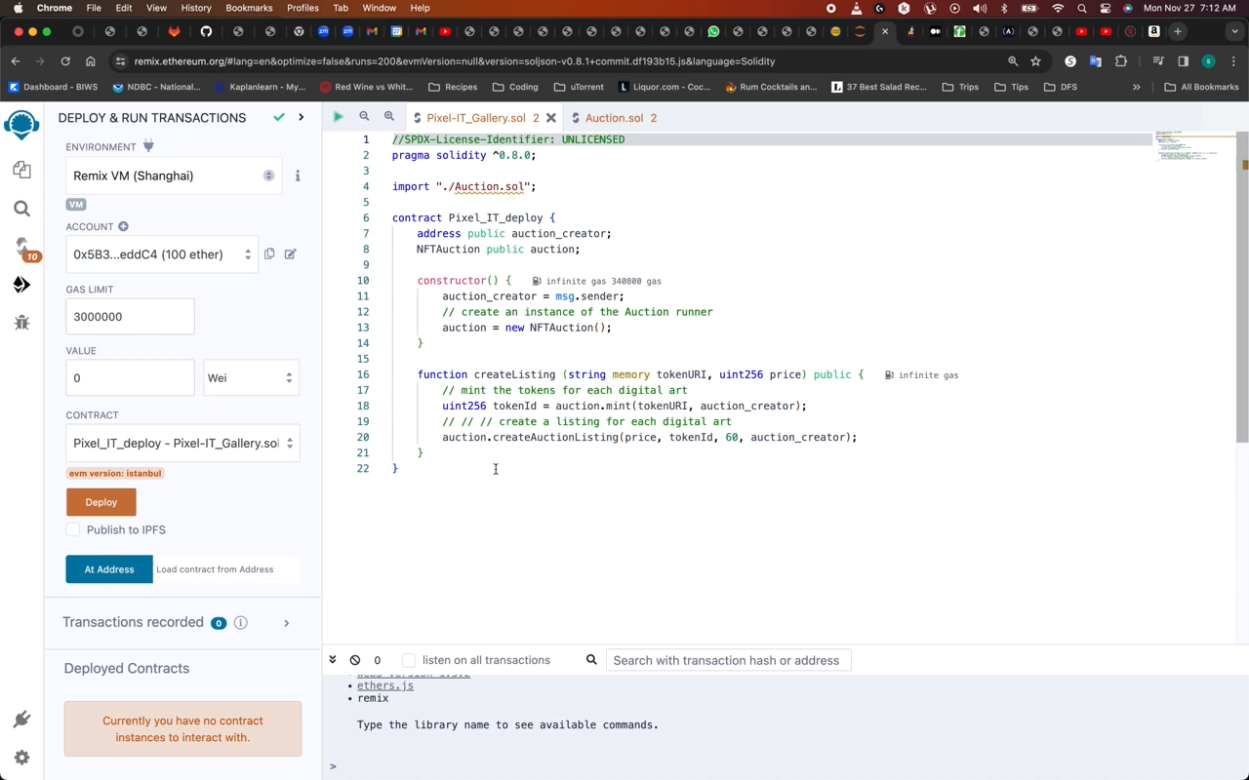
Let’s tinker with it…
DEMO

Slide 7
There is ample room for improvement…
Enhance
Iterate
Improve the user experience with an appealing functionality layout in StreamLit
Build and test out additional functionalities on the platform, such as validating ownership of token URIs, and force-ending open auctions as a seller
Research
Expand
Determine how to properly link Ganache accounts and Solidity contracts via Web3.
Enable users to add their own digital token URIs to an auction, and launch it.
Continuous Improvement

Slide 8

THANK YOU!

