Slide 1
Intro to Identifying Networks
A Look at Sequential Substitution Systems
By: Jeanna Toulouse
Chris Trana
Dr. Ken Caviness

Slide 2
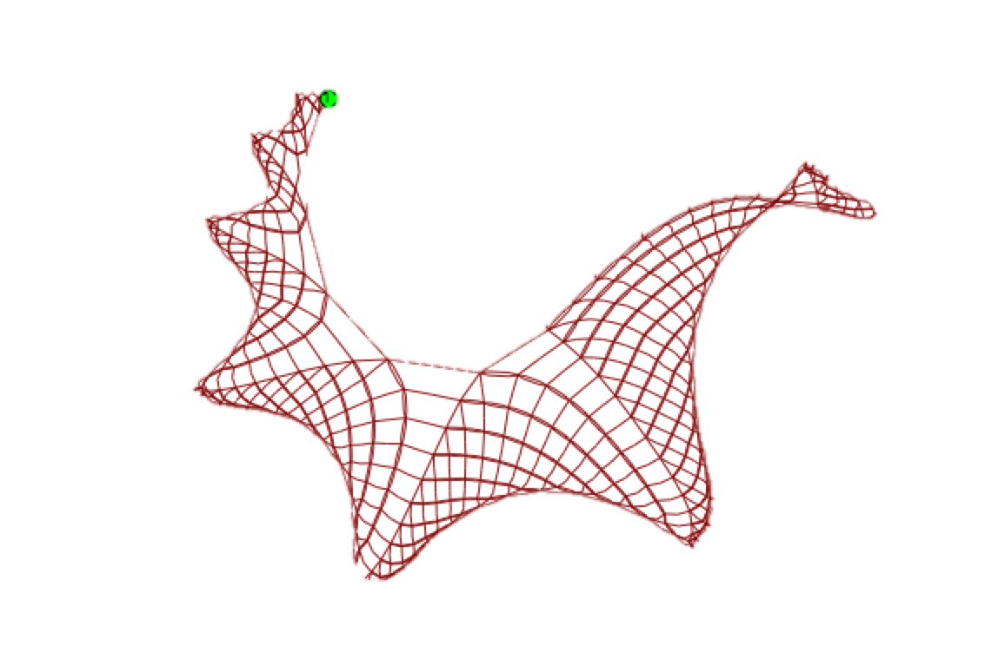
SESSIEs
Can simple rules explain the complex patterns of the universe?
Notes:
Need photo of the most incredible sessie to-date.
Very complicated patterns that are created by very simple rules.
Simple explanations usually work to create complicated things that are seen in nature or in the universe.

Slide 3
SESSIEs
What they are:
Sequential Substitution Systems
A set of rules are applied to construct a network (A grid of cells tells each node what to do)
To look for patterns and complex behavior
“Substitution” → we substitute one cell for another. This tells the SESSIE to go on down the line following the rules and creating a network until reaching a potential stopping point

Slide 4
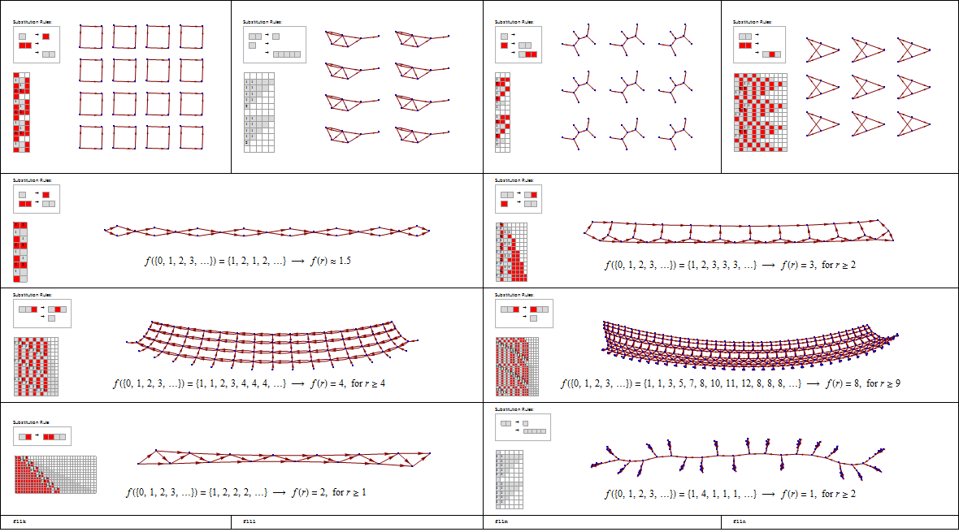
Different Rule Sets → Different Sessies → Different Networks

Slide 5
Different Rule Sets → Different Sessies → Different Networks

Slide 6
Different Rule Sets → Different Sessies → Different Networks

Slide 7
Network Dimension 1-D
Notes:
1-D disconnected and 1-D connected

Slide 8
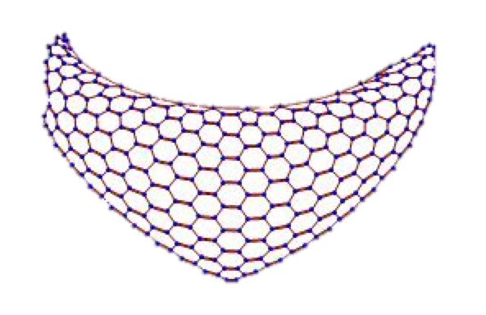
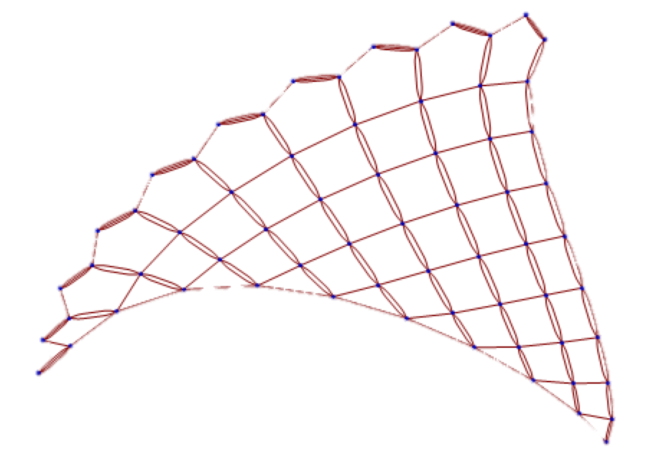
Network Dimension 2-D
Notes:
2D

Slide 9
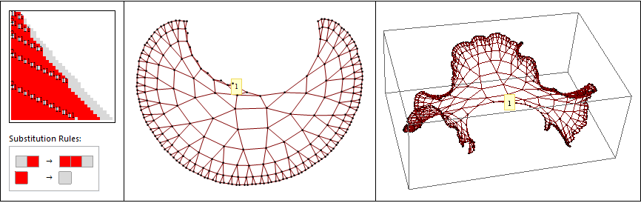
Network Dimension 3-D
Notes:
3D

Slide 10

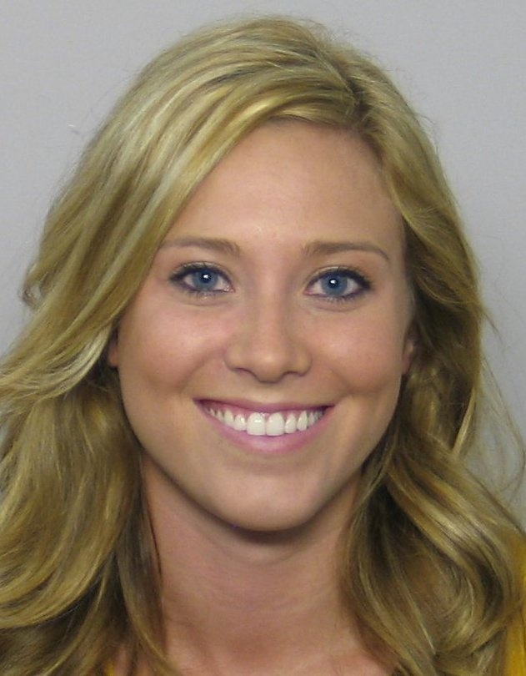
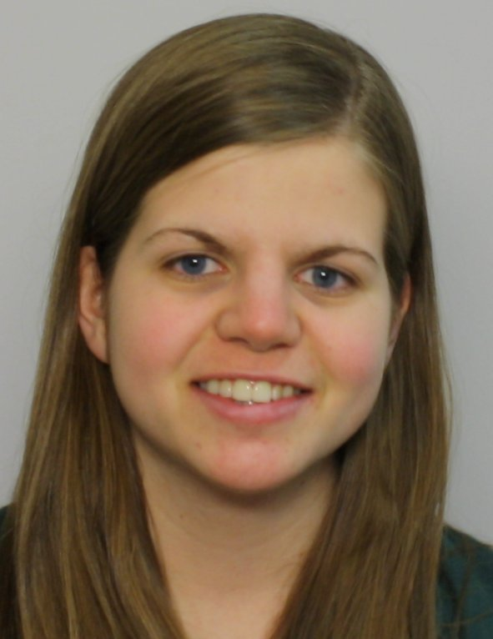
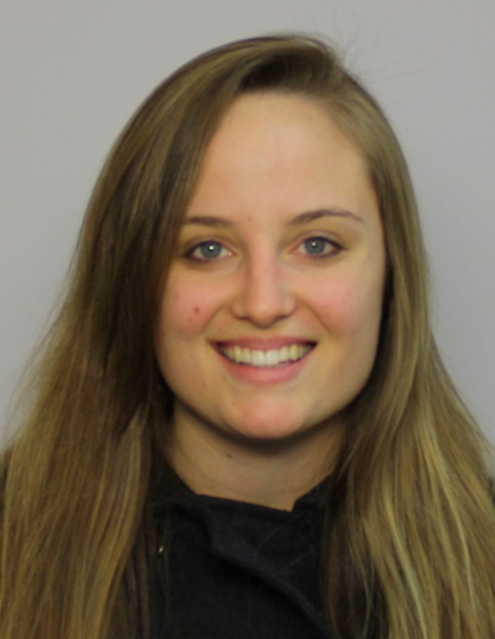
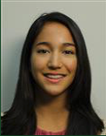

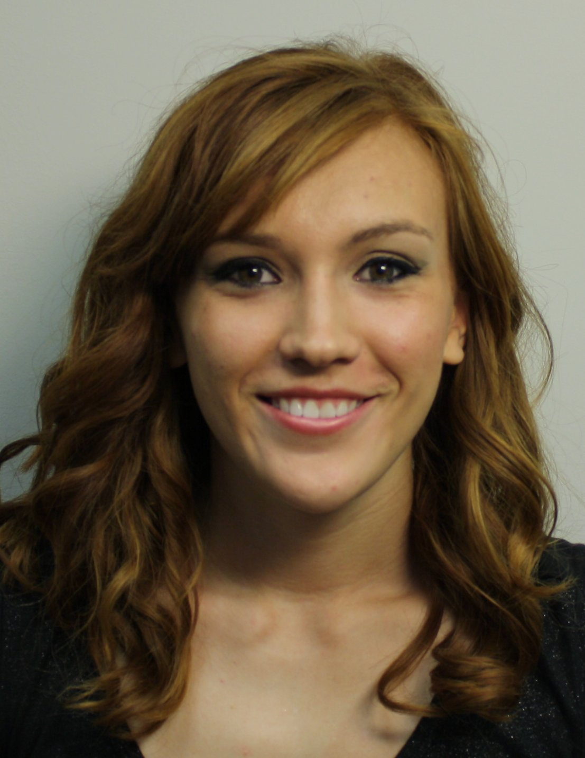

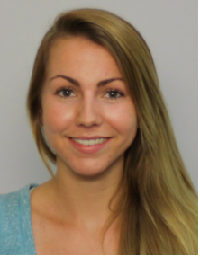

Recap
Overview of SESSIEs up until this point
Breanna Bowden-Green W11
Kelsey Dobbs, W10
1. Human inspection of networks.
Amy Bead W12
2. Mathematical treatment of network properties.
Christen Case F14
Jade Deschamps ?
3. Improved enumeration & acceleration.
Lucas Valenca
F16
Camille Morrow
W18
Drew Blake
W17
Jeanna Toulouse
W19
Christofer Trana
W19
4. Programmatic identification of dimension.
5. Identifying Networks

Slide 11
Steps Toward Identifying Networks
Where our research begins

Slide 12
Creating Summaries for Networks
{1→2, 2→3, 3→4, 4→5, 5→6, 6→7, 7→8 ..... }: Summary: {{1→2}, +1}
Done by hand
What does this mean to a newcomer?
Notes:
…… means that all networks go on forever, except dead ones (That we don’t care about). We only care about repeating sessies, no “dead” or non-initiating cases.
Done by hand first, summarized by a human in order to make a way for the computer to do the same but automatically. Add photo along with summary.

Slide 13
Normalizing Summaries
Subtract numbers to make the smallest node in a network a 1.

Slide 14
Reducing 1D Summaries
Notes:
Taking the network and subtracting the nodes. So we replace every link by a difference.
Take one subtraction and if the difference between nodes does not increase, if it is always 1D: 1,1,1,1,…,1 : Computer generated summary: {1}
- Should we call this reducing summaries or normalizing summaries?

Slide 15
Reducing 2D Summaries
Difference between nodes is growing:
{1,1,2,1,2,4,
1,1,2,1,3,1,5,5
1,1,2,1,4,1,6,1,6,6}
{1 2,1 2,1 3,2->3,2->4,3->7,4->5,4->5,4->6,5->6,5->8,6->7,6->11,7->12,8->9,8->9,8->10,9->10,9->
Notes:
Differences between nodes is growing but the difference between them is still 1.
Show colored sessie, then show growing network, then say that we are focusing on find the difference between the nodes.
Find colored sessie on mathematica – examples, scroll down to 2D and 3D case.

Slide 16
Reducing 3D Summaries
Notes:
Difference between nodes is growing and the difference between those differences is also growing.

Slide 17
Take Summaries & Convert them into a Mathematical Definition

