Slide 1
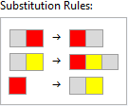
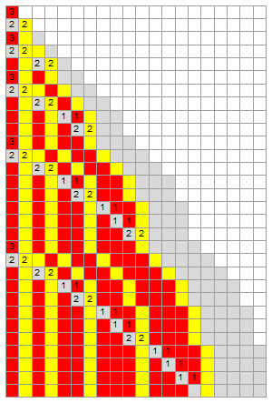
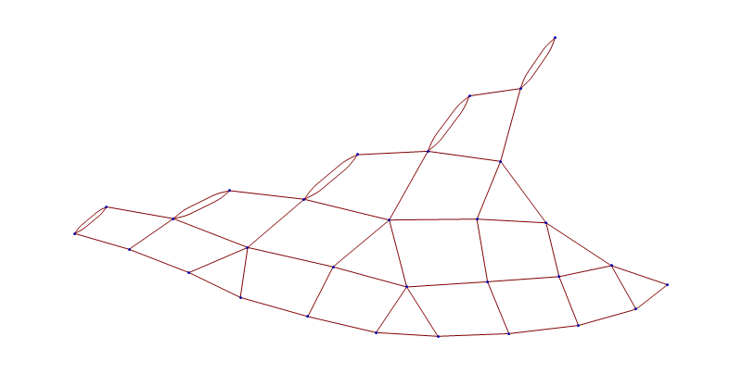
Our first 3-d network: {"AB"->"BA", "AC"->"BCA", "B"->"AC"}
Notes:
This is our first case of a Sessie ruleset generating a three-dimensional causal network. At first the network looks 2-d, as if it could lie flat in a plane, …

Slide 2
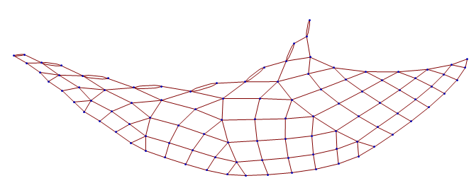
Our first 3-d network: {"AB"->"BA", "AC"->"BCA", "B"->"AC"}
Notes:
But it soon needs to curve in order to lie flat, …

Slide 3
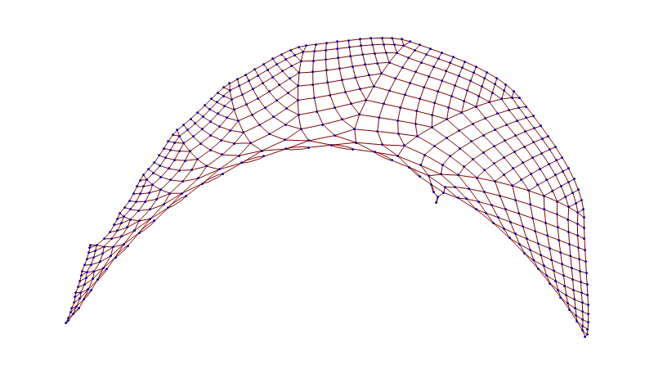
Our first 3-d network: {"AB"->"BA", "AC"->"BCA", "B"->"AC"}
Notes:
And eventually it would curve back over itself

Slide 4
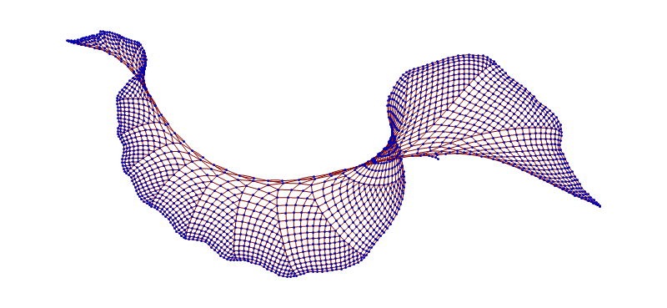
Our first 3-d network: {"AB"->"BA", "AC"->"BCA", "B"->"AC"}
Notes:
Or start filling up a 3rd dimension. This could be arranged to evenly fill a growing cone-shape in 3 dimensions, but it does need 3-d.

Slide 5

Our first 3-d network: {"AB"->"BA", "AC"->"BCA", "B"->"AC"}
Let’s build this ruleset from its base-5 code identifier:
The subscript “5” just reminds us that here are only 5 allowed digits:
0, 1, 2, 3, 4
Each digit has a precise significance for constructing the ruleset, and this base-5 code identifies and results in one unique ruleset.
Notes:
All sessies are generated from sets of substitution rules, and every ruleset corresponds to a unique code number. Let’s build this ruleset …

Slide 6
Our first 3-d network: {"AB"->"BA", "AC"->"BCA", "B"->"AC"}
Base-5 digit meanings:
0. End this string, insert two empty strings, start a new string with an “A”.
1. End this string, insert one empty string, start a new string with an “A”.
2. End this string and start a new string with an “A”.
3. End this character and start a new character (as an “A”).
4. Increment this character.
Notes:
You’ll start to recognize the meaning of the different digit codes as we work through this example….

Slide 7
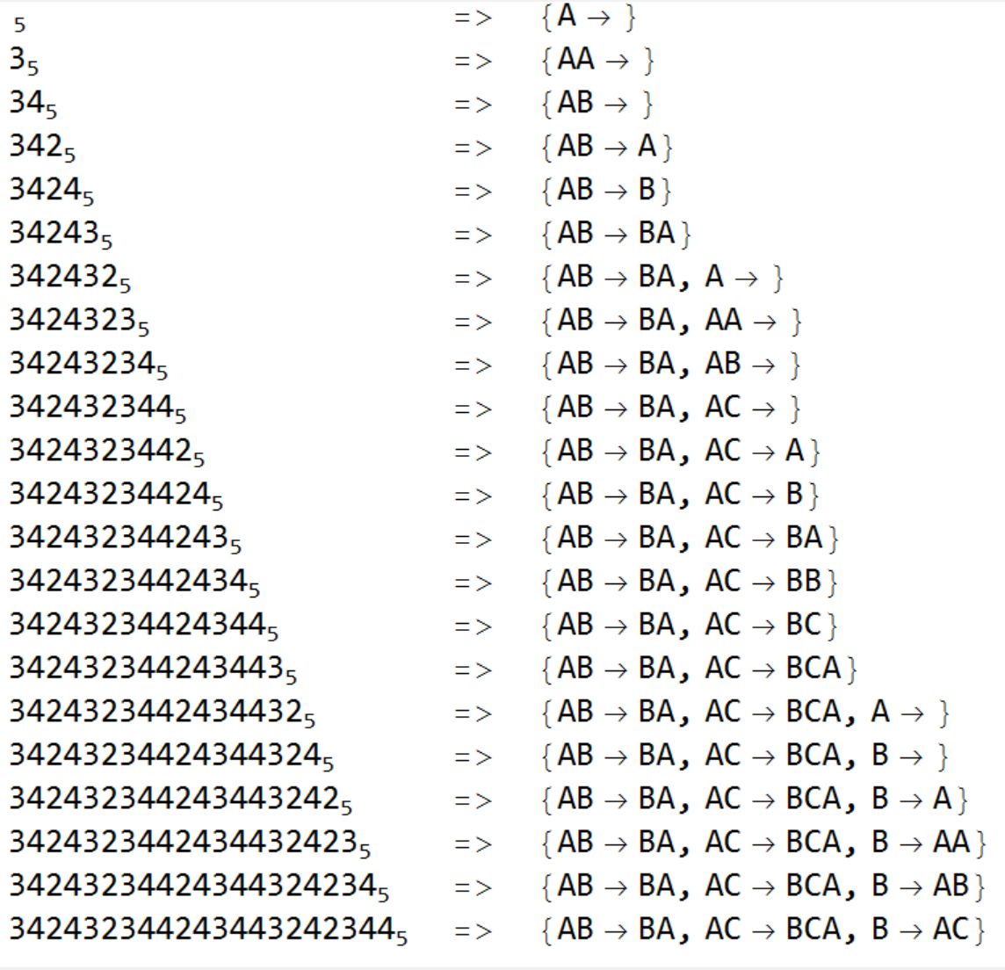
Base-5 digit meanings:
0. End this string, insert two empty strings and start a new string with an “A”.
1. End this string, insert one empty string and start a new string with an “A”.
2. End this string and start a new string with an “A”.
3. End this character and start a new character (as an “A”).
4. Increment this character.
Ruleset under construction:
Notes:
Camille, can you make the window at the bottom scroll up?
After all the code digits are scanned, the complete ruleset has been built. Wait, that was too fast!

Slide 8
Base-5 digit meanings:
0. End this string, insert two empty strings and start a new string with an “A”.
1. End this string, insert one empty string and start a new string with an “A”.
2. End this string and start a new string with an “A”.
3. End this character and start a new character (as an “A”).
4. Increment this character.
Digit being treated: 342432344243443242344
Ruleset under construction:
Start: {“A”}
Notes:
Let’s look at it one step at a time. Even before we look at any of the digits, we start the ruleset with a single “A”.

Slide 9
Base-5 digit meanings:
0. End this string, insert two empty strings and start a new string with an “A”.
1. End this string, insert one empty string and start a new string with an “A”.
2. End this string and start a new string with an “A”.
3. End this character and start a new character (as an “A”).
4. Increment this character.
Digit being treated: 342432344243443242344
Ruleset under construction:
{“A”}
=> {“AA”}
Notes:
3 means “append an A”

Slide 10
Base-5 digit meanings:
0. End this string, insert two empty strings and start a new string with an “A”.
1. End this string, insert one empty string and start a new string with an “A”.
2. End this string and start a new string with an “A”.
3. End this character and start a new character (as an “A”).
4. Increment this character.
Digit being treated: 342432344243443242344
Ruleset under construction:
{“AA”}
=> {“AB”}
Notes:
4 means “increment the final character”

Slide 11
Base-5 digit meanings:
0. End this string, insert two empty strings and start a new string with an “A”.
1. End this string, insert one empty string and start a new string with an “A”.
2. End this string and start a new string with an “A”.
3. End this character and start a new character (as an “A”).
4. Increment this character.
Digit being treated: 342432344243443242344
Ruleset under construction:
{“AB”}
=> {“AB”->“A”}
Notes:
2 means “end this string and start a new string with a single A”

Slide 12
Base-5 digit meanings:
0. End this string, insert two empty strings and start a new string with an “A”.
1. End this string, insert one empty string and start a new string with an “A”.
2. End this string and start a new string with an “A”.
3. End this character and start a new character (as an “A”).
4. Increment this character.
Digit being treated: 342432344243443242344
Ruleset under construction:
{“AB”->“A”}
=> {“AB”->“B”}
Notes:
Increment the A to become a B

Slide 13
Base-5 digit meanings:
0. End this string, insert two empty strings and start a new string with an “A”.
1. End this string, insert one empty string and start a new string with an “A”.
2. End this string and start a new string with an “A”.
3. End this character and start a new character (as an “A”).
4. Increment this character.
Digit being treated: 342432344243443242344
Ruleset under construction:
{“AB”->“B”}
=> {“AB”->“BA”}
Notes:
Append an A

Slide 14
Base-5 digit meanings:
0. End this string, insert two empty strings and start a new string with an “A”.
1. End this string, insert one empty string and start a new string with an “A”.
2. End this string and start a new string with an “A”.
3. End this character and start a new character (as an “A”).
4. Increment this character.
Digit being treated: 342432344243443242344
Ruleset under construction:
{“AB”->“BA”}
=> {“AB”->“BA”, “A”}
Notes:
Start a new string

Slide 15
Base-5 digit meanings:
0. End this string, insert two empty strings and start a new string with an “A”.
1. End this string, insert one empty string and start a new string with an “A”.
2. End this string and start a new string with an “A”.
3. End this character and start a new character (as an “A”).
4. Increment this character.
Digit being treated: 342432344243443242344
Ruleset under construction:
{“AB”->“BA”, “A”}
=> {“AB”->“BA”, “AA”}
Notes:
Append an A

Slide 16
Base-5 digit meanings:
0. End this string, insert two empty strings and start a new string with an “A”.
1. End this string, insert one empty string and start a new string with an “A”.
2. End this string and start a new string with an “A”.
3. End this character and start a new character (as an “A”).
4. Increment this character.
Digit being treated: 342432344243443242344
Ruleset under construction:
{“AB”->“BA”, “AA”}
=> {“AB”->“BA”, “AB”}
Notes:
Increment the A to become a B

Slide 17
Base-5 digit meanings:
0. End this string, insert two empty strings and start a new string with an “A”.
1. End this string, insert one empty string and start a new string with an “A”.
2. End this string and start a new string with an “A”.
3. End this character and start a new character (as an “A”).
4. Increment this character.
Digit being treated: 342432344243443242344
Ruleset under construction:
{“AB”->“BA”, “AB”}
=> {“AB”->“BA”, “AC”}
Notes:
Increment the B to become a C

Slide 18
Base-5 digit meanings:
0. End this string, insert two empty strings and start a new string with an “A”.
1. End this string, insert one empty string and start a new string with an “A”.
2. End this string and start a new string with an “A”.
3. End this character and start a new character (as an “A”).
4. Increment this character.
Digit being treated: 342432344243443242344
Ruleset under construction:
{“AB”->“BA”, “AC”}
=> {“AB”->“BA”, “AC”->“A”}
Notes:
Start a new string

Slide 19
Base-5 digit meanings:
0. End this string, insert two empty strings and start a new string with an “A”.
1. End this string, insert one empty string and start a new string with an “A”.
2. End this string and start a new string with an “A”.
3. End this character and start a new character (as an “A”).
4. Increment this character.
Digit being treated: 342432344243443242344
Ruleset under construction:
{“AB”->“BA”, “AC”->“A”}
=> {“AB”->“BA”, “AC”->“B”}
Notes:
Increment

Slide 20
Base-5 digit meanings:
0. End this string, insert two empty strings and start a new string with an “A”.
1. End this string, insert one empty string and start a new string with an “A”.
2. End this string and start a new string with an “A”.
3. End this character and start a new character (as an “A”).
4. Increment this character.
Digit being treated: 342432344243443242344
Ruleset under construction:
{“AB”->“BA”, “AC”->“B”}
=> {“AB”->“BA”, “AC”->“BA”}
Notes:
Append

Slide 21
Base-5 digit meanings:
0. End this string, insert two empty strings and start a new string with an “A”.
1. End this string, insert one empty string and start a new string with an “A”.
2. End this string and start a new string with an “A”.
3. End this character and start a new character (as an “A”).
4. Increment this character.
Digit being treated: 342432344243443242344
Ruleset under construction:
{“AB”->“BA”, “AC”->“BA”}
=> {“AB”->“BA”, “AC”->“BB”}
Notes:
Increment

Slide 22
Base-5 digit meanings:
0. End this string, insert two empty strings and start a new string with an “A”.
1. End this string, insert one empty string and start a new string with an “A”.
2. End this string and start a new string with an “A”.
3. End this character and start a new character (as an “A”).
4. Increment this character.
Digit being treated: 342432344243443242344
Ruleset under construction:
{“AB”->“BA”, “AC”->“BB”}
=> {“AB”->“BA”, “AC”->“BC”}
Notes:
Increment

Slide 23
Base-5 digit meanings:
0. End this string, insert two empty strings and start a new string with an “A”.
1. End this string, insert one empty string and start a new string with an “A”.
2. End this string and start a new string with an “A”.
3. End this character and start a new character (as an “A”).
4. Increment this character.
Digit being treated: 342432344243443242344
Ruleset under construction:
{“AB”->“BA”, “AC”->“BC”}
=> {“AB”->“BA”, “AC”->“BCA”}
Notes:
Append

Slide 24
Base-5 digit meanings:
0. End this string, insert two empty strings and start a new string with an “A”.
1. End this string, insert one empty string and start a new string with an “A”.
2. End this string and start a new string with an “A”.
3. End this character and start a new character (as an “A”).
4. Increment this character.
Digit being treated: 342432344243443242344
Ruleset under construction:
{“AB”->“BA”, “AC”->“BCA”}
=> {“AB”->“BA”, “AC”->“BCA”, “A”}
Notes:
Start a new string

Slide 25
Base-5 digit meanings:
0. End this string, insert two empty strings and start a new string with an “A”.
1. End this string, insert one empty string and start a new string with an “A”.
2. End this string and start a new string with an “A”.
3. End this character and start a new character (as an “A”).
4. Increment this character.
Digit being treated: 342432344243443242344
Ruleset under construction:
{“AB”->“BA”, “AC”->“BCA”, “A”}
=> {“AB”->“BA”, “AC”->“BCA”, “B”}
Notes:
Increment

Slide 26
Base-5 digit meanings:
0. End this string, insert two empty strings and start a new string with an “A”.
1. End this string, insert one empty string and start a new string with an “A”.
2. End this string and start a new string with an “A”.
3. End this character and start a new character (as an “A”).
4. Increment this character.
Digit being treated: 342432344243443242344
Ruleset under construction:
{“AB”->“BA”, “AC”->“BCA”, “B”}
=> {“AB”->“BA”, “AC”->“BCA”, “B”->“A”}
Notes:
Start a new string

Slide 27
Base-5 digit meanings:
0. End this string, insert two empty strings and start a new string with an “A”.
1. End this string, insert one empty string and start a new string with an “A”.
2. End this string and start a new string with an “A”.
3. End this character and start a new character (as an “A”).
4. Increment this character.
Digit being treated: 342432344243443242344
Ruleset under construction:
{“AB”->“BA”, “AC”->“BCA”, “B”->“A”}
=> {“AB”->“BA”, “AC”->“BCA”, “B”->“AA”}
Notes:
Append

Slide 28
Base-5 digit meanings:
0. End this string, insert two empty strings and start a new string with an “A”.
1. End this string, insert one empty string and start a new string with an “A”.
2. End this string and start a new string with an “A”.
3. End this character and start a new character (as an “A”).
4. Increment this character.
Digit being treated: 342432344243443242344
Ruleset under construction:
{“AB”->“BA”, “AC”->“BCA”, “B”->“AA”}
=> {“AB”->“BA”, “AC”->“BCA”, “B”->“AB”}
Notes:
Increment

Slide 29
Base-5 digit meanings:
0. End this string, insert two empty strings and start a new string with an “A”.
1. End this string, insert one empty string and start a new string with an “A”.
2. End this string and start a new string with an “A”.
3. End this character and start a new character (as an “A”).
4. Increment this character.
Digit being treated: 342432344243443242344
Ruleset under construction:
{“AB”->“BA”, “AC”->“BCA”, “B”->“AB”}
=> {“AB”->“BA”, “AC”->“BCA”, “B”->“AC”}
Notes:
Increment

Slide 30
Base-5 digit meanings:
0. End this string, insert two empty strings and start a new string with an “A”.
1. End this string, insert one empty string and start a new string with an “A”.
2. End this string and start a new string with an “A”.
3. End this character and start a new character (as an “A”).
4. Increment this character.
Digit being treated: 342432344243443242344
Ruleset under construction:
{“AB”->“BA”, “AC”->“BCA”, “B”->“AC”}
DONE!
Notes:
Every base-5 code number results in a unique sequential substitution system ruleset. But let’s look at another example, …

Slide 31
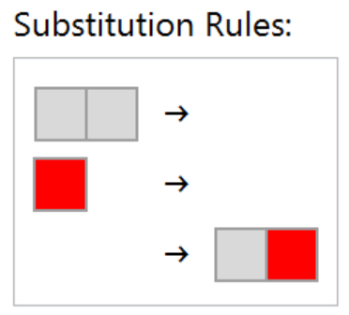
Base-5 digit meanings:
0. End this string, insert two empty strings and start a new string with an “A”.
1. End this string, insert one empty string and start a new string with an “A”.
2. End this string and start a new string with an “A”.
3. End this character and start a new character (as an “A”).
4. Increment this character.
A simpler example: 314034
Ruleset under construction:
Start: {“A”}
Notes:
A simpler one, but containing the digits 0 and 1. Again, start with a single A.

Slide 32
Base-5 digit meanings:
0. End this string, insert two empty strings and start a new string with an “A”.
1. End this string, insert one empty string and start a new string with an “A”.
2. End this string and start a new string with an “A”.
3. End this character and start a new character (as an “A”).
4. Increment this character.
A simpler example: 314034
Ruleset under construction:
{“A”}
=> {“AA”}
Notes:
Append

Slide 33
Base-5 digit meanings:
0. End this string, insert two empty strings and start a new string with an “A”.
1. End this string, insert one empty string and start a new string with an “A”.
2. End this string and start a new string with an “A”.
3. End this character and start a new character (as an “A”).
4. Increment this character.
A simpler example: 314034
Ruleset under construction:
{“AA”}
=> {“AA”->“”, “A”}
Notes:
1 means “insert an empty string, then start a new string with a single A”

Slide 34
Base-5 digit meanings:
0. End this string, insert two empty strings and start a new string with an “A”.
1. End this string, insert one empty string and start a new string with an “A”.
2. End this string and start a new string with an “A”.
3. End this character and start a new character (as an “A”).
4. Increment this character.
A simpler example: 314034
Ruleset under construction:
{“AA”->“”, “A”}
=> {“AA”->“”, “B”}
Notes:
Increment

Slide 35
Base-5 digit meanings:
0. End this string, insert two empty strings and start a new string with an “A”.
1. End this string, insert one empty string and start a new string with an “A”.
2. End this string and start a new string with an “A”.
3. End this character and start a new character (as an “A”).
4. Increment this character.
A simpler example: 314034
Ruleset under construction:
{“AA”->“”, “B”}
=> {“AA”->“”, “B”->“”, “”->“A”}
Notes:
0 means “insert 2 empty strings, then a new string starting with an A”

Slide 36
Base-5 digit meanings:
0. End this string, insert two empty strings and start a new string with an “A”.
1. End this string, insert one empty string and start a new string with an “A”.
2. End this string and start a new string with an “A”.
3. End this character and start a new character (as an “A”).
4. Increment this character.
A simpler example: 314034
Ruleset under construction:
{“AA”->“”, “B”->“”, “”->“A”}
=> {“AA”->“”, “B”->“”, “”->“AA”}
Notes:
Append

Slide 37
Base-5 digit meanings:
0. End this string, insert two empty strings and start a new string with an “A”.
1. End this string, insert one empty string and start a new string with an “A”.
2. End this string and start a new string with an “A”.
3. End this character and start a new character (as an “A”).
4. Increment this character.
A simpler example: 314034
Ruleset under construction:
{“AA”->“”, “B”->“”, “”->“AA”}
=> {“AA”->“”, “B”->“”, “”->“AB”}
Notes:
Increment

Slide 38
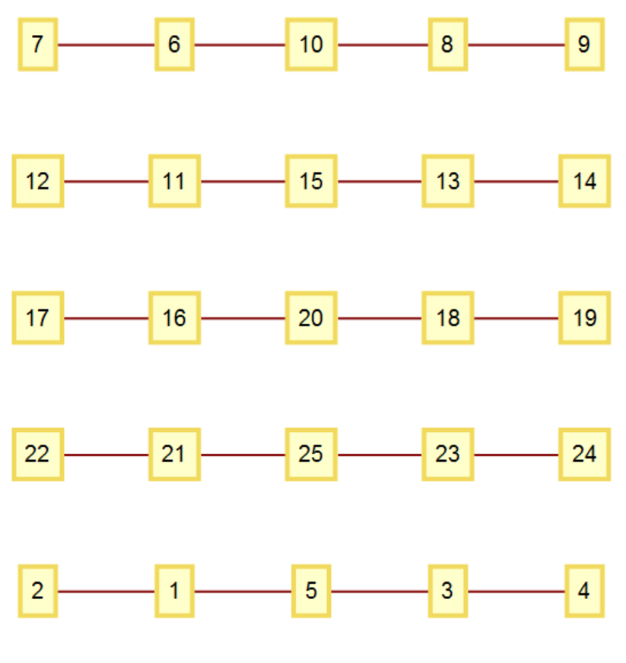
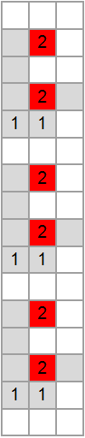
Base-5 digit meanings:
0. End this string, insert two empty strings and start a new string with an “A”.
1. End this string, insert one empty string and start a new string with an “A”.
2. End this string and start a new string with an “A”.
3. End this character and start a new character (as an “A”).
4. Increment this character.
A simpler example: 314034
Ruleset under construction:
{“AA”->“”, “B”->“”, “”->“AB”}
DONE!
Notes:
Done. Although this simpler ruleset generates a rather simple repetitive sessie and network, as shown here.

Slide 39
Notice that by construction the initial part of the ruleset is created by the initial part of the code number, so as we advance through the enumeration of ALL sessie rulesets, we see that for a long time the initial part of the ruleset remains constant.
The real use for this knowledge is to be able to jump through rulesets to more interesting sections that we need to study.
If there is some rule conflict early in a ruleset, we can jump past all rulesets that share that same problem, moving on to other cases without any danger of skipping something interesting.
Examples of rule conflict….

