Slide 1
The NRPI multi-tracer gas PFT method as a new radon diagnostic tool
Michal Šesták, Karel Jílek

Slide 2
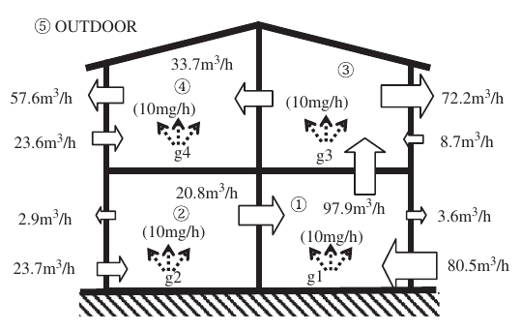
Introduction
Motivation: locating radon sources
perfluorocarbon tracers method
radon concentration measurement (TESLA TERA and CANARY detectors), volume measurement (laser measure)
radon flow sources define known radon entry rates
calculation of radon entry rates into compartments
verification of the calculation model on measured data
three experiments were realized
Fig. 0: Partition of a building to compartments, https://doi.org/10.1016/j.buildenv.2008.04.014

Slide 3
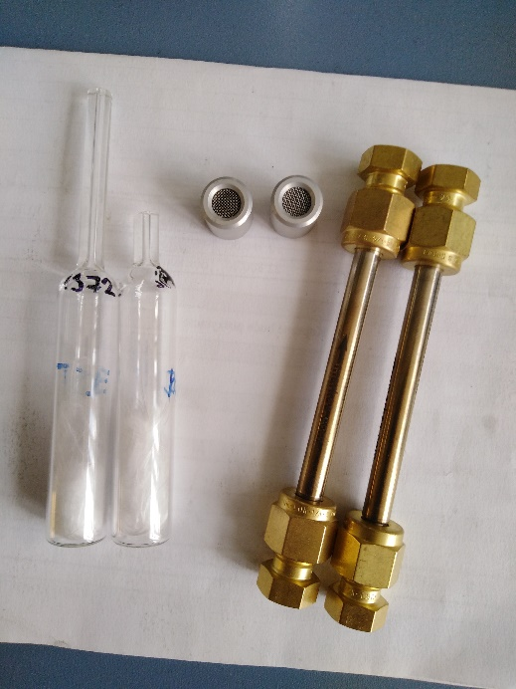
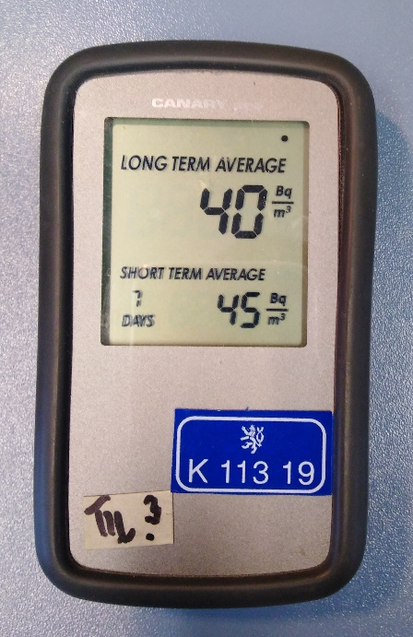
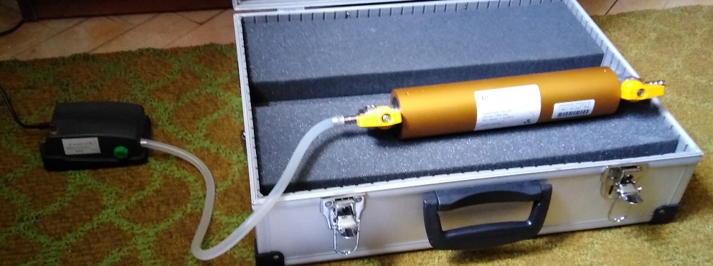
Fig. 1: Tracers sources and TD detectors
Fig. 2: CANARY continuous detector
Fig. 4: Radon flow source

Slide 4
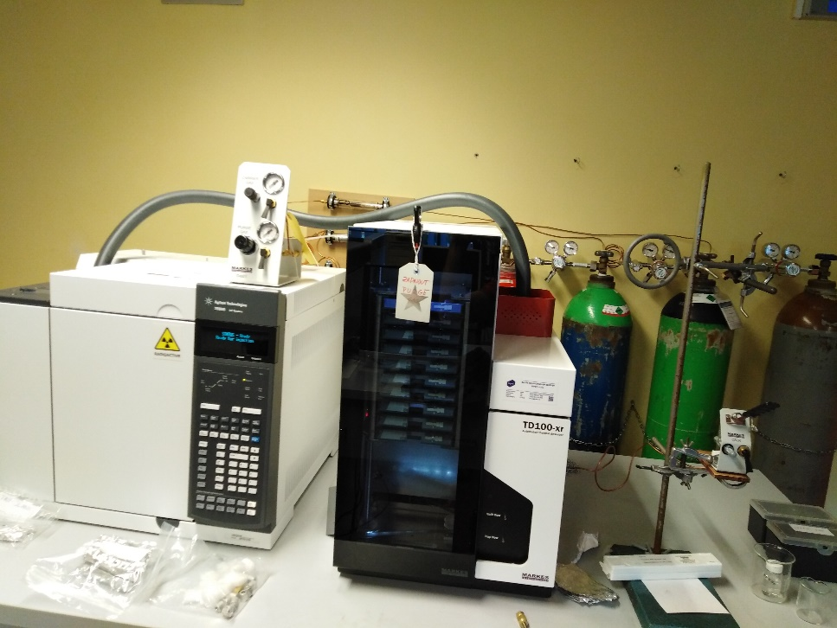
Multi-tracer gas PFT method
measurement usually lasts from 14 to 31 days
number of gases ≥ number of compartments
also measurements of temperature and pressure have to be done
evaluation by gas chromatography with thermal desorption
output: weight of gases absorbed in TD detectors
intrazonal airflows and exfiltrations can be calculated
Fig. 4: Chromatograph

Slide 5
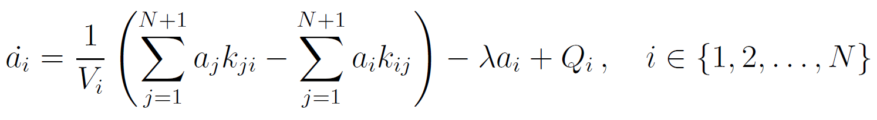
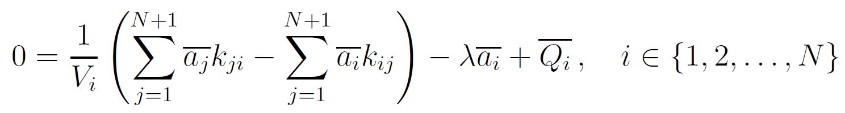
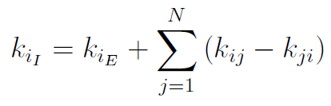
Radon entry rates calculation
implementation in python (including uncertainty propagation handling)
or

Slide 6
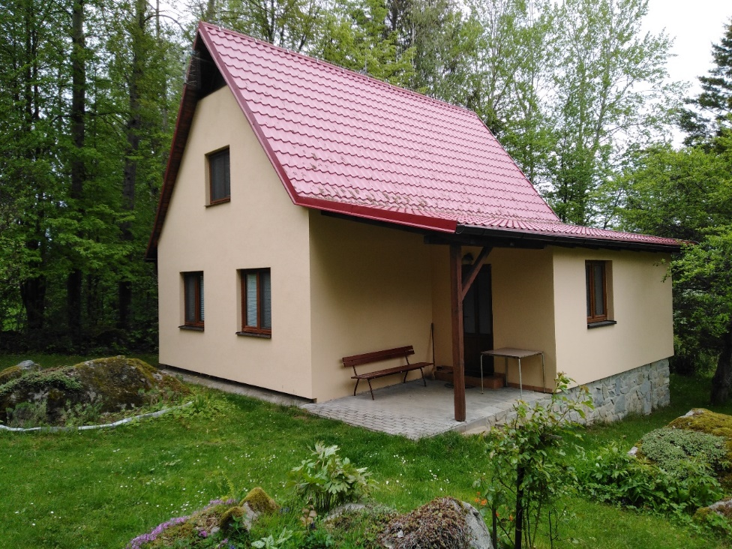
Example experiment
typical object
measurement duration=14 days
three compartments (floors)
14 tracers sources, 12 TD detectors and 3 thermometers were deployed
six types of tracers were used, in each zone two
two radon sources were emplaced in basement and in kitchen)
eight radon monitors were used (4x TESLA TSR, 4x CANARY)
Fig. 5: House in which the experiment took place

Slide 7
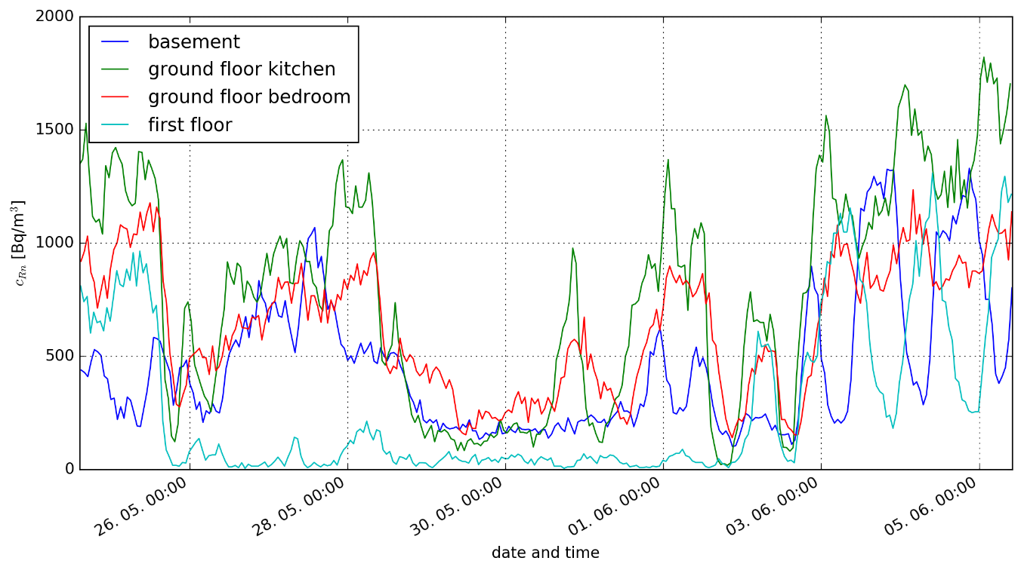
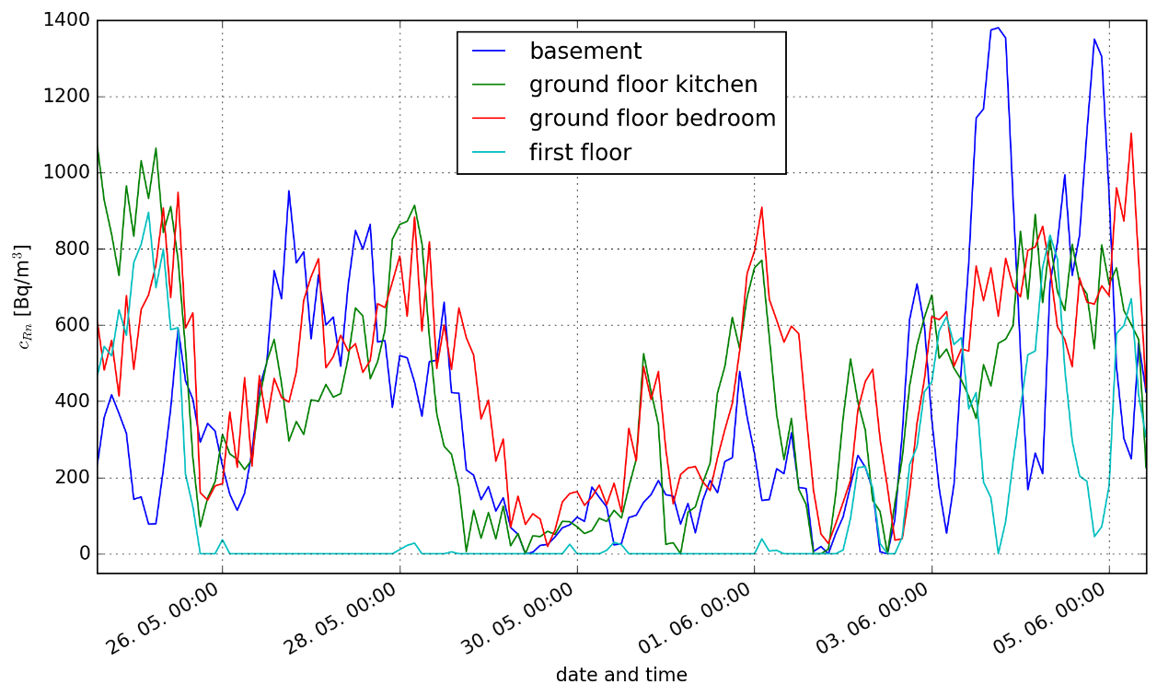
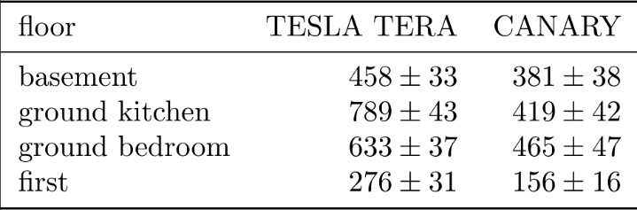
Radon concentrations in compartments
Fig. 6: Radon concentrations measured by TESLA TERA detectors
Fig. 7: Radon concentrations measured by CANARY detectors
Tab. 1: Average radon concentrations measured by TERA and CANARY detectors

Slide 8
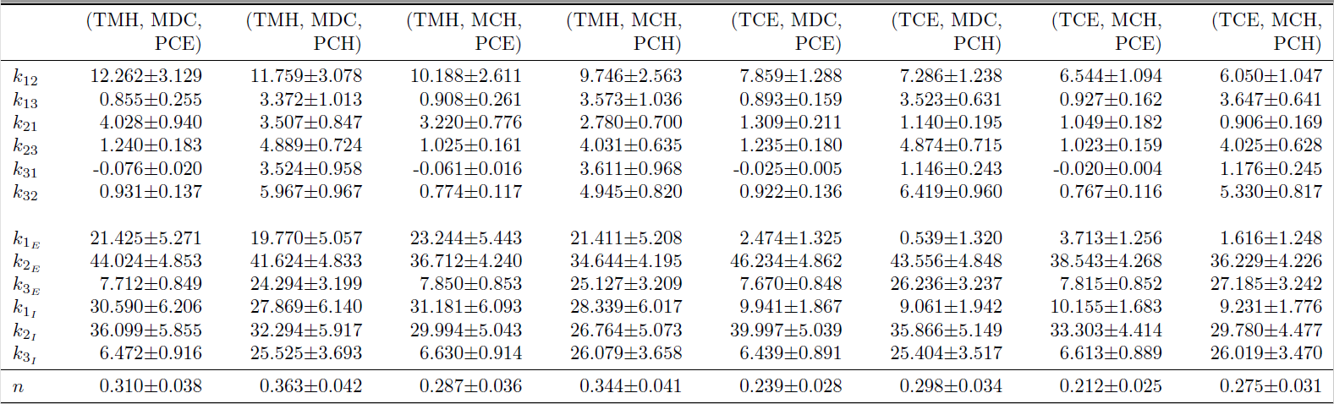
Airflows between compartments (m³/hour)
Tab. 2: The airflows between compartments for two selected combinations of tracers, the last line cointains air exchage rates (1/hour)

Slide 9
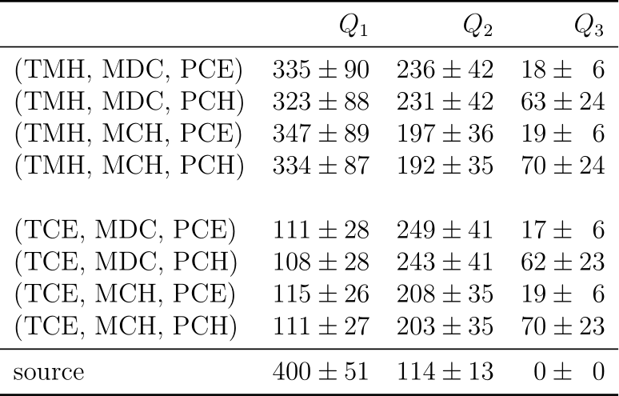
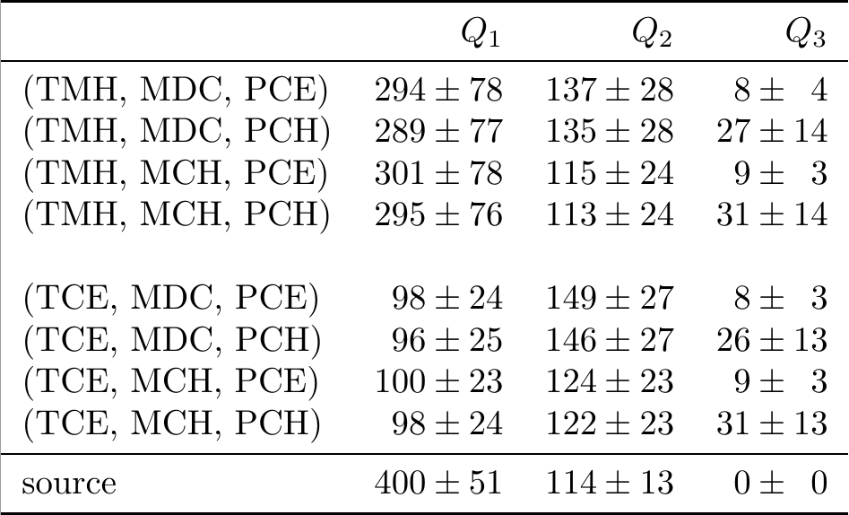
Radon entry rates (Bq/m³/hour)
TMH, MCH, PCH and MDC are perfluorocarbons
TCE and PCE are chlorinated hydrocarbons
Tab. 3: Calculated radon entry rates from RAC measured by TESLA TSR, in the last line there are known radon entry rates from the radon sources
Tab. 3: Calculated radon entry rates from RAC measured by CANARY detectors, in the last line there are known radon entry rates from the radon sources

Slide 10
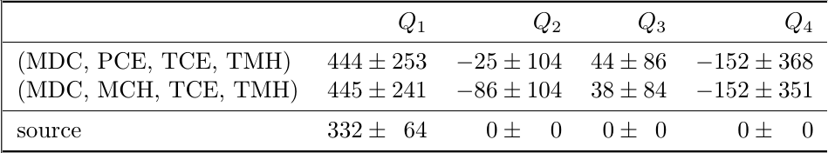

Problems
saturation of TD detectors (due to the use of many tracers sources and unrealistic conditions)
reliability of continuous radon monitors (TESLA TSR3D)
unknown natural radon concentrations
Tab. 4: Radon entry rates to the zones of Object 2 (flat), the unit is Bq/m³/hour
Tab. 5: Radon entry rates to the zones of Object 3 (family house), the unit is Bq/m^{3/}hour

Slide 11
Conclusion
one experiment was inaccurate
more experiments need to be done
multi-tracer gas PFT method have to be done more carefully
otherwise this method gives good results

