Slide 1
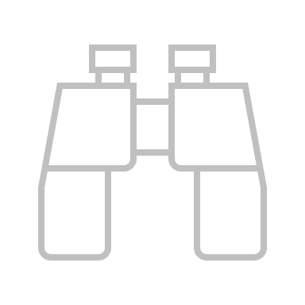



{title}
{bullet_1}
{bullet_1_description}
{bullet_2}
{bullet_2_description}
{bullet_3}
{bullet_2_description}
{bullet_4}
{bullet_4_description}
{bullet_1_content}
{bullet_2_content}
{bullt_3_content}
{bullet_4_content}
Keywords: venn diagram, diagrams, icon, icons, value

