Slide 1
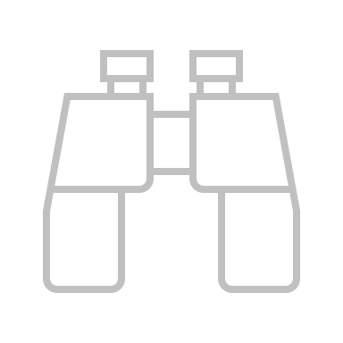


{title}
{bullet_1}
{bullet_1_description}
{bullet_2}
{bullet_2_description}
{bullet_3}
{bullet_3_description}
{bullet_1_content}
{bullet_2_conttent}
{bullet_3_content}
Keywords: venn diagram, diagrams, icon, icons, value

