Slide 1
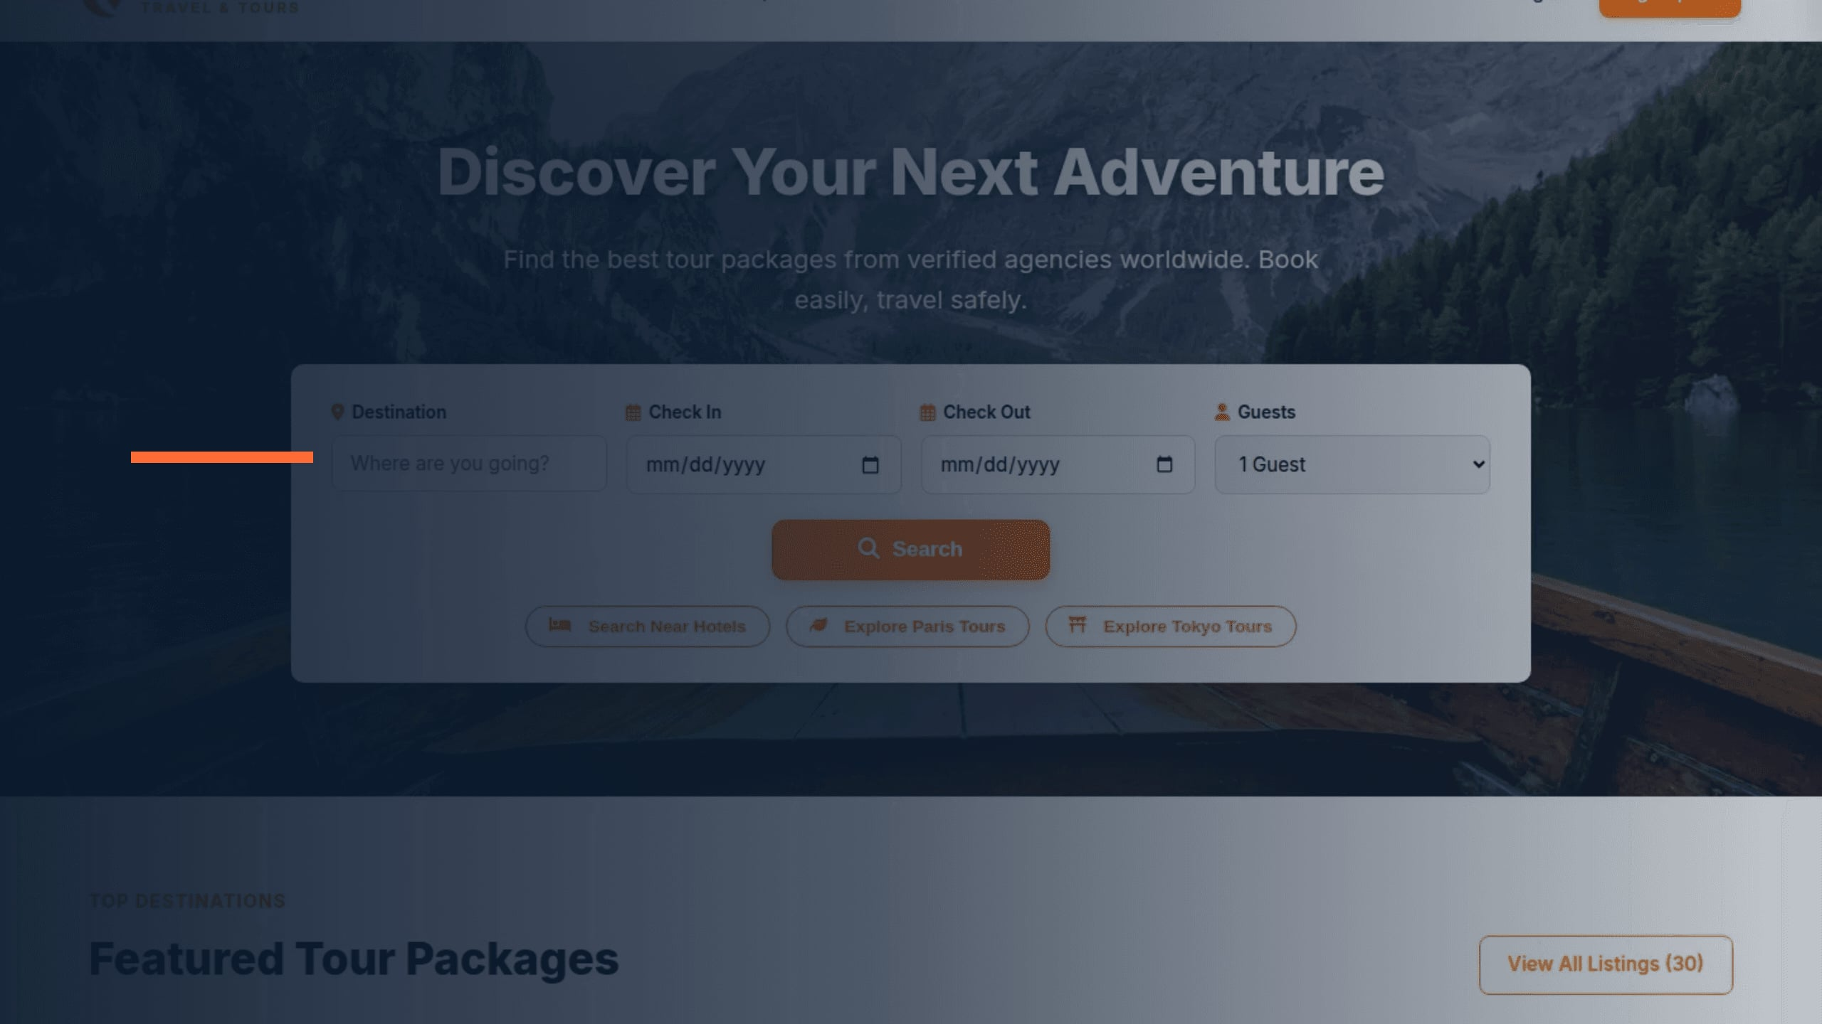
TRAVEL & TOURS
SAFAR
UI/UX Design for a Travel and Tour Booking Web App
Mohammed Tanvir • ID: 232-134-001

Slide 2
01 / PROJECT OVERVIEW
One Platform for Discovering, Booking and Managing Travel
Visual Travel Marketplace
SAFAR serves as a centralized digital marketplace for exploring curated holiday tours and luxury hotels worldwide with transparent pricing.
SAFAR THREE-TIER ECOSYSTEM
👤 Traveler / Tourist
Explores destination packages • Checks real-time pricing • Books securely
Two-Sided Connectivity
Connects independent travelers directly with verified travel agencies, eliminating communication friction and fragmented booking channels.
🏢 Verified Travel Agency
Publishes tour & hotel inventory • Moderates booking requests • Tracks earnings
Role-Based Management
Tailored interfaces for Travelers (discovery & booking), Agencies (package publishing & requests), and Admins (governance & moderation).
🛡️ Platform Administrator
Controls global ledger • Verifies agencies • Governs commission & master inventory

Slide 3
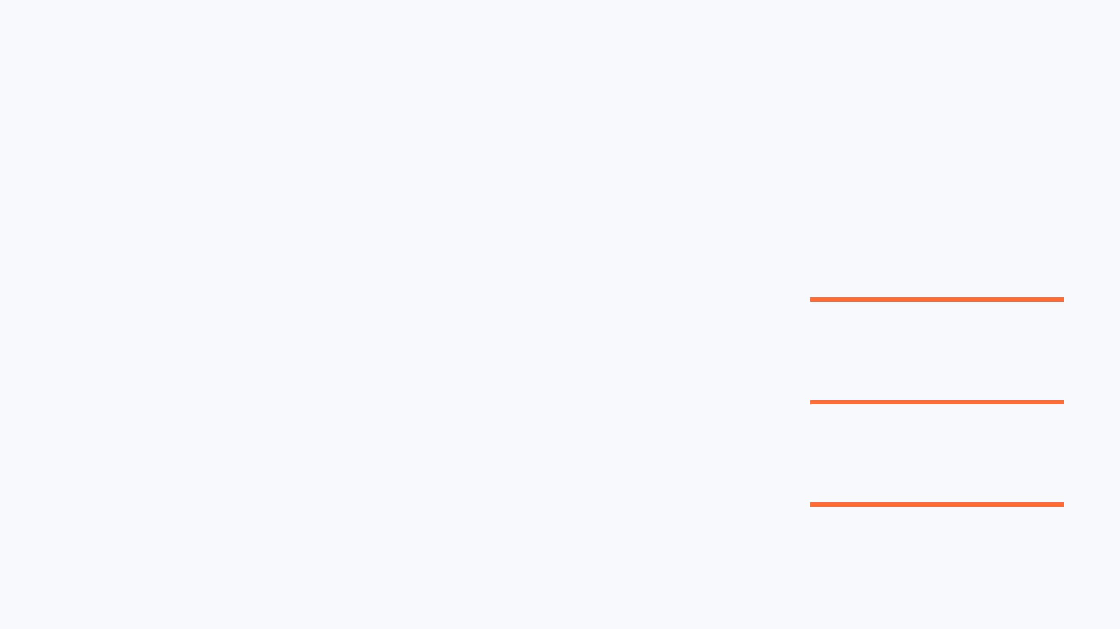
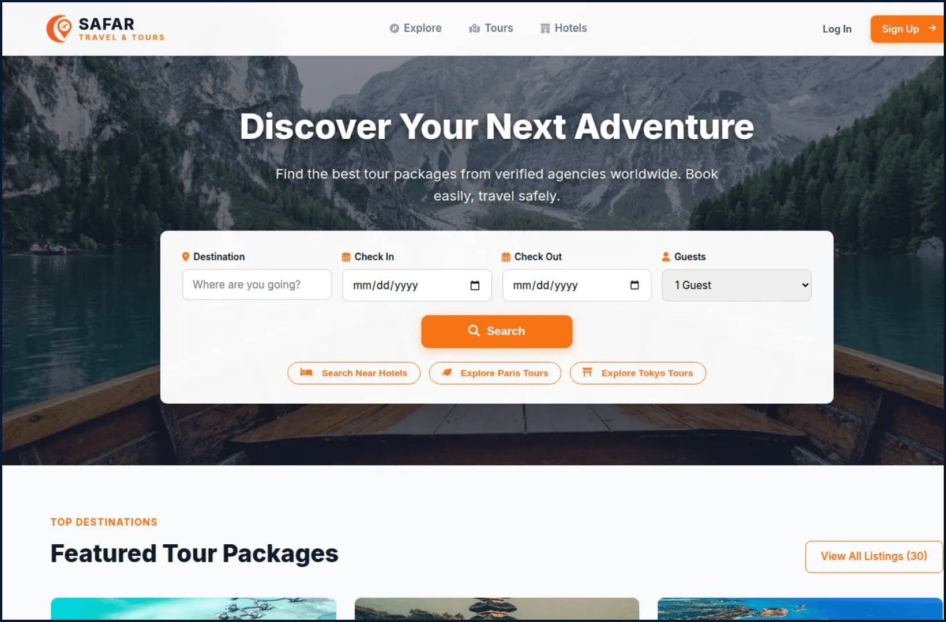
01 / HOMEPAGE
IMPLEMENTED SCREEN
DISCOVER → SEARCH → BOOK
SAFAR turns discovery into a confident first step
Hero with purpose
“Discover Your Next Adventure” makes the product promise immediate and emotionally clear.
One starting point
Destination, dates, guests, and Search are grouped into a single booking-oriented panel.
Inspiration becomes action
Featured packages continue the path with consistent “View Details” and “Book Now” actions.

Slide 4
02 / PROBLEM & OBJECTIVES
The Experience Must Reduce Booking Friction
CORE USER CHALLENGES
DESIGN OBJECTIVES & STRATEGY
• Information Overload: Travelers encounter dense, text-heavy listings without clear comparison metrics or transparent duration details.
✓ Visual-First Discovery Engine
Implement high-impact card layouts with prominent imagery, duration tags, and location markers to guide choices.
• Unclear Booking Costs: Hidden surcharges and complex multi-step forms create high drop-off rates before transaction confirmation.
✓ Frictionless Modal Booking Flow
Streamline the checkout journey into a single modal with live price calculation and instant payment method selection.
• Fragmented Agency Tools: Local travel agencies lack dedicated digital dashboards to update availability or manage booking statuses.
✓ Unified Design Token System
Establish consistent typography, button hierarchy, and color tokens across traveler, agency, and admin screens.
• Admin Governance Gap: Administrators require real-time visibility into transactions, verification queues, and inventory control.
✓ Predictable Management Hubs
Design purpose-built data tables, status badges, and quick-action filters for rapid agency and admin workflows.

Slide 5
03 / USERS & INFORMATION ARCHITECTURE
Role-Based Structure Keeps Each Journey Focused
Traveler (Tourist)
Seeks memorable holiday packages, fast date/guest filtering, and transparent booking confirmation without hidden fees.
Agency Partner
Needs frictionless inventory publication, real-time booking request moderation, and package CRUD management.
Platform Administrator
Requires global system governance, verified partner onboarding, financial ledger tracking, and platform health stats.
SAFAR SITE MAP & INFORMATION ARCHITECTURE (IA)
1. Public & Traveler Space
• / (Home: Hero Search & Highlights)
• /explore (All Packages & Filters)
• /tours & /hotels (Categorized Catalog)
• /package/:id (Itinerary & Details)
• /dashboard/traveler (Booking History)
2. Agency Partner Hub
• /dashboard/agency (Overview & Stats)
• Package Manager (Add / Edit / Delete)
• Booking Requests (Approve / Reject)
• Live Agency Verification Status
• Revenue & Commission Ledger
3. Master Admin Control
• /admin (Executive KPI Analytics)
• Master Inventory Control & CSV Export
• Agency Verification & Audit Log
• Global User Roles & Permissions
• Platform Commission Settings

Slide 6
04 / USER FLOW & PROGRESSIVE DISCLOSURE
The Core Booking Flow Moves from Discovery to Confirmation
1
2
3
4
5
6
1. Land on Home
Hero Search with Destination & Date input
2. Explore Catalog
Filter by Tour/Hotel, budget & rating
3. Inspect Package
Examine itinerary, amenities & photos
4. Initiate Booking
Modal appears with server-side price
5. Choose Payment
Select Card, Crypto, or Demo Wallet
6. Confirmation
Instant status update & live booking ID
💡 UX DESIGN PRINCIPLE: PROGRESSIVE DISCLOSURE
The user flow follows progressive disclosure: high-level destination cards spark initial interest, detailed itineraries provide validation on demand, and checkout remains contained in a non-disruptive modal. Users never lose their browsing context.

Slide 7
05 / WIREFRAME TO HIGH-FIDELITY
Structure Was Validated Before Visual Polish
LOW-FIDELITY STRUCTURE (EARLY EXPLORATION)
HIGH-FIDELITY DESIGN TRANSITION (FIGMA)
📐 Greyscale Grid Layout
Focused strictly on element hierarchy, card proportions (340px min-width), and search-bar placement without color bias.
✨ SAFAR Brand Identity Integration
Applied the authentic crescent-plane brand mark and vibrant SAFAR Orange (#F97316) for emotional resonance.
📐 Whitespace & Scanning Patterns
Arranged headline, duration badges, and pricing tags using the F-shaped reading pattern for quick scannability.
✨ Rich Photographic Imagery
Curated high-resolution imagery for Ratargul, Maldives, Bali, and Paris to elevate perceived travel value.
📐 Form Field Accessibility
Grouped Destination, Check In, Check Out, and Guests inputs into balanced horizontal slots with clear labels.
✨ Glassmorphism & Micro-Shadows
Implemented subtle multi-layered elevation (0 4px 20px rgba(0,0,0,0.06)) and frosted-glass navbar blurs.
📐 Button Action Prominence
Identified primary call-to-action positions (Search, View Details, Reserve) before applying gradients or brand marks.
✨ Polished Interactive States
Added distinct hover elevations, outline focus rings, and animated badges for real-time status feedback.

Slide 8
06 / DESIGN SYSTEM & DESIGN TOKENS
A Consistent Design System Makes SAFAR Feel Trustworthy
COLOR TOKENS (FIGMA STYLES)
TYPOGRAPHY SCALE (INTER)
UI COMPONENT VARIANTS
Primary Action
#F97316
Display Title
36px / Bold 800 • Hero Headlines
Primary Action Button
Filled SAFAR Orange with soft elevation (#F97316)
Deep Slate (Text/Nav)
#0F172A
Section Heading
24px / Bold 700 • Category & Section Titles
Secondary Outline
Muted Secondary
#64748B
Card Title
18px / SemiBold 600 • Package & Hotel Titles
Clean 1.5px border with primary hover
Success / Approved
#10B981
Danger / Cancel
Body Text
15px / Regular 400 • Descriptions & Details
Muted red background with dark red text (#E11D48)
Danger / Cancel
#E11D48
Caption / Badge
12px / Medium 500 • Status & Duration Tags
Status Badges
Surface Light
#F8FAFC
Approved (Green), Pending (Amber), Rejected (Red)

Slide 9

02 / VISUAL LANGUAGE
IMPLEMENTED SYSTEM
The visual system balances travel energy with booking clarity
Warm actions
Dependable type
Orange buttons create a recognizable call-to-action rhythm from Search to Book Now.
Deep navy headings and dark body text support legibility against light surfaces.
Optimistic status
Emotional context
Mint badges and chips add a light travel accent for availability and listing types.
Large destination photography provides the feeling; structured controls provide the confidence.
SAFAR uses a small, repeatable palette and a clear hierarchy so destination imagery can stay expressive while booking controls remain easy to read.

Slide 10
07 / KEY TRAVELER SCREENS
Visual Discovery Leads to Confident Booking Decisions
1. Landing & Hero Search
2. Curated Explore Catalog
Prominent 4-parameter search box (Destination, Check-In, Check-Out, Guests) with quick filter pills for instant discovery.
Interactive grid displaying Tour Packages and Luxury Hotels with duration tags, ratings, and instant price badges.
📍 Figma Frame: Desktop_Landing_Hero
📍 Figma Frame: Explore_Catalog_Grid
3. Detailed Itinerary View
4. Authoritative Booking Modal
Comprehensive package breakdown: photo gallery, full day-by-day plan, agency credentials, and inclusion highlights.
Streamlined checkout modal with live guest multiplier, payment strategy selection, and instant confirmation state.
📍 Figma Frame: Package_Details_Modal
📍 Figma Frame: Booking_Transaction_Flow

Slide 11
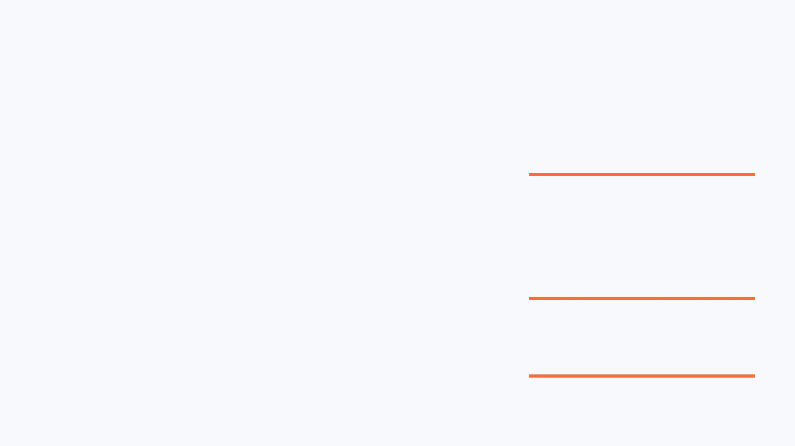
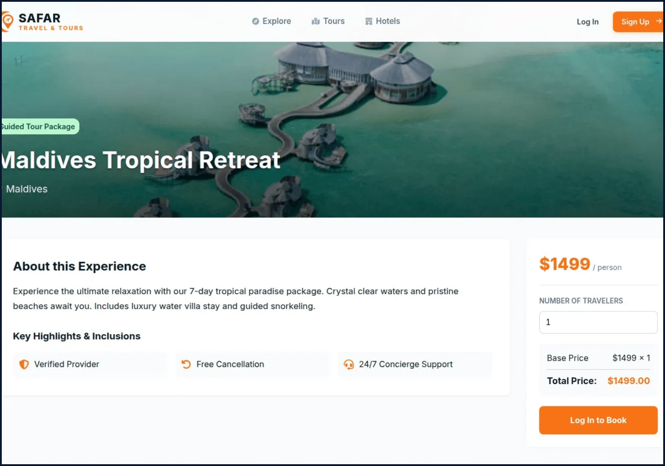
04 / PACKAGE DETAILS
IMPLEMENTED SCREEN
TRUST → PRICE → CONVERT
Package details convert interest into a transparent decision
Trust cues at the point of intent
Verified Provider, Free Cancellation, and 24/7 Support are placed directly below the description to reduce booking hesitation.
Verified Provider
Free Cancellation
24/7 Support
Pricing transparency
The right-side booking panel keeps traveler count, base price, and total price visible together at all times.
Explicit next step
The primary “Log In to Book” action makes the next requirement unmistakable without hiding cost information.

Slide 12
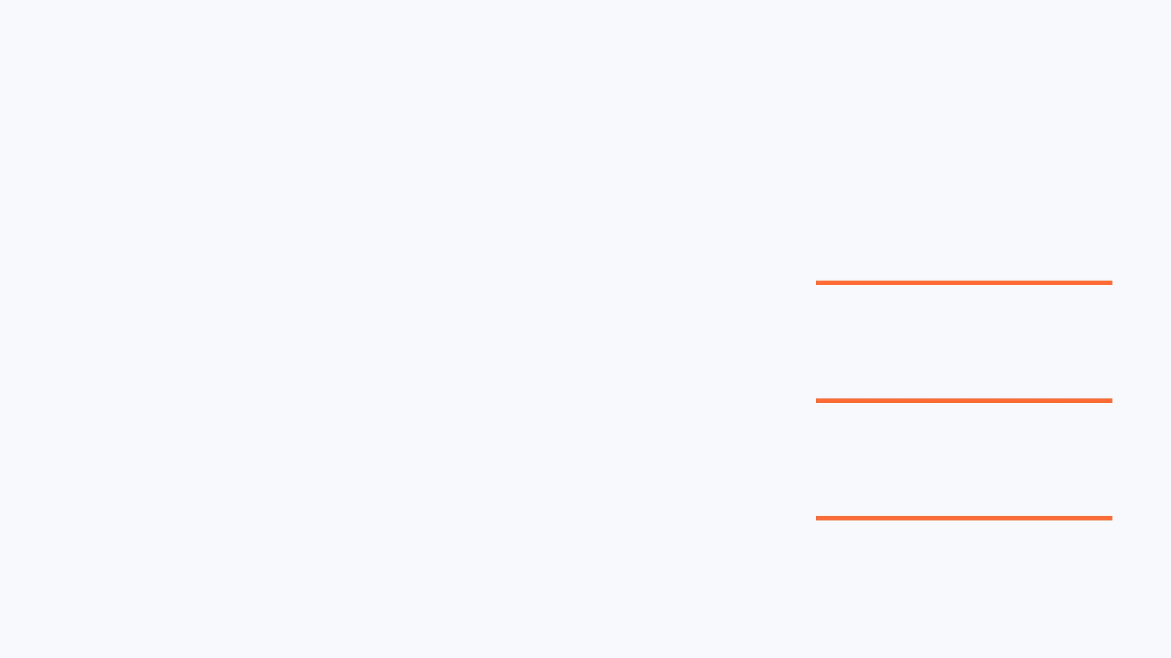
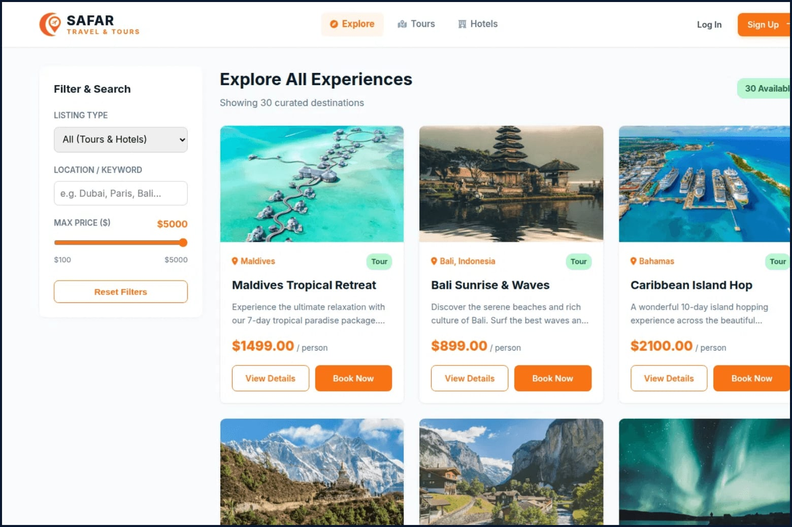
03 / EXPLORE & FILTER
IMPLEMENTED SCREEN
CATALOG MANAGEMENT
Explore makes a large catalog feel easy to scan
Focused filtering
Listing type, location, and price range filters allow users to narrow 30+ destinations instantly.
Repeatable patterns
The two-column grid uses a consistent card hierarchy, making comparison intuitive and fast.
Clear intent
Separate “View Details” and “Book Now” buttons distinguish research from final commitment.

Slide 13
08 / AGENCY & ADMIN EXPERIENCE
Management Interfaces Turn Travel Data into Action
🏢 AGENCY PARTNER MANAGEMENT HUB
🛡️ MASTER ADMINISTRATOR CONTROL SUITE
• Inventory CRUD Management
Agencies create, edit, and publish tour and hotel listings with custom pricing, durations, and images.
• Executive KPI Overview Cards
Real-time metrics: Total Inventory, Verified Agencies, Active Bookings, and Total Platform Revenue.
• Booking Moderation Workflow
Incoming customer reservation requests can be approved or rejected with real-time status chips.
• Master Inventory & CSV Export
Full tabular control over all marketplace listings with one-click Master CSV data export.
• Verification Status Visibility
Clear security indicator showing Verified vs. Pending agency accreditation.
• Agency Moderation Queue
One-click approval and revocation for partner onboarding with instant visual badges.
• Revenue & Ledger Overview
At-a-glance summary cards showing active listings, total reservations, and estimated revenue.
• User Directory & Settings
User role inspection and platform commission percentage configuration tools.

Slide 14
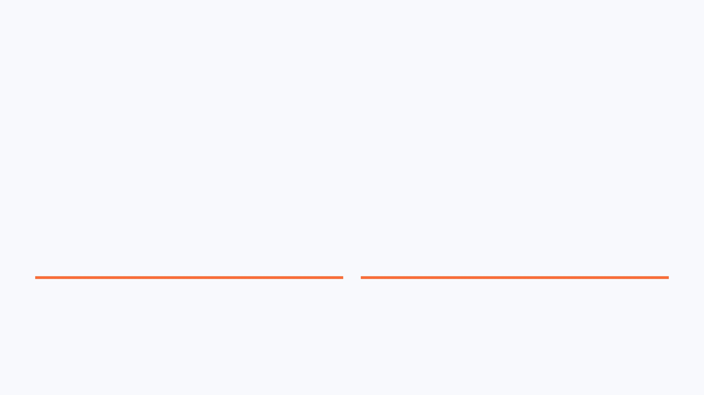
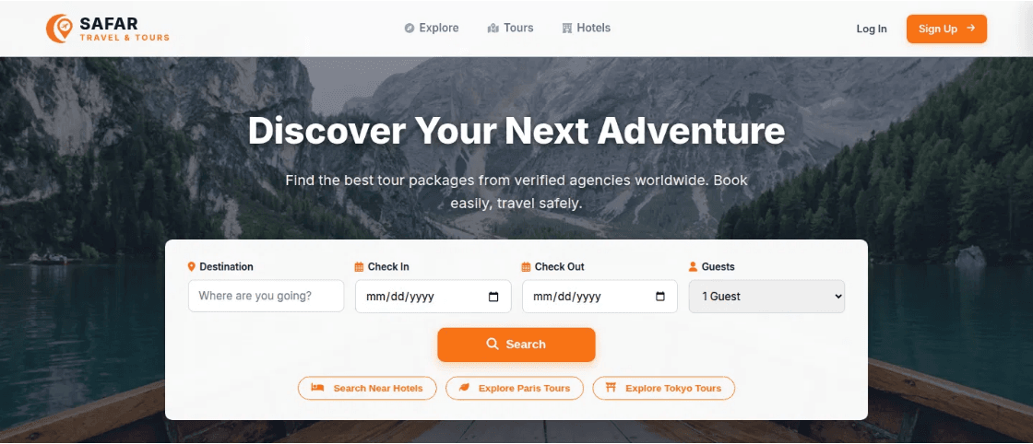
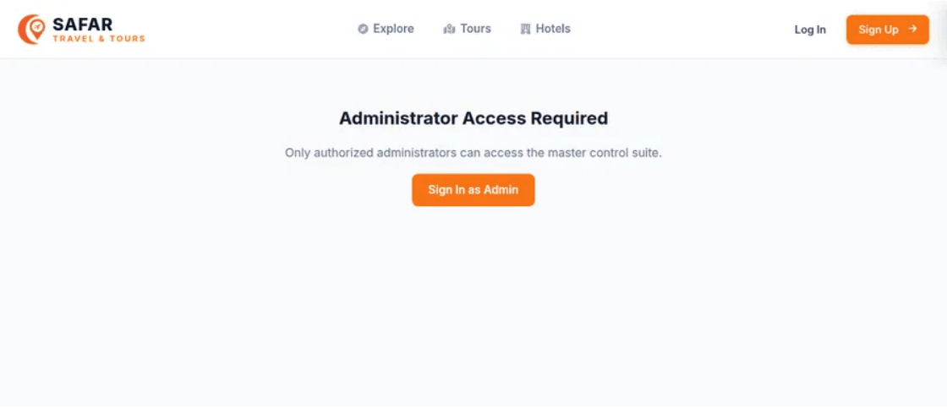
05 / USER JOURNEYS
BRAND CONTINUITY
UNIFIED ARCHITECTURE
One brand language supports multiple user journeys
Public Discovery
Operational Portals
Travelers move from discovery to exploration using a consistent header, navigation, and card-based interaction model.
The same visual system extends to Agency and Admin portals, ensuring a professional and familiar management experience.

Slide 15

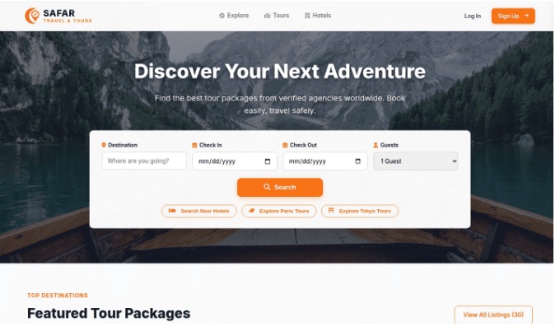
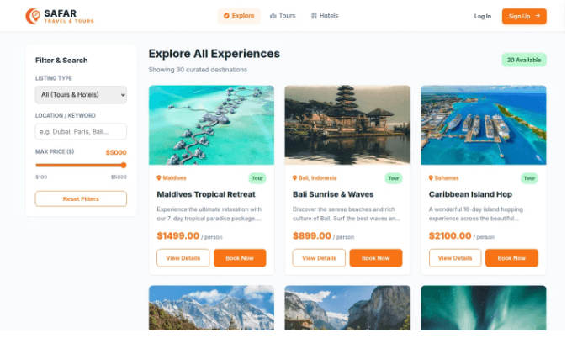
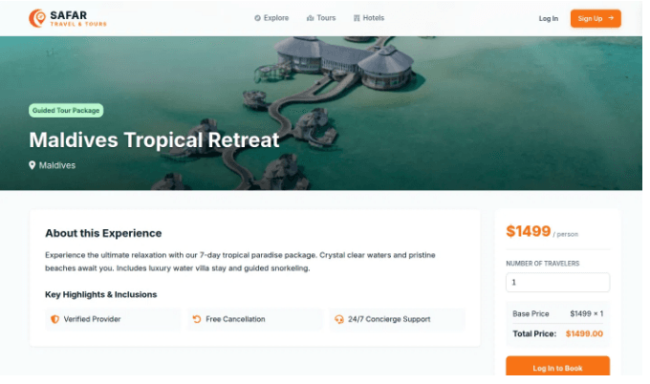
06 / UX STRATEGY
USER JOURNEY FLOW
SAFAR’s strongest UX choice is progressive disclosure
01
02
03
INSPIRATION
REFINEMENT
COMMITMENT
The homepage presents only the essential first decision: where and when to travel, reducing initial cognitive load.
Explore adds refinement and comparison tools only when the user is ready to evaluate specific options.
Package details reveal deeper trust signals, exact pricing, and booking forms at the moment of high intent.

Slide 16
09 / RESPONSIVE DESIGN & ACCESSIBILITY
The Experience Remains Usable Across Devices
Desktop (1360px+)
Full expanded horizontal navigation, 3-4 column package grids, sticky sidebar filters, and expansive hero slider visuals.
Tablet (768px – 992px)
Fluid 2-column card layouts, collapsible search forms, responsive data tables with horizontal scroll containers.
Mobile (375px – 480px)
Slide-in navigation drawer with backdrop blur, full-width touch cards, 44px+ minimum tap targets, and stacked checkout inputs.
ACCESSIBILITY & USABILITY STANDARDS (WCAG 2.1 GUIDELINES)
✓ High Contrast Ratios (WCAG AAA): Deep navy text (#0F172A) on white cards provides a contrast ratio exceeding 14:1 for effortless outdoor readability.
✓ Keyboard Focus States: Visible :focus-visible outlines (2px solid #F97316) on all buttons, links, and form fields ensure full keyboard navigation support.
✓ Semantic Hierarchy & Touch Targets: All interactive buttons adhere to iOS/Android 44x44px minimum touch targets to prevent accidental taps on mobile devices.
✓ Screen Reader Compatibility: Every icon and brand mark includes descriptive ARIA labels (e.g. aria-label='SAFAR Travel Homepage') and alt tags.

Slide 17

08 / CONCLUSION
SCALABLE FOUNDATION
READY FOR SCALE
COHERENT IDENTITY
Unified visual language across discovery, comparison, and booking ensures a seamless user experience and brand trust.
A focused foundation for a travel marketplace
EXTENSIBLE ARCHITECTURE
The design system is built to support richer filters, authenticated traveler profiles, and diverse listing types without friction.
SAFAR establishes a coherent visual identity that bridges the gap between Figma design and functional implementation.
OPERATIONAL READINESS
Established portals for Agencies and Admins provide the necessary infrastructure for a multi-sided marketplace growth.
SAFAR UI/UX Design Presentation • Mohammed Tanvir

Slide 18

SAFAR Turns Travel Discovery into a Structured Digital Experience
★ Unified Brand Experience
A memorable, consistent visual identity balancing vibrant travel warmth (#F97316) with enterprise trust (#0F172A).
★ Frictionless User Journey
Progressive disclosure reduces cognitive friction from initial destination search to instant booking confirmation.
★ Scalable Design Token System
Built modularly in Figma with reusable components, flexible Auto Layouts, and standardized typography styles.
★ Proposed Next Evaluation
Conduct moderated usability testing with 5-8 travelers and agencies to refine filter density and mobile checkout speed.
Thank You for Your Time & Evaluation! | Questions & Feedback Welcomed

Slide 19
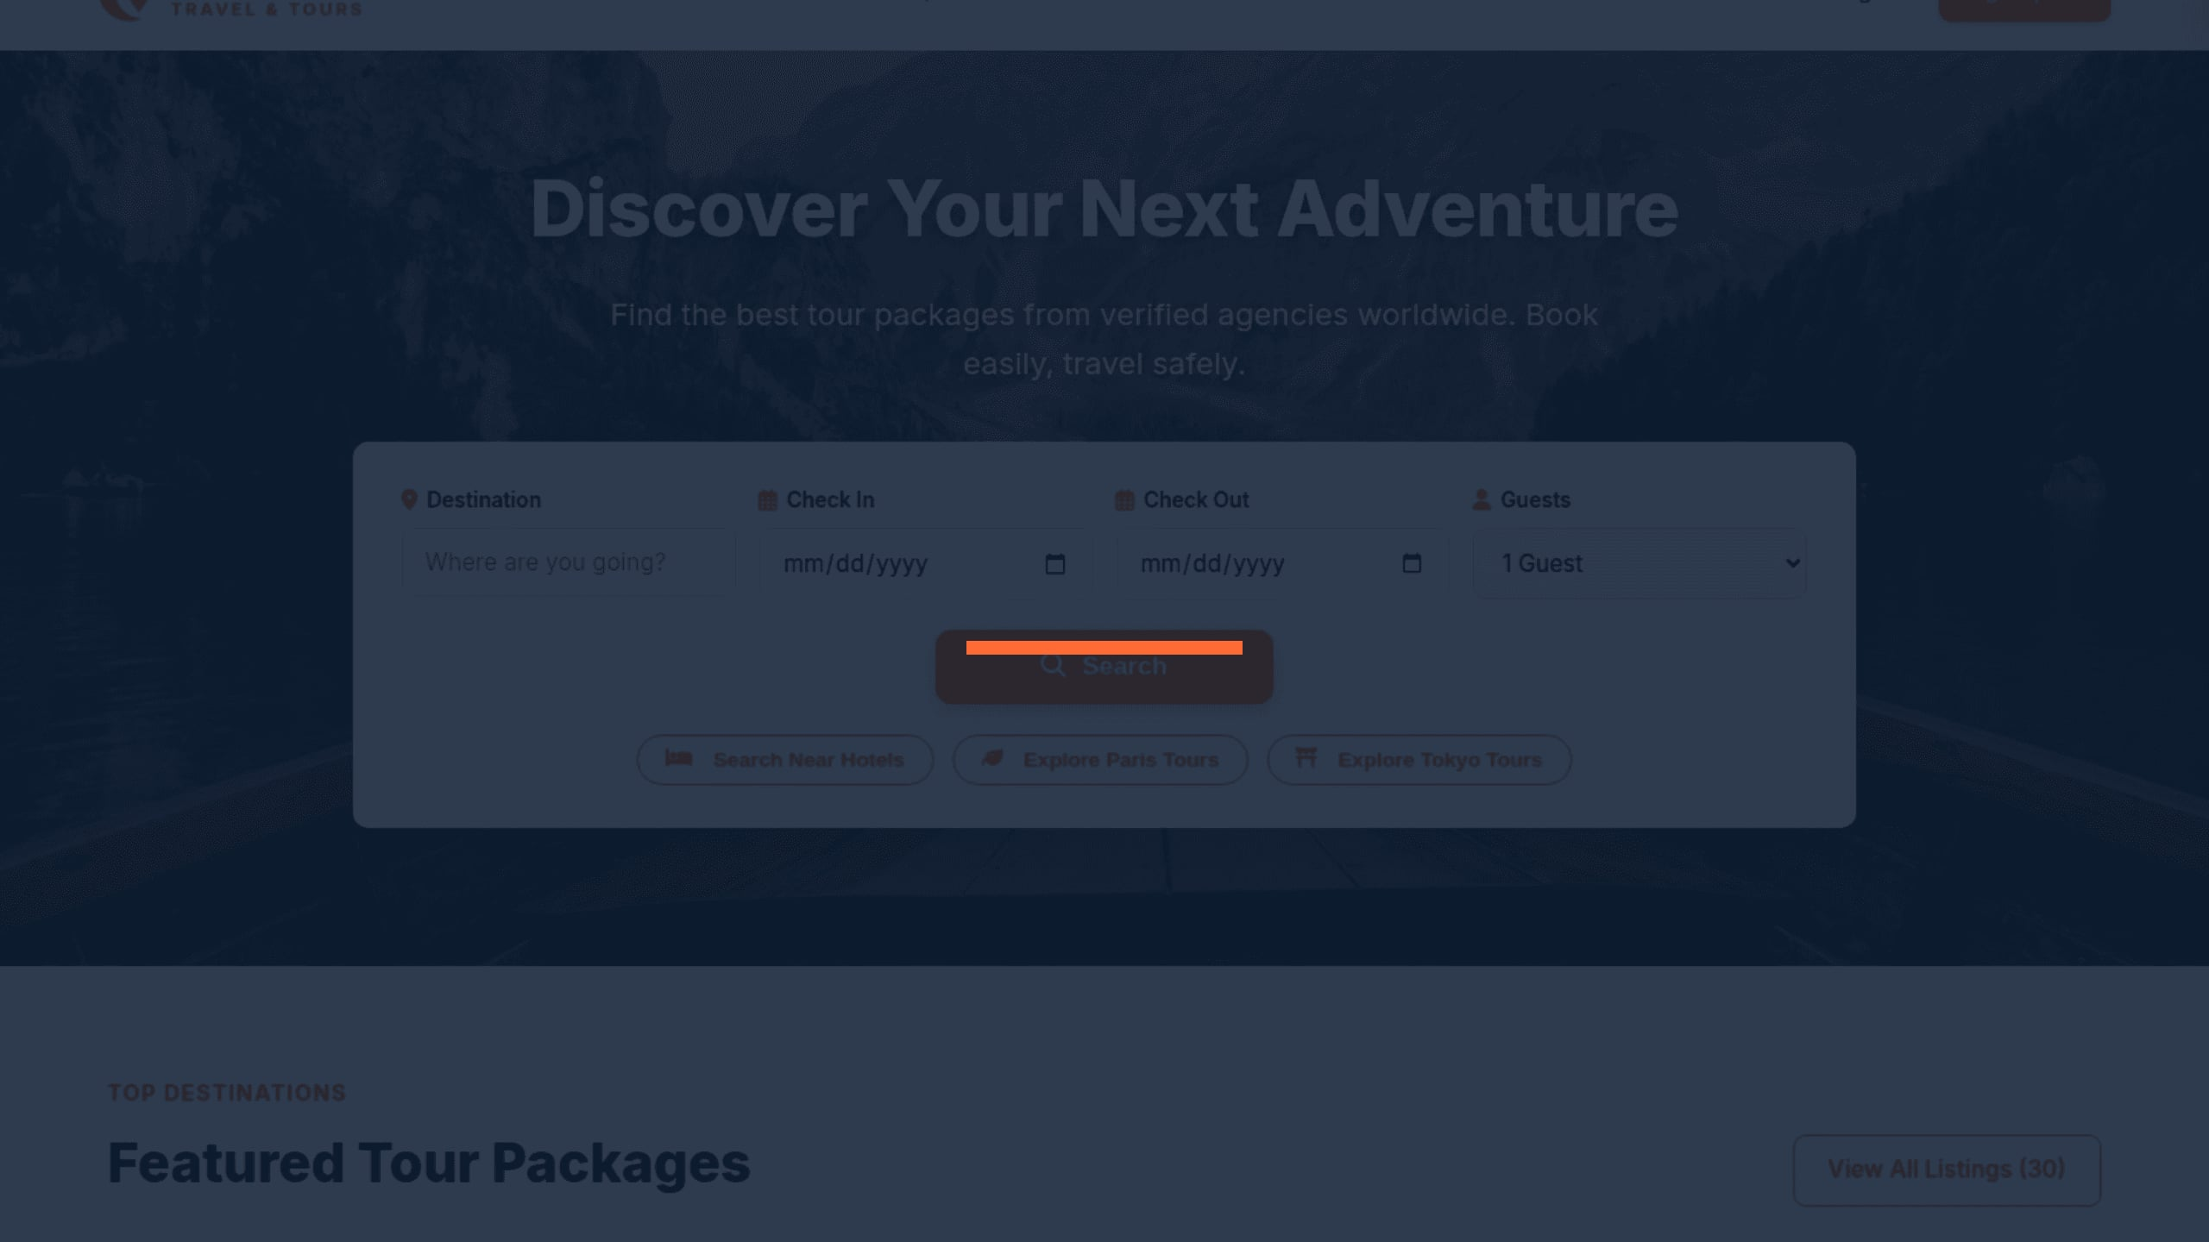
SAFAR
Thank You
Travel with confidence
Mohammed Tanvir•ID: 232-134-001

