Slide 1
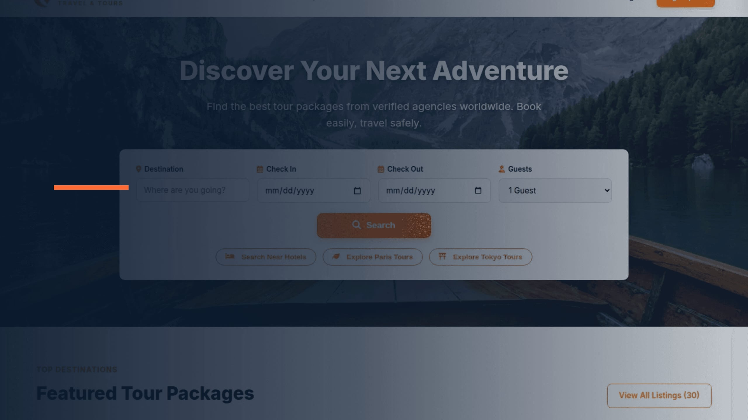
TRAVEL & TOURS
SAFAR
UI/UX Design for a Travel and Tour Booking Web App
Mohammed Tanvir • ID: 232-134-001

Slide 2

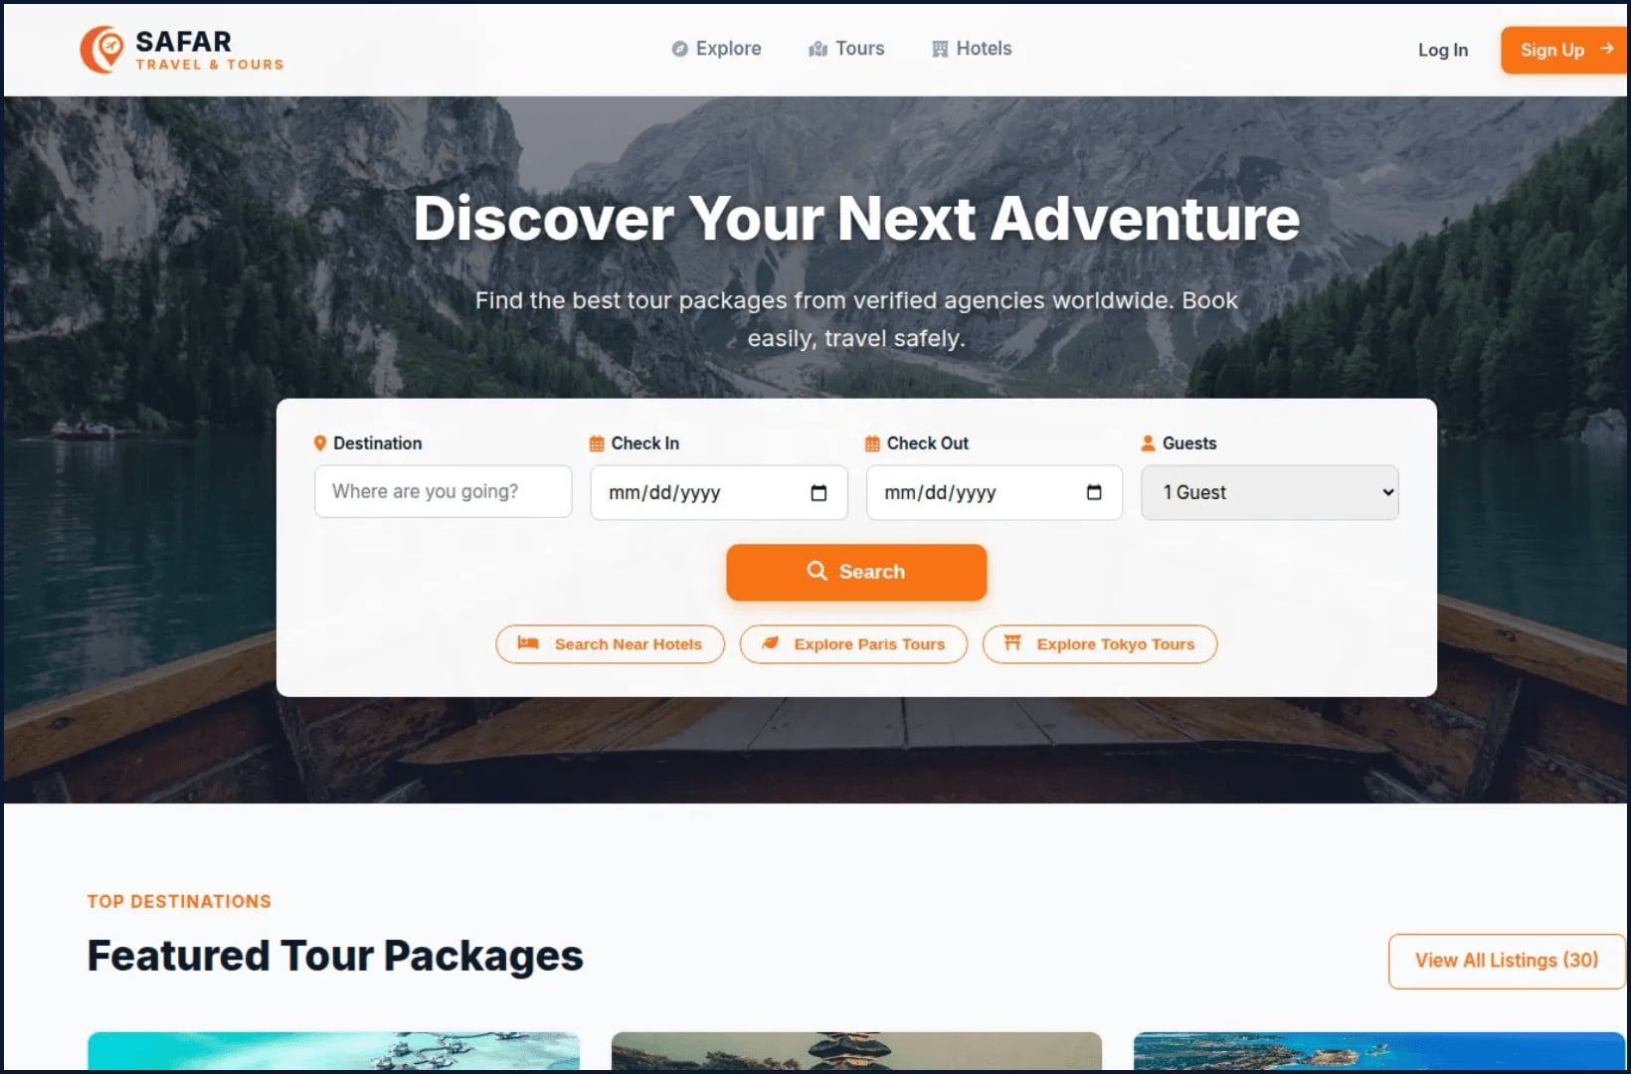
01 / HOMEPAGE
IMPLEMENTED SCREEN
DISCOVER → SEARCH → BOOK
SAFAR turns discovery into a confident first step
Hero with purpose
“Discover Your Next Adventure” makes the product promise immediate and emotionally clear.
One starting point
Destination, dates, guests, and Search are grouped into a single booking-oriented panel.
Inspiration becomes action
Featured packages continue the path with consistent “View Details” and “Book Now” actions.

Slide 3

02 / VISUAL LANGUAGE
IMPLEMENTED SYSTEM
The visual system balances travel energy with booking clarity
Warm actions
Dependable type
Orange buttons create a recognizable call-to-action rhythm from Search to Book Now.
Deep navy headings and dark body text support legibility against light surfaces.
Optimistic status
Emotional context
Mint badges and chips add a light travel accent for availability and listing types.
Large destination photography provides the feeling; structured controls provide the confidence.
SAFAR uses a small, repeatable palette and a clear hierarchy so destination imagery can stay expressive while booking controls remain easy to read.

Slide 4

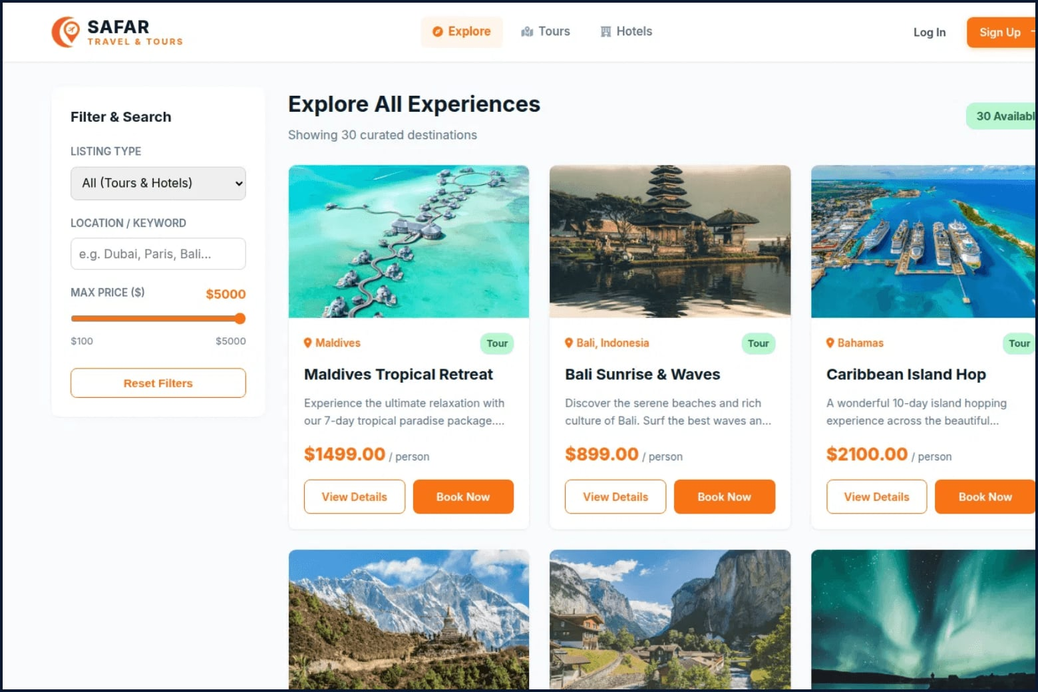
03 / EXPLORE & FILTER
IMPLEMENTED SCREEN
CATALOG MANAGEMENT
Explore makes a large catalog feel easy to scan
Focused filtering
Listing type, location, and price range filters allow users to narrow 30+ destinations instantly.
Repeatable patterns
The two-column grid uses a consistent card hierarchy, making comparison intuitive and fast.
Clear intent
Separate “View Details” and “Book Now” buttons distinguish research from final commitment.

Slide 5

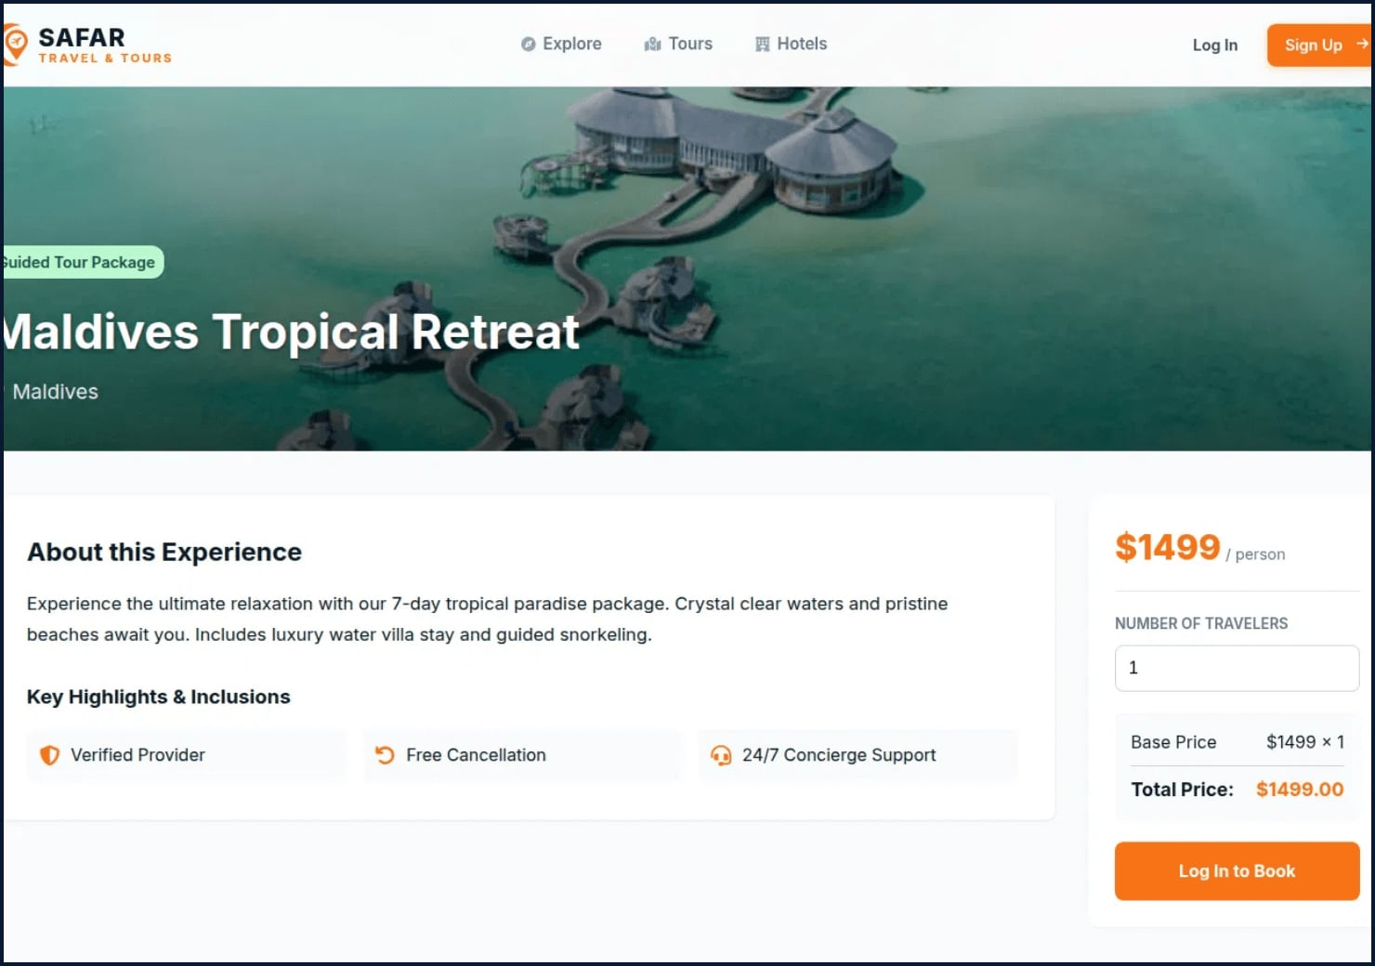
04 / PACKAGE DETAILS
IMPLEMENTED SCREEN
TRUST → PRICE → CONVERT
Package details convert interest into a transparent decision
Trust cues at the point of intent
Verified Provider, Free Cancellation, and 24/7 Support are placed directly below the description to reduce booking hesitation.
Verified Provider
Free Cancellation
24/7 Support
Pricing transparency
The right-side booking panel keeps traveler count, base price, and total price visible together at all times.
Explicit next step
The primary “Log In to Book” action makes the next requirement unmistakable without hiding cost information.

Slide 6

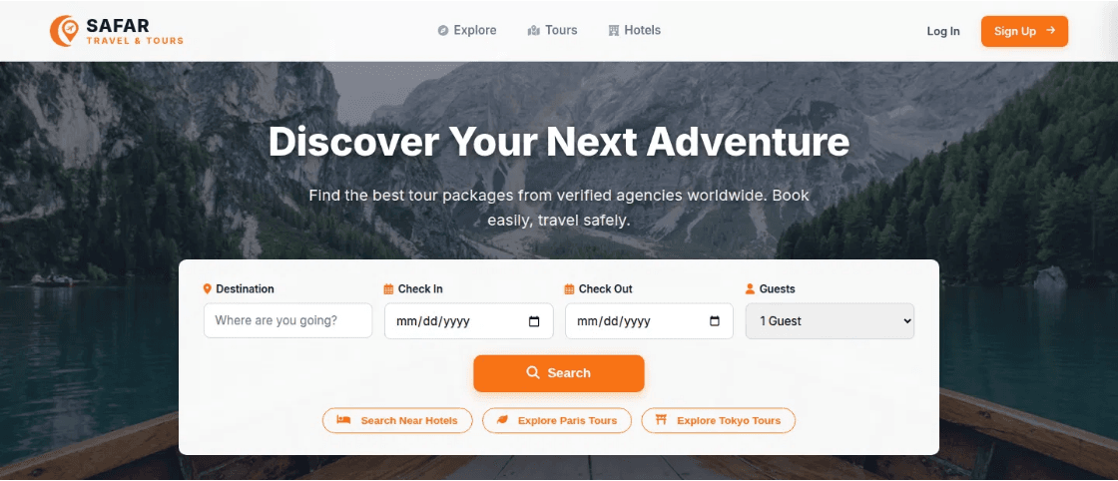
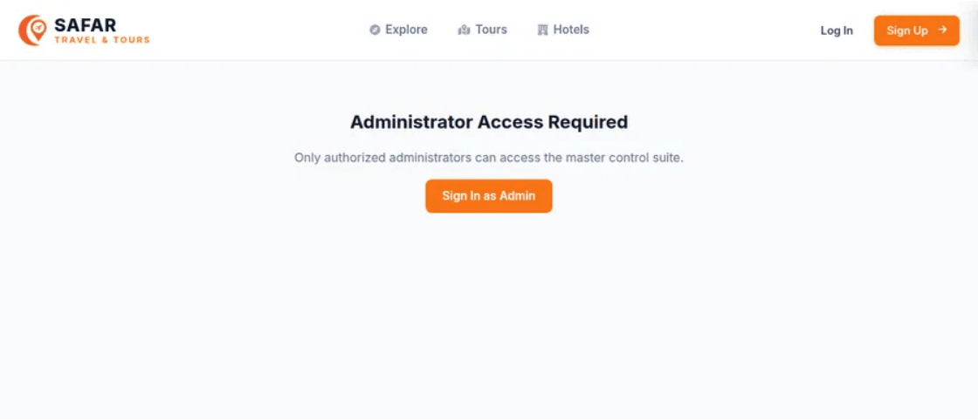
05 / USER JOURNEYS
BRAND CONTINUITY
UNIFIED ARCHITECTURE
One brand language supports multiple user journeys
Public Discovery
Operational Portals
Travelers move from discovery to exploration using a consistent header, navigation, and card-based interaction model.
The same visual system extends to Agency and Admin portals, ensuring a professional and familiar management experience.

Slide 7

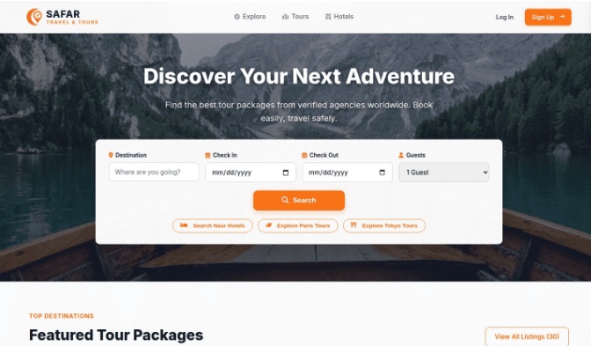
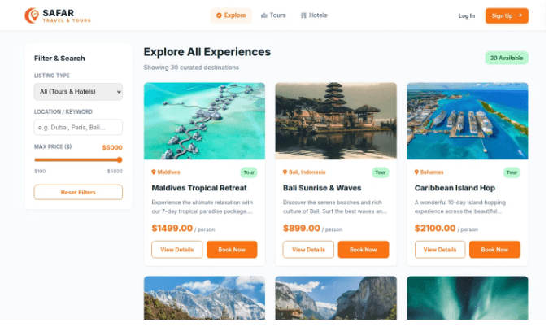
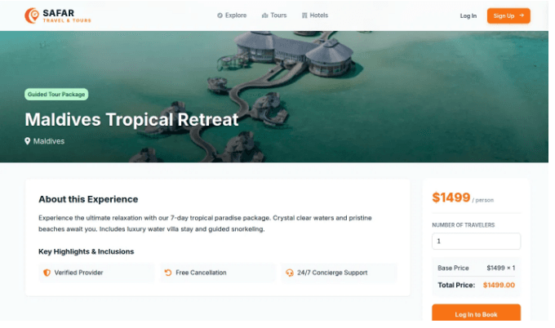
06 / UX STRATEGY
USER JOURNEY FLOW
SAFAR’s strongest UX choice is progressive disclosure
01
02
03
INSPIRATION
REFINEMENT
COMMITMENT
The homepage presents only the essential first decision: where and when to travel, reducing initial cognitive load.
Explore adds refinement and comparison tools only when the user is ready to evaluate specific options.
Package details reveal deeper trust signals, exact pricing, and booking forms at the moment of high intent.

Slide 8

08 / CONCLUSION
SCALABLE FOUNDATION
READY FOR SCALE
COHERENT IDENTITY
Unified visual language across discovery, comparison, and booking ensures a seamless user experience and brand trust.
A focused foundation for a travel marketplace
EXTENSIBLE ARCHITECTURE
The design system is built to support richer filters, authenticated traveler profiles, and diverse listing types without friction.
SAFAR establishes a coherent visual identity that bridges the gap between Figma design and functional implementation.
OPERATIONAL READINESS
Established portals for Agencies and Admins provide the necessary infrastructure for a multi-sided marketplace growth.
SAFAR UI/UX Design Presentation • Mohammed Tanvir

Slide 9
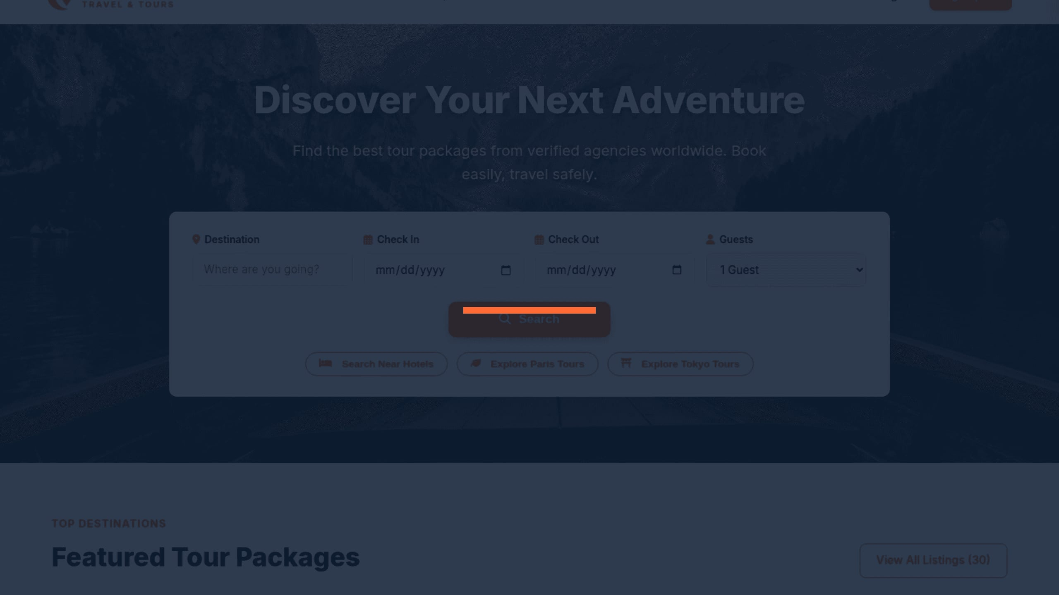
SAFAR
Thank You
Travel with confidence
Mohammed Tanvir•ID: 232-134-001

