Slide 1

Invited Talk:
Artificial Intelligence in Medicine Laboratory
Technion Institute of Technology
Dani Kiyasseh
dani.kiyasseh@eng.ox.ac.uk
August 19th, 2020

Slide 2
Roadmap
Proposed Methods
Qualitative Results
Quantitative Results
Conclusion
Cardiac Signals
Problem Formulation

Slide 3

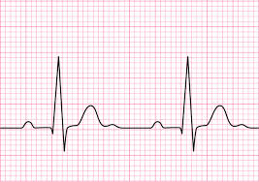

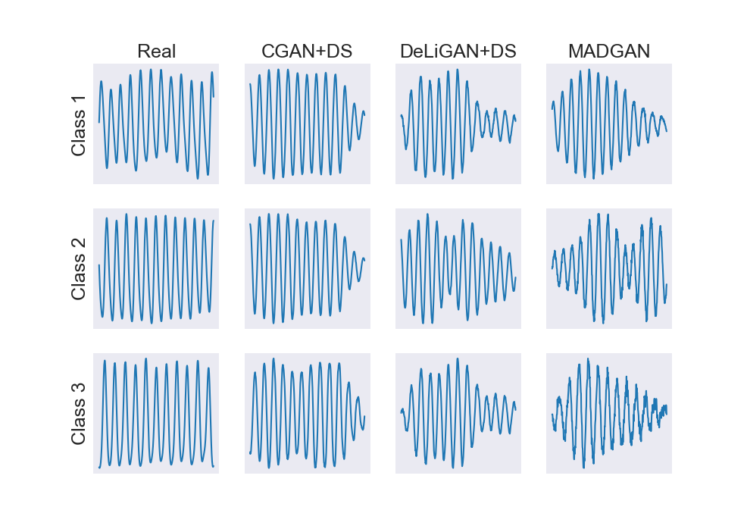


The Power of Cardiac Signals
Electrocardiogram (ECG)
Measures the electrical activity of the heart
Photoplethysmogram (PPG)
Measures peripheral blood volume changes
Cardiac Signals
Problem Formulation
Proposed Methods
Qualitative Results
Quantitative Results
Conclusion

Slide 4






Problem Formulation
Shortage of Medical Supplies
Low Physician to Patient Ratio
Low Quality Expertise
Paucity of data
Few labelled data
Noisy labels
*In low-resource clinical settings
Cardiac Signals
Problem Formulation
Proposed Methods
Qualitative Results
Quantitative Results
Conclusion

Slide 5
Need Statement
Physicians need support in diagnosing the severity of medical conditions in low-resource clinical settings in order to improve resource allocation and patient outcomes
Cardiac Signals
Problem Formulation
Proposed Methods
Qualitative Results
Quantitative Results
Conclusion

Slide 6
Potential Solution – Data Augmentation
Data Augmentation
Intuition
Examples
increase the amount and diversity of data provided to network
Time-warping
Random noise
Improved diversity allows the network to capture the true data distribution
SpecAugment
Cardiac Signals
Problem Formulation
Proposed Methods
Qualitative Results
Quantitative Results
Conclusion

Slide 7
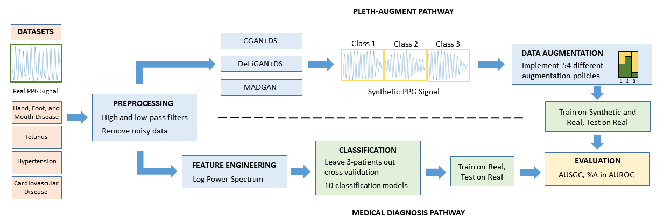
Proposed Pipeline
Cardiac Signals
Problem Formulation
Proposed Methods
Qualitative Results
Quantitative Results
Conclusion

Slide 8
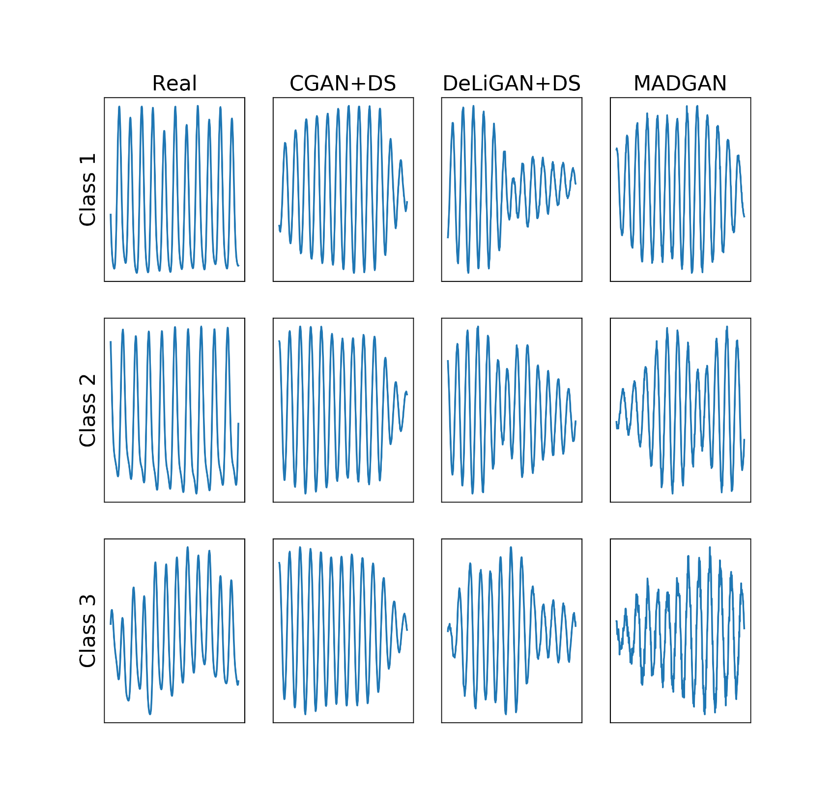



Conditional GANs
Synthetic
c
z
G
D
Fake or Real
Generator Loss
Real
Discriminator Loss
$$ℒ_{G}={−E}_{z\sim p_{z}}[\text{log}D\left(G\left(z|c\right)\right)]$$
$${ℒ_{G}=−E}_{z\sim p_{z}}[\text{log}D\left(G\left(z\right)\right)]$$
$${ℒ_{D}=E}_{z\sim p_{z}}\left[D\left(G\left(z\right)\right)\right]−E_{x\sim p_{d}}[D\left(x\right)]$$
$$ℒ_{D}=E_{z\sim p_{z}}\left[D\left(G\left(z|c\right)\right)\right]−E_{x\sim p_{d}}\left[D\left(x|c\right)\right]$$
Cardiac Signals
Problem Formulation
Proposed Methods
Qualitative Results
Quantitative Results
Conclusion

Slide 9



Conditional GANs Cont.
DeLiGAN
MADGAN
$$z_{1}=μ_{1}+σ_{1}ε$$
G₁
ε
$$z_{2}=μ_{2}+σ_{2}ε$$
G
z
G₂
$$z_{3}=μ_{3}+σ_{3}ε$$
G₃
Learnable class-specific Gaussian parameters
Unique generator per class
(Gurumurthy et al., 2017)
(Ghosh et al., 2018)
Cardiac Signals
Problem Formulation
Proposed Methods
Qualitative Results
Quantitative Results
Conclusion

Slide 10
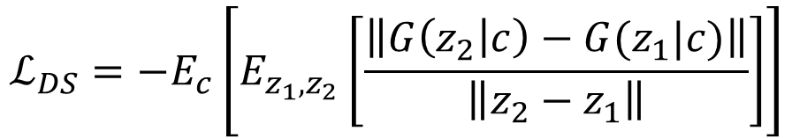
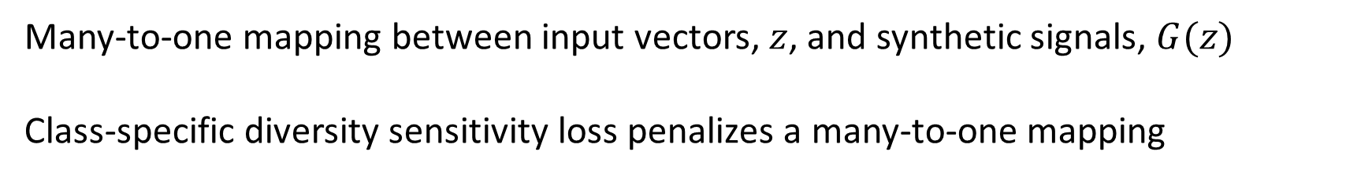
Avoiding Mode Collapse
Many-to-one mapping between input vectors, $z$, and synthetic signals, $G(z)$
Class-specific diversity sensitivity loss penalizes a many-to-one mapping
$$ℒ_{DS}=−E_{c}\left[E_{z_{1},z_{2}}\left[\frac{\left\|G\left(z_{2} | c\right)−G(z_{1}|c)\right\|}{\left\|z_{2}−z_{1}\right\|}\right]\right]$$
Cardiac Signals
Problem Formulation
Proposed Methods
Qualitative Results
Quantitative Results
Conclusion

Slide 11
Qualitative Results
Class-specific PPG data generated by the various CGANs
Capture naturally-occurring physiological phenomenon, known as respiratory sinus arrhythmia (RSA)
Cardiac Signals
Problem Formulation
Proposed Methods
Qualitative Results
Quantitative Results
Conclusion

Slide 12
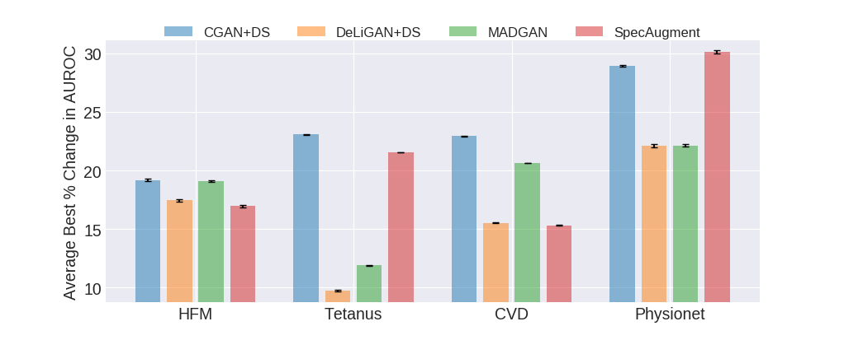
Quantitative Results - AUROC
CGAN+DS outperforms or is on par with SpecAugment
Cardiac Signals
Problem Formulation
Proposed Methods
Qualitative Results
Quantitative Results
Conclusion

Slide 13
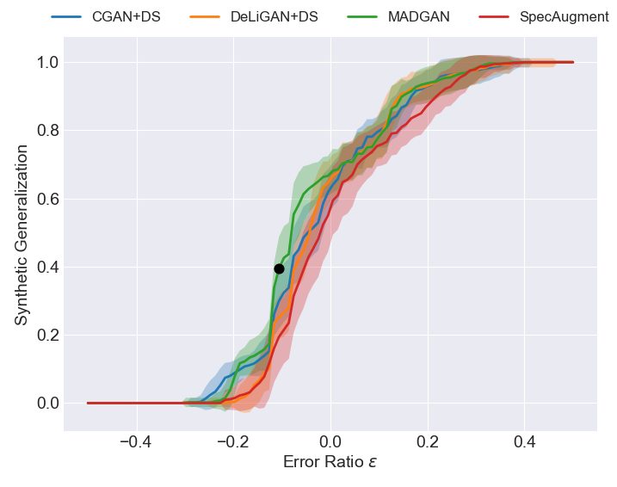
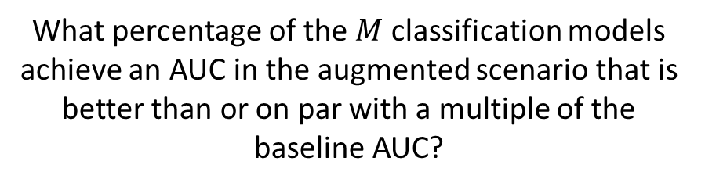
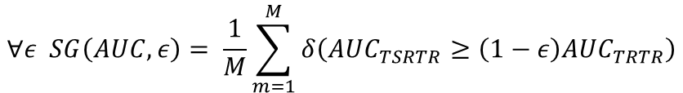
Synthetic Generalization Curve
$$∀ε SG\left(AUC,ε\right)= \frac{1}{M}\sum_{m=1}^{M}{δ\left({AUC}_{TSRTR}≥\left(1−ε\right){AUC}_{TRTR}\right)}$$
What percentage of the $M$ classification models achieve an AUC in the augmented scenario that is better than or on par with a multiple of the baseline AUC?
Better than baseline
Worse than baseline
Cardiac Signals
Problem Formulation
Proposed Methods
Qualitative Results
Quantitative Results
Conclusion

Slide 14
Conclusion
CGAN+DS generates realistic synthetic PPG data
Train on Synthetic and Real and Test on Real (TSRTR) paradigm improves classification performance by up to 29% relative to baseline
Synthetic generalization curve allows for holistic comparison of GANs used for data augmentation
Cardiac Signals
Problem Formulation
Proposed Methods
Qualitative Results
Quantitative Results
Conclusion

Slide 15
Glossary
Proposed Methods
Qualitative Results
Quantitative Results
Conclusion
Cardiac Signals
Problem Formulation

Slide 16
References
Ghosh, A., et al. (2018). Multi-Agent Diverse Generative Adversarial Networks. Retrieved from https://arxiv.org/pdf/1704.02906.pdf
Gurumurthy, S., et al. (2017). DeLiGAN : Generative Adversarial Networks for Diverse and Limited Data. Retrieved from https://arxiv.org/pdf/1706.02071.pdf
Mirza, M., Osindero, S. (2014). Conditional Generative Adversarial Nets. Retrieved from https://arxiv.org/pdf/1411.1784.pdf

