Slide 1
Project report
Multi-Agent Reinforcement Learning via Adaptive Kalman Temporal Difference and Successor Representation
Mohammad Salimibeni | Arash Mohammadi | Parvin Malekzadeh and Konstantinos N. Plataniotis
RLinControl | Fall 2024
Professor: Dr. Saeed Shamaghdari
Seyede Setare Khosravi | Mobina Lashgari

Slide 2
Table of contents
Abstract
Introduction
Problem Formulation
MAK-TD Framework
MAK-SR Framework
Experimental Results
Simulation Results
Conclusions

Slide 3
Abstract
Reinforcement Learning Challenges
Fixed Reward Function
Overfitting, High sensitivity and …
Kalman an Idea to Solve The Challenges
Online Learning and …

Slide 4
Introduction
MARl
Questions!

Slide 5
Introduction
MARl
Challenges!

Slide 6
Problem
Formulation

Slide 7

Single Agent Reinforcement learning

Slide 8
Single Agent Reinforcement learning

Slide 9
TD Learning

Slide 10

TD Learning

Slide 11
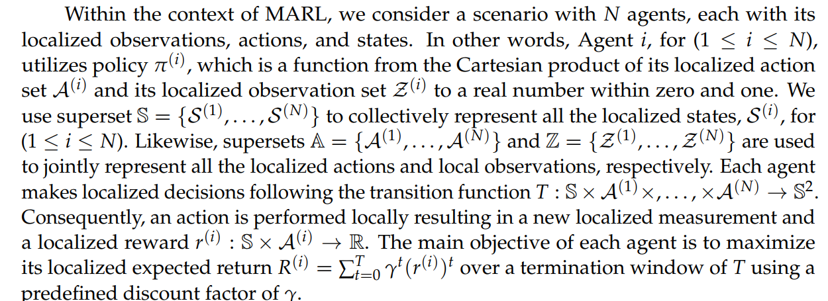



Multi agent setting

Slide 12
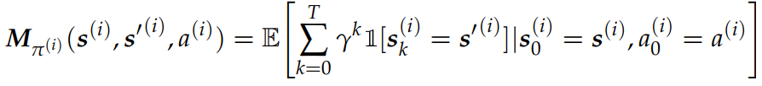
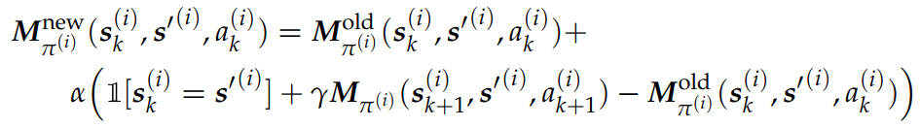
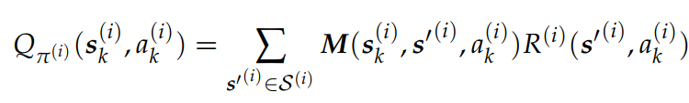
Multi agent sr

Slide 13
Multi agent sr

Slide 14
Multi agent sr

Slide 15


MAK-TD Framework

Slide 16
MAK-TD Framework

Slide 17




MAK-TD Framework

Slide 18
MAK-TD Framework

Slide 19
MAK-TD Framework

Slide 20
MAK-TD Framework

Slide 21


MAK-TD Framework

Slide 22
MAK-TD Framework

Slide 23

MAK-TD Framework

Slide 24
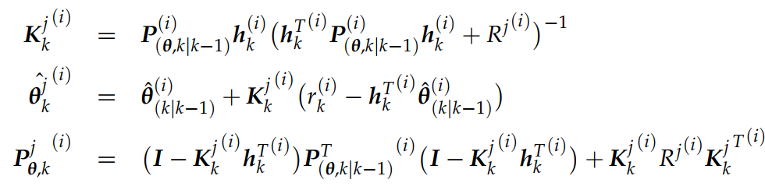
MAK-TD Framework

Slide 25


MAK-TD Framework

Slide 26
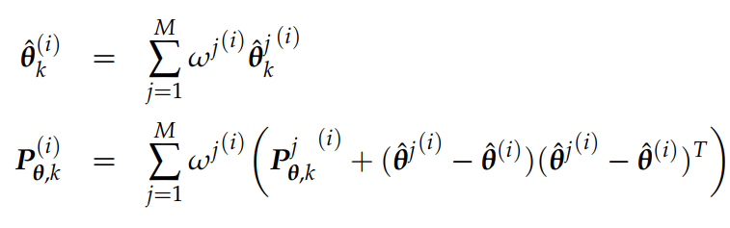
MAK-TD Framework

Slide 27

MAK-TD Framework

Slide 28
MAK-TD Framework

Slide 29
MAK-TD Framework

Slide 30

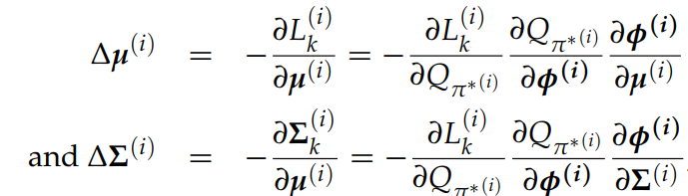
MAK-TD Framework

Slide 31
MAK-TD Framework

Slide 32
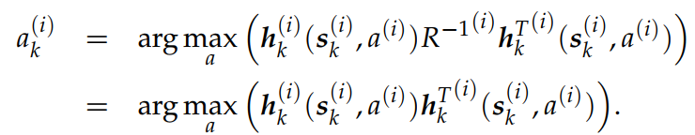
MAK-TD Framework

Slide 33
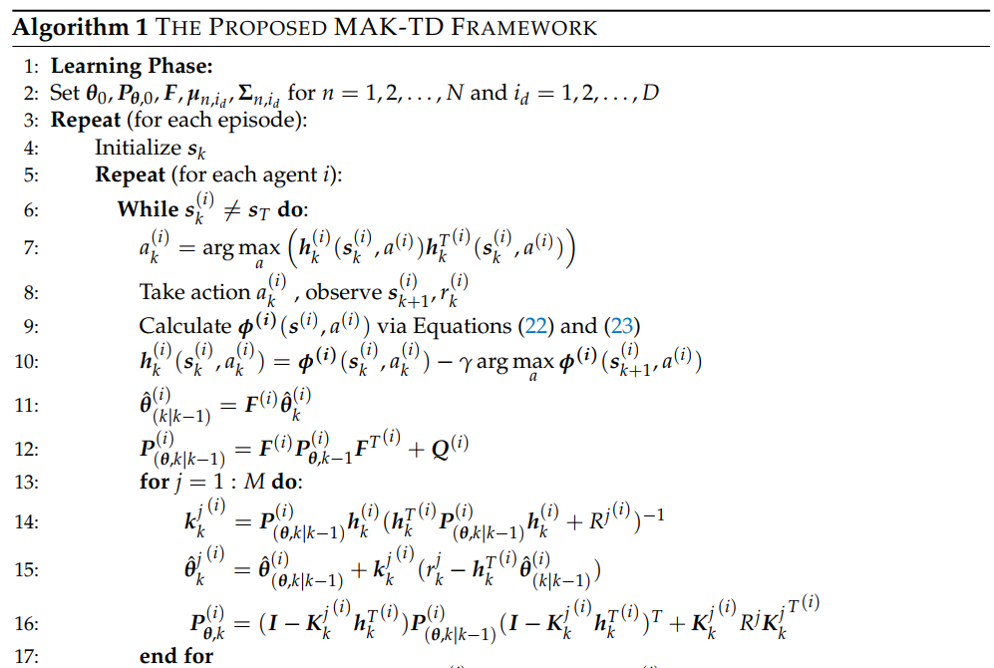

Slide 34
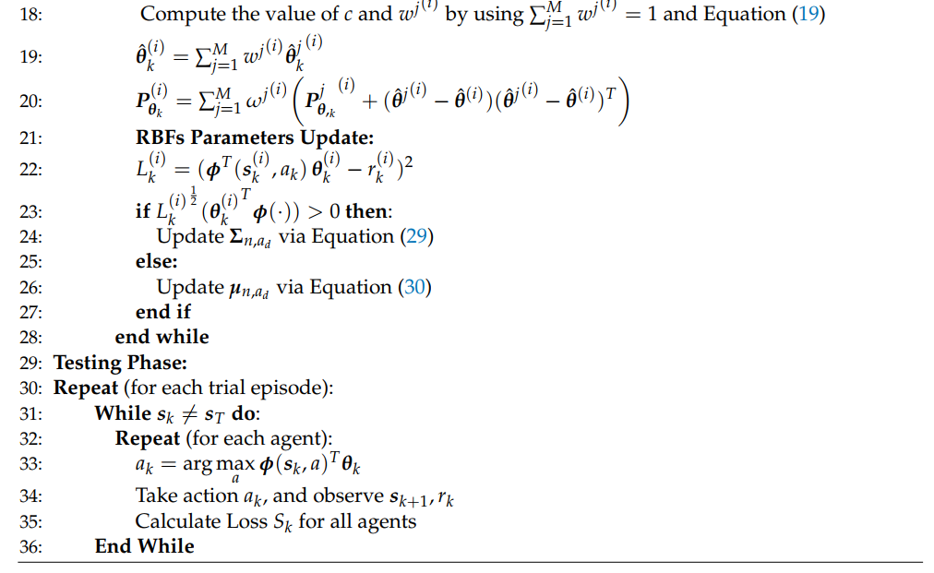

Slide 35




MAK-SR Framework

Slide 36
MAK-SR Framework

Slide 37
MAK-SR Framework

Slide 38
MAK-SR Framework

Slide 39
MAK-SR Framework

Slide 40

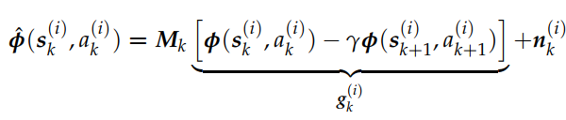


MAK-SR Framework

Slide 41
MAK-SR Framework

Slide 42
MAK-SR Framework

Slide 43
MAK-SR Framework

Slide 44
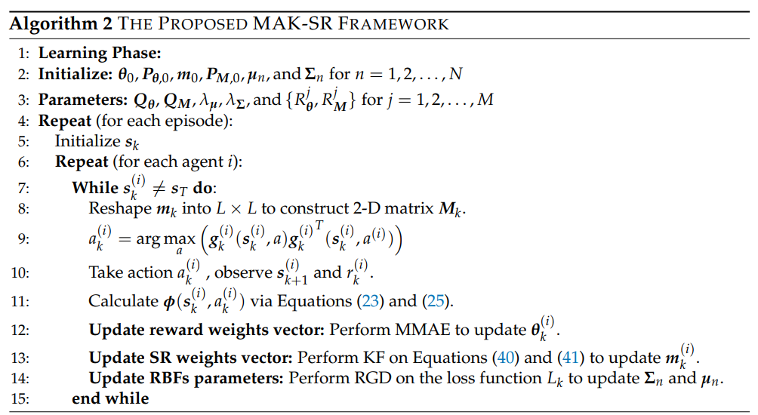

Slide 45
Experimental
Results

Slide 46
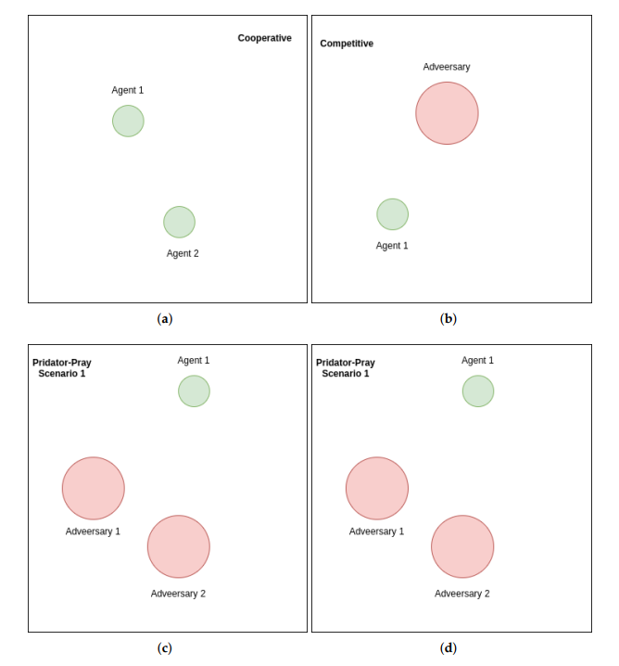
Experimental Results

Slide 47
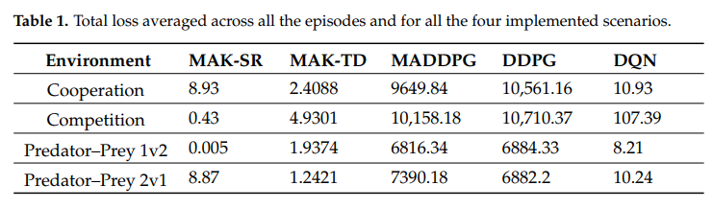
Experimental Results

Slide 48
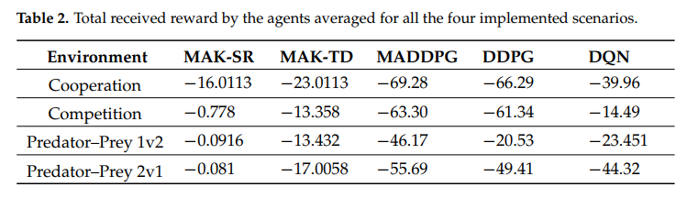
Experimental Results

Slide 49
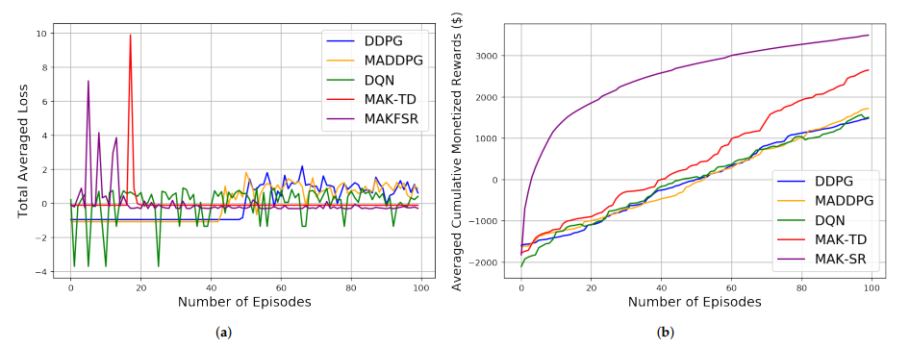
Experimental Results

Slide 50
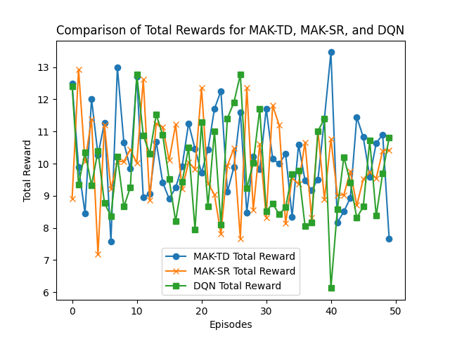

Simulation Results

Slide 51
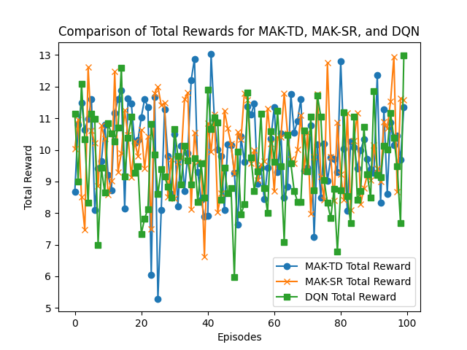

Simulation Results

Slide 52
Conclusions
Key Achievements:
MAK-TD
MAK-SR

Slide 53
Thank you!
Winter 2025

