Slide 1







Estimating breeding values with BLUPF90
Slides adapted from Gabriela Mafra Fortuna, Raphael Mrode, Gregor Gorjanc
ILRI
Feb 2026
@HighlanderLab

Slide 2
What is BLUPF90
Programme for solving mixed-models
Estimate variance components
Estimate approximated model accuracy
Perform Genome-wide association studies (GWAS)

Slide 3
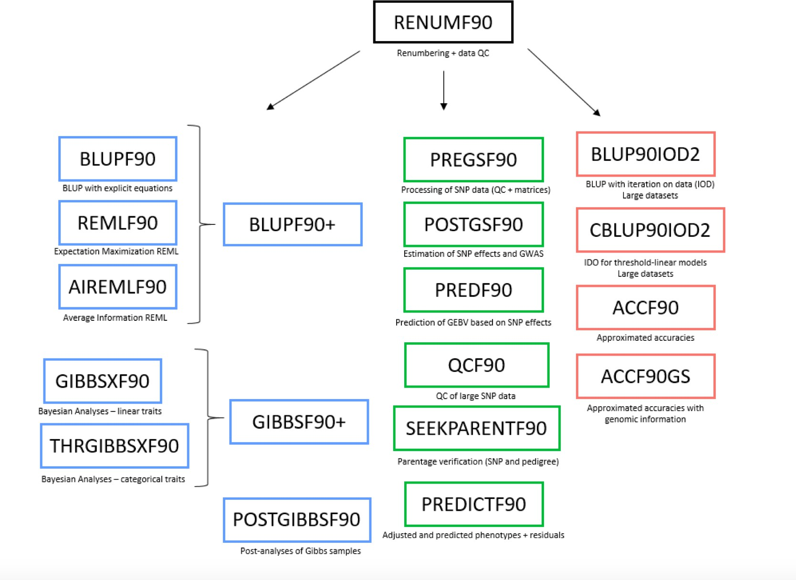
What is BLUPF90

Slide 4
What is BLUPF90

Slide 5
For this course
PBLUP
  Pedigree
  Phenotype
GBLUP
  SNP
  Phenotype
ssGBLUP
  Pedigree
  SNP
  Phenotype

Slide 6
Input files
Pedigree format:
  Iid fid mid
  No header
  Cannot contain #
  Space delimited
  Missing data is coded as 0
  No need to be ordered
id1 | 0 | 0
id2 | 0 | 0
id3 | 0 | id2
id4 | id1 | id2
id5 | id3 | id4
id6 | id3 | id4

Slide 7
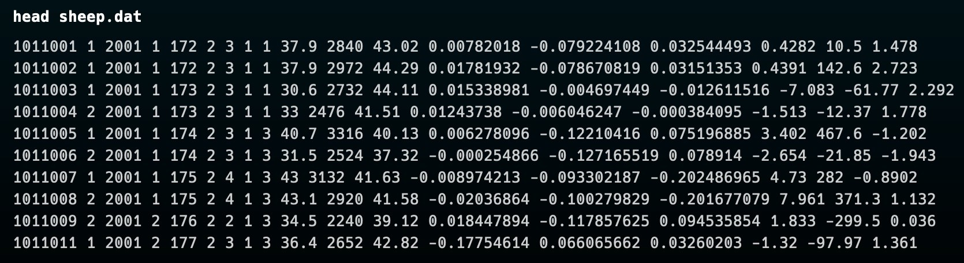
Input files
Data file:
  No header
  Cannot contain #
  Space delimited
  Missing is coded 0

Slide 8
Pedigree Blup (PBLUP)

Slide 9
Getting started: RENUMF90
Renumbering programme
Performs pedigree checks
Perform data summaries
Supports unknown parent groups
* It is convenient and reduces the chances of further error

Slide 10
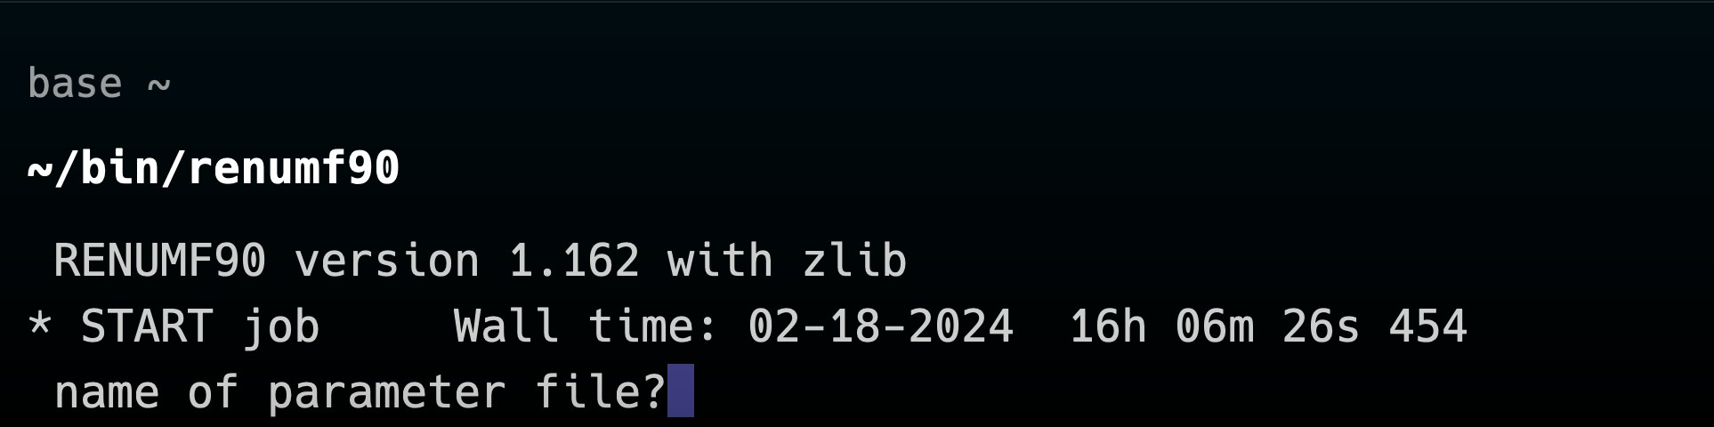
Parameter files

Slide 11
Parameter files
Datafile
Pedigree/SNP file
What are the covariates
What are the random effects
Variances
…
All the information that you used to build and solve the mixed-models so far

Slide 12
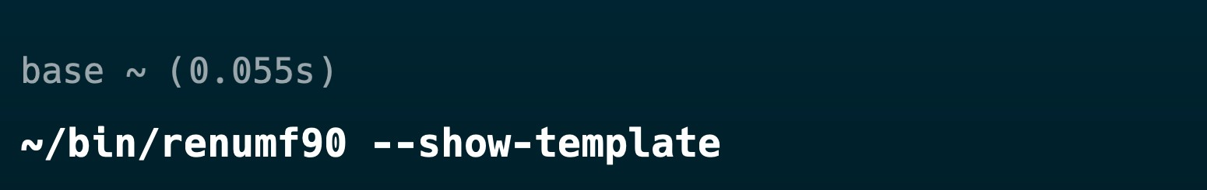
RENUMF90 parameter file

Slide 13
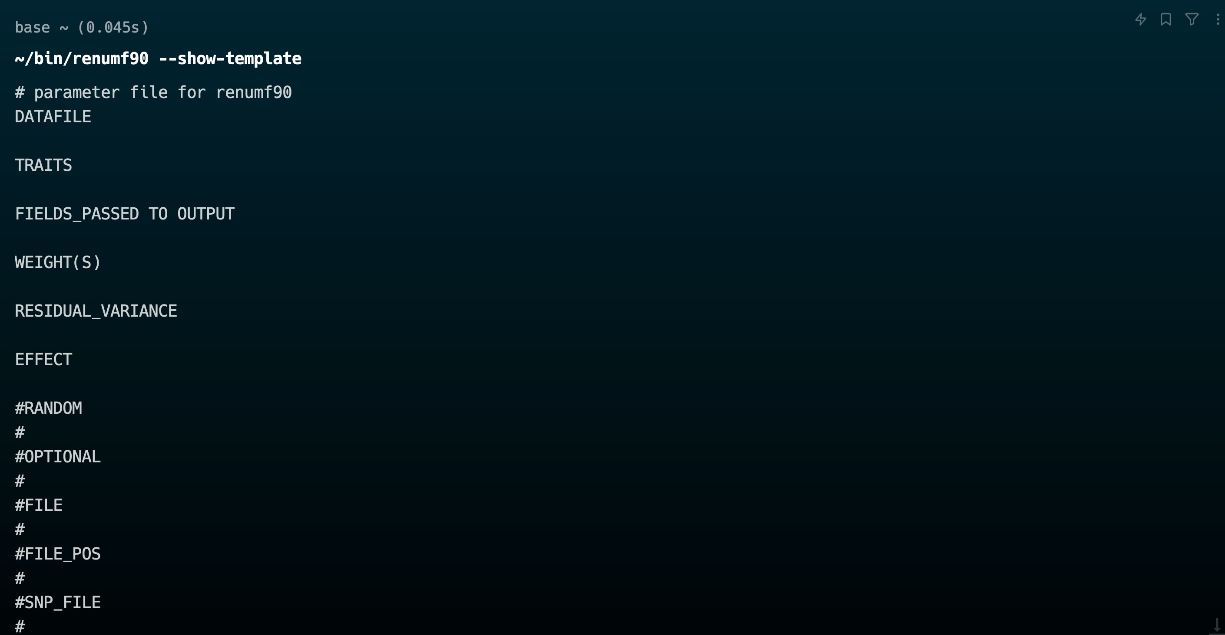
RENUMF90 parameter file

Slide 14
RENUMF90 parameter file
Save the template by piping the output of the renumf90 command to a file:

Slide 15
RENUMF90 parameter file
Save the template by piping the output of the renumf90 command to a file:
We will use a text editor to adapt that template to our dataset

Slide 16
RENUMF90 parameter file
Model:
FIXED
y = sex + year + litter_size + dam_age + group + line + dob + litter + animal + e
covariate
RANDOM

Slide 17
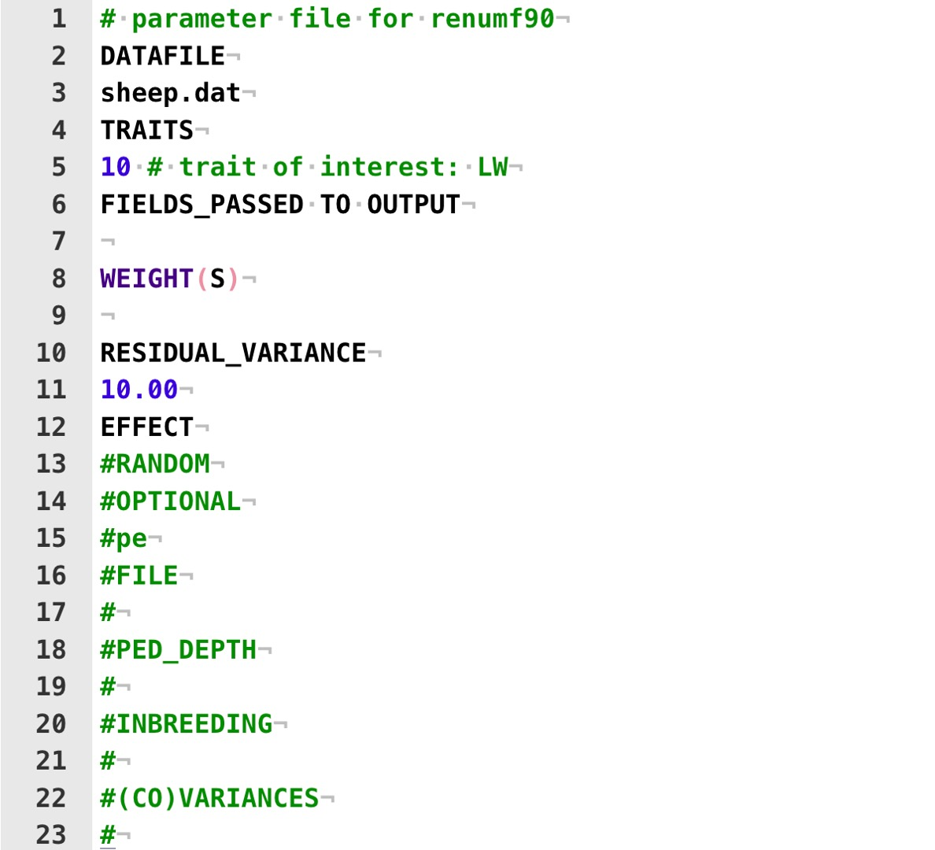
RENUMF90 parameter file: fixed effects
y = sex + year + litter_size + dam_age
+ group + line + dob + litter +
animal + e

Slide 18
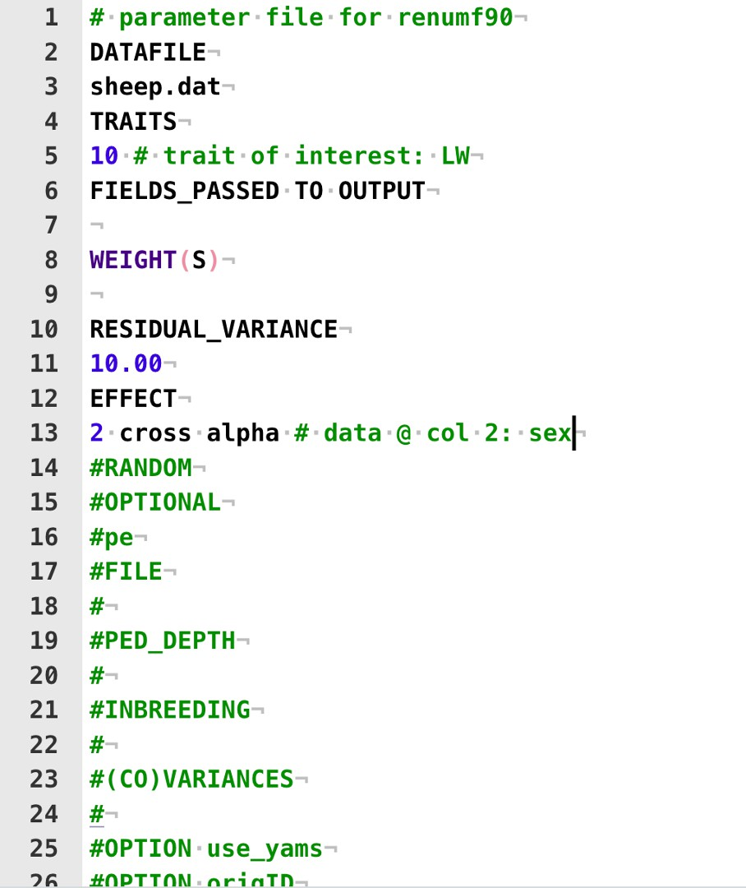
RENUMF90 parameter file: fixed effects
y = sex + year + litter_size + dam_age
+ group + line + dob +
litter + animal + e

Slide 19
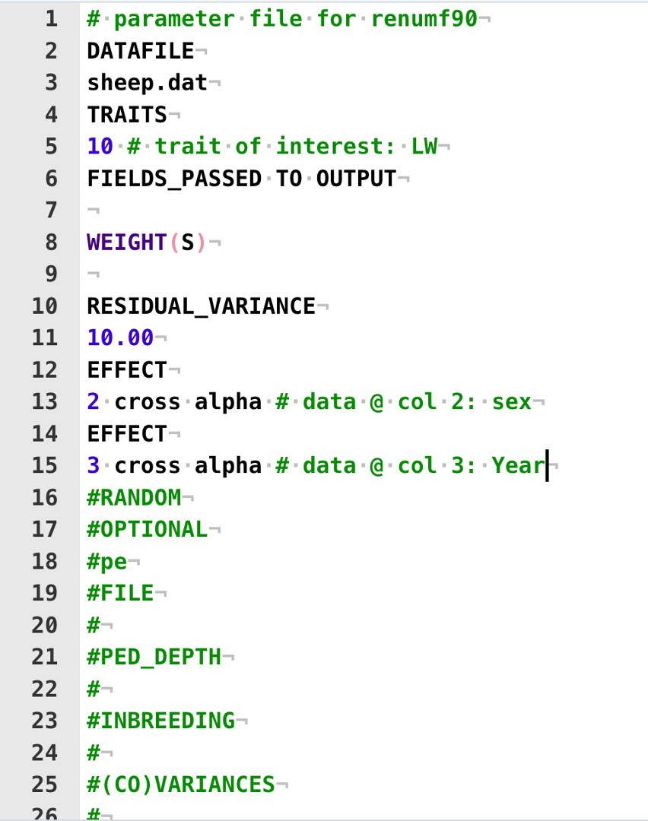
RENUMF90 parameter file: fixed effects
y = sex + year + litter_size + dam_age
+ group + line + dob +
litter + animal + e

Slide 20
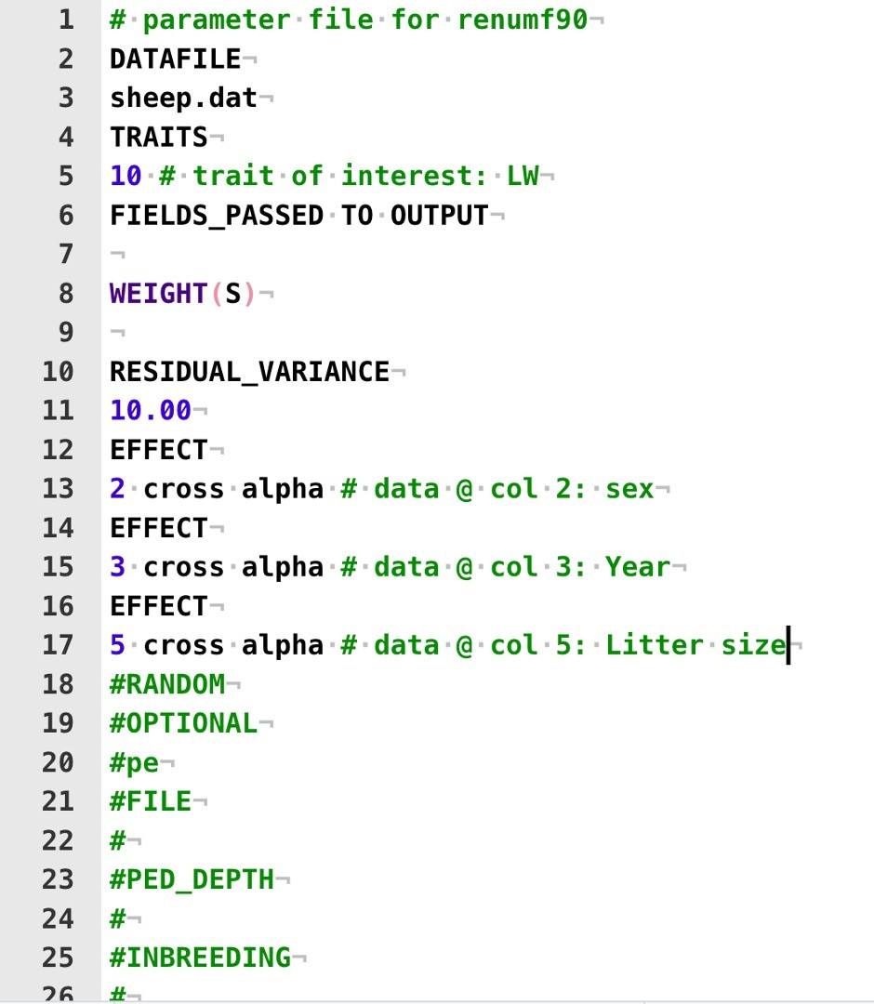
RENUMF90 parameter file: fixed effects
y = sex + year + litter_size + dam_age
+ group + line + dob +
litter + animal + e

Slide 21
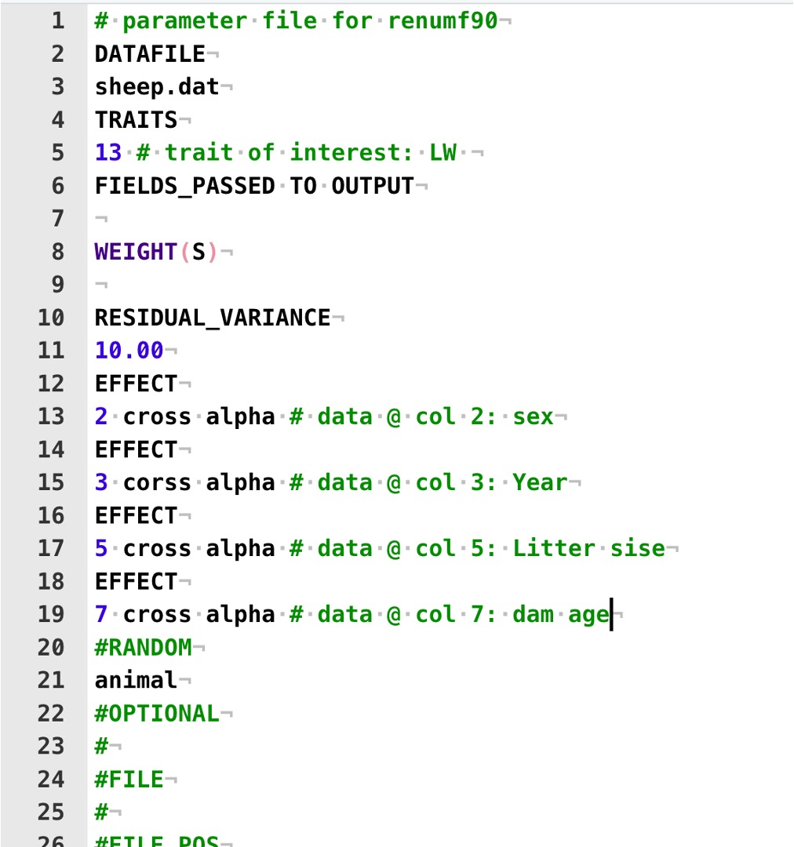
RENUMF90 parameter file: fixed effects
y = sex + year + litter_size + dam_age
+ group + line + dob + litter +
animal + e

Slide 22
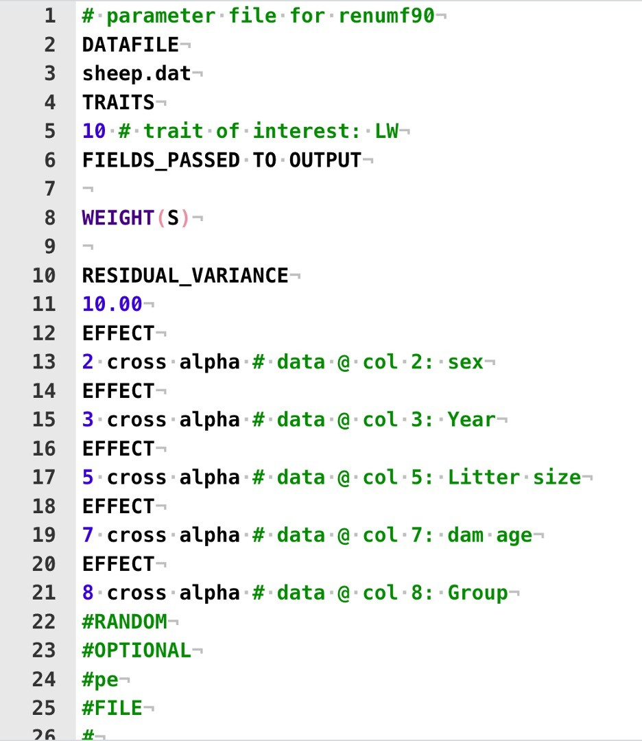
RENUMF90 parameter file: fixed effects
y = sex + year + litter_size + dam_age
+ group + line + dob +
litter + animal + e

Slide 23
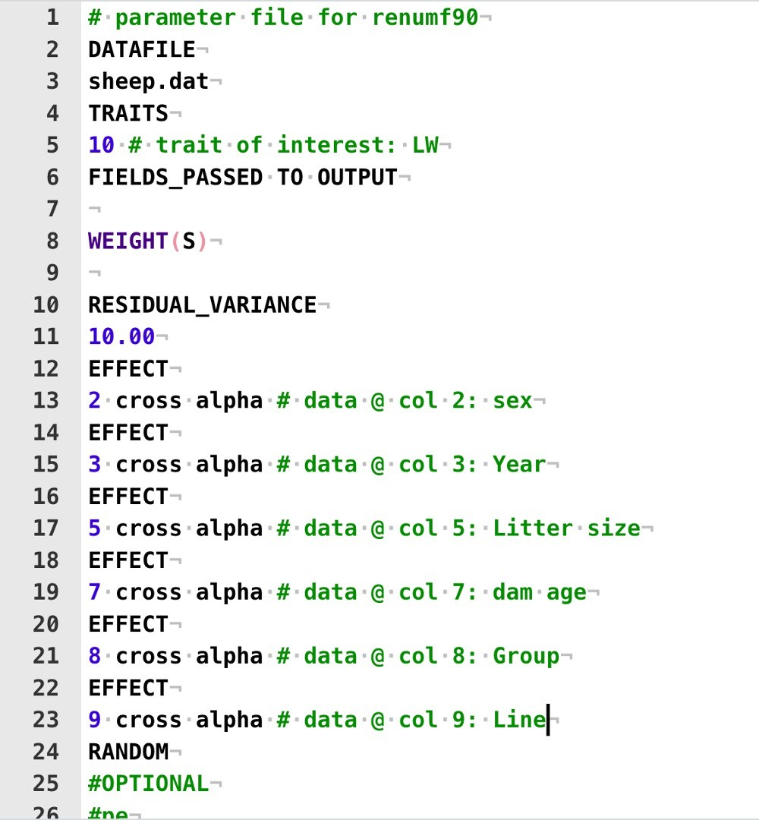
RENUMF90 parameter file: fixed effects
y = sex + year + litter_size + dam_age
+ group + line + dob +
litter + animal + e

Slide 24
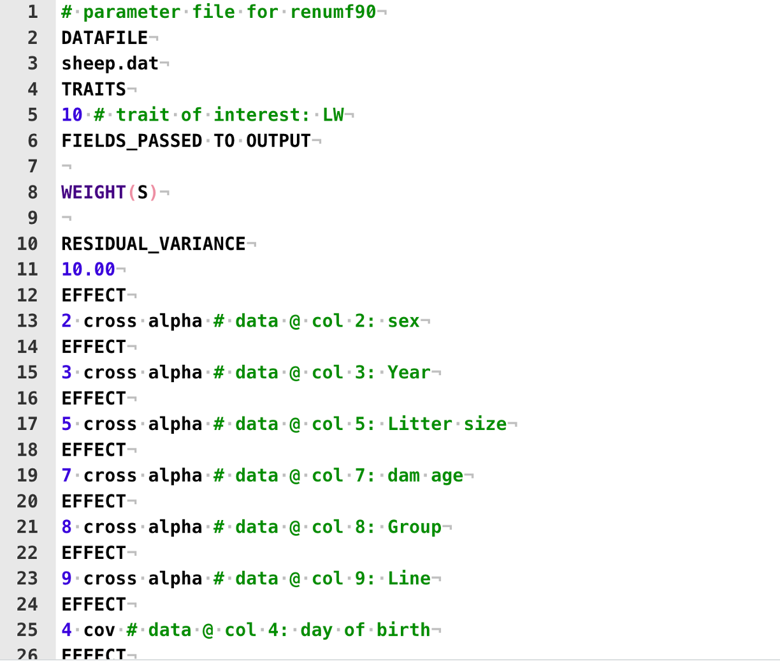
RENUMF90 parameter file: fixed effects
y = sex + year + litter_size + dam_age
+ group + line + dob +
litter + animal + e

Slide 25
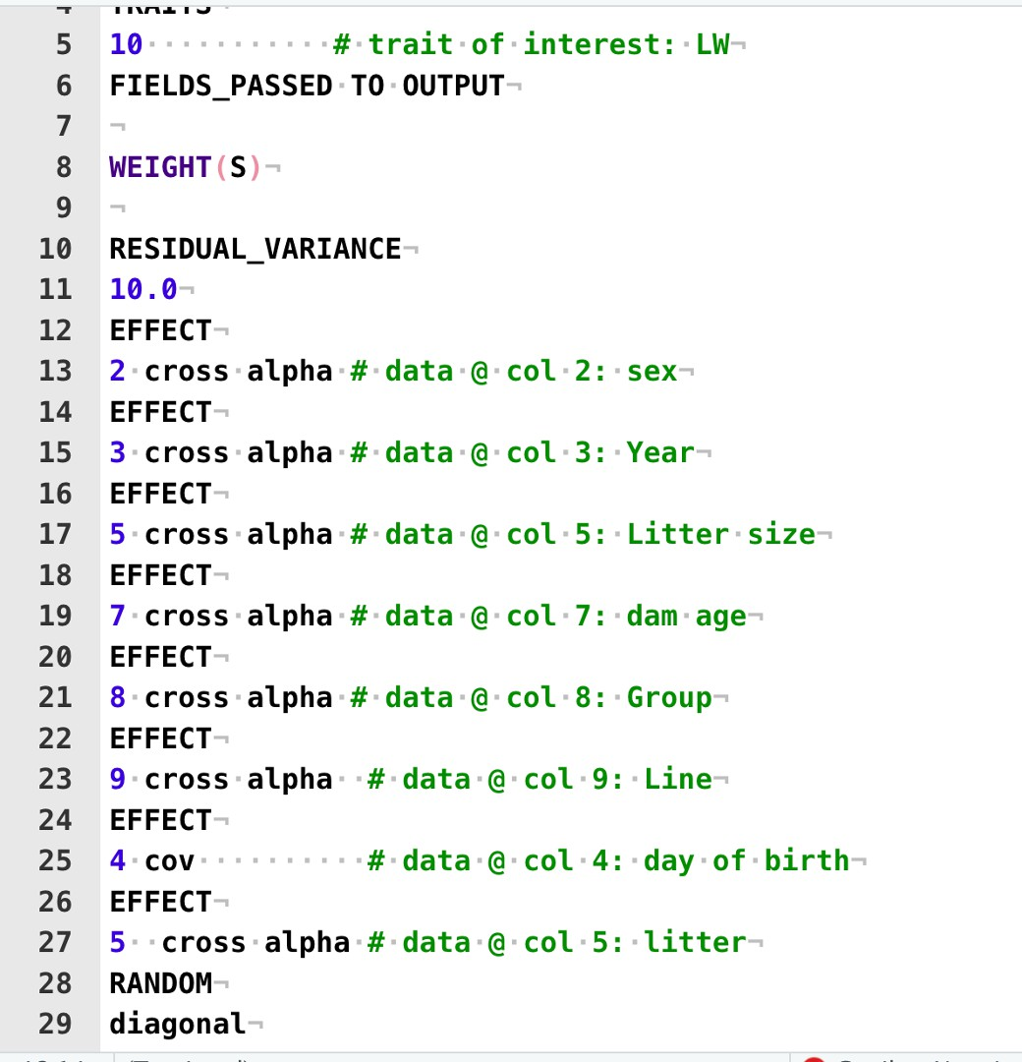
RENUMF90 parameter file: random effects
y = sex + year + litter_size + dam_age + group + line +
litter + animal + e

Slide 26
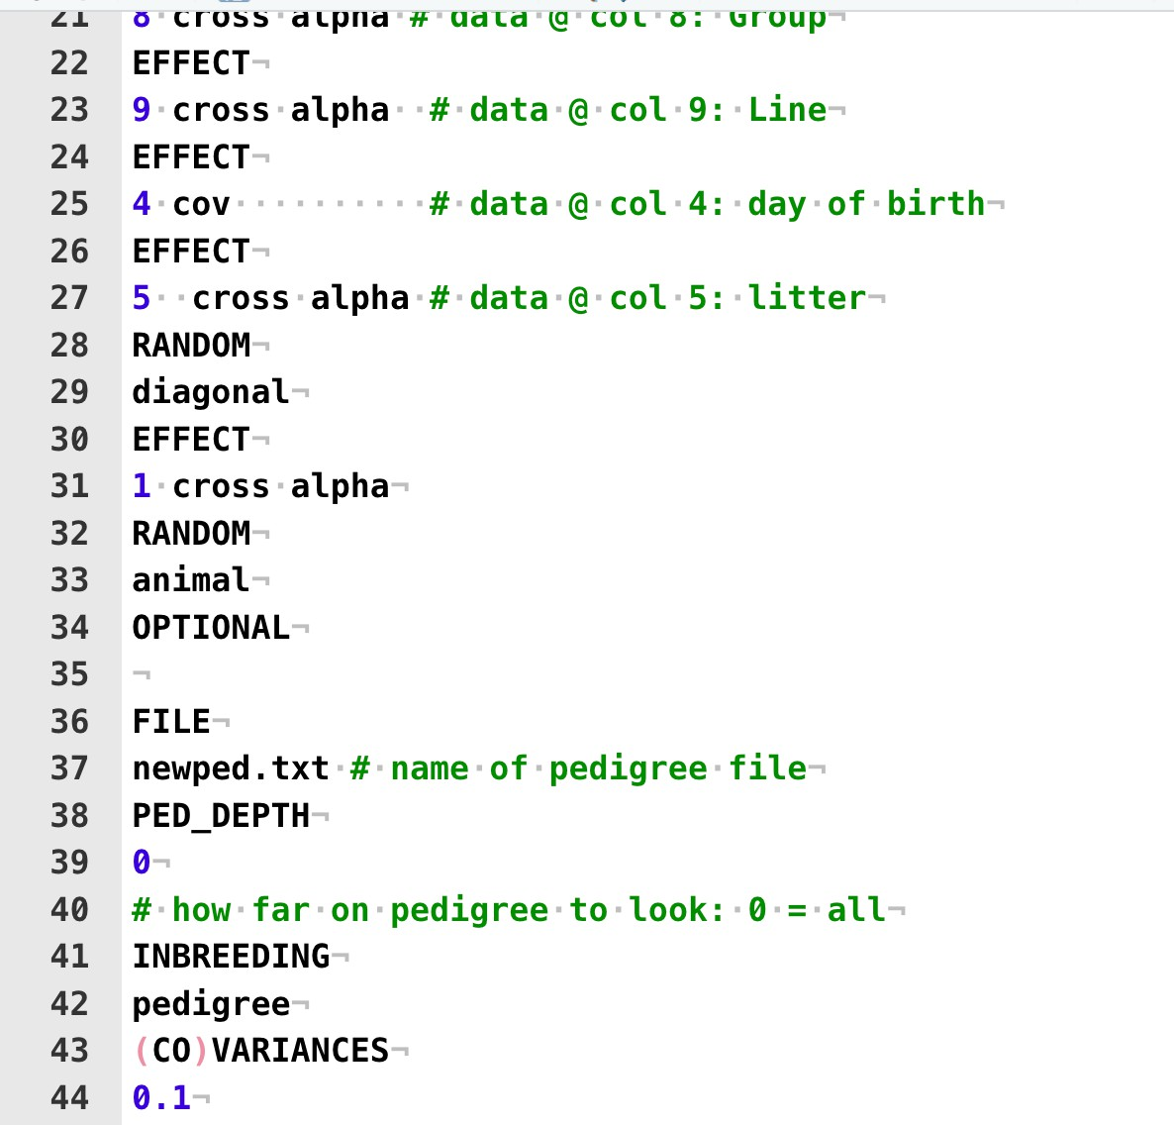
RENUMF90 parameter file: random effects
y = sex + year + litter_size + dam_age + group + line + animal + e

Slide 27
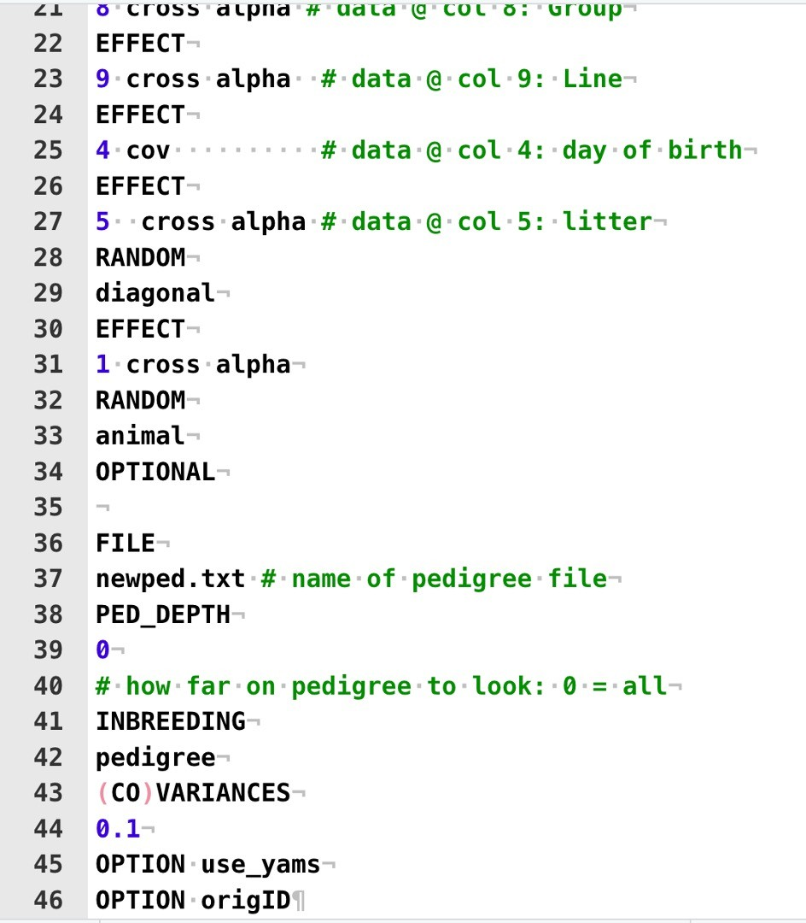
RENUMF90 parameter file: optional arguments
OPTION use_yams
Uses the programme YAMS. Improves computational time. OPTION origID
To keep original ids
(it makes it easier when retrieving results)

Slide 28
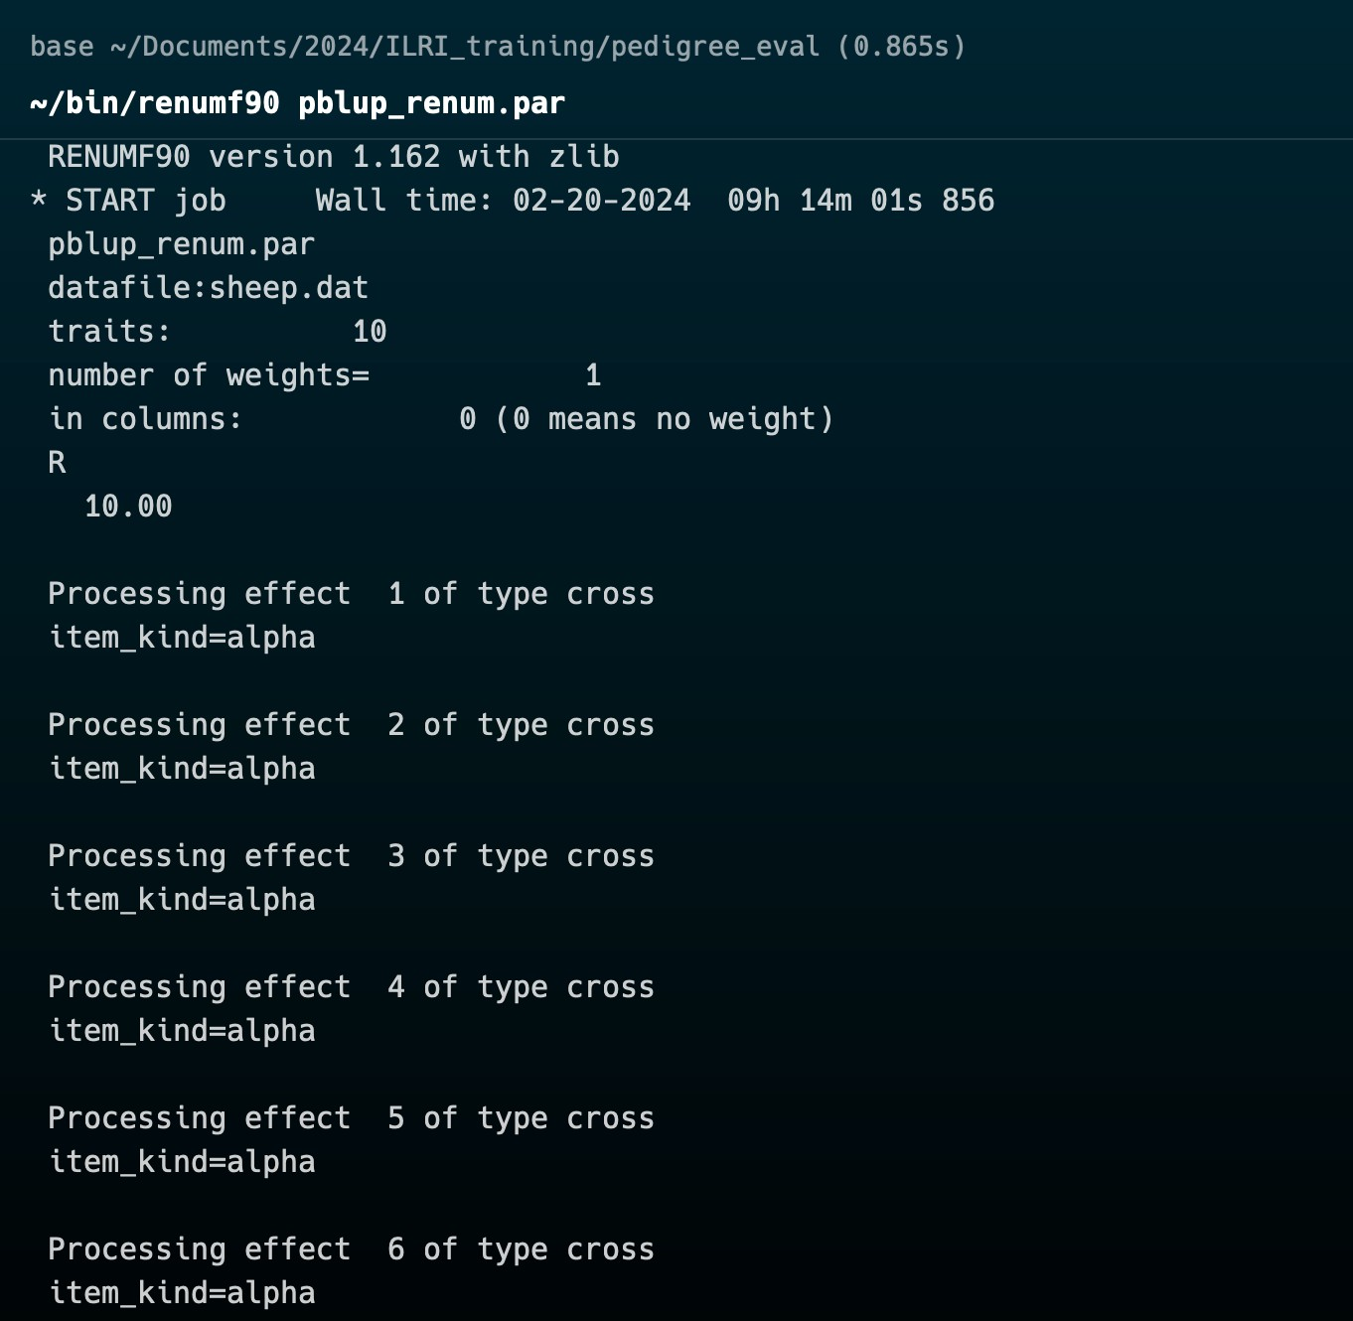
Running RENUMF90
Renumf90 <parameter_file>

Slide 29
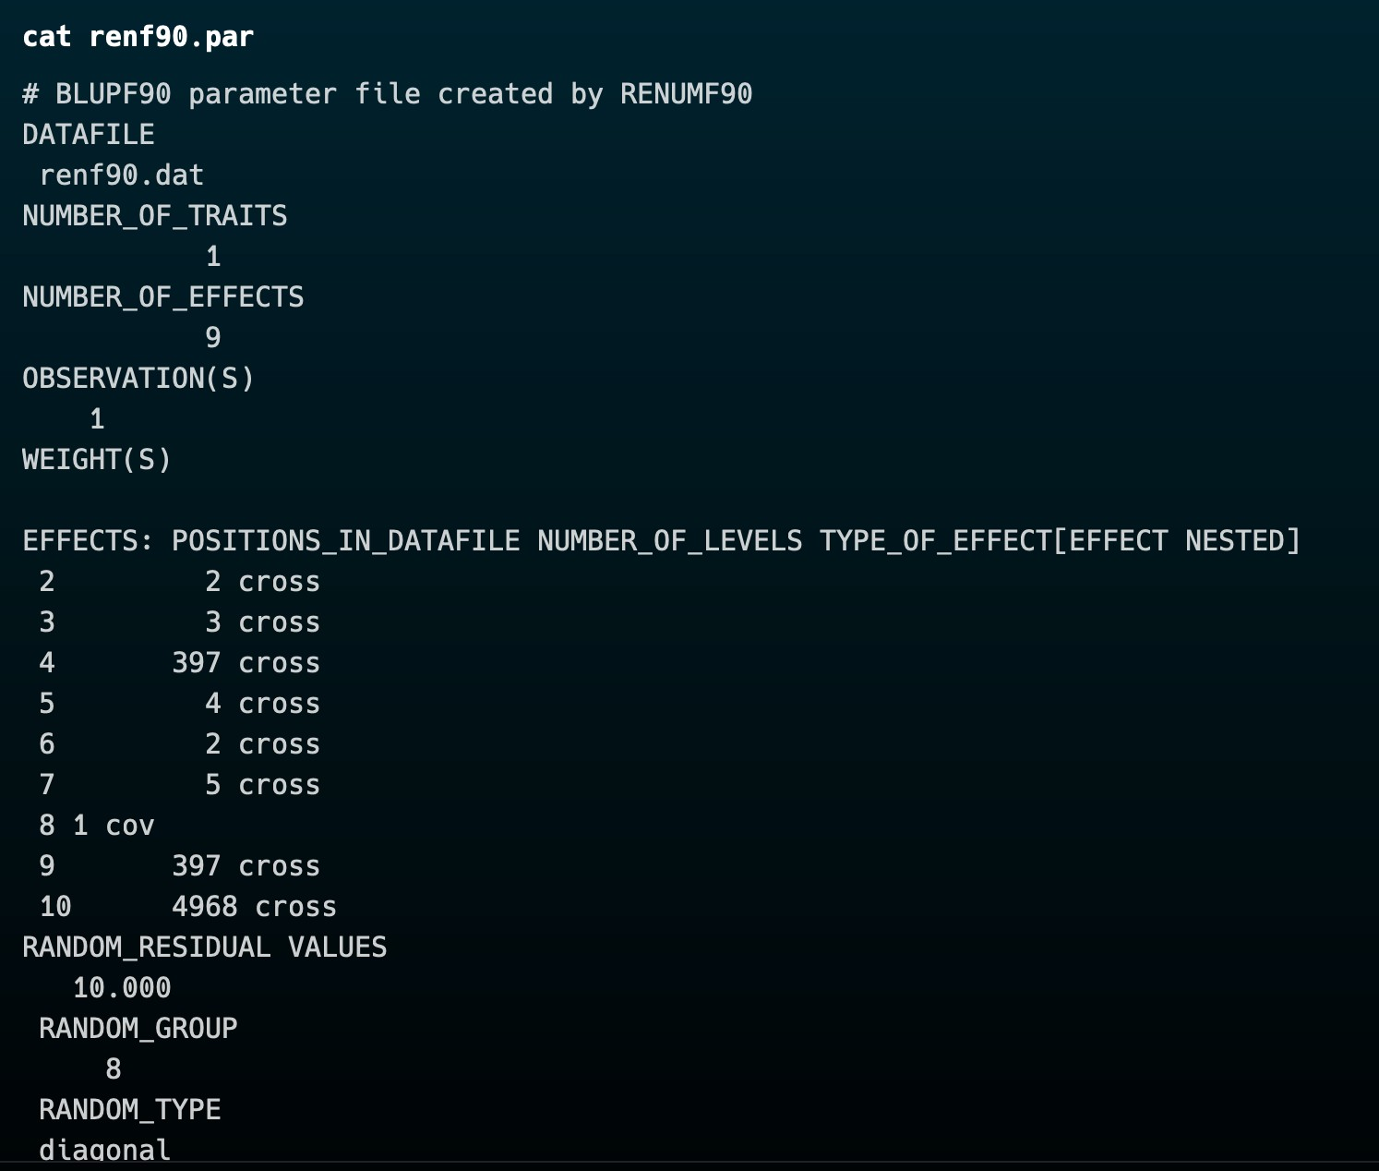
Running BLUPF90
Renumf90 will generate the parameter file for BLUPF90 called renf90.par
We can run blupf90
as we done with renumf90:
blupf90+ renf90.par
All files generated by both programmes have standard names and structures

Slide 30
Understanding the solutions
R again!!!

