Slide 1


Finding Adhesion Energies of Graphene and MoS₂ for Thermo-Electric Power Conversion Devices

Slide 2
Sections
Key Concepts
Thermo-Electric Power, Seebeck Effect, 2D materials
Experiment Set-up
Sample Preparation, Calculations
Imaging
SEM Location, AFM Imaging
Adhesion Energies
Table Summary and Analysis
Conclusion and Future Work

Slide 3
Key Concepts

Slide 4
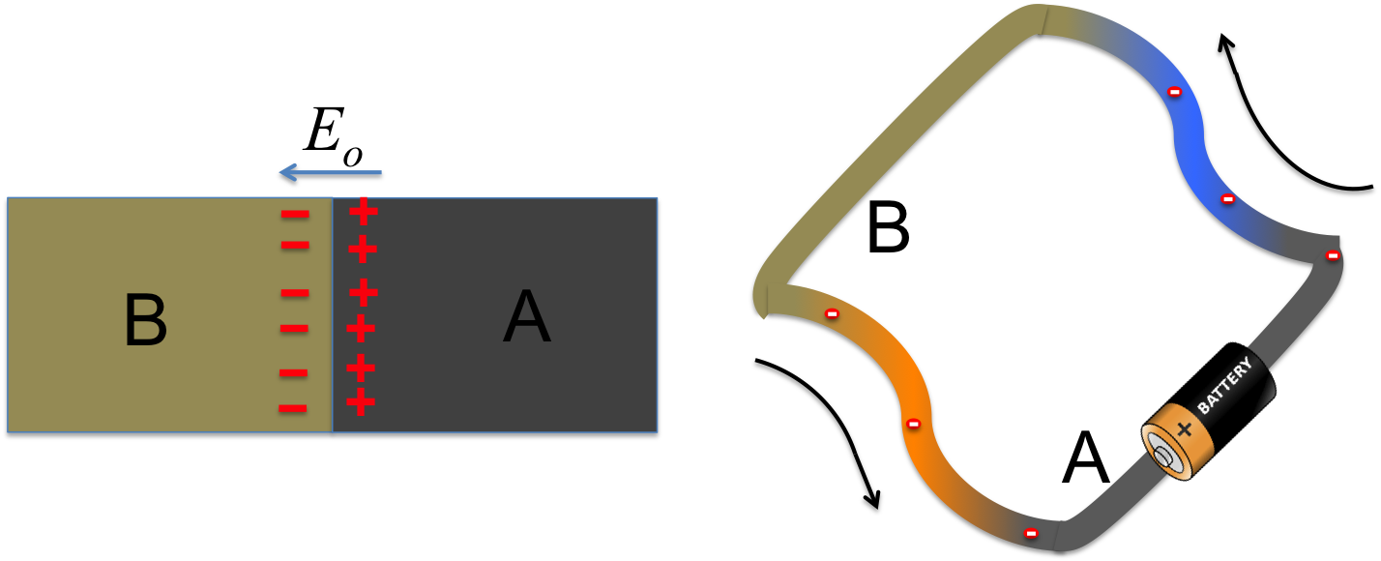
Thermo-Electric Power
Gradients
Thermal: 2nd Law of Thermodynamics
Electrical: potential and electrostatics
What happens if these are coupled?

Slide 5
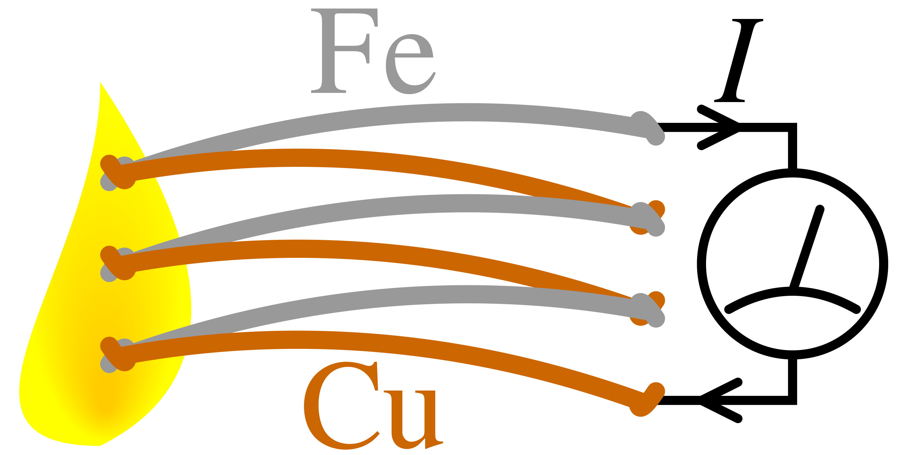
The Seebeck Effect
Thermoelectric Effect: Seebeck, Peltier, Thomson
Seebeck Effect
Generation of voltage via heat due to unequal electron energies, governed by Seebeck coefficient. Often utilized in thermopiles:

Slide 6
2D Materials
Definition: crystalline materials arranged into a single sheet of atoms.
Δz
Advantages: High SA:V → efficient conductivity (λ, σ)
Disadvantages: difficult integration, structurally less secure
Between MoS₂ and Graphene, which has higher adhesion energy (γ) to metal substrates?

Slide 7
Experiment Set-Up

Slide 8

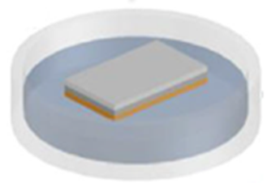


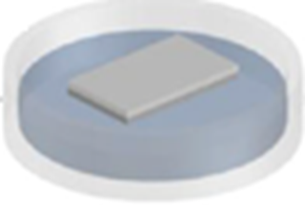


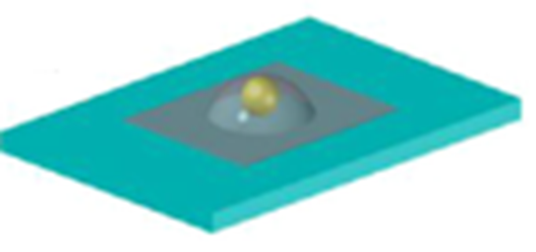
Sample Preparation
Copper etched away
Copper growth substrate cleaned
2D material grown via CVD
PMMA spun on
PMMA washed away
Test substrate cleaned
Nanoparticle deposited
Prepare 2D material
Deposit nanoparticle (Au) onto metal substrate
Layer on 2D material
Sample ready for imaging

Slide 9
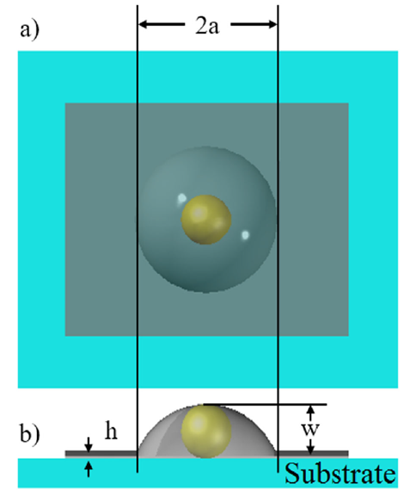

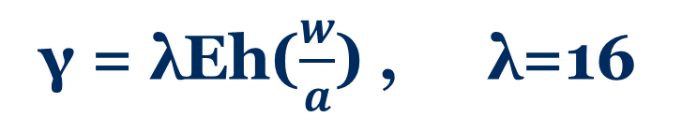
Calculations
Assumptions:
Negligible deformation and contact area, small debonding angle, and spherical nanoparticle
Modeling:
Thin plastic membrane with centralized load, with simplifications:
4
Parameters of interest, a) top view b) side view
γ = λEh($\frac{w}{a}$) , λ=16

Slide 10
Imaging

Slide 11
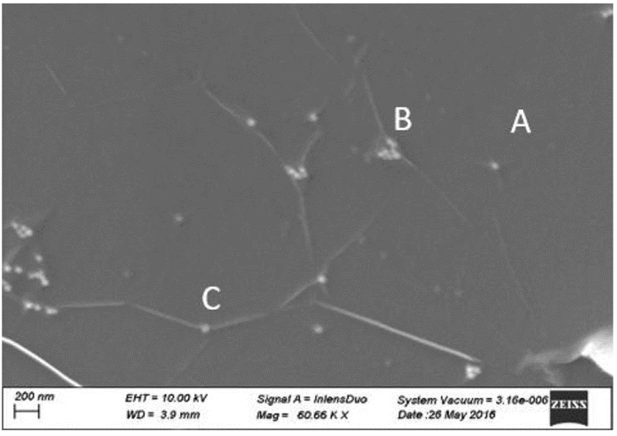
SEM Location
SEM image of graphene on SiN with gold nanoparticles:
Blister types:
Compound – clumping of multiple nanoparticles
Wrinkle – large infolding or crease of 2D material
Simple – target for most accurate modeling
Working distance: 3.9mm, Magnification: 60.00kx, Operating Voltage: 10kV

Slide 12
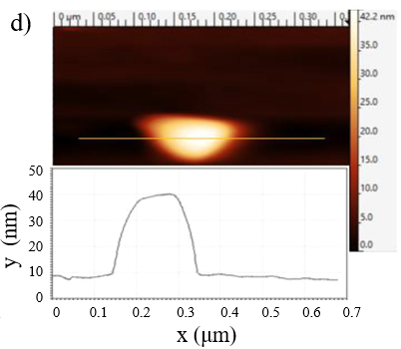
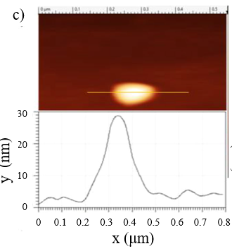
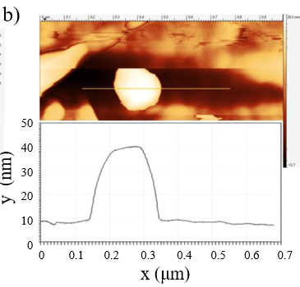
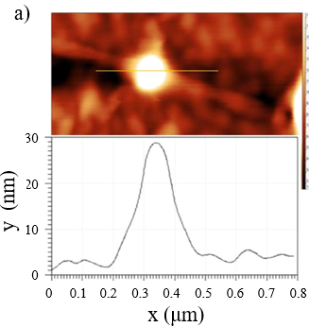
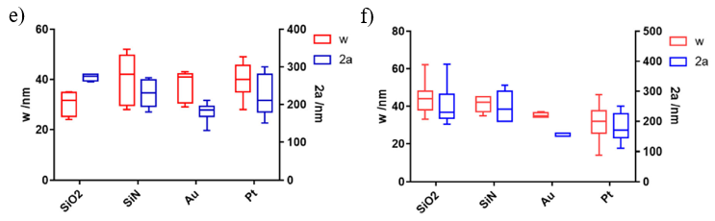
AFM imaging
Graphene on:
MoS₂ on:
Lot Statistics:
SiO₂: Pt:
Graphene: MoS₂:
Average nanoparticle dimensions are comparable
Graphene variability possibly due to CVD process
Notes:
Useful in Prognosis
Poor prognosis typically consistent with higher blood concentrations
Normal concentration: <100pg/mL, grey 100-800pg/mL, high 1000pg/mL

Slide 13
Adhesion Energies

Slide 14
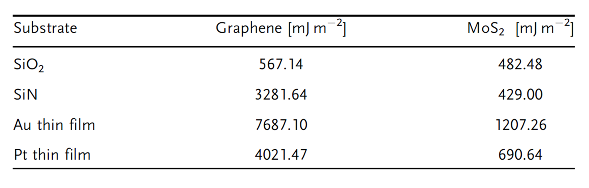
Adhesion Energy Results
[E_{grn} = 1 TPa, E_{MoS2} = 0.33TPa]
Graphene shows overall stronger bonding
γ is not directly proportional to E
Other surface effects such as Van der Waals have significant effect

Slide 15
Conclusions and Future Work

Slide 16
Conclusion & Future work
In this research, a test was conducted to determine which 2D material would have optimal binding to different metal substrates.
Graphene had better binding results than MoS₂ across the board, especially for gold, which is the most polarizing substrate. This suggests that other surface forces have significant effects such as Van der Waals.
Future work involves further testing of different materials, device design and fabrication, and characterization.

Slide 17
Acknowledgements
Special thanks to Dr. Yun and Jorge Torres, MCSI staff and organizers for the research opportunity.
Project funding came from:
ECCS1709307 and NSF HRD 1434012

Slide 18
Questions?

