Slide 1


McGraw-Hill/Irwin
Copyright © 2009 by The McGraw-Hill Companies, Inc. All rights reserved.

Slide 2
Chapter 11
Logistics and Facility Location

Slide 3
Learning Objectives
11-<number>
After completing the chapter you will:
Know what a third-party logistics provider is
Understand the major issues that need to be considered when locating a plant or warehouse facility
Be able to use the transportation method of linear programming to analyze location problems
Know how a factor rating system can be used to narrow potential location sites
Understand the centroid method to locating entities such as cell phone communication towers

Slide 4
What is Logistics?
11-<number>
The movement of goods through the supply chain
“the art and science of obtaining, producing, and distributing material and product in the proper place and in proper quantities”
Notes:
3

Slide 5
Decisions Related to Logistics
11-<number>
How to best transport goods
  Modes of transportation
    Truck, ship, rail pipelines
  Warehouses
    Consolidation
    Cross Docking
    Hub-and-Spoke systems
Facility Location

Slide 6
Issues in Facility Location
11-<number>
Proximity to Customers
Business Climate
Total Costs
Infrastructure
Quality of Labor
Suppliers
Other Facilities
Notes:
4

Slide 7
Issues in Facility Location
11-<number>
Free Trade Zones
Political Risk
Government Barriers
Trading Blocs
Environmental Regulation
Host Community
Competitive Advantage
Notes:
8

Slide 8
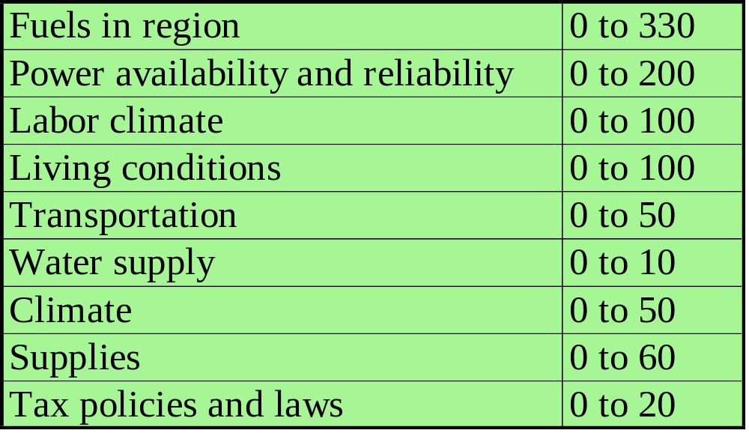
Plant Location Methodology: Factor Rating Method Example
11-<number>
Two refineries sites (A and B) are assigned the following range of point values and respective points, where the more points the better for the site location.
Sites
A B
Major factors for site location
Pt. Range
123
150
54
24
45
4
8
5
5
156
100
63
96
50
5
4
50
20
Best Site is B
Total pts. 418 544
Notes:
9

Slide 9
Plant Location Methodology: Transportation Method of Linear Programming
11-<number>
Transportation method of linear programming seeks to minimize costs of shipping n units to m destinations or its seeks to maximize profit of shipping n units to m destinations
Notes:
10

Slide 10
Plant Location Methodology: Centroid Method
11-<number>
The centroid method is used for locating single facilities that considers existing facilities, the distances between them, and the volumes of goods to be shipped between them
This methodology involves formulas used to compute the coordinates of the two-dimensional point that meets the distance and volume criteria stated above
Notes:
10

Slide 11
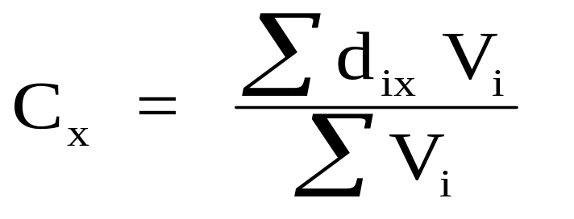
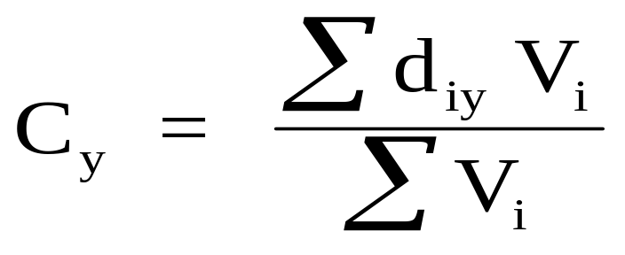
Plant Location Methodology: Centroid Method Formulas
11-<number>
Where:
C_{x} = X coordinate of centroid
C_{y} = X coordinate of centroid
d_{ix} = X coordinate of the ith location
d_{iy} = Y coordinate of the ith location
V_{i} = volume of goods moved to or from ith
location
Notes:
12

Slide 12
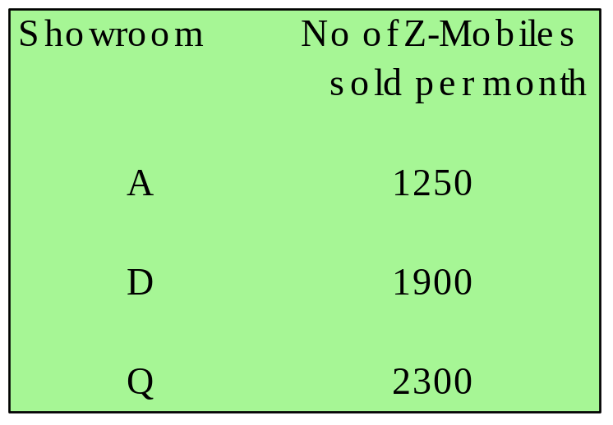
Plant Location Methodology: Example of Centroid Method
11-<number>
Centroid method example
  Several automobile showrooms are located according to the following grid which represents coordinate locations for each showroom
Y
Q
(790,900)
D
(250,580)
A
(100,200)
(0,0)
X
Question: What is the best location for a new Z-Mobile warehouse/temporary storage facility considering only distances and quantities sold per month?
Notes:
11

Slide 13

Plant Location Methodology: Example of Centroid Method (Continued): Determining Existing Facility Coordinates
11-<number>
To begin, you must identify the existing facilities on a two-dimensional plane or grid and determine their coordinates.
Y
Q
(790,900)
D
(250,580)
A
(100,200)
(0,0)
X
You must also have the volume information on the business activity at the existing facilities.
Notes:
12

Slide 14

Plant Location Methodology: Example of Centroid Method (Continued): Determining the Coordinates of the New Facility
11-<number>
You then compute the new coordinates using the formulas:
You then take the coordinates and place them on the map:
Y
Q
New location of facility Z about (443,627)
(790,900)
Z
D
(250,580)
A
(100,200)
(0,0)
X
Notes:
13

Slide 15
Question Bowl
11-<number>
Criteria that influences manufacturing plant and warehouse location planning can include which of the following?
Proximity to customers
Business climate
Infrastructure
Quality of labor
All of the above
Answer: e. All of the above
Notes:
7

Slide 16
Question Bowl
11-<number>
Criteria that influences manufacturing plant and warehouse location planning can include which of the following?
Political risk
Government barriers
Environmental regulation
All of the above
None of the above
Answer: d. All of the above
Notes:
7

Slide 17
Question Bowl
11-<number>
Which of the following are plant location methods?
Transportation method of linear programming
Factor-rating systems
Centroid method
All of the above
None of the above
Answer: d. All of the above
Notes:
7

Slide 18
Question Bowl
11-<number>
Which of the following methods of plant location analysis considers the existing facilities, the distances between them, and the volumes of goods to be shipped?
Transportation method of linear programming
Factor-rating systems
Centroid method
All of the above
None of the above
Answer: c. Centroid method
Notes:
7

Slide 19
Question Bowl
11-<number>
Which of the following methods of plant location analysis is the most widely used general location technique because it combines diverse factors in an easy-to-understand format?
Transportation method of linear programming
Factor-rating systems
Centroid method
All of the above
None of the above
Answer: b. Factor-rating systems
Notes:
7

Slide 20
Question Bowl
11-<number>
The location decision for service facilities is closely tied to which of the following?
Market selection decision
Material costs
Nearness to distributors
Nearness to high-skilled labor
None of the above
Answer: a. Market selection decision
Notes:
7

Slide 21
End of Chapter 11
11-<number>

