Slide 1
Welcome
Pub/Sub and Event Driven Design with Kafka
Wednesday, October 11, 2023

Slide 2
Contents
Background
Our Project Today
Lab

Slide 3

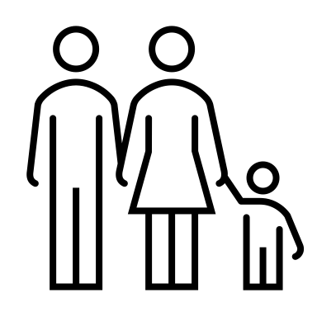
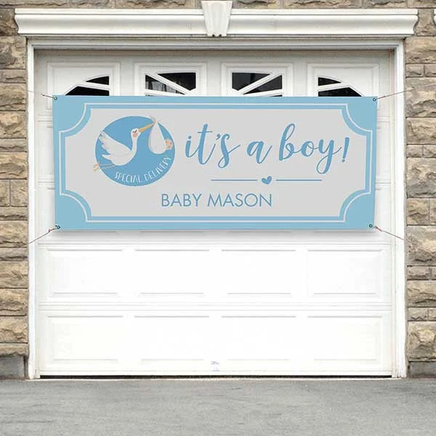
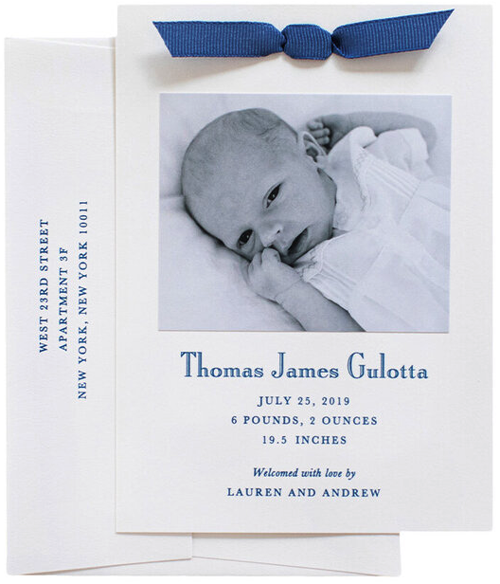

Pub/Sub Architecture: Introduction
Your Friends
API driven
Event driven
You

Slide 4
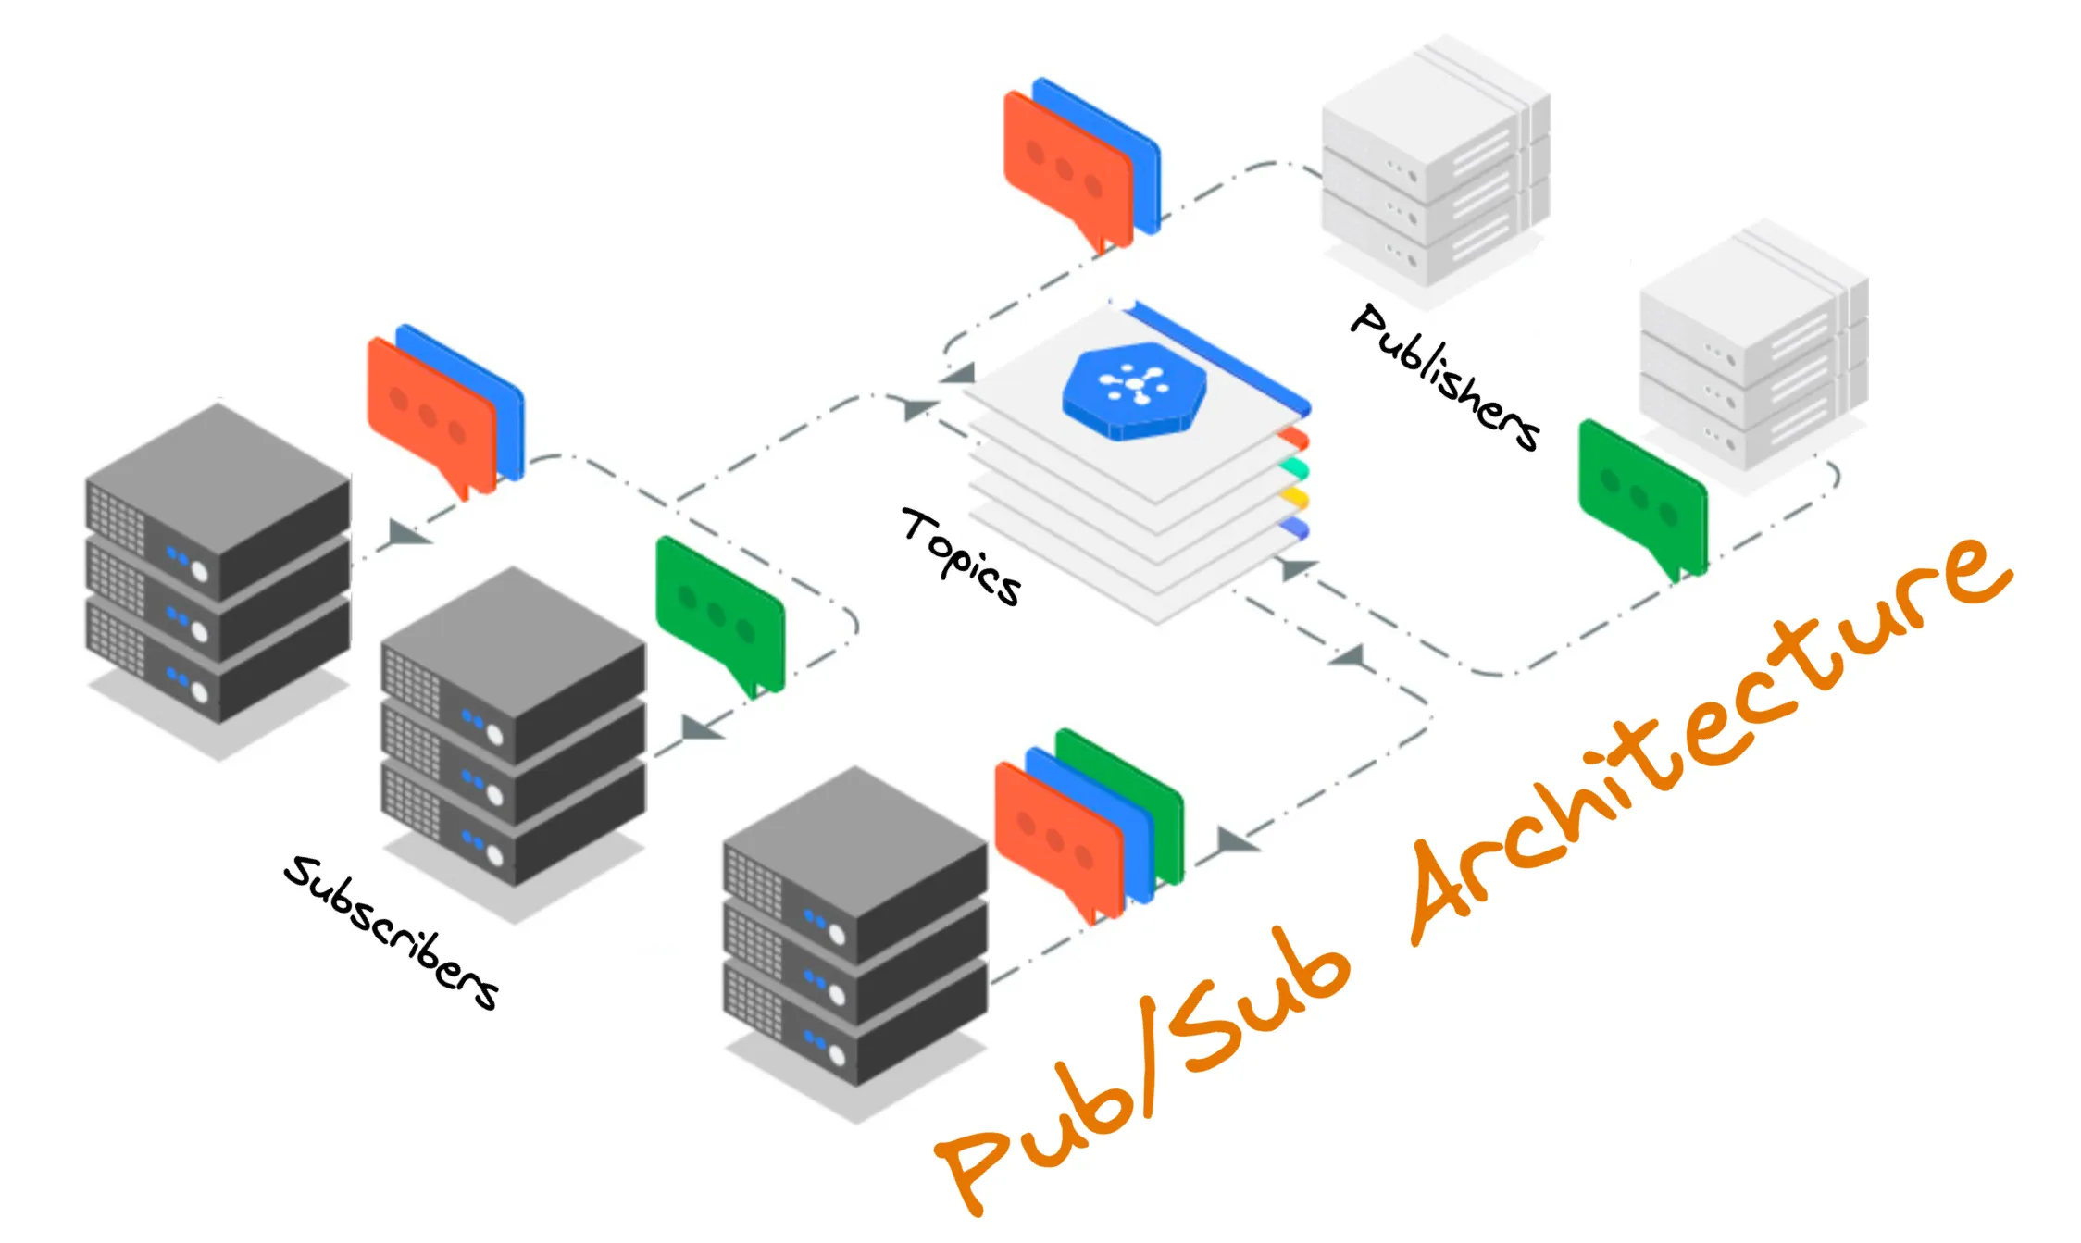
The Broker: Organising topics and messages
Producers
Publish messages…
…organised by topic
Broker
Decouples multiple publishers from multiple subscribers
Organises messages within topics
Consumers
Subscribe to select topics only
Consume messages in that topic
Can pull or be pushed to

Slide 5
Pub/Sub Architecture: Introduction
In Pub / Sub:
A Producer publishes information without knowing who may be interested in it.
A Consumer of the information does not need to interact with the Publisher to have knowledge of that information.
A Broker needs to be highly available and redundant

Slide 6
Contents
Background
Our Project Today
Lab

Slide 7
Today’s Project: Introduction
A (basic) Food Delivery Application
Start with
Containerised Kafka cluster
a basic command line python producer and consumer
Then move on to our food delivery app : Asciiliveroo
Event driven based on file delivery (orders.csv)
A containerised producer awaiting files
Producer publishes messages to several topics about orders
Multiple containerized Consumers that subscribe to various topics
No frontends; we will examine StdOut in container logs

Slide 8
Contents
Background
Our Project Today
Lab

Slide 9
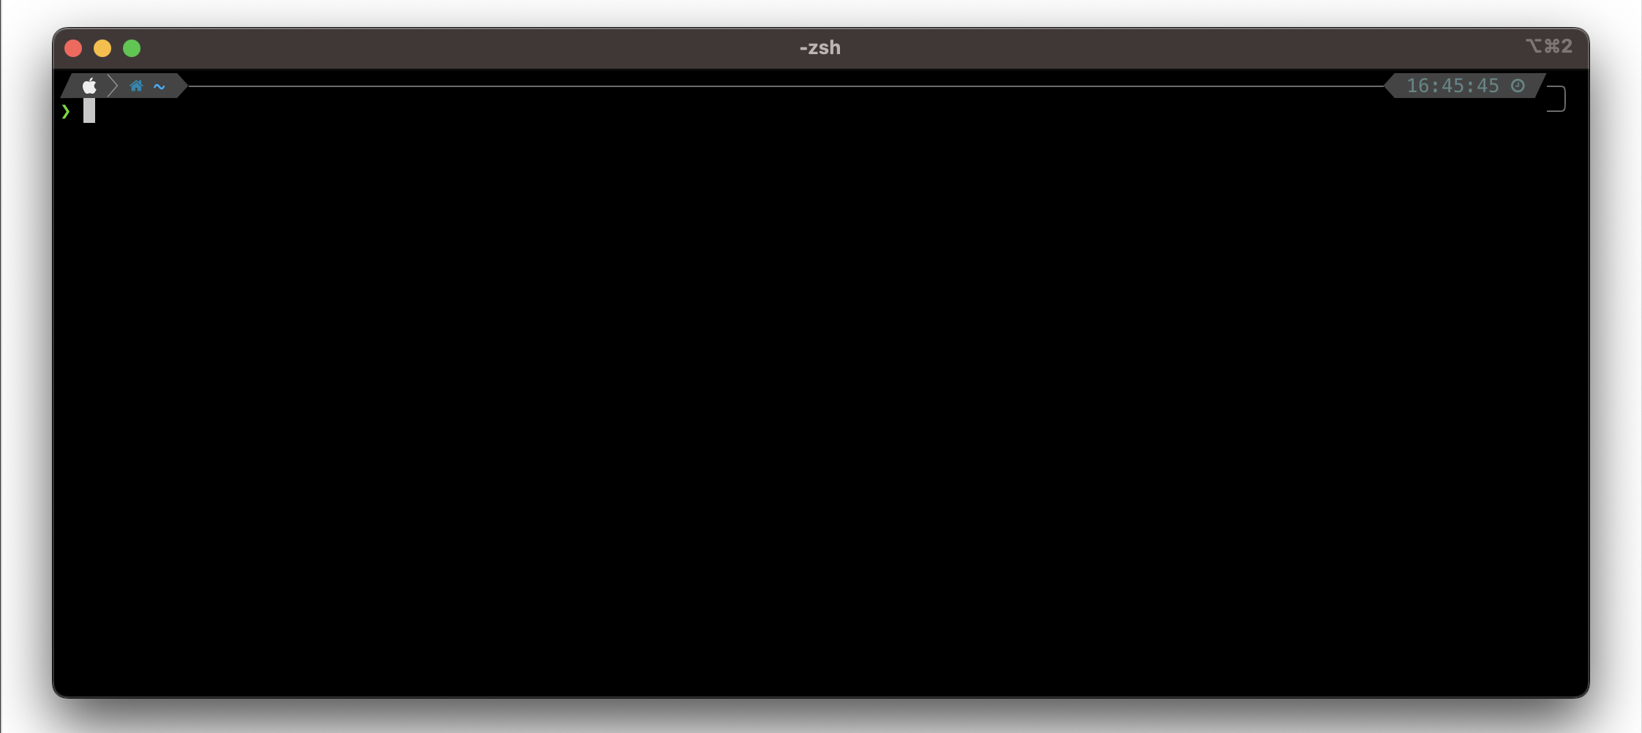
Today’s Project: Clone & Build
$ cd /tmp
$ mkdir /tmp/ps; cd /tmp/ps
$ git clone https://github.com/sethfreach-qs/qs-pubsub.git .
$ pip install -r requirements.txt
$ docker compose -f zk-single-kafka-single.yml up -d

Slide 10
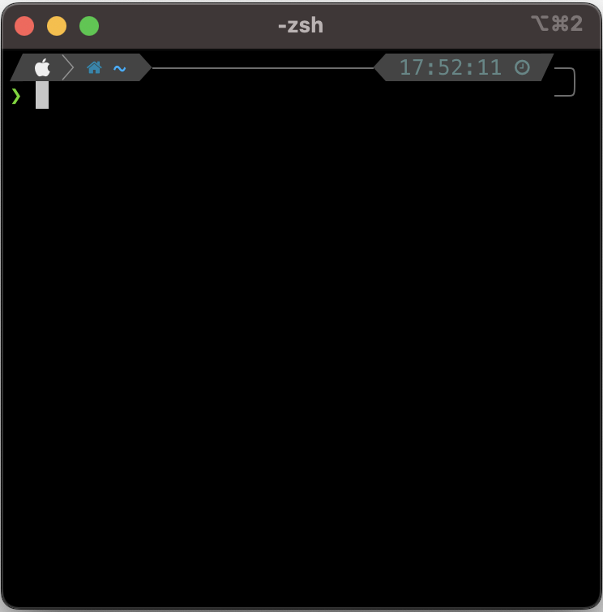
Today’s Project: System Running
With a Kafka broker and a Zookeeper orchestrator now running locally:
$ python producer.py
$ python consumer.py

Slide 11





Today’s Project: Basic Architecture
test_topic
producer.py
consumer.py

Slide 12
Today’s Project: A Better Delivery App
$ git checkout step2
$ docker compose -f orders-app.yml up –d
$ bash observe.sh

Slide 13





Today’s Project: Delivery App Architecture
orders.csv
city-manchester
city-london
city-york
order-processor
payment-processor
consumer.py

Slide 14
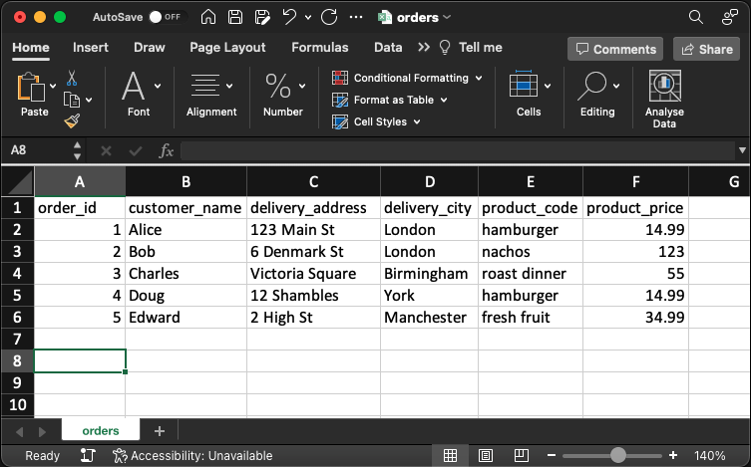
Today’s Project: Delivery App Order Placement
Sample CSV file with headers provided in /tmp/ps/src/order-processor/orders.csv
Edit and save to /tmp/ps/src/order-processor/orders/orders.csv
Previously running the observe.sh script opened a terminal monitor for each container application. Observe each application’s behaviour as it responds to events.

Slide 15
Today’s Project: Cleanup
$ docker compose -f orders-app.yml down
$ docker compose -f zk-single-kafka-single.yml down
$ cd; rm –rf /tmp/ps
$ docker image rm \
ps-city-london \
ps-city-manchester \
ps-city-york \
ps-payment-processor \
ps-order-processor
$ docker image rm confluentinc/cp-kafka:7.3.2 confluentinc/cp-zookeeper:7.3.2

Slide 16
Pub/Sub Architecture: To Recap
Takeaways
Producers publish messages without having to know any details about who (if anyone!) may care or beneifit from the information downstream.
Messages are arranged by topic.
By subscribing to topics, Consumers observe events that occur, receive details of the event, and can choose to act on or ignore the event.
To avoid becoming a single point of failure in production systems, Brokers are implemented as complex distributed clusters.

Slide 17
Thank you

