Slide 1
Analysis of Adc waveforms
Seth Hirsh

Slide 2
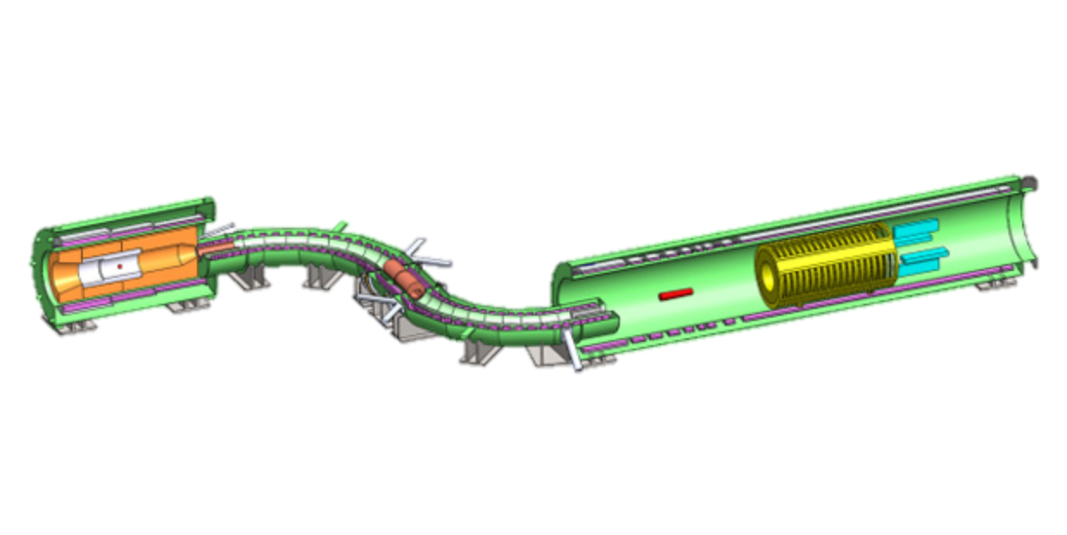
Mu2e at Fermilab
Searching for neutrinoless muon-to-electron conversion.
Discovery would reveal existence of charged lepton conversion.
According to standard model, conversion should be extremely rare <10^{-50.} Some SUSY theories predict conversion will occur with probabilities up to 10⁻¹⁵.
10,000 more times sensitive than previous experiments
Results would severely restrict possible SUSY theories.

Slide 3
Significance
Remove “noise hits” due to protons
Protons easy to differentiate due to their high dE/dx
Possible differentiation of muons from electrons (depending on precision of measurement)

Slide 4
Goals
Help determine an optimal design for the ADC’s, which are yet to be built.
Achieve optimum precision in final measurements
Achieve greater understanding of dependence between various contributions to noise and precision in measurements
Compare precision of output for varying shaping times
20 ns
40 ns
100 ns
Analyze effects of varying parameters:
Varying starting time
Electronic Noise?
Methods for computing total “charge” of output

Slide 5
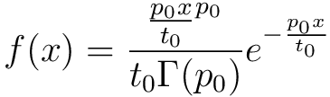
Simulation
Uniformly random distribution of starting times for measurement minus a constant subtracted time
Computes value of current using:
Gaussian Distribution of Electronic Noise
10,000 Trials

Slide 6
Digitization
Collect at 7 times during each trial
2 “prevalues”
Conversion to bits (floor float values)
Fixed clock frequency (20 ns)

Slide 7
Analysis
Compute total “charge”
Compute difference in values (used only for large shaping times)
Compute sum
Fit function with waveform and integrate
Fitted Parameters
Starting Time
Scaling factor
Vertical shift

Slide 8
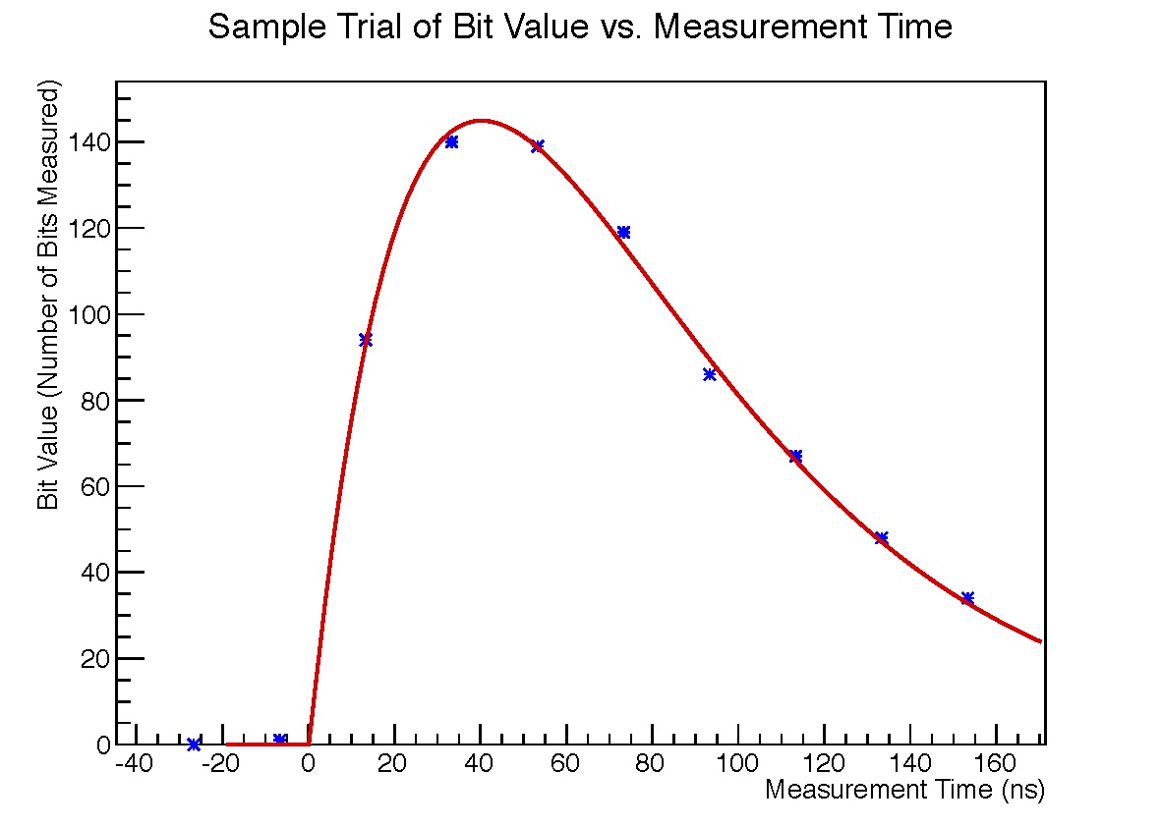
Analysis

Slide 9
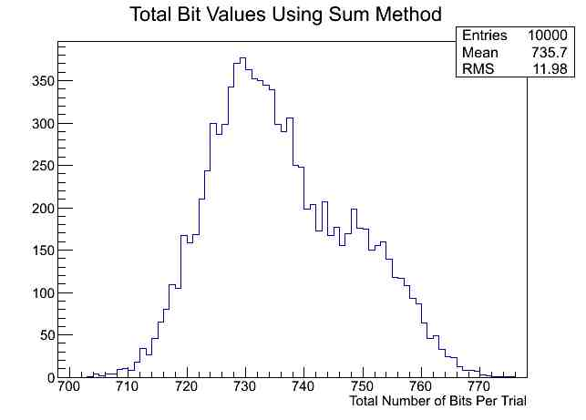
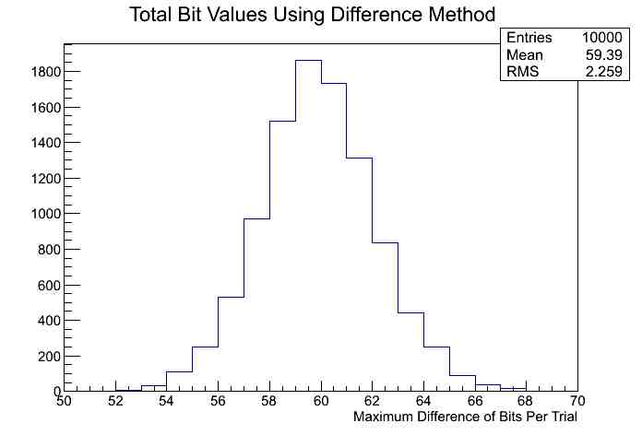
Results
Compared computing sum method of lower shaping time (40 ns) to difference method of greater shaping time (100 ns)
Comparable Precision computing sum of lower shaping times, than differences of greater shaping times.

Slide 10
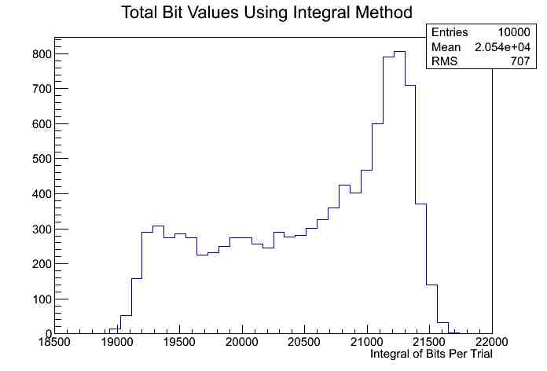
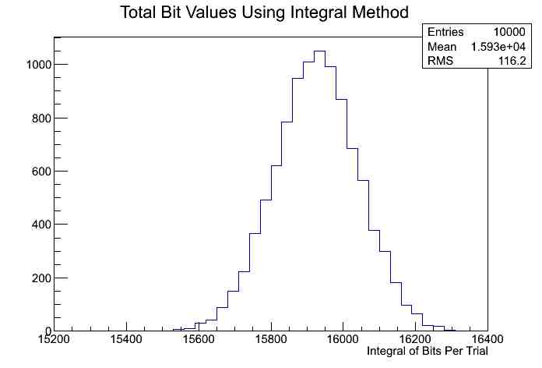
Fit and Integral Method
Fit function and compute integral.
Significantly more accurate than using sum or difference method.
20 ns & 40 ns shaping times.
20 ns shaping time a few times more accurate than 40 ns shaping time.

Slide 11
Summary of Precision in Methods (7 Value per Trial)
Shaping Time | 20 ns | 40 ns | 100 ns
Sum Method | 0.03951 | 0.03723 | 0.0737
Difference Method | 0.03754 | 0.01951 | 0.04064
Fit Method | 0.03341 | 0.007975 | 0.02864

Slide 12
Summary of Precision in Methods (10 Value per Trial)
Shaping Time | 20 ns | 40 ns | 100 ns
Sum Method | 0.03748 | 0.01650 | 0.03903
Difference Method | 0.03738 | 0.01932 | 0.03741
Fit Method | 0.03400 | 0.007312 | 0.01817

Slide 13
f(x) = \frac{{\frac{p_0 x}{t_0}}^{p_0}}{t_0 \Gamma (p_0)} e^{-\frac{p_0 x}{t_0}}

