Slide 1
A SOLID design in CACHÉ Object

Slide 2


The Requirement….
Employee Database
Route | Method Type | Sample Request | Sample Response
http://dummy.restapiexample.com/api/v1/create | POST | { "name":"test", "salary":"123", "age":"23“ } | { "name":"test", "salary":"123", "age":"23", "id":"719“ }
All we need to do is create a utility which will :
Call the rest API to create record
Display the results

Slide 3



I don’t want to see the
Output, but This is dumbest code I ever seen!!
Everything is written in a single Class, VERY RISKY!!
Don’t you know about any Design Principles
Code is ready for your review and you can also check the output. The requirement is solved in a single class having
56 Lines!!
Haha, I am the greatest DEVELOPER!!
I heard about
Solid Principles!!
I need to revisit my code again with a different approach.

Slide 4
Single-responsibility Principle
A class should have one and only one reason to change,
meaning that a class should have only one job.

Slide 5
Class BuildJSON
Class CreateEmployee { ClassMethod Execute(params) As %Status {
}
}
Class Client
//Request JSON
//Rest Client, Build Request Body and POST
//Handle Errors
// write Response
Class ProcessError
Class ProcessResponse

Slide 6
ADAPTIVE
MAINTAINABLE
REQUIREMENT
V2 API
Accept XML not JSON

Slide 7
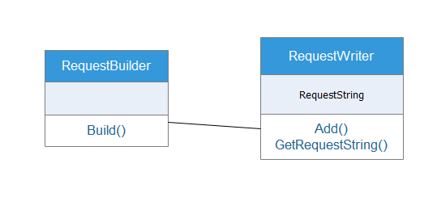
Current Design
ObjRequestWriter.Add(Type)
Check Type
WRITE XML
JSON
WRITE JSON
XML
Add Method have multiple Responsibilities
ERROR Prone Design

Slide 8
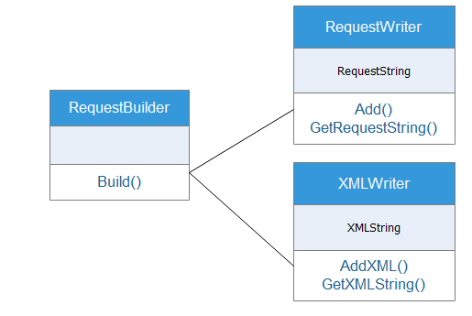
Proposed Design 1
JSONWriter

Slide 9
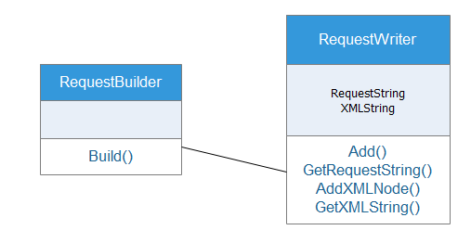
Proposed Design 2

Slide 10
Open/Closed Principle
In programming, the open/closed principle states that software entities(Class, Methods) should be open for extension,
but closed for modification.
Liskov Substitution Principle
In programming, objects should be replaceable with instances of their subtypes without altering the correctness of that program.

Slide 11
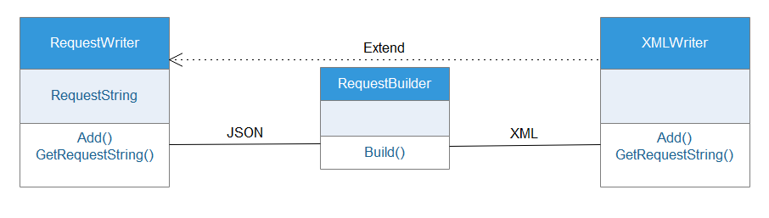
Class Test.RequestBuilder Extends %RegisteredObject {
/// we can pass object of XMLWriter / RequestWriter Method Build(objWriter As RequestWriter) { do objWriter.Add("Key1","Value1") do objWriter.Add("Key2","Value2") Set Request = objWriter.GetRequestString()
……

Slide 12
But there are still some stuffs, which are bothering me:
Why RequestWriter, it should be JSONWriter.
Currently, JSONWriter only supports Simple JSON having KEY - Value. What will happen if tomorrow, the request message gets complex like this. If we have to keep employee Children Details or Address, which might be Array of Object or Object embedded into JSON.
For now, as requirement is only for Simple Structure, same can apply in XML Writer.
WHY XMLWriter is extending RequestWriter/JSONWriter. There should be a generalized definition.
{
“name” : “dsf”,
“salary” : “XXXXXXX”,
“age” : “XX”,
“children”:
[
{
“name “ : “sdf”,
},
{
“name “ : “hgf”,
}
],
“homeAddress” :
{
“addressLine1” : “44 street”,
“addressLine2” : “Zootopia”
}
}

Slide 13
Interface Segregation Principle
Clients should not be forced to implement interfaces they don't use. Instead of one fat interface, many small interfaces are preferred based on groups of methods, each one serving one submodule.
In Cache Objects, we don’t have Interface Class, but we do have ABSTRACT class. So we can use ABSTRACT class as Interface class.

Slide 14
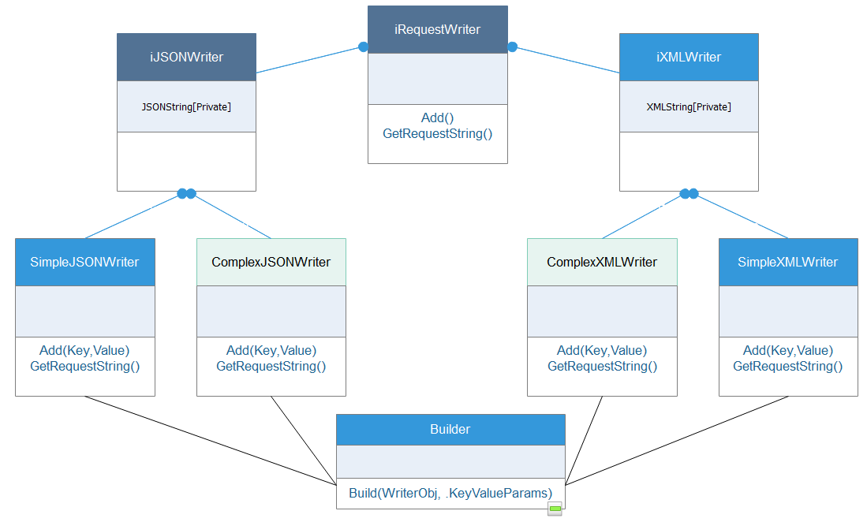


Slide 15
{
“name” : “dsf”,
“salary” : “XXXXXXX”,
“age” : “XX”,
“children”:
[
{
“name “ : “sdf”,
},
{
“name “ : “hgf”,
}
],
“homeAddress” :
{
“addressLine1” : “44 street”,
“addressLine2” : “Zootopia”
}
}
SIMPLE
COMPLEX
COMPLEX

Slide 16
Dependency Inversion Principle
This principle is a way to decouple software modules.
To comply with this principle, we need to use Dependency Injection.
Dependency injection is used simply by ‘injecting’ any dependencies of a class through the class’ constructor as an input parameter.

Slide 17
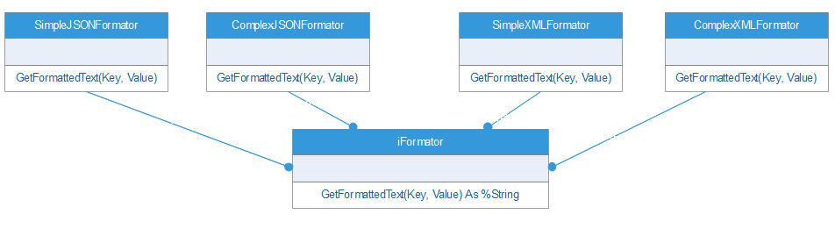

Slide 18
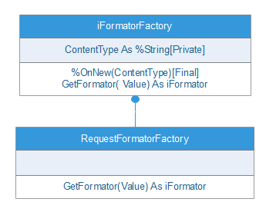

Slide 19
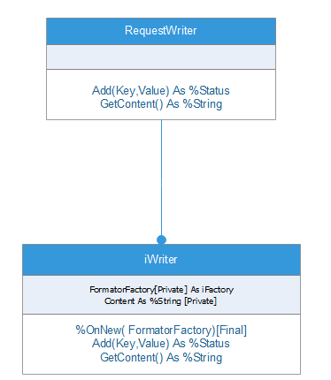

Slide 20
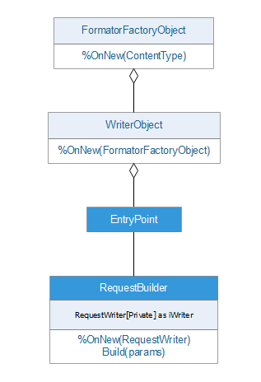

Slide 21
