Slide 1
CQRS

Slide 2
CQRS
Command Query Responsibility Segregation

Slide 3
What Is CQRS?
Just separating reads and writes
Complete architecture
Event oriented Domain Driven Design
.NET oriented
Greg Young
Udi Dahan

Slide 4
Read/Write Segregation
Separate read and write models
Actions can either be
Commands which change data, but return nothing*
Queries which return data, but change nothing

Slide 5
Event Sourcing
Store events, not state
Create state by replaying events
Performance
In memory caching
Snapshots
Can recreate state at any time
Built in audit

Slide 6
Read Model
Table per view
Highly optimized

Slide 7
Conceptual View
UI
Write Model
Events
Read Model

Slide 8
Should I do CQRS?
Probably not

Slide 9
But…
Provides independently scalable read and write
High performance
In memory
Optimized read model
Potentially better concurrency model
Appropriate for some Bounded Contexts

Slide 10
Bounded Context
Context in which terms have meaning
Imperfectly can be thought of as a subsystem

Slide 11
Aggregate
Collection of entities
Aggregate Root is responsible for maintaining internal consistency

Slide 12
Rules
Aggregate Roots receive commands and events
Aggregate Roots publish events

Slide 13
Saga or ProcessManager
Encapsulates logic of a business transaction
Stateful

Slide 14
Axon Framework

Slide 15
From Axon Documentation

Slide 16
Note All business logic / rules are defined in the @CommandHandlers, and all state changes are defined in the @EventSourcingHandlers. The reason for this is when we want to get the current state of event-sourced Aggregate, we have to apply all sourced events - we have to invoke @EventSourcingHandlers. If the state of our Aggregate is changed outside of @EventSourcingHandlers it will not be reflected when we do a replay.

Slide 17
Demo

Slide 18
UI Mashup
Bounded contexts can be autonomous and connected through the UI
Udi Dahan

Slide 19
Amazon Example

Slide 20
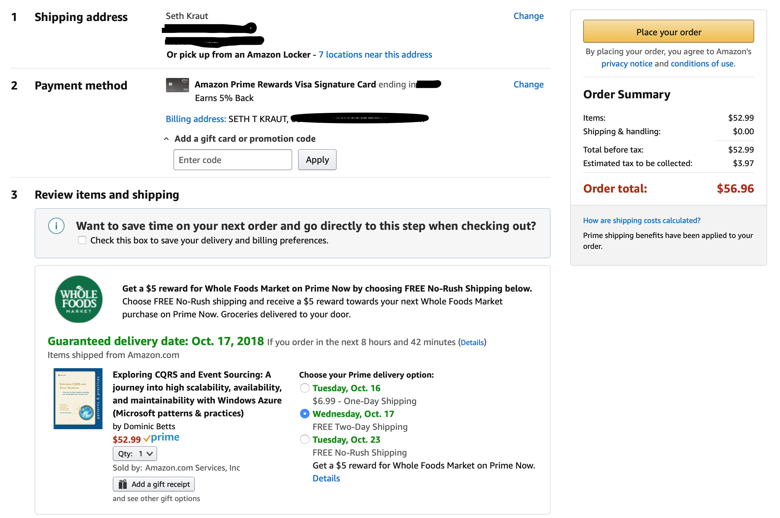

Slide 22
More Resources
Udi Dahan
Greg Young

Slide 23
Contact Me
Seth Kraut
sethkraut@gmail.com
sethkraut on twitter
https://github.com/sethkraut/presentation-cqrs

