Slide 1
Reactive Streams
Notes:
Ask for familiarity with Java 8 Streams
Ask for familiarity with Reactive Streams

Slide 2
What are they?
Multiple value
Aynchronous/Non-blocking
Composable
Backpressurable

Slide 3
Why should you care?
Significant momentum
Java 9 as Flows
Spring 5 will have extensive support
Better performance
Streams-like API
Marble diagrams are awesome
Tuples

Slide 4
Iterator
Methods
hasNext()
next()
Pull
No error handling

Slide 5
Rx Observable
Methods
onNext(value)
onError(error)
onComplete()
Push
Adds error handling

Slide 6
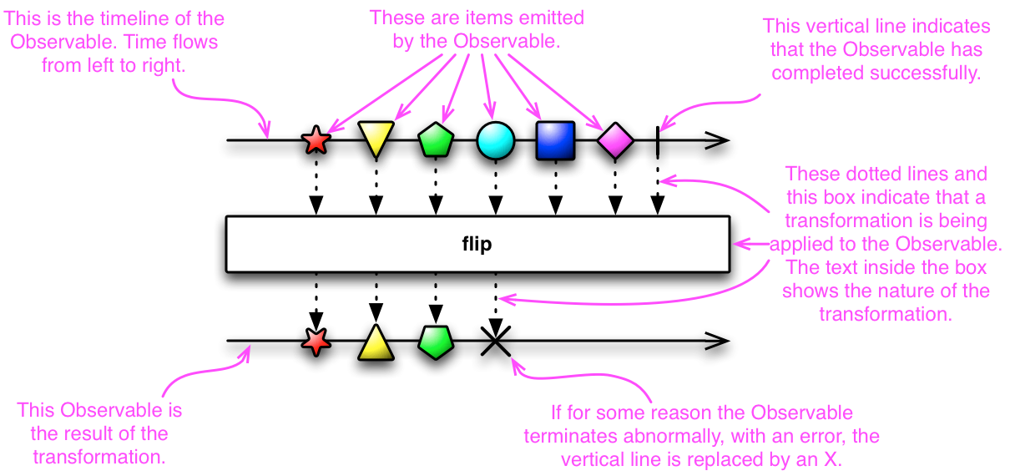
Marble Diagram

Slide 7
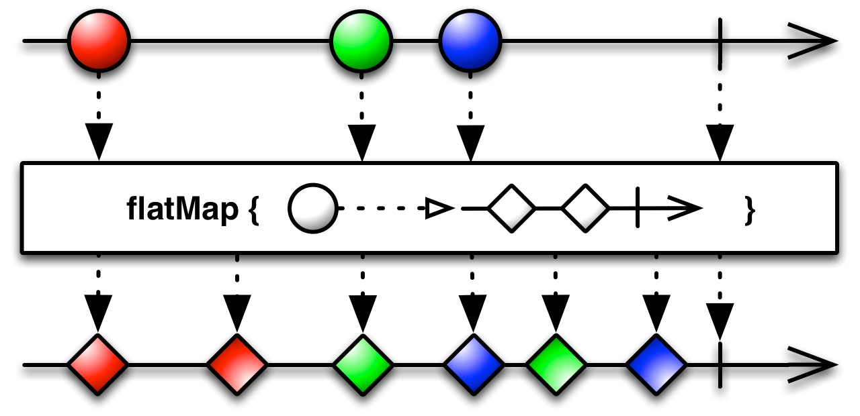
Flat Map

Slide 8
Reactive Streams
Adds backpressure
Adds subscription management
Allows interoperability between reactive libraries
Specification of 4 interfaces
Publisher
Subscriber
Subscription
Processor

Slide 9
Publisher<T>
subscribe(Subscriber<T>)

Slide 10
Subscriber<T>
onSubscribe(Subscription)
onNext(T)
onError(Throwable)
onComplete()

Slide 11
Subscription
cancel()
request(long)

Slide 12
Processor
Extends Publisher and Subscriber

Slide 13
Spring Reactor
Started as a layer over top of LMAX and similar
Evolved to initial reactive stream support
In process with major changes for Reactive Streams
High performance with a fluent API

Slide 14
Examples

Slide 15
Reactive Streams Libraries
Ratpack
Spring Reactor
Akka Streams
Vert.x

Slide 16
Resources
http://reactivex.io/
http://www.reactive-streams.org/
https://projectreactor.io/ (soon)
http://rxmarbles.com/

Slide 17
Seth Kraut - sethkraut@gmail.com
https://github.com/sethkraut/presentation-reactive-streams

