Slide 1



SIMILE Monitor
Telegram bot
Join us in the efforts to preserve the waters of our beautiful lake by using our new telegram bot.
by Shengshen Li
Prof. Maria Antonella Brovelli
Dr. Daniele Oxoli

Slide 2

What Can the Bot Do?
1
Citizen Science
2
Light-weight
We count on you! To provide us information about the lake.
No apps, no installation. Just exploit the potential of your chatting app.
3
Efficiency
Redis + PostgreSQL + telebot(Python). Simple development, easy deployment.

Slide 3
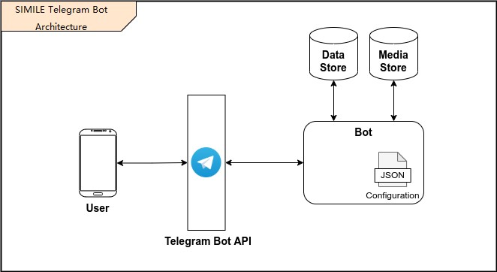
How to Use the Bot?
Step 1
Step 2
Step 3
Find our bot.
@Simile_app_bot
Hit the "start" button, your account will be automatically created.
Follow the prompts, input what you see, then submit.

Slide 4
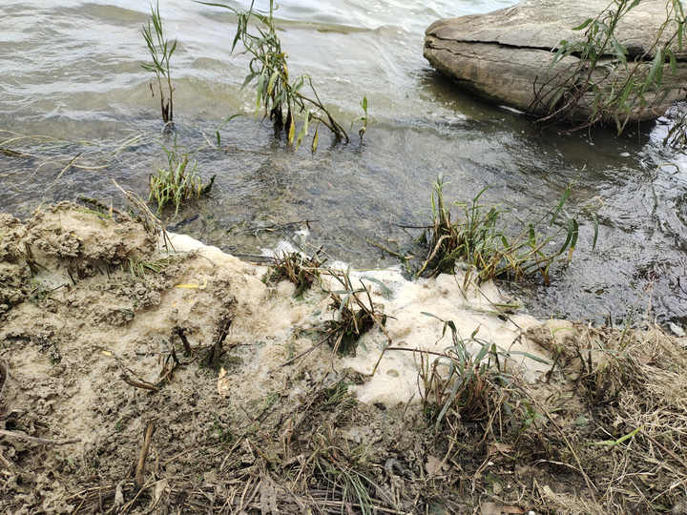
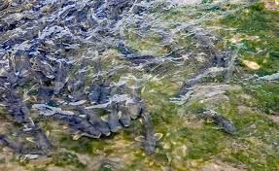
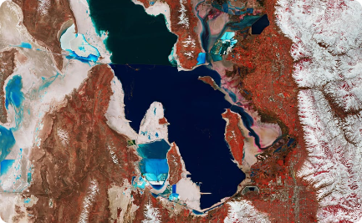
What Information we want from you
Pollution
Fauna
Weather
Foams, algae… Tell us where those disgusting things are.
Fishes! Turtles! I see it!
Generate from you position, so you don't need to stick your head out of the window to check the cloud conditions!

Slide 5
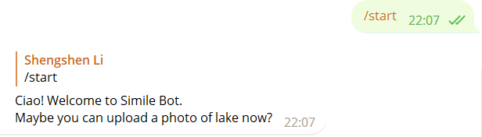
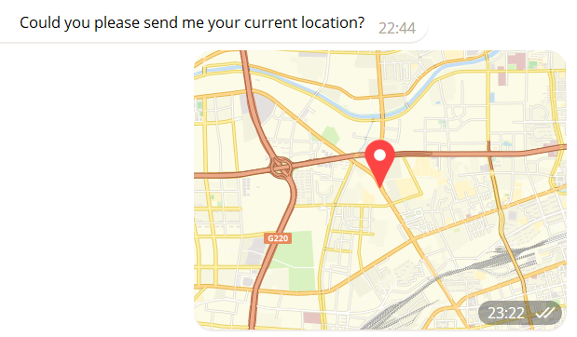
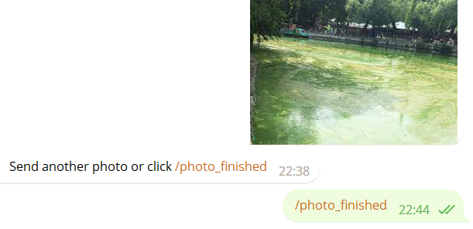
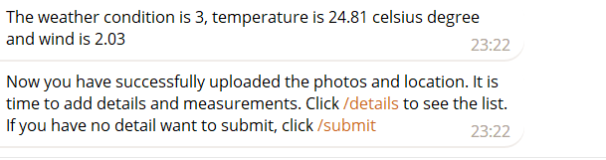
Standard Operation Procedures

Slide 6
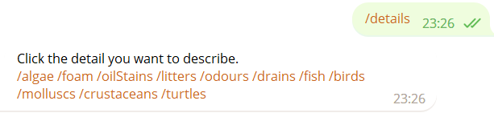
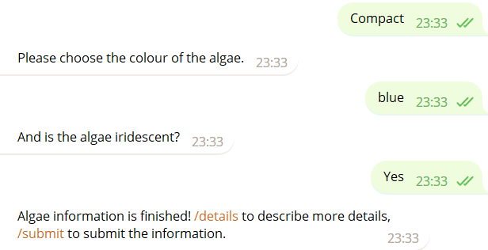
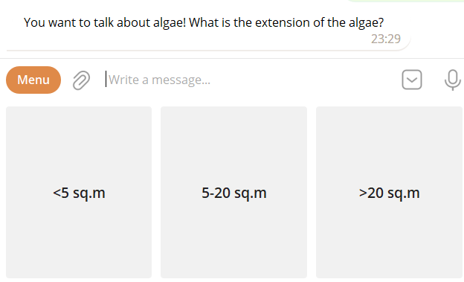
Standard Operation Procedures

Slide 7
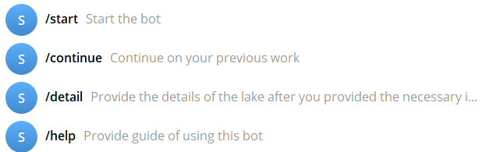
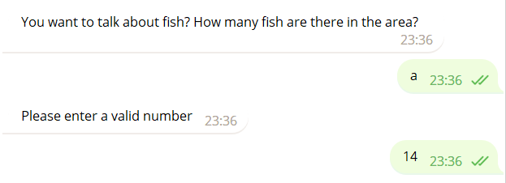
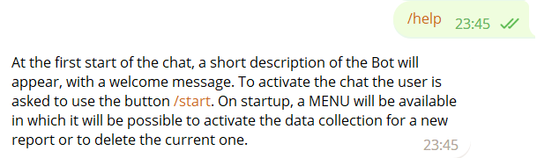
Beyond the SOP

Slide 8
Conclusion
Simple and User-friendly
Citizen Science is the Key!
Redis + DB : 1+1>2
By using our telegram bot, we can all play a role in protecting our lake for generations to come.
We need to make sure the credibility of the data. Encourage and educate to contribute the data correctly!
The combination of powerful read and write capabilities with durable persistence.

