Slide 1
Title here

Slide 2
Outline
Duplicated 3-4 times as placeholder

Slide 3
Seth MIG stuff here

Slide 4
Data Synthesis
Start with 10 overlapping Worldview-1 images
  5 stereo pairs, GSD~0.5m
  Common overlap area includes 36N 117.5W
  Dolloff, Settergren, ASPRS 2010
Perturb adjustable parameters (pos, att, vel, etc)
  99 variants per original→1000 images
Choose ground point, project to 1000 image points
  UTM11N 455000 3984000 1700
  “Truth” = perfect 1000-image ray intersection
Further perturb 1000 images
  Each parameter perturbation randomly sampled Normal with controlled sigma
  “Error” = 1000 image rays that don't intersect

Slide 5
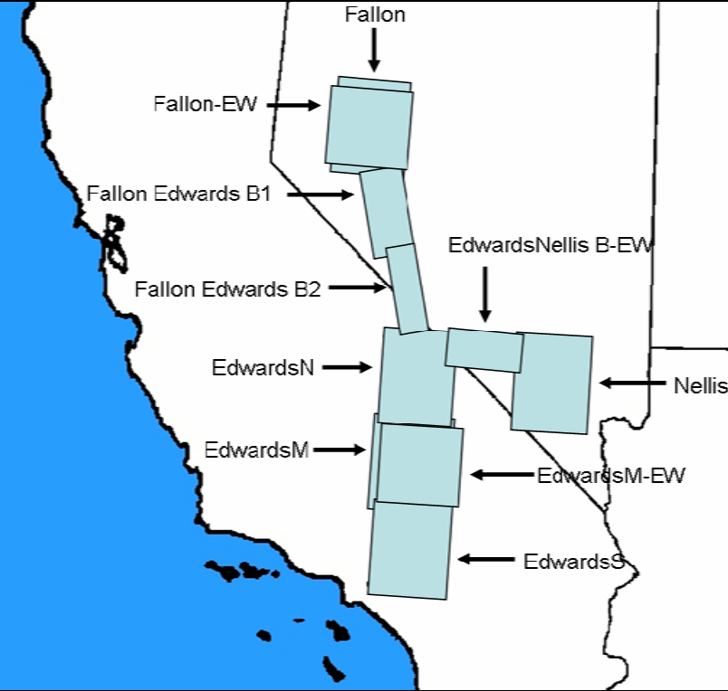
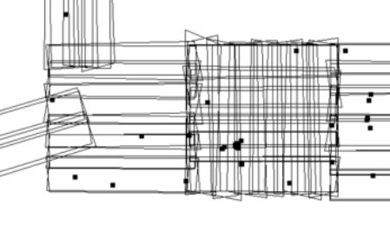
Original 10 Images

Slide 6
Data Amplification
<original 10 look vectors>
<original 1000 look vectors>
<perturbed 1000 hi intersections>

Slide 7
Methodology
For N=4...1000
  For K=1...100
    Randomly sample subset of N images
    Compute MIG
      MIG - truth = measured error
      Output covariance = predicted error
      Reference variance = self-consistency check
Analyze
  What is the distribution of errors as N grows large?
  Are reference variances ~ 1?
  Do measured errors fit predictions (C_{out})?

Slide 8
Use charts from paper

Slide 9
Hourglassin

Slide 10
More charts

