Slide 1
Outline
Introduction
  Least squares for polynomial regression
  Least squares for Multi-Image Geopositioning (MIG)
  Improved accuracy with increasing number of images
Experimental Results
  Data synthesis, Methodology
  Results
Conclusion

Slide 2
Outline
Introduction
  Least squares for polynomial regression
  Least squares for Multi-Image Geopositioning (MIG)
  Improved accuracy with increasing number of images
Experimental Results
  Data synthesis, Methodology
  Results
Conclusion

Slide 3
Least Squares Line Fitting
Solve for m,b that minimize
y
x

Slide 4
Least Squares Line Fitting
Use initial guess of m,b to compute r_{i}
What Δm,Δb best fulfills the residuals?
Solution of overdetermined linear system:

Slide 5
Least Squares Line Fitting
Use initial guess of m,b to compute r_{i}
What Δm,Δb best fulfills the residuals?
Solution of overdetermined linear system:

Slide 6
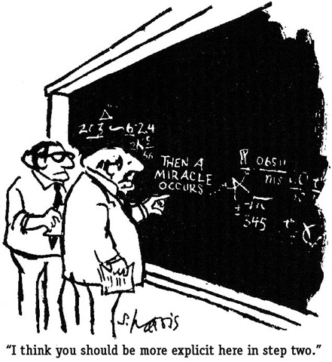
Least Squares Line Fitting
Use initial guess of m,b to compute r_{i}
What Δm,Δb best fulfills the residuals?
Solution of overdetermined linear system:

Slide 7
Least Squares Line Fitting
(3,5)
2
(2,3)
(1,2)
1
1

Slide 8
Least Squares Line Fitting
(3,5)
2
(2,3)
(1,2)
1
1

Slide 9
Least Squares Line Fitting

Slide 10
Least Squares Polynomial Fitting
The principle can be extended beyond linear:

Slide 11
Least Squares Polynomial Fitting
The principle can be extended beyond linear:

Slide 12
Least Squares Polynomial Fitting
The principle can be extended beyond linear:

Slide 13
Least Squares Polynomial Fitting
The principle can be extended to general functions:

Slide 14
Weighted Least Squares
Consider adding error bars
“Unweighted” solution?
  All observations weighted
  Note diagonal W⁻¹ and W pull through as scalars and cancel

Slide 15
Weighted Least Squares
Large covariance:
  Large uncertainty
  Small weight
  Large residuals not penalized
  Outliers have little effect on solution

Slide 16
Weighted Least Squares
Small covariance:
  High certainty
  Large weight
  Large residuals penalized
  Outliers have significant effect on solution

Slide 17
Weighted Least Squares
Output covariance C_{out}:
  Estimate of the accuracy of Δ
  Reflection of the Input Covariance C=W⁻¹
  Can be too large/too small
Reference variance v:
  Essentially weighted average of residuals, unitless
  Cov too big → v << 1
  Cov too small → v >> 1
  Cov just right → v ~ 1

Slide 18
Outline
Introduction
  Least squares for polynomial regression
  Least squares for Multi-Image Geopositioning (MIG)
  Improved accuracy with increasing number of images
Experimental Results
  Data synthesis, Methodology
  Results
Conclusion

Slide 19
Multi-Image Geopositioning
Multiple overhead images see a ground feature
If we know position/orientation/etc, we can triangulate the location of the ground feature

Slide 20

Multi-Image Geopositioning
Multiple overhead images see a ground feature
If we know position/orientation/etc, we can triangulate the location of the ground feature

Slide 21
Multi-Image Geopositioning
In reality, position/orientation/etc are imperfect estimates
Rays do not intersect!
  Location of ground feature cannot be known certainly
  Need to find ground point “closest to all” rays

Slide 22
Multi-Image Geopositioning
“Sensor Model” functions map between ground/image
  Ground-to-image (g2i), Image-to-ground (i2g) are inverses
Many (infinite) ground points map to each image point
  Image rays are all (x,y,z) that g2i map to the same (r,c)
  Equivalent: i2g(r,c,z) for all z

Slide 23
Multi-Image Geopositioning
For any ground point

Slide 24
Multi-Image Geopositioning
For any ground point
g2i into all images

Slide 25
Multi-Image Geopositioning
For any ground point
g2i into all images
Minimize sum of
squares of image residuals
rc
rr

Slide 26
Multi-Image Geopositioning
For any ground point
g2i into all images
Minimize sum of
squares of image errors
Cov/Weight come from accuracy of measurement

Slide 27
Multi-Image Geopositioning
Additional weight comes from
sensor uncertainty
  What if the camera has a different position/orientation?
  What would be the spread of g2i?
  That determines C_{sens}=W_{sens}⁻¹

Slide 28
Multi-Image Geopositioning
Define:

Slide 29
Ground Partial Derivatives
<insert ground partials slides from SM101>

Slide 30
Multi-Image Geopositioning
Define:

Slide 31
Multi-Image Geopositioning
Find the ground point that minimizes: r'Wr
Iterative, weighted least-
squares solution:
  Choose a starting (x,y,z)
  Use g2i to evaluate residuals r
  Populate matrix A with partial
  derivatives of g2i
  Correct (x,y,z) with
    Dims: (3x2N*2Nx2N*2Nx3)*3x2N*2Nx2N*2Nx1
  Iterate!
Output covariance is
Reference variance is

Slide 32
Decomposition
Note highly block-diagonal form of problem
Large matrix multiplication/inversion decomposes
into many 3x3 problems (Only with independent images!)

Slide 33
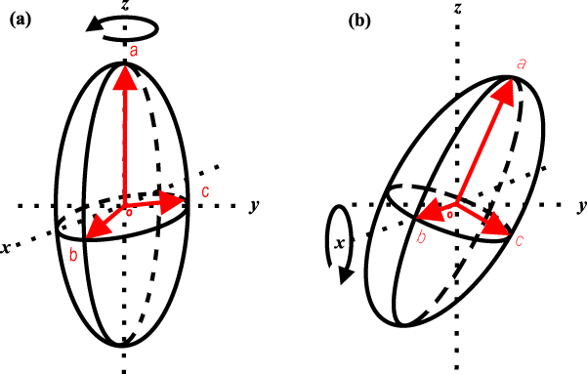
Output Covariance
is output covariance (predicted error)
  Estimate of accuracy of solved answer
  Depends on measurement sigmas, sensor parameter sigmas, collection geometry
  Can visualize with “Error Ellipsoid”
    Diagonal: square-roots (sigmas) are radii along X/Y/Z
    More general: radii are sqrts of eigenvals along 3 eigenvecs
    Different scales for different confidence levels

Slide 34
Outline
Introduction
  Least squares for polynomial regression
  Least squares for Multi-Image Geopositioning (MIG)
  Improved accuracy with increasing number of images
Experimental Results
  Data synthesis, Methodology
  Results
Conclusion

Slide 35

Combining Weight/Covariance
Start with one nadir ray, image error
Line of sight is Z axis
Matrix A (ground partials) is X/Y axes
With just one ray, the least squares system under-determined!
  2 equations, 3 unknowns

Slide 36
Combining Weight/Covariance
Error “Ellipsoid” is vertical cylinder

Slide 37
Combining Weight/Covariance
Consider a second image looking along the X axis
Error “ellipsoid” is horizontal cylinder

Slide 38
Combining Weight/Covariance
Combine both rays in a MIG
Ellipsoid shape:
  X and Z radii
  Y radius

Slide 39
Combining Weight/Covariance
Add a 3rd ray along Y axis
Ellipsoid is spherical
  All radii are

Slide 40
Combining Weight/Covariance
Each additional ray reduces uncertainty in two directions orthogonal to it
  Lots of near-nadir images→lots of vertical uncertainty
  Near-horizontal rays all around→horizontal uncertainty
  Photogrammetry is mostly overhead→generally more vertical uncertainty
Calculation of C_{out} is independent of residuals!
  Purely a function of relative geometry of rays
  Refvar measures how well C_{out} predicts ground accuracy

Slide 41
Increasing Number of Images
In our example, when N increases from 1 to 2:
  Variance of y decreases: σ²→σ²/2
  Standard deviation of y decreases: σ→σ/sqrt(2)
What about when N=3,4,...?
What about when geometry is not trivial?
We will see that accuracy scales as 1/sqrt(N)
  Law of Large Numbers/Central Limit Theorem
  Average of N samples has accuracy ~ 1/sqrt(N)

Slide 42
Outline
Introduction
  Least squares for polynomial regression
  Least squares for Multi-Image Geopositioning (MIG)
  Improved accuracy with increasing number of images
Experimental Results
  Data synthesis, Methodology
  Results
Conclusion

Slide 43
Data Synthesis
Start with 10 overlapping Worldview-1 images
  5 stereo pairs, GSD~0.5m
  Common overlap area includes 36N 117.5W
  Dolloff, Settergren, ASPRS 2010
Perturb adjustable parameters (pos, att, vel, etc)
  99 variants per original→1000 images
Choose ground point, project to 1000 image points
  UTM11N 455000 3984000 1700
  “Truth” = perfect 1000-image ray intersection
Further perturb 1000 images
  Each parameter perturbation randomly sampled Normal with controlled sigma
  “Error” = 1000 image rays that don't intersect

Slide 44
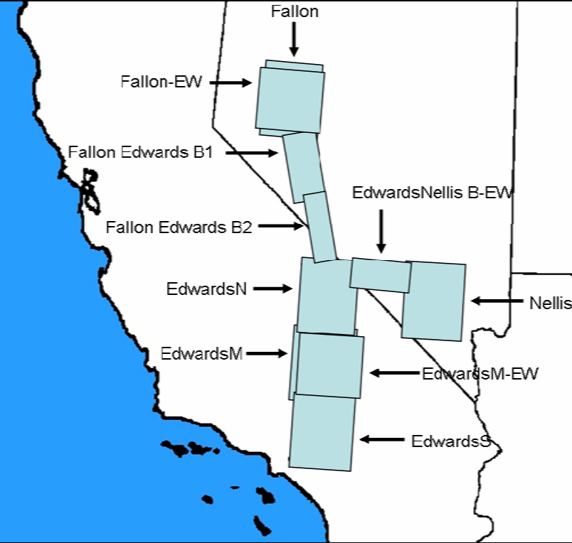
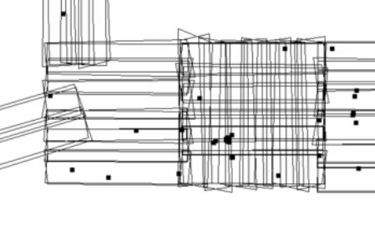
Original 10 Images

Slide 45
Data Amplification
<original 10 look vectors>
<original 1000 look vectors>
<perturbed 1000 hi intersections>

Slide 46
Methodology
For N=4...1000
  For K=1...100
    Randomly sample subset of N images
    Compute MIG
      MIG - truth = measured error
      Output covariance = predicted error
      Reference variance = self-consistency check
Analyze
  What is the distribution of errors as N grows large?
  Are reference variances ~ 1?
  Do measured errors fit predictions (C_{out})?

Slide 47
Outline
Introduction
  Least squares for polynomial regression
  Least squares for Multi-Image Geopositioning (MIG)
  Improved accuracy with increasing number of images
Experimental Results
  Data synthesis, Methodology
  Results
Conclusion

Slide 48
Results
Refvars~1, clustering tighter as N+++
Predicted error decreasing as N+++
Horizontal, vertical errors decrease as N+++

Slide 49
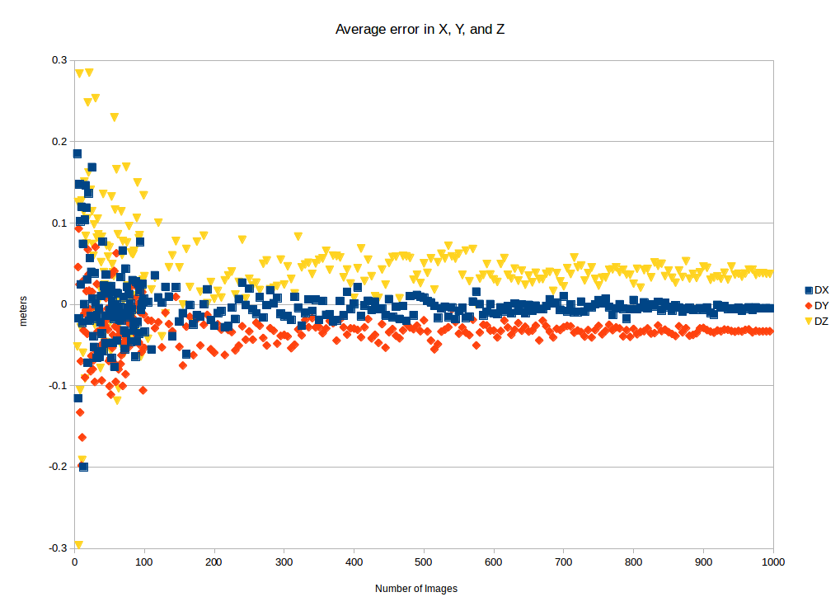
Average Raw Error
+/- Cancel; very small bias remains

Slide 50
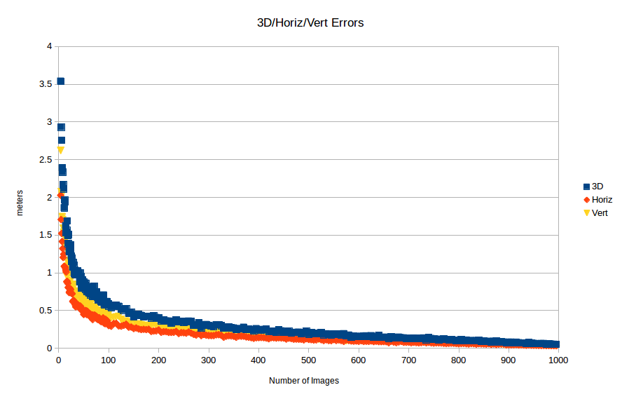
Average 3D/Horiz/Vert Error
Decreasing error, Vertical is larger

Slide 51
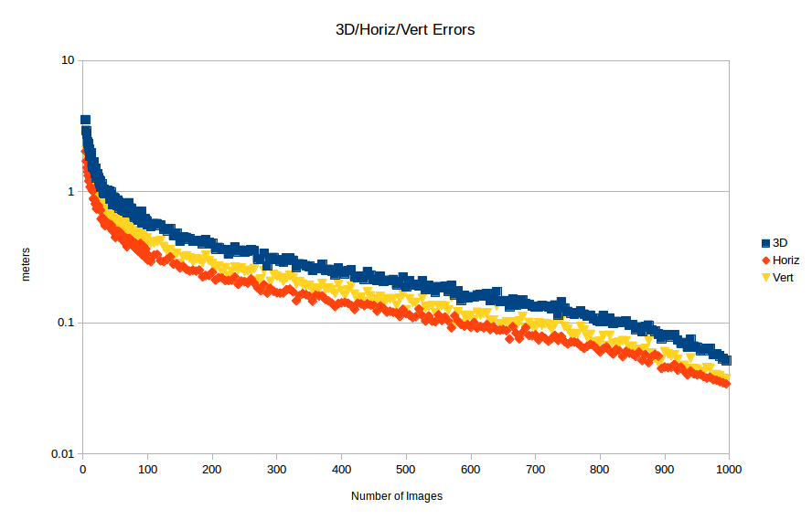
Average 3D/Horiz/Vert Error
Decreasing error, Vertical is larger

Slide 52
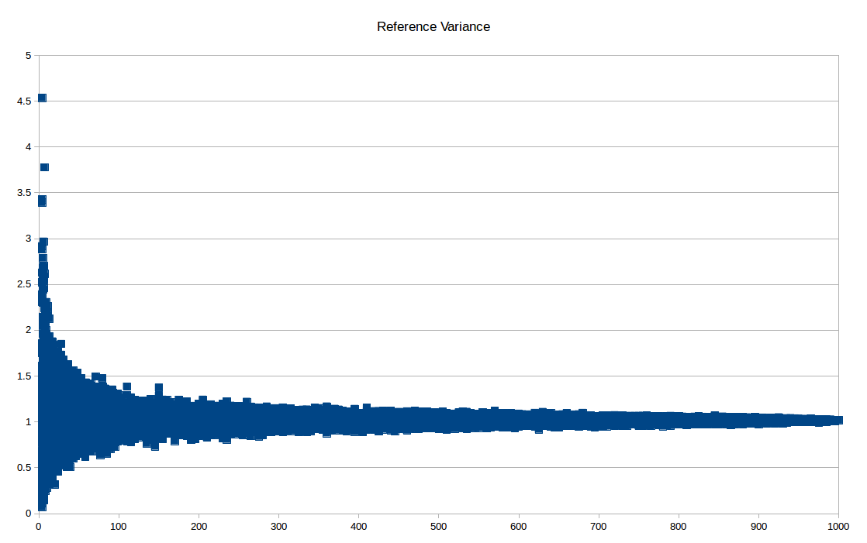
Reference Variance
Clustered tightly around 1

Slide 53
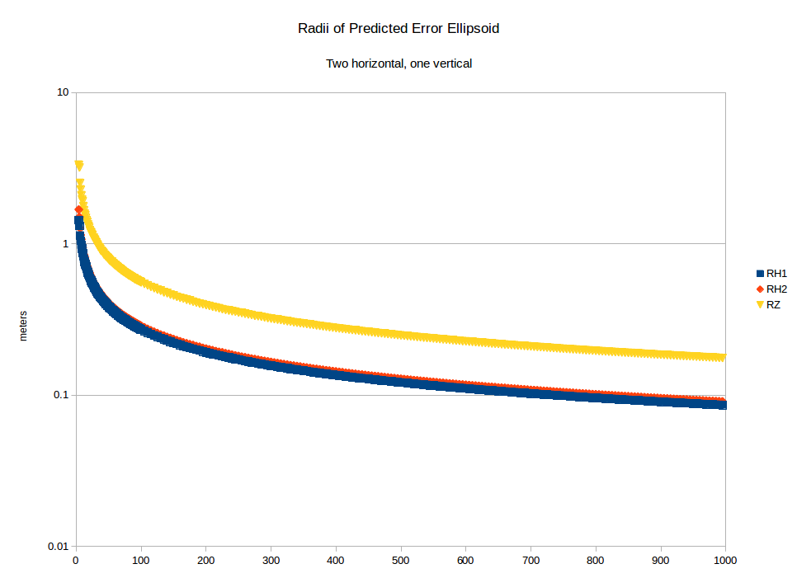
Predicted Error
Larger vertical, two equivalent horizontal

Slide 54
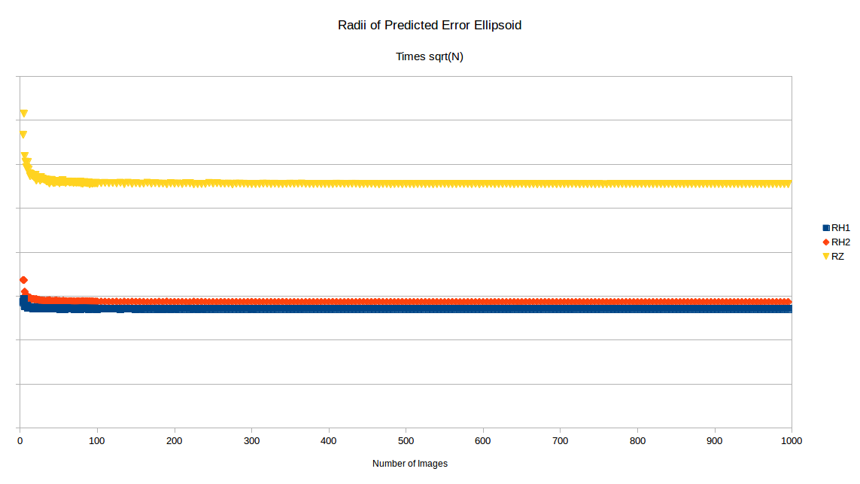
Predicted Error * Sqrt(N)
Predicted error decreases like 1/sqrt(N)

Slide 55
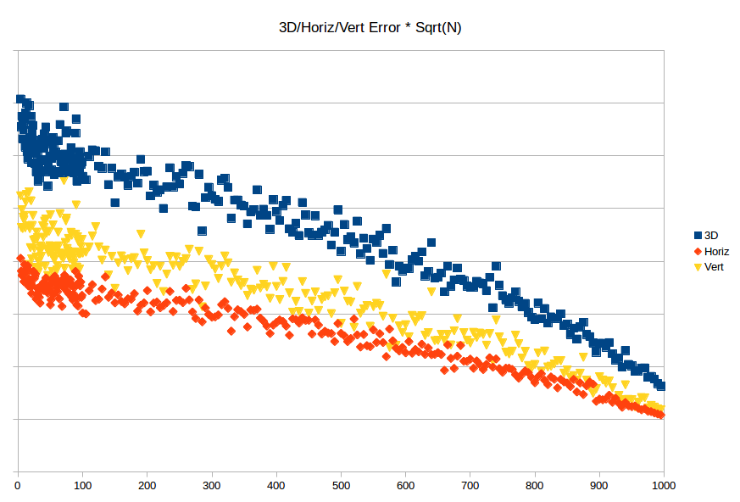
Measured Error * Sqrt(N)
Measured error decreasing faster than 1/sqrt(N)?

Slide 56
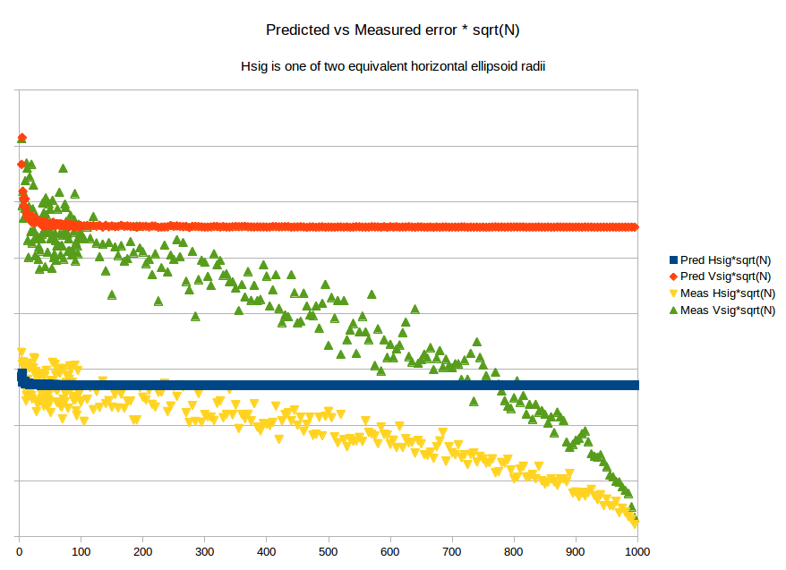
Finite Population Error
Measured spread artificially small due to sampling from finite population

Slide 57
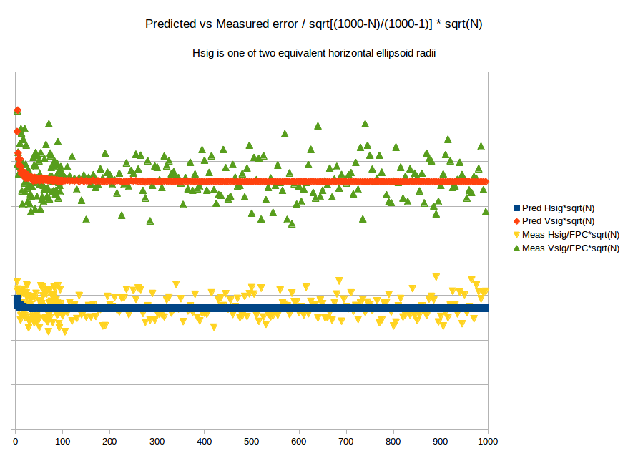
Finite Population Correction
Standard technique corrects for Finite Population effect

Slide 58
Variations
Increased measurement error
  Add σ=½, 1, 2, 4 pixels of random measurement error
Variable sensor error
  Increase all sensor parameter σ by a factor of 1--5
Outer/Inner Cones
  Sample MIG images from only inner (more vertical)/outer (more oblique) images
Half/Quarter Cones
  Sample MIG images from only half (Northern-looking) or quarter (Northeast-looking) images

Slide 59
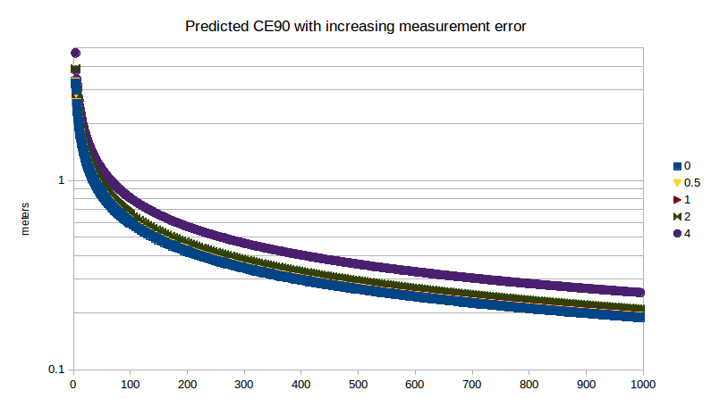
Increased Measurement Error
pix
Reasonable measurement error has little effect

Slide 60
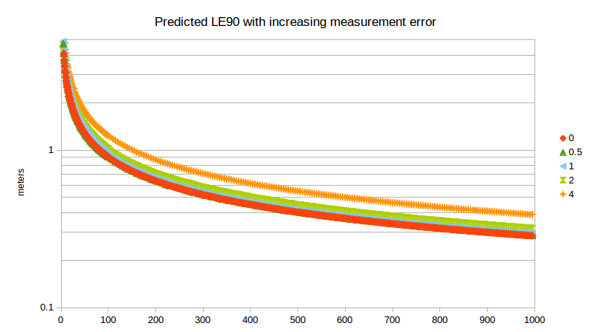
Increased Measurement Error
pix
Reasonable measurement error has little effect

Slide 61
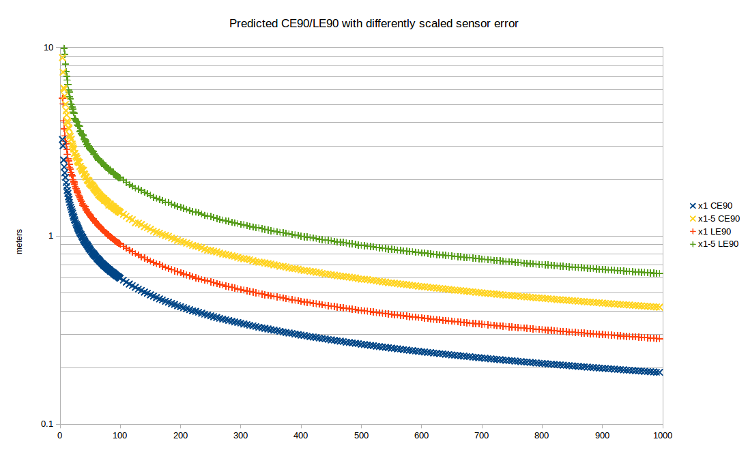
Variable Sensor error
Ground error larger, but still decreasing

Slide 62
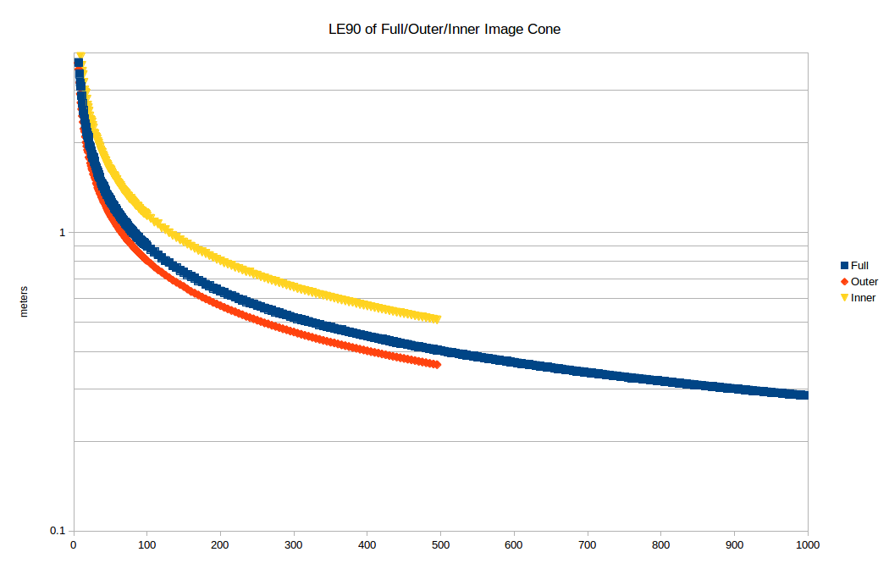
Outer/Inner Cones
Narrower cone→More vertical error

Slide 63
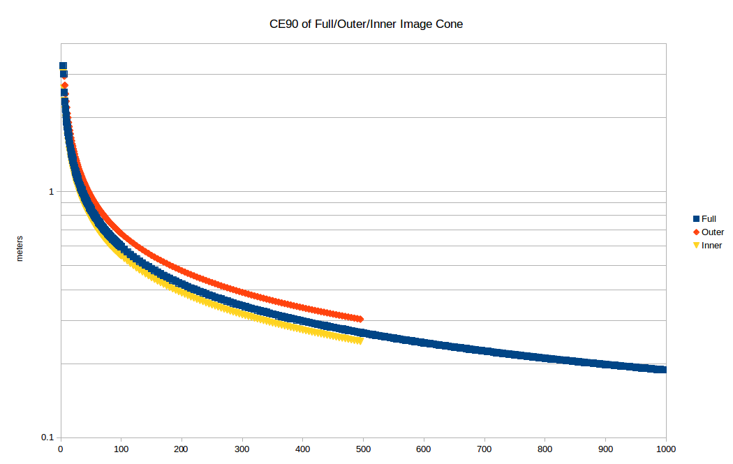
Outer/Inner Cones
Wider cone→More horizontal error

Slide 64
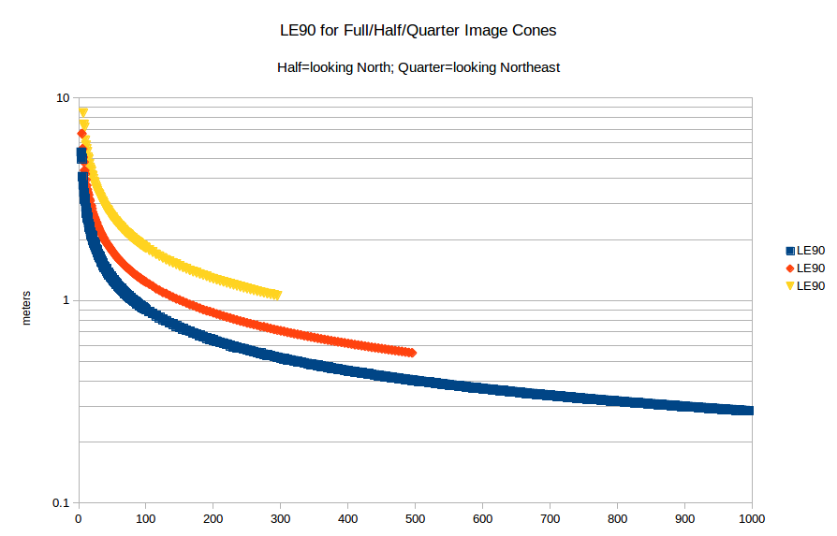
Half/Quarter Cones: Vertical
Narrower cone→More vertical error

Slide 65
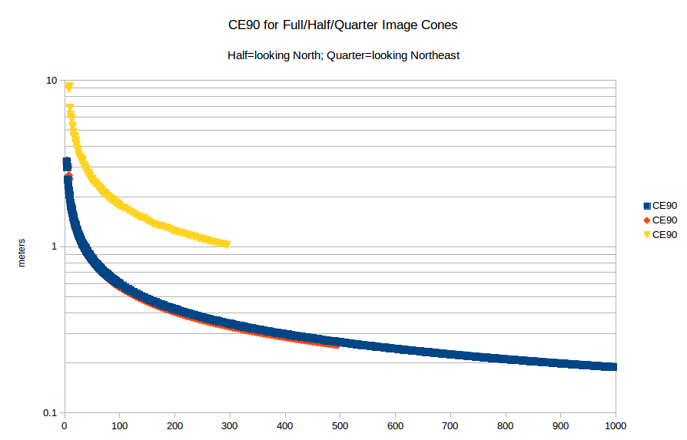
Half/Quarter Cones: Horizontal
Half→less horizontal error; but Quarter→more?

Slide 66
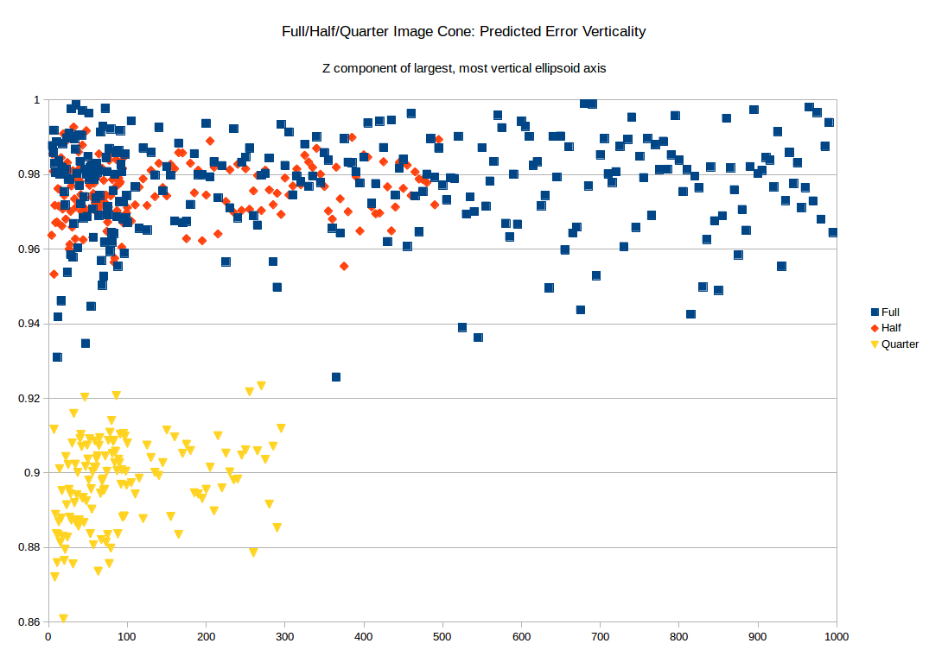
Half/Quarter Cones: Ellipsoid Lean
Quarter: Ellipsoid lean causes 'vertical' error to bleed into horizontal

Slide 67
Outline
Introduction
  Least squares for polynomial regression
  Least squares for Multi-Image Geopositioning (MIG)
  Improved accuracy with increasing number of images
Experimental Results
  Data synthesis, Methodology
  Results
Conclusion

Slide 68
Conclusion
With N independent images, MIG ground error decreases like 1/sqrt(N)
Despite many forms of degradation, sufficiently many independent images can still achieve high accuracy

