Slide 1
Asymptotically Small Geopositioning Error
from Large Numbers of Images
Reuben Settergren
Seth Merickel
IGTF 2017, Baltimore MD

Slide 2
Outline
Least-squares MIG
  Decreasing error as number of images grows
  Synthetically-augmented testbed
  Simulated results
Hourglassing
  Definition
  Similarity of results to MIG

Slide 3
Outline
Least-squares MIG
  Decreasing error as number of images grows
  Synthetically-augmented testbed
  Simulated results
Hourglassing
  Definition
  Similarity of results to MIG

Slide 4
Seth MIG stuff here

Slide 5
Outline
Least-squares MIG
  Decreasing error as number of images grows
  Synthetically-augmented testbed
  Simulated results
Hourglassing
  Definition
  Similarity of results to MIG

Slide 6
Data Synthesis
Start with 10 overlapping Worldview-1 images
  5 stereo pairs, GSD~0.5m
  Common overlap area includes 36N 117.5W
  Dolloff, Settergren, ASPRS 2010
Perturb adjustable parameters (pos, att, vel, etc)
  99 variants per original→1000 images
Choose ground point, project to 1000 image points
  UTM11N 455000 3984000 1700
  “Truth” = perfect 1000-image ray intersection
Further perturb 1000 images
  Each parameter perturbation randomly sampled Normal with controlled sigma
  “Error” = 1000 image rays that don't intersect
  CE90 at truth height: 6.5m

Slide 7
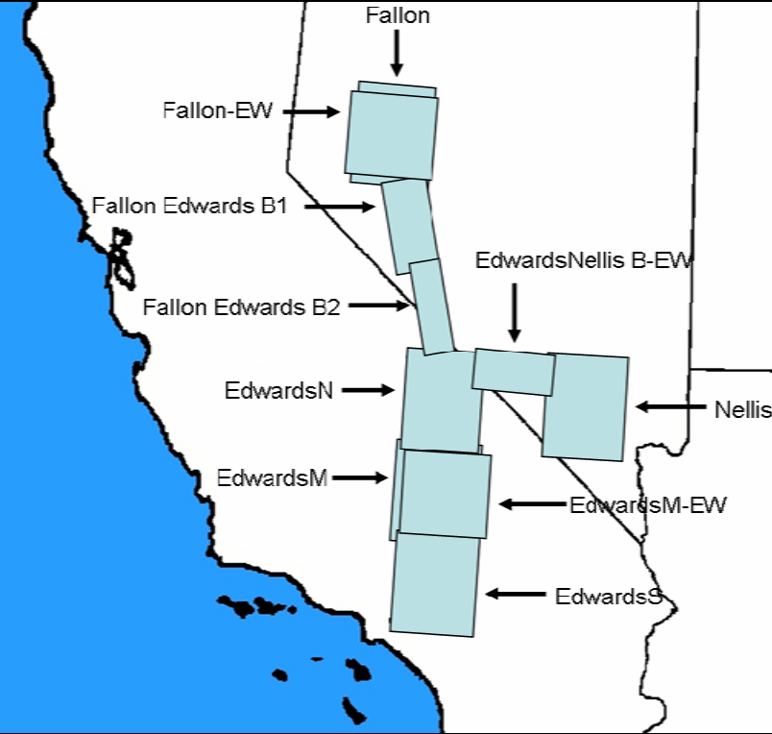
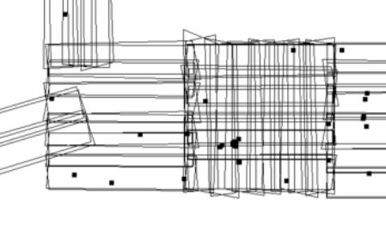
Original 10 Images

Slide 8
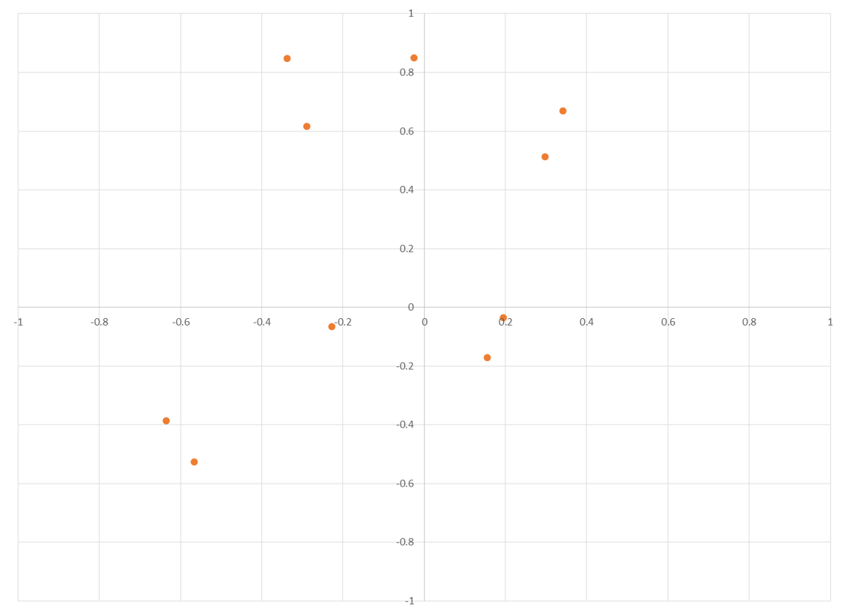
Data Amplification
Original 10 images (1m above truth)

Slide 9
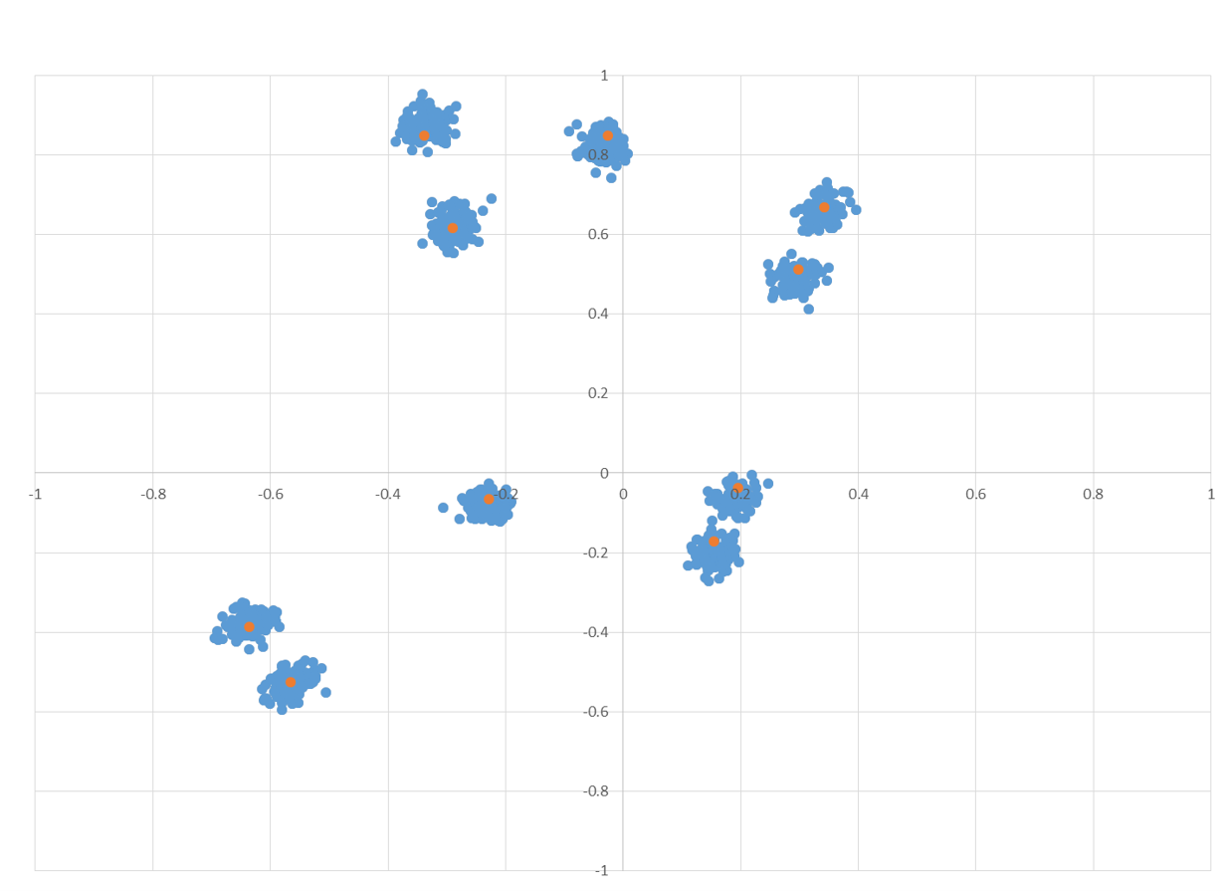
Data Amplification
1000 images (1m above truth)

Slide 10
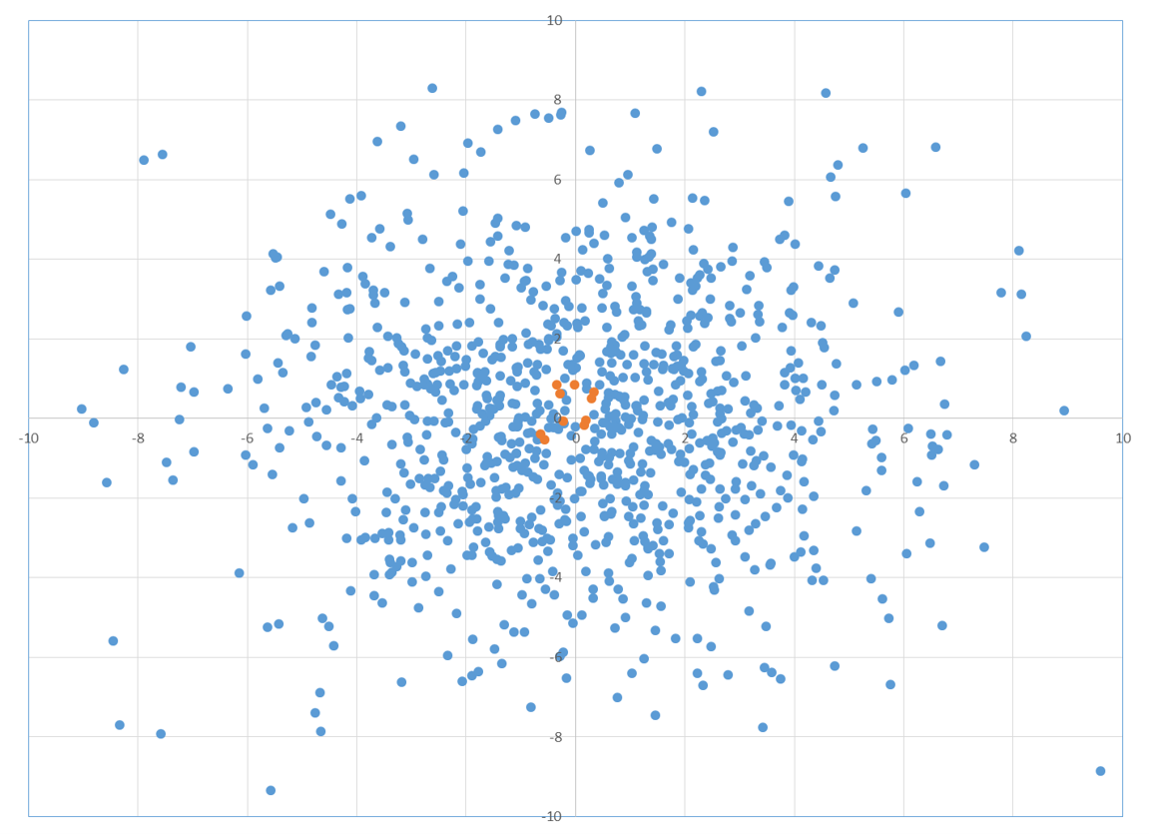
Data Amplification
1000 images perturbed (1m above truth)

Slide 11
Outline
Least-squares MIG
  Decreasing error as number of images grows
  Synthetically-augmented testbed
  Simulated results
Hourglassing
  Definition
  Similarity of results to MIG

Slide 12
Methodology
For N=4...1000
  For K=1...100
    Randomly sample subset of N images
    Compute MIG
      Reference variance = self-consistency check
      MIG - truth = measured error
      Output covariance = predicted error
Analyze
  What is the distribution of errors as N grows large?
  Are reference variances ~ 1?
  Do measured errors fit predictions?

Slide 13
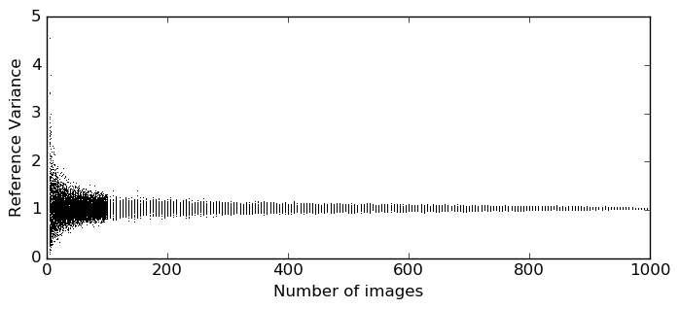
Reference Variance

Slide 14
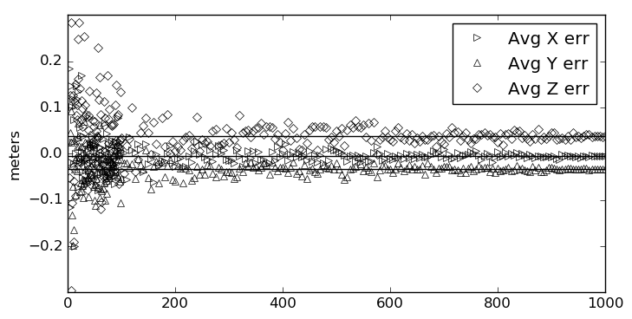
Average Error

Slide 15
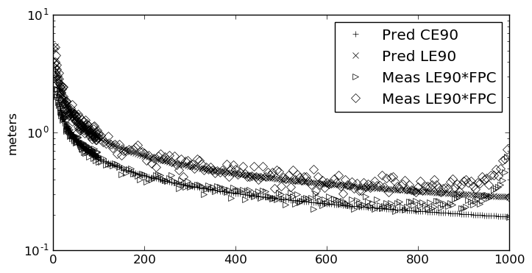
Measured vs Predicted Error

Slide 16
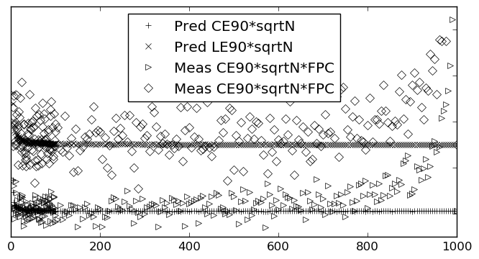
Error * sqrt(N)

Slide 17
Outline
Least-squares MIG
  Decreasing error as number of images grows
  Synthetically-augmented testbed
  Simulated results
Hourglassing
  Definition
  Similarity of results to MIG

Slide 18
Hourglassing
MIG is a complex algorithm
High bar for input data
  Sensor models
    Ground partial derivatives
  Apriori error
    Adjustable parameters
    Meaningful covariance
    Sensor partial derivatives
Hourglassing requires only imageToGround

Slide 19
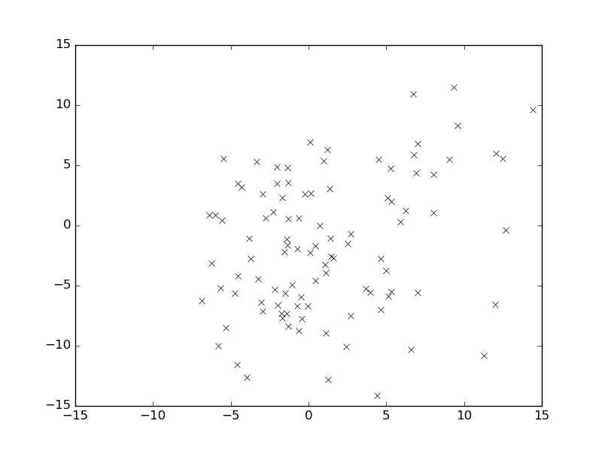
Hourglassing:
Find height that minimizes spread

Slide 20
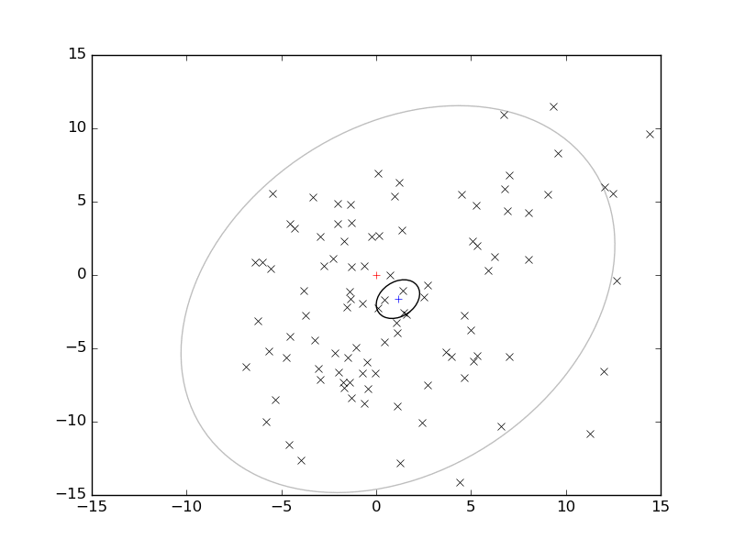
Hourglassing:
Find height that minimizes spread

Slide 21
Hourglassing: Computation
Option 1.5: Not-quite-so-brute Force
  Choose high and low Z: z+ and z-
  Compute imageToGround for all measurements
  For other Z, interpolate instead of imageToGround

Slide 22
Hourglassing: Computation
Option 1: Brute Force
  Choose a Z
  Compute imageToGround for all measurements
  Compute spread of X,Y
  Repeat

Slide 23
Hourglassing: Computation
Option 1.5: Not-quite-so-brute Force
  Choose high and low heights: z+ and z-
  Compute imageToGround for all measurements at both heights
  For other Z, interpolate instead of imageToGround

Slide 24
Hourglass: Computation
Option 2: Direct solve
  Area of 2d error ellipse is proportional to determinant of 2x2 covariance matrix
  Each term is quadratic in λ
  Determinant is quartic in λ
  Minimizer is real root of cubic in λ
Details in paper

Slide 25
Outline
Least-squares MIG
  Decreasing error as number of images grows
  Synthetically-augmented testbed
  Simulated results
Hourglassing
  Definition
  Similarity of results to MIG

Slide 26
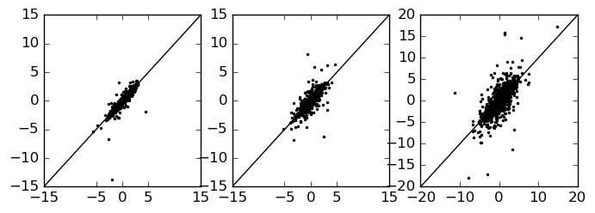
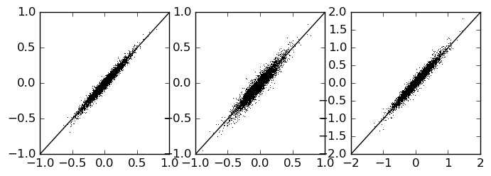
MIG vs Hourglassing:
Measured Error
N<=10
N>10

Slide 27
Self-Projected Error Estimation
Recall meas/pred err
Estimate error at 4N :
  Many MIG with N (subsample the 4N)
  Sample variance
  Scale by ¼ or ½
  Scale by FPC (4N-1)/(4N-N) ~ 4/3
N*4
Var/4
Stdev/2
CELE/2

Slide 28
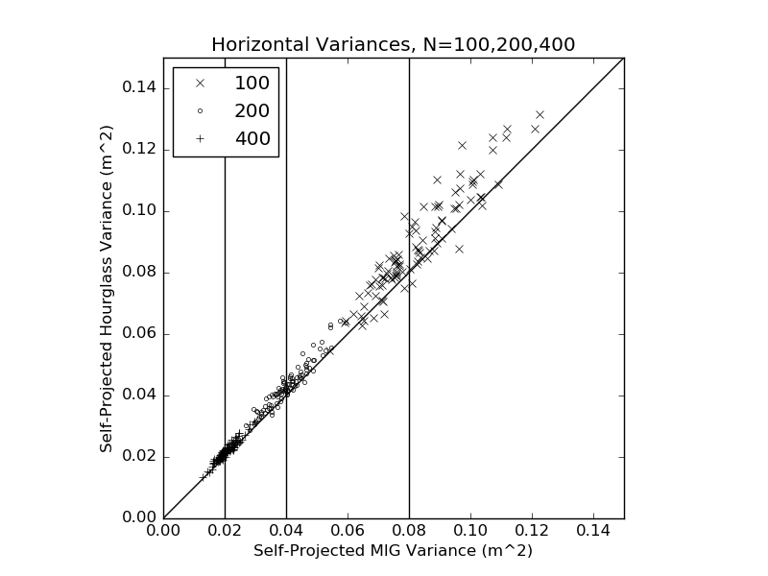
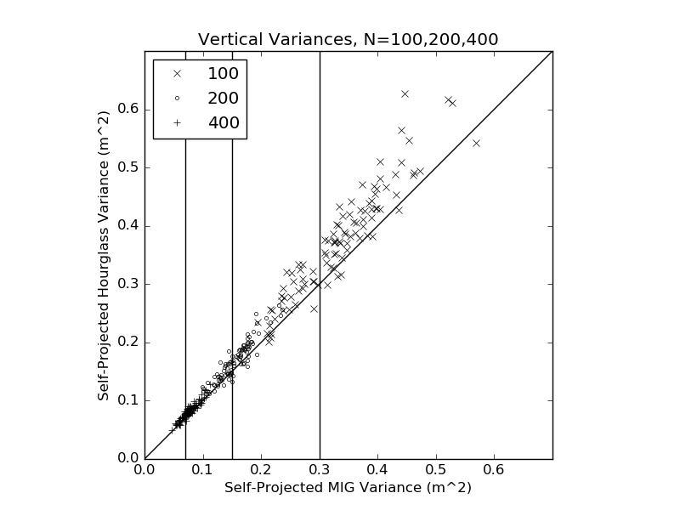
Self-Projected Error Estimation

Slide 29
Title here
Outline
Outline
Outline
Data Synthesis
Original 10 Images
Data Amplification
Data Amplification
Data Amplification
Outline
Methodology
Reference Variance
Average Error
Measured vs Predicted Error
Error * sqrt(N)
Outline
Hourglassing
Hourglassing:
Find height that minimizes spread
Hourglassing:
Find height that minimizes spread
Hourglassing: Computation
Hourglassing: Computation
Hourglass: Computation
Outline
MIG vs Hourglassing:
Measured Error
Self-Projected Error Estimation
Self-Projected Error Estimation

Slide 30
Title here
Outline
Outline
Outline
Data Synthesis
Original 10 Images
Data Amplification
Data Amplification
Data Amplification
Outline
Methodology
Reference Variance
Average Error
Measured vs Predicted Error
Error * sqrt(N)
Outline
Hourglassing
Hourglassing:
Find height that minimizes spread
Hourglassing:
Find height that minimizes spread
Hourglassing: Computation
Hourglassing: Computation
Hourglass: Computation
Outline
MIG vs Hourglassing:
Measured Error
Self-Projected Error Estimation
Self-Projected Error Estimation

