Slide 1

Customer Shopping Behavior — Project Overview
Analysis of 3,900 purchases to reveal spending, segments, product prefs, and subscription behavior.

Slide 2
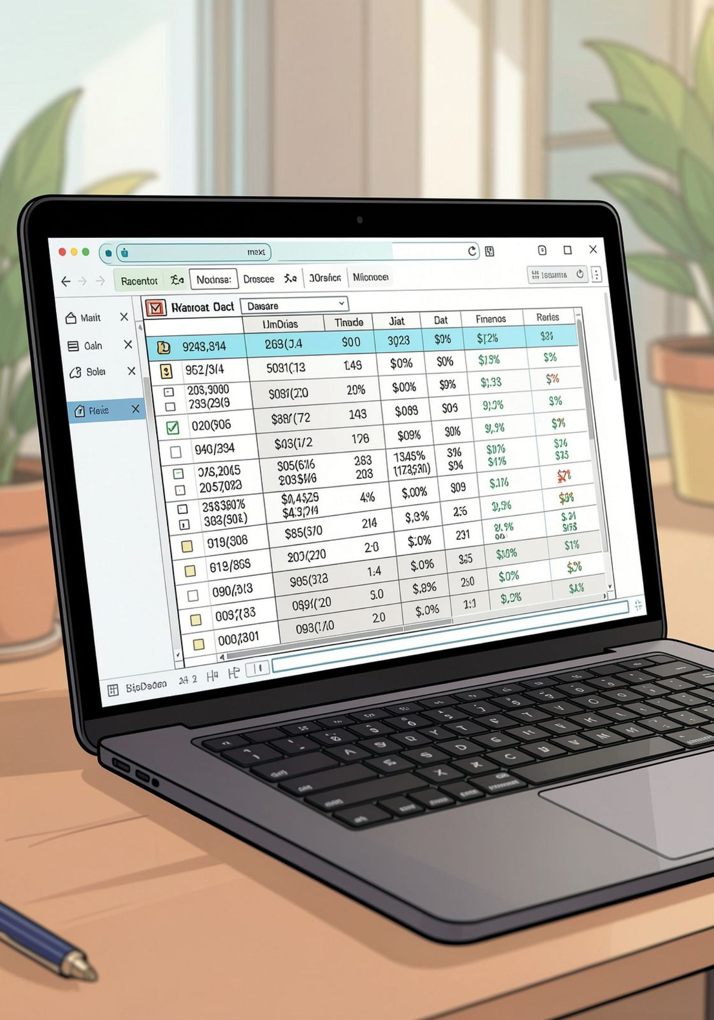
Dataset Snapshot
Rows & Columns
Key Features
3,900 rows · 18 columns
Demographics, purchase details, behavior, shipping, discounts
Missing
37 missing values in Review Rating

Slide 3

Data Prep & Feature Engineering
- Loaded with pandas
- df.info() & .describe()
- Imputed review ratings by category median
- Renamed to snake_case
- Added age_group and purchase_frequency_days
- Dropped promo_code_used (redundant)

Slide 4
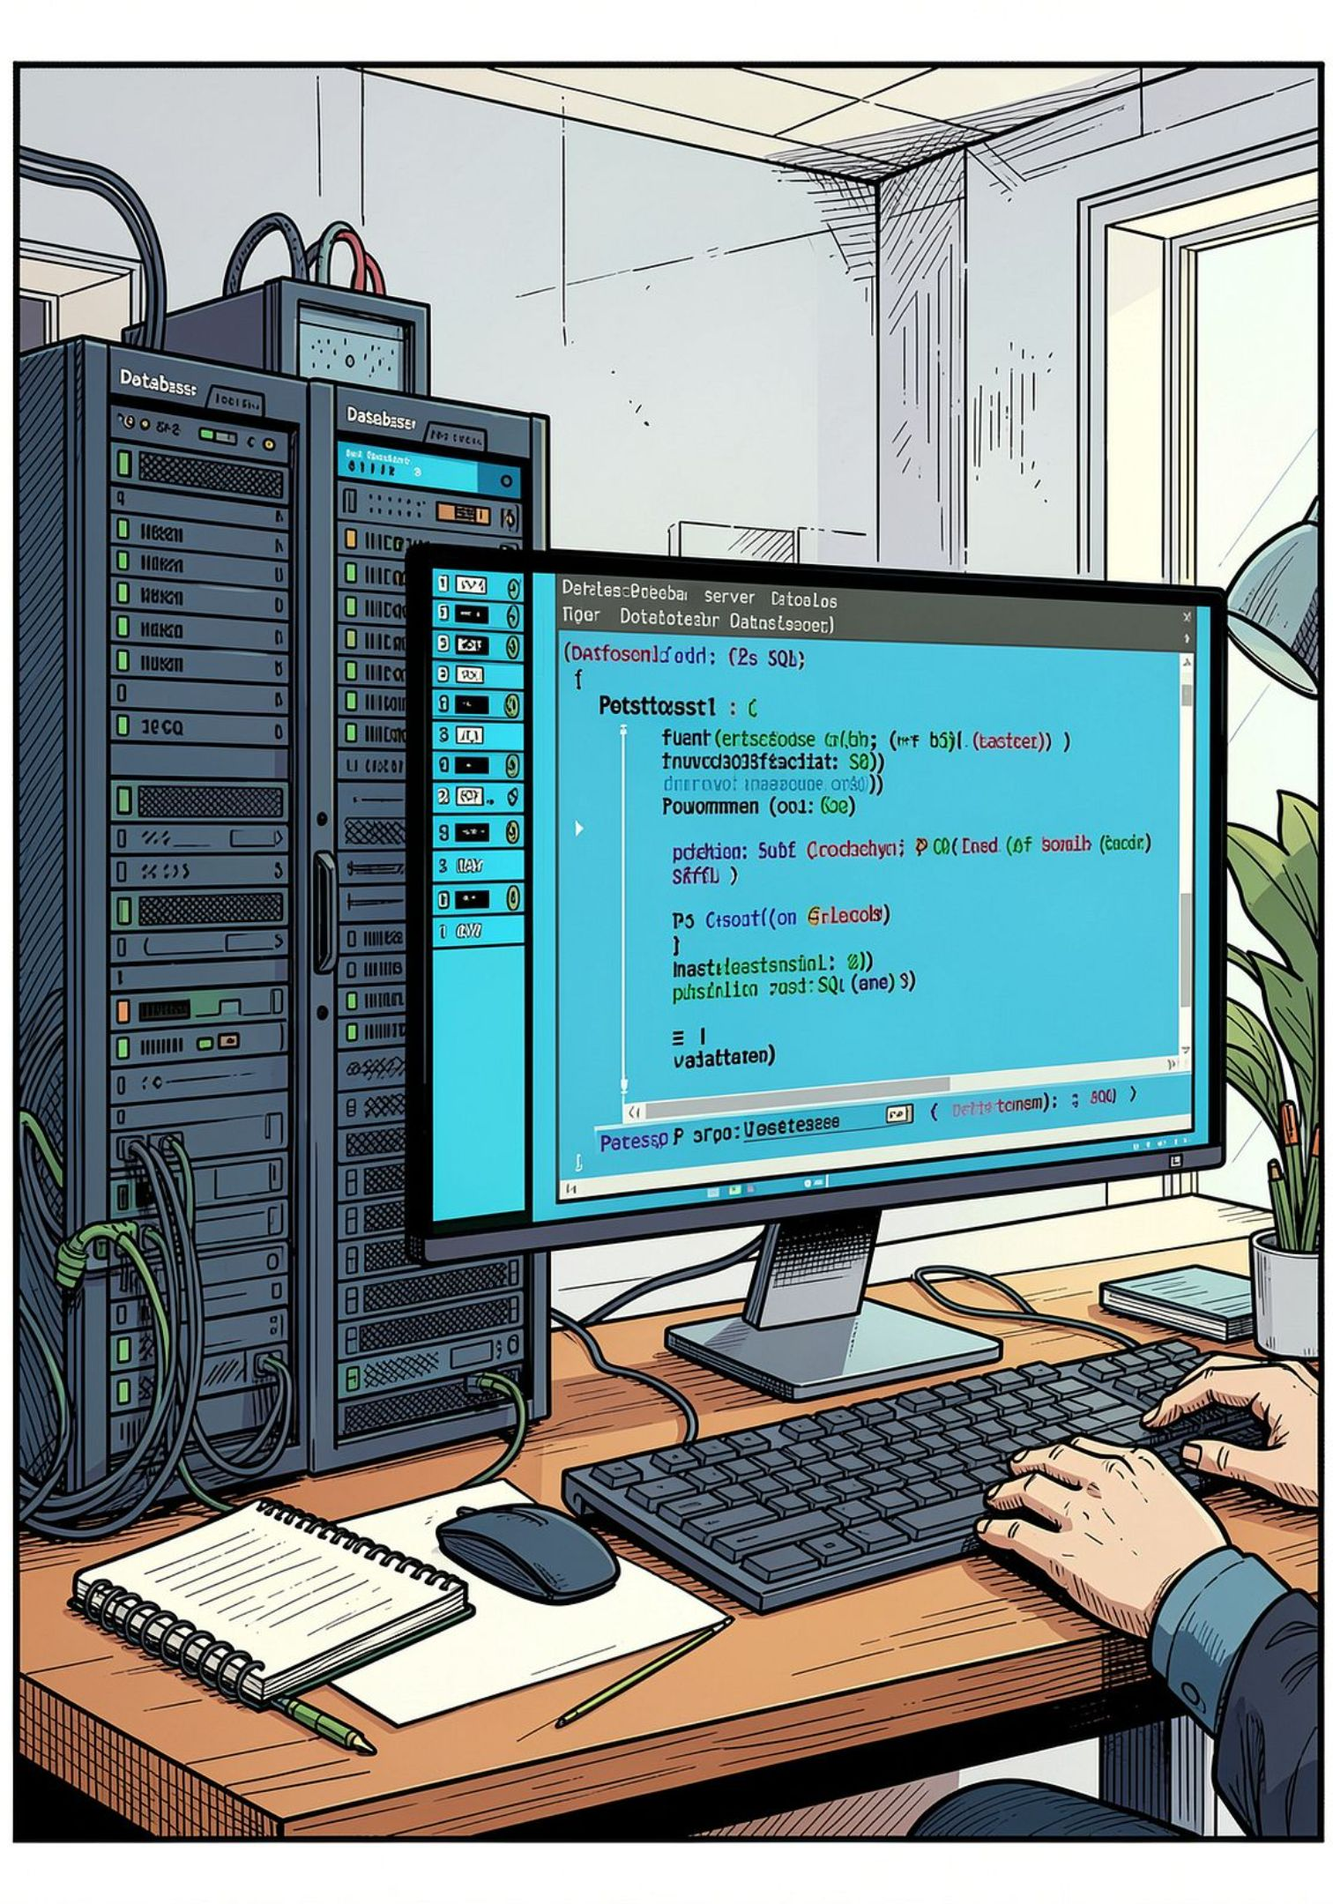
DB Integration & SQL Analysis
Cleaned DataFrame loaded to PostgreSQL for structured queries and business metrics.
Why SQL?
Fast aggregation, joins, repeatable business queries
Used For
Revenue by group, discount patterns, top products, segmentation

Slide 5
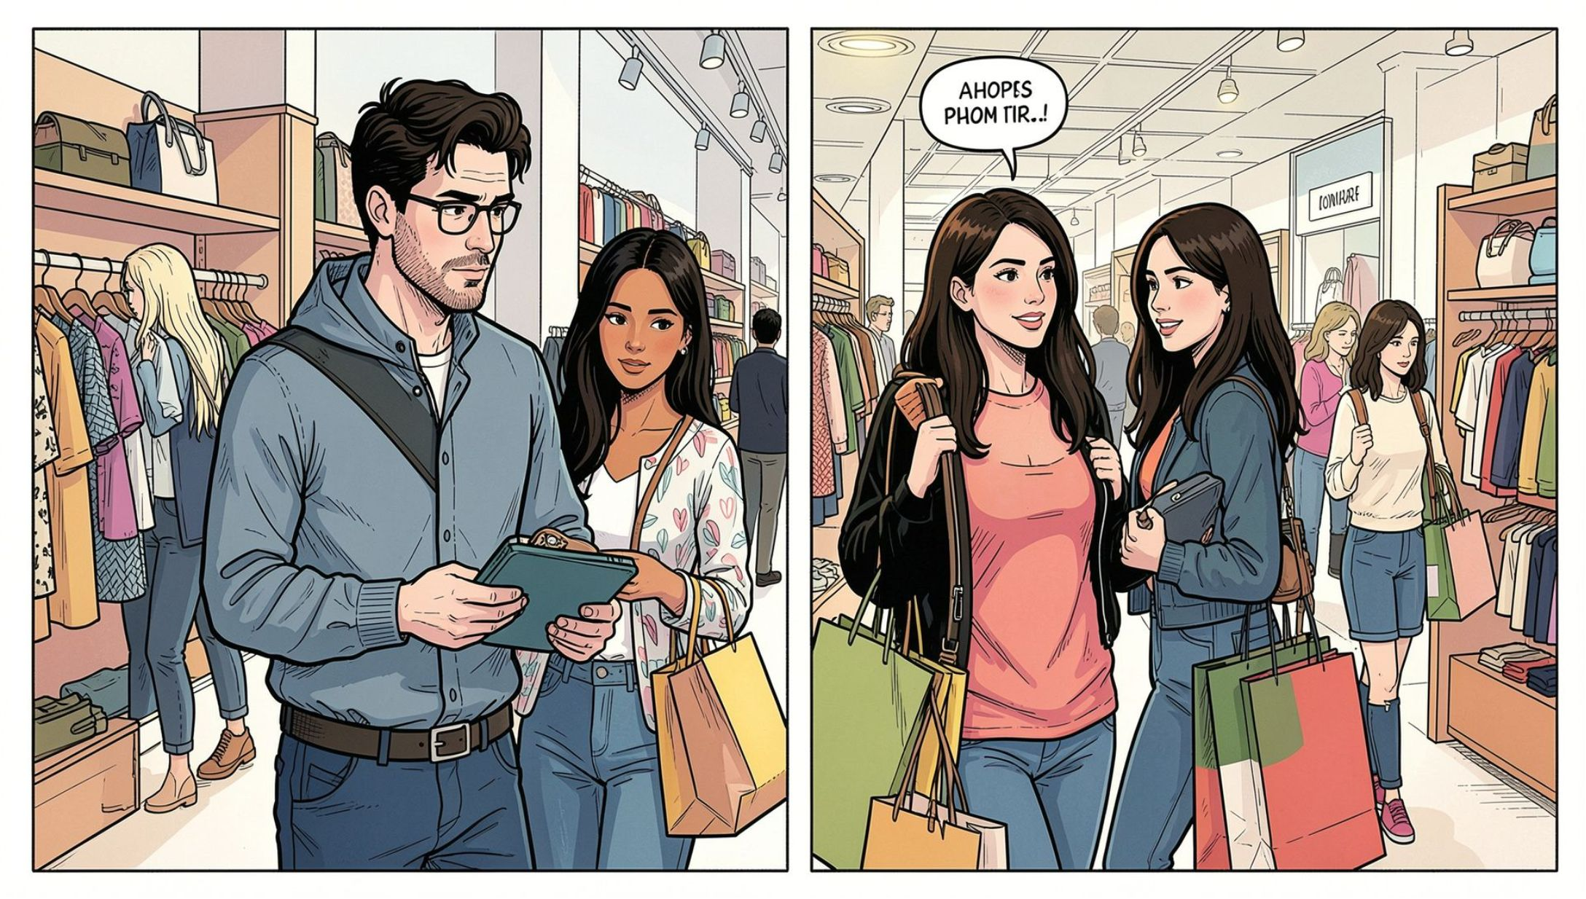

Revenue by Gender
Totals
Male revenue: 157,890
Female revenue: 75,191
Male customers generated ~2x the revenue

Slide 6
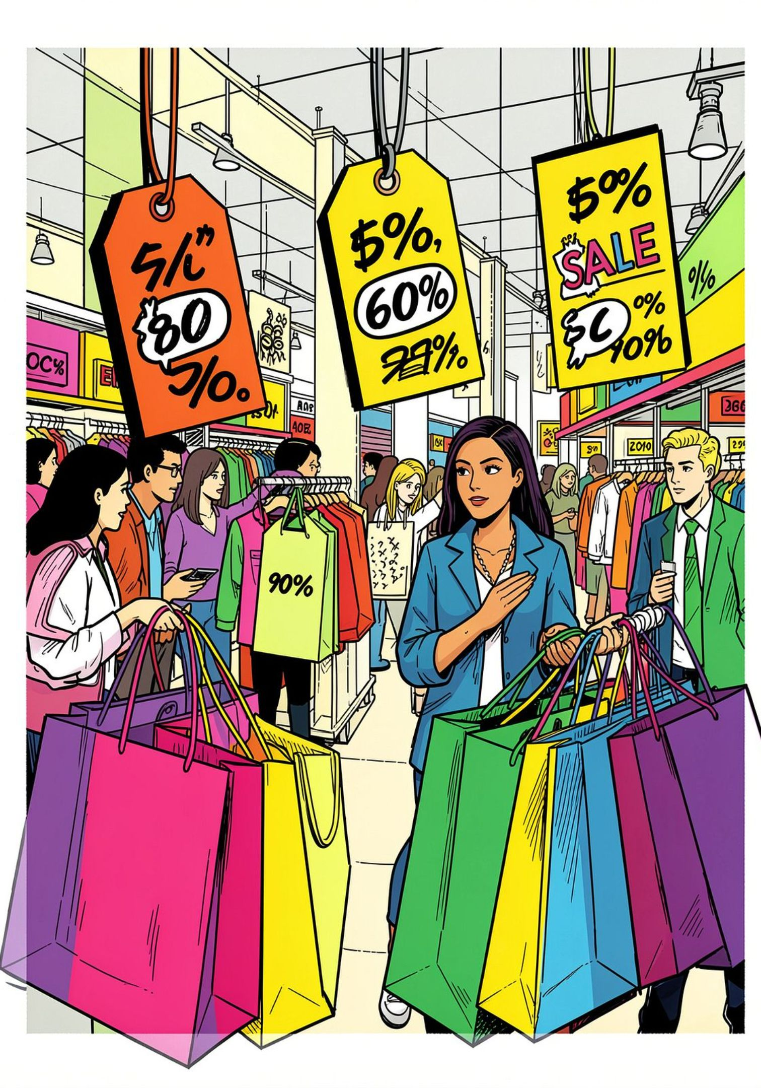


Discounts & High-Spenders
839 rows: customers who used discounts yet spent above average purchase amount.
Discount-Dependent Items
Top items with high discount rates: Hat, Sneakers, Coat, Sweater, Pants
High-Spenders Using Discounts
Identified list of customers maintaining high spend despite discounts

Slide 7
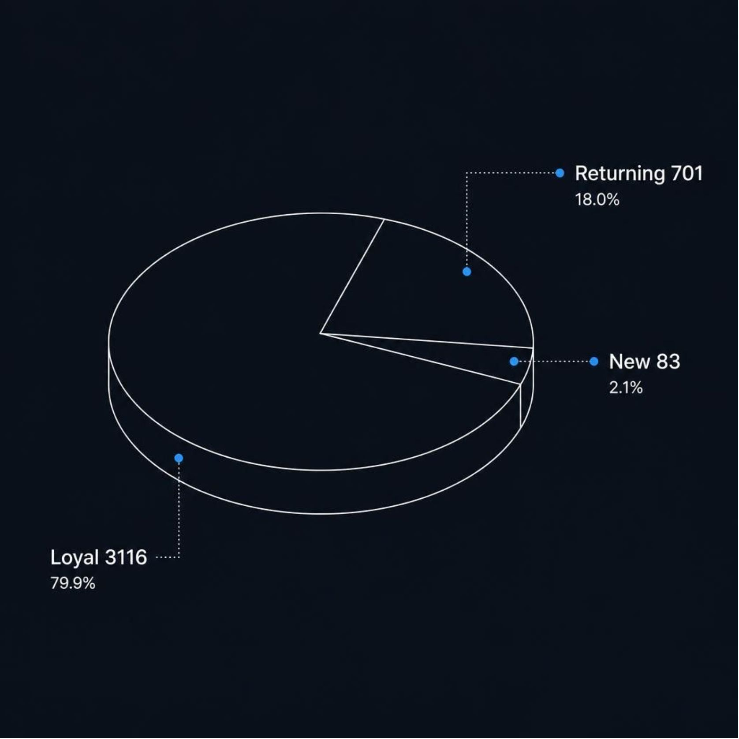

Customer Segmentation
- Loyal: 3,116 customers
- Returning: 701
- New: 83
Focus loyalty programs on the large Loyal base to increase lifetime value

Slide 8
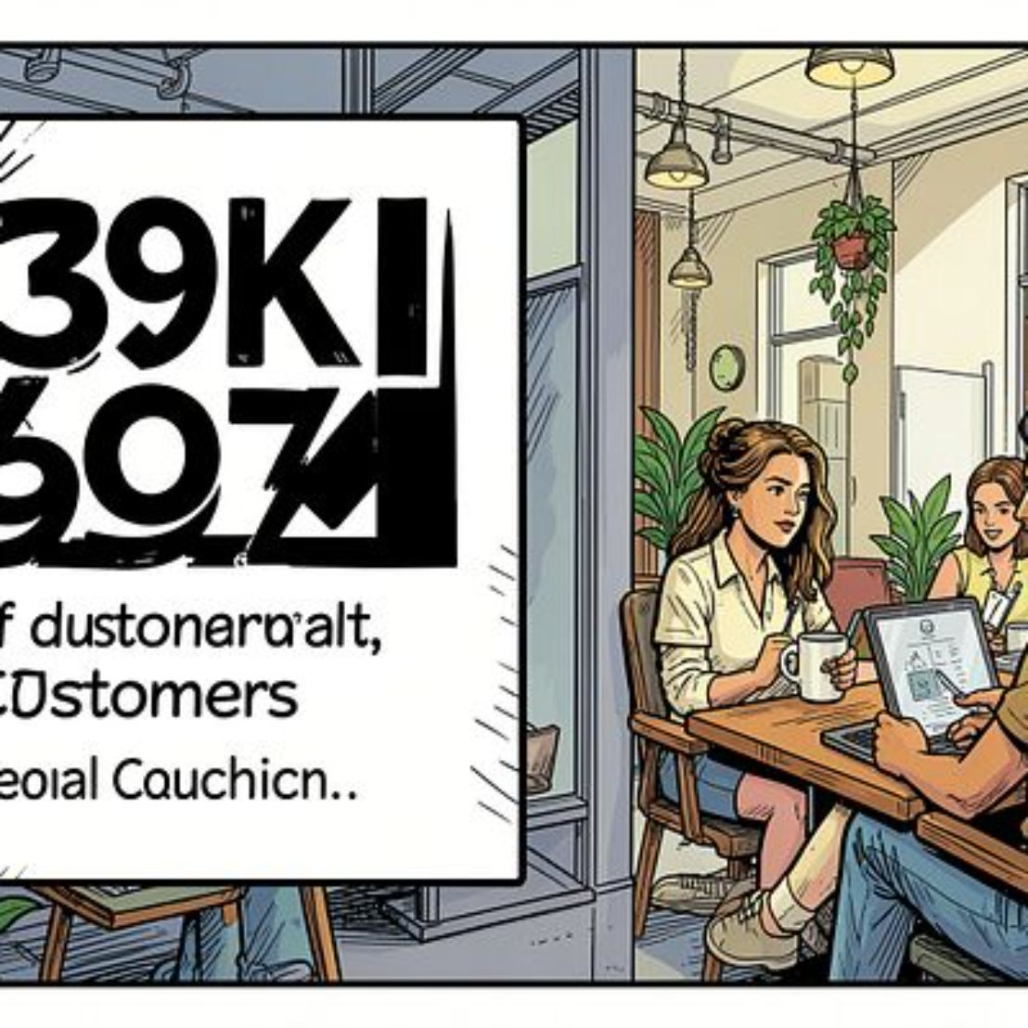
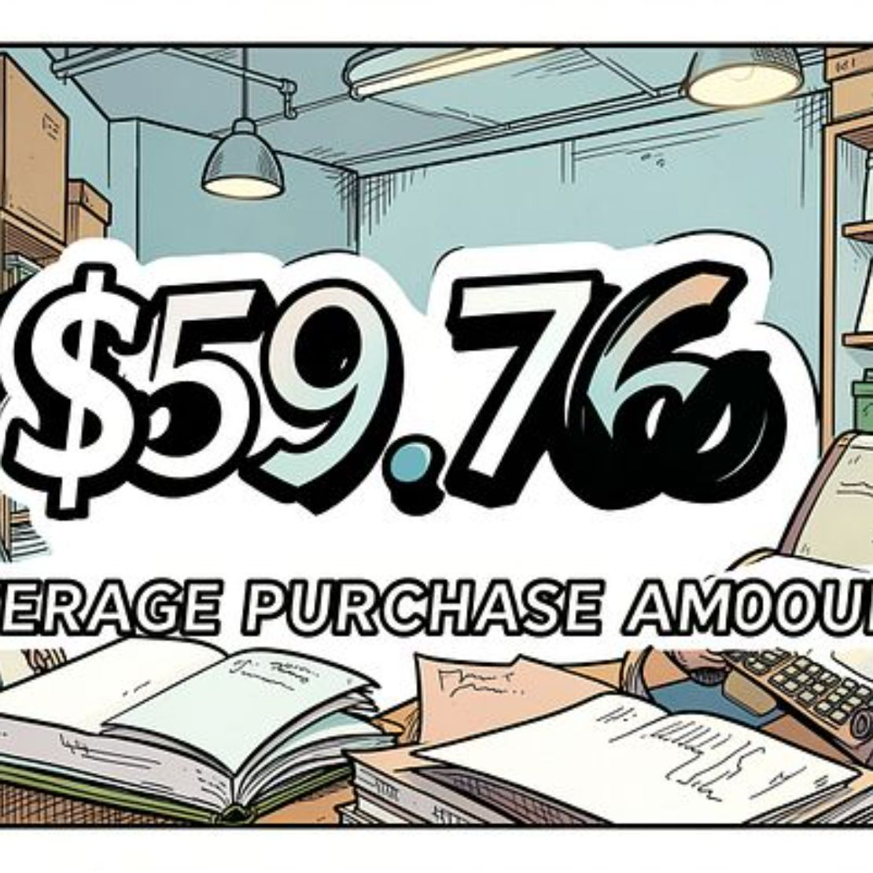
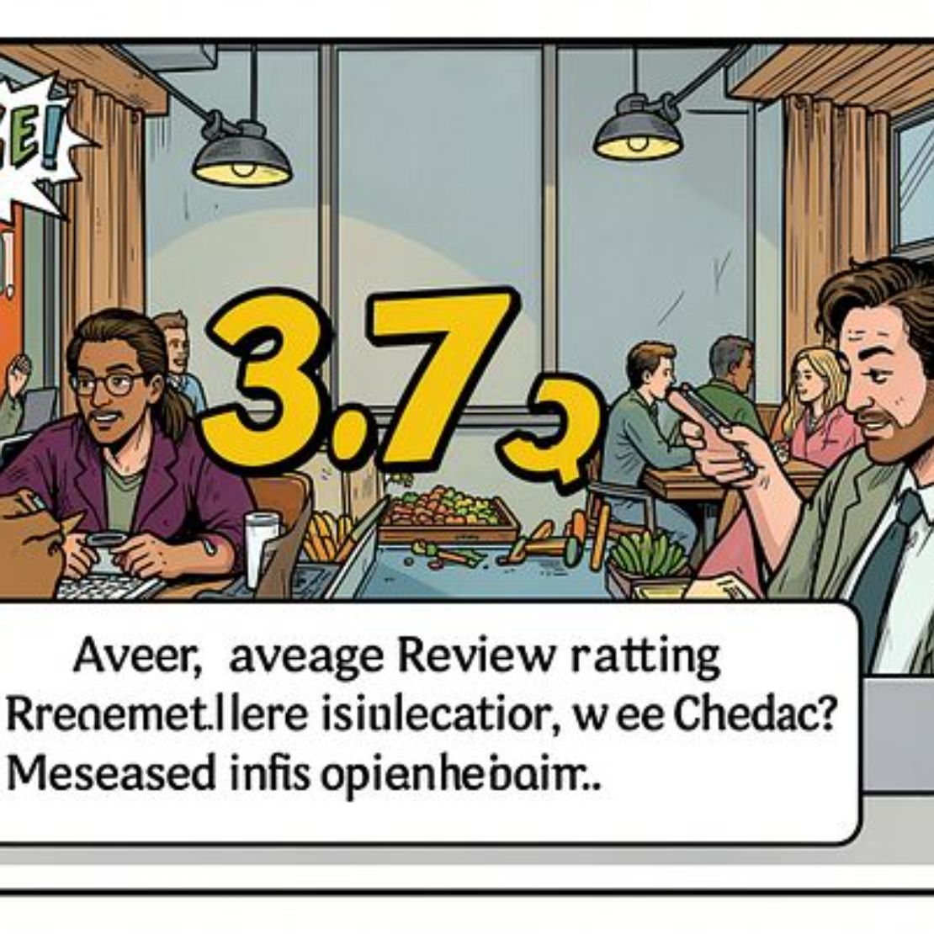
Power BI Dashboard — Key Metrics
Donut: Subscribers Yes 27% / No 73 • Revenue & Sales by category and age groups shown

Slide 9
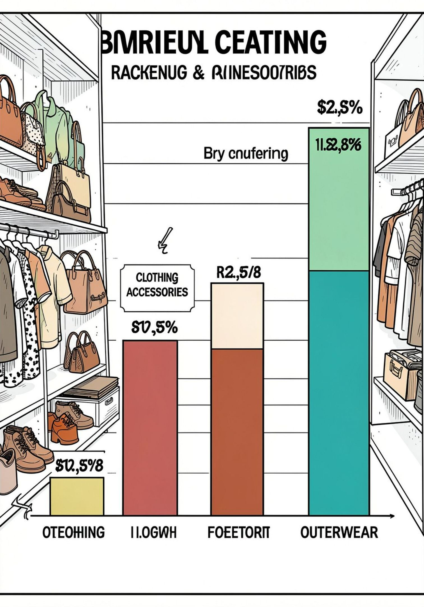
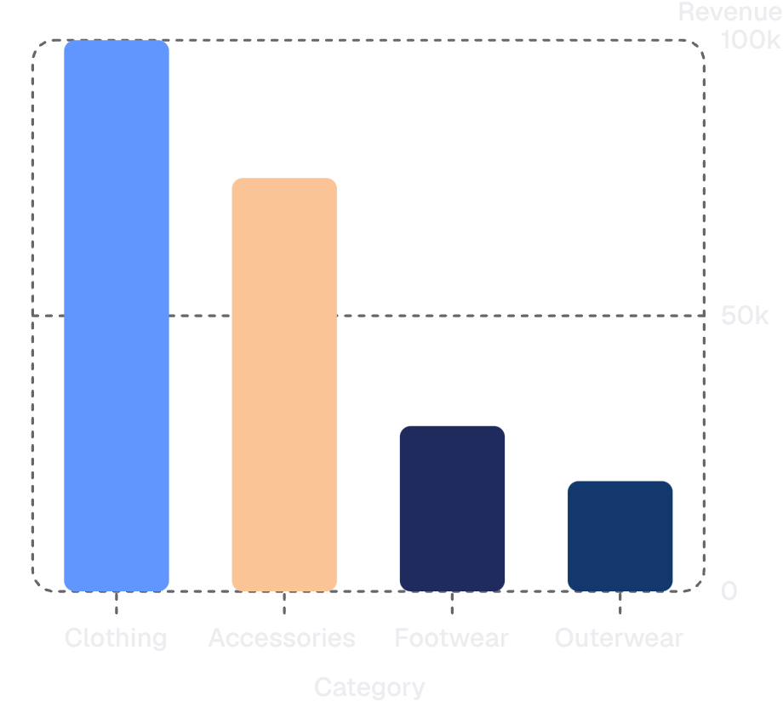
Top Products & Category Insights
Top Rated Products
Gloves 3.86 · Sandals 3.84 · Boots 3.82 · Hat 3.80 · Skirt 3.78
Top Sellers by Category
Clothing: Blouse, Pants, Shirt · Footwear: Sandals, Shoes, Sneakers · Accessories: Jewelry, Sunglasses, Belt

Slide 10





Business Recommendations
Boost Subscriptions
Loyalty Programs
Review Discounts
Promote exclusive subscriber benefits
Reward repeat buyers to increase loyalty
Balance sales uplift with margin control
Product Positioning
Targeted Marketing
Highlight top-rated & best-selling items
Focus on high-revenue age groups & express-shipping users
Next steps: prioritize subscription growth and optimized discount strategy

