Slide 1
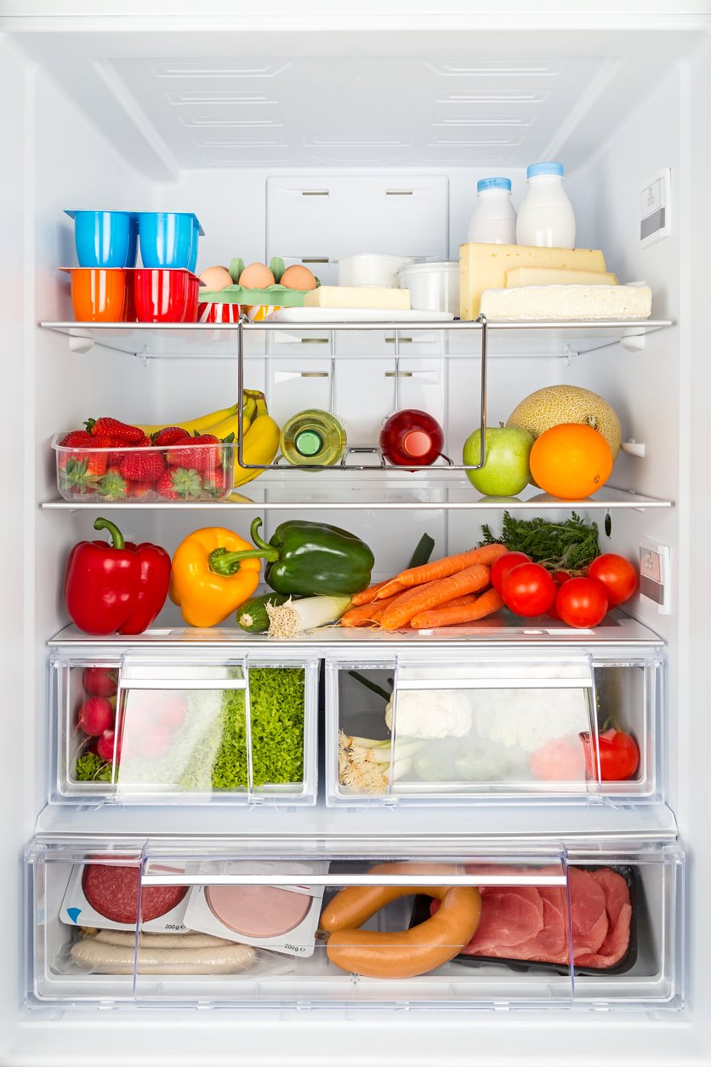
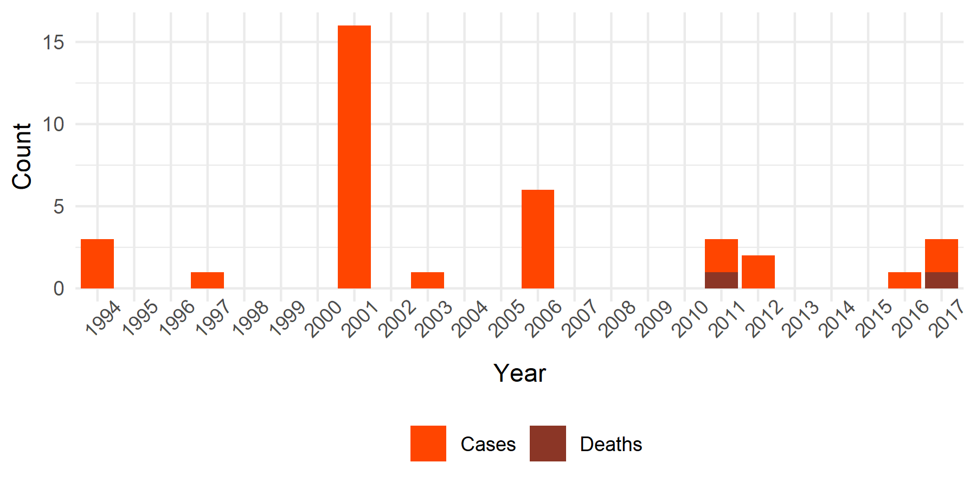
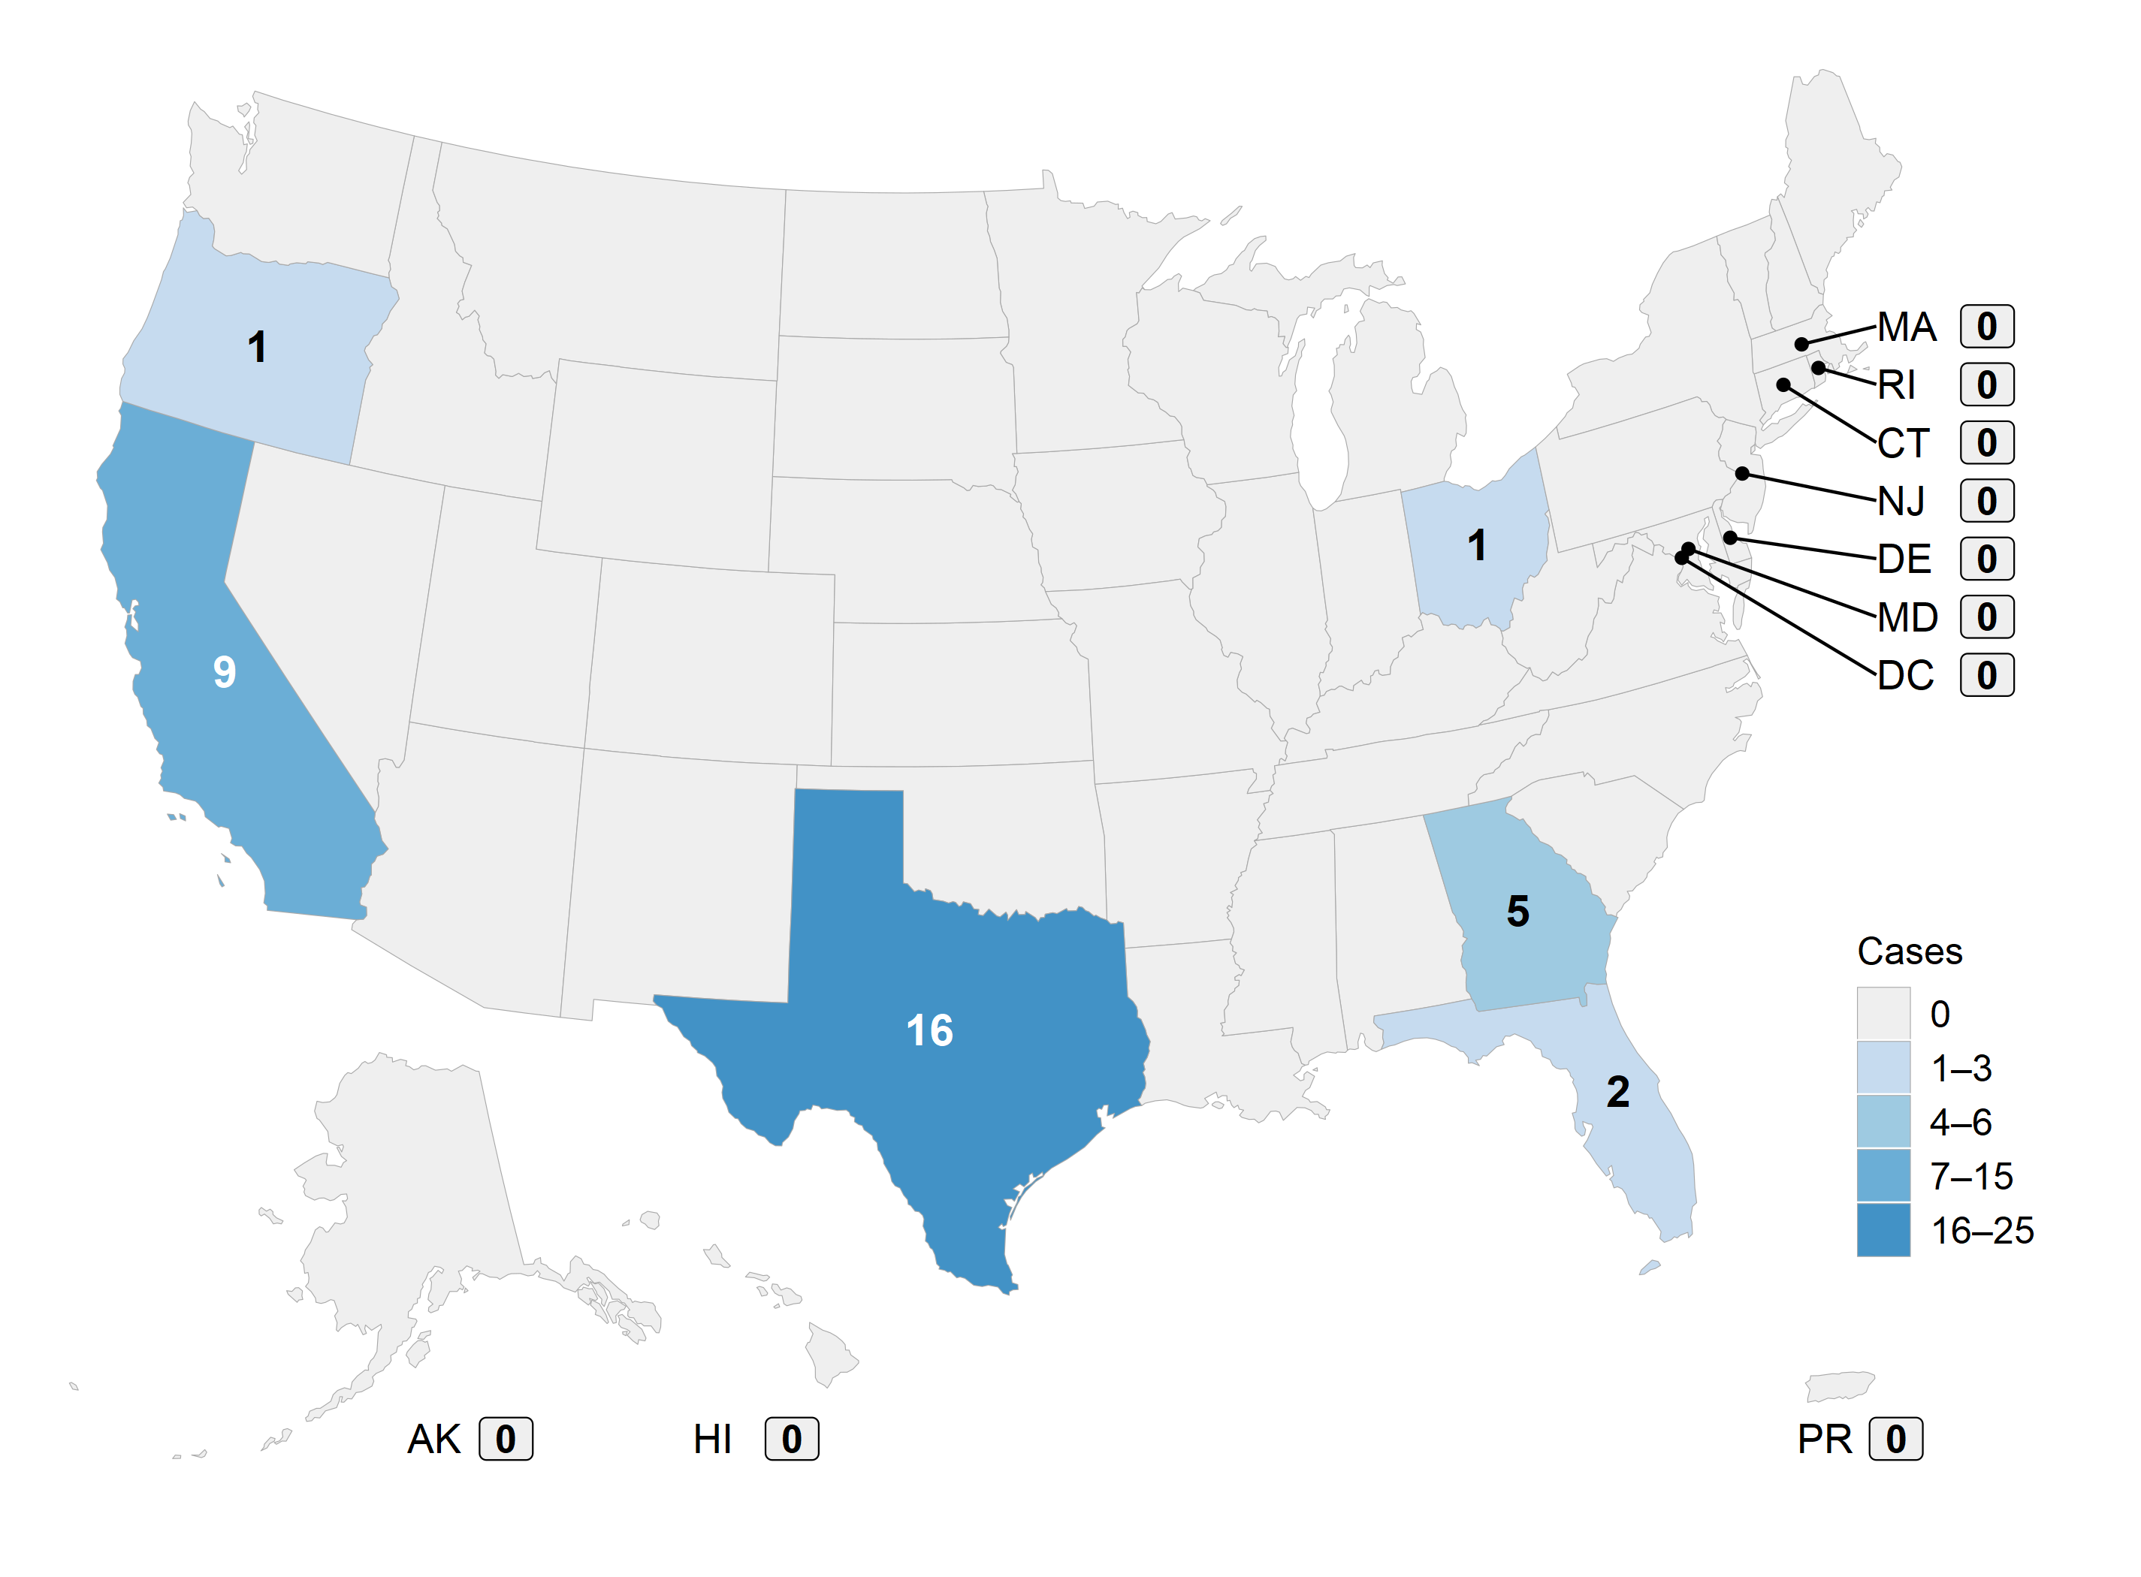

Inadequate Refrigeration of Commercial Foods as a Continued Source of Foodborne Botulism in the United States, 1994–2017 S. Edmunds,^{1,2} D. J. Vugia³, H. Rosen³, K. Wong¹, K. Chatham-Stephens¹ ¹Centers for Disease Control and Prevention, Atlanta, GA; ²Oak Ridge Institute for Science and Education, Oak Ridge, TN; ³California Department of Public Health, Richmond and Los Angeles, CA
Background
Foodborne botulism is a rapidly-progressive and potentially fatal paralyzing illness caused by the consumption of botulinum neurotoxin, most commonly produced by Clostridium botulinum. Refrigeration serves as the primary barrier to botulinum neurotoxin production in many minimally- processed foods meant to be refrigerated. However, when foods are not properly refrigerated, C. botulinum toxin production has occurred and caused foodborne botulism in the United States.
Findings
During 1994–2017, we identified 34 cases, including 3 deaths, from 11 botulism events associated with the inadequate refrigeration of commercially-prepared products. In 9 events, the patient stored the product unrefrigerated at home; in 2 events, a product was kept unrefrigerated at the store before the consumer purchased it. In 3 events, there were issues with the refrigeration instructions: 1 label printed on outer but not inner packaging, 1 label not clearly visible, and 1 label in Korean only. The number of people affected per event ranged from 1–16. Using enhanced cost estimates for foodborne botulism cases from a published economic model, these events were estimated to cost over $64M.¹
Recommendations
Add a secondary barrier, such as an acidifier, to prevent botulinum toxin production
Improve labeling to convey risks of minimally- processed, refrigerated foods to help prevent improper storage and handling.
References
1. Scharff, R. L. 2015. State estimates for the annual cost of foodborne illness. J Food Prot. 78:1064-71.
Foodborne Botulism Cases Due to Inadequate Refrigeration of Commercial Foods and Resulting Deaths, United States, 1994–2017
Refrigeration instructions are not always enough.
Additional strategies are necessary to prevent foodborne botulism outbreaks from some commercially-prepared foods.
Geographic Distribution of Foodborne Botulism Cases Due to Inadequate Refrigeration of Commercial Foods, United States, 1994–2017
Implicated Commercial Foods causing Foodborne Botulism Due to Inadequate Refrigeration, United States, 1994–2017
Bean dip
Clam chowder
Burrito
Frozen chili
Carrot juice
Potato soup
Broccoli soup
Grain and vegetable product
Herbal tea
CONTACT INFO
Seth Edmunds
wex2@cdc.gov
SCAN HERE FOR MORE INFORMATION

