Slide 1
CSCI 6840 · PROJECT 1
Customer Segmentation
Using Clustering Techniques
Finding hidden customer groups in the Mall Customers dataset — and turning them into marketing strategy
Unsupervised Learning · K-Means · Hierarchical Clustering
Notes:
Introduce the project: we were given 200 mall customer records with no labels, and asked to find natural groups in them using clustering. Clustering is unsupervised learning — there is no right answer given to us, so we have to discover the structure ourselves and then prove it is real.

Slide 2
THE PROBLEM
Why Customer Segmentation?
The business problem
What clustering does
A mall has 200 customers and one marketing budget.
Treating everyone the same wastes money — a discount coupon is useless to someone who already spends freely.
But nobody has labelled which customers belong together.
We need to discover the groups from the data itself.
Clustering groups customers who are close to each other in the data, and separates those who are far apart.
Supervised learning
You are given the answer (labels) and learn to predict it.
Unsupervised learning ← this project
No answer is given. You explore the data to find structure that was already there.
Notes:
The key framing point: this is unsupervised learning. Nobody tells us the correct groups, so we cannot measure accuracy the way we would with a classifier. That is why later we have to use silhouette score and cross-check with a second algorithm — those replace the accuracy metric we do not have.

Slide 3
WHAT WE WORKED WITH
The Dataset
200
5
0
0
customers
columns
missing values
duplicates
Columns in Mall_Customers.csv
Column | Range | Decision
CustomerID | 1 – 200 | Just an ID — dropped, it carries no information
Gender | Male / Female | Tested, but did not improve the clusters
Age | 18 – 70 | Tested, but did not improve the clusters
Annual Income (k$) | 15 – 137 | USED — what a customer can afford to spend
Spending Score (1-100) | 1 – 99 | USED — how much they actually do spend
Notes:
200 customers, five columns, and importantly zero missing values and zero duplicates — so no imputation was needed. I still wrote the missing-value check into the code, because you cannot know the data is clean until you look. Mention that CustomerID was dropped: it is just a row number, and including it would have let the algorithm cluster on the arbitrary order of the file.

Slide 4
THE PROCESS
Our Approach
1
2
3
4
Explore & Prepare
Find k
Cluster
Interpret
Load the data, check for missing values, pick features, and put them on the same scale.
→
Use three independent methods to decide how many clusters the data actually has.
→
Run two different algorithms and compare whether they agree.
→
Turn the clusters into named customer segments with marketing actions.
The order matters: we decide how many clusters exist BEFORE we run any clustering algorithm, so we are not just picking the number that gives us the answer we want.
Notes:
Walk through the four steps. Emphasise the note at the bottom — choosing k first, using objective methods, and only then clustering, is what stops this from being a result we picked because it looked nice.

Slide 5
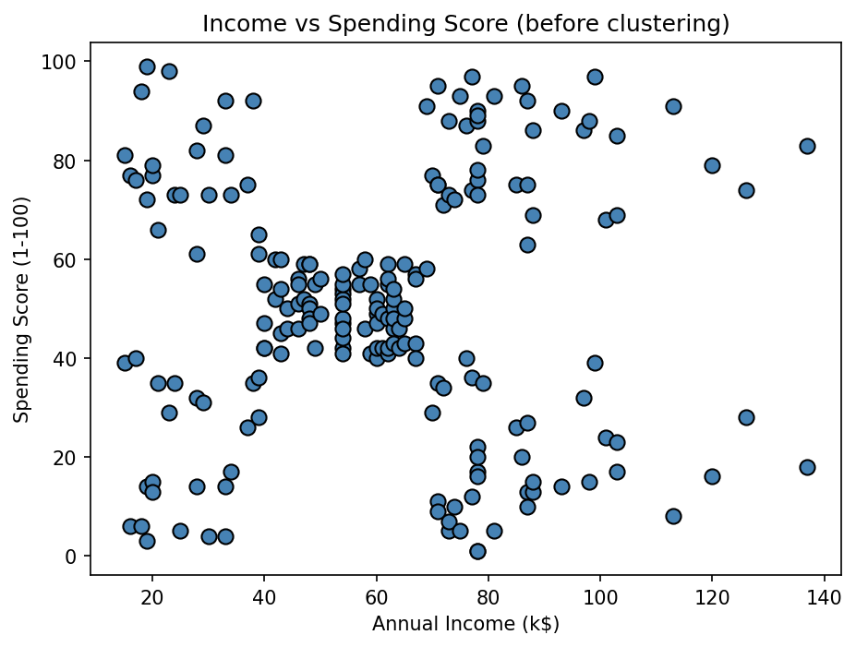
DATA EXPLORATION
Step 1 — Exploring the Data
What the plot tells us
Before running any algorithm, we plotted income against spending score.
Five separate blobs are visible by eye: four in the corners and one dense group in the middle.
This is our first clue that k = 5 — and it means we can sanity-check whatever the algorithms produce.
It also confirms the groups are roughly round, which matters because K-Means can only find round clusters.
Notes:
This slide is about why EDA comes first. We could have jumped straight to K-Means, but then we would have had no way to tell whether the output was sensible. Seeing five blobs by eye gives us an expectation to test against. It also tells us the clusters are roughly circular, which is exactly the shape K-Means is good at — so K-Means is a reasonable choice for this data rather than a default one.

Slide 6
PREPROCESSING
Step 1 — Preparing the Data
1
2
3
Missing values
Feature selection
Standardization
We checked every column with isnull().sum(). The result was zero, so no imputation was needed.
The check still belongs in the code — you cannot claim data is clean without testing it.
We used Annual Income and Spending Score.
These are the two things marketing can act on, and using two features means we can plot the result directly with no dimensionality reduction.
Income runs 15–137. Spending Score runs 1–99.
Clustering measures distance, so without scaling, Income would dominate purely because its numbers are bigger.
StandardScaler puts both at mean 0, std 1 — so each counts equally.
Notes:
Standardization is the most important idea on this slide and the most likely thing to be asked about. Clustering is built on distance. A $50k gap in income and a 50-point gap in spending score are very different things, but to a distance formula they are both just 'fifty'. Scaling removes that unfairness. Without it, the clusters would have been decided almost entirely by income.

Slide 7
A DECISION WE TESTED
Why Only Two Features?
What we tried
What that taught us
The dataset also has Age and Gender, so we tested adding them.
Gender is text, so it first has to be converted to numbers using one-hot encoding.
We then compared the silhouette score with and without the extra features.
More features does not mean a better model.
Every extra feature adds a dimension to the distance calculation. If that feature has no real pattern in it, all it adds is noise — and noise pushes genuinely similar customers apart.
Gender turned out to carry almost no signal: every cluster came back close to the dataset's own 56% / 44% female-male split, meaning the groups were not divided by gender at all.
Result: the score went DOWN, and the clusters became harder to explain.
Notes:
This is a good slide to spend time on, because it shows a decision was tested rather than assumed. If asked 'why didn't you use all the columns?', the answer is that we did try, measured it, and it made the result worse. A negative result is still a result. Also worth saying: because each cluster kept the same gender ratio as the whole dataset, gender simply is not what separates these customers.

Slide 8
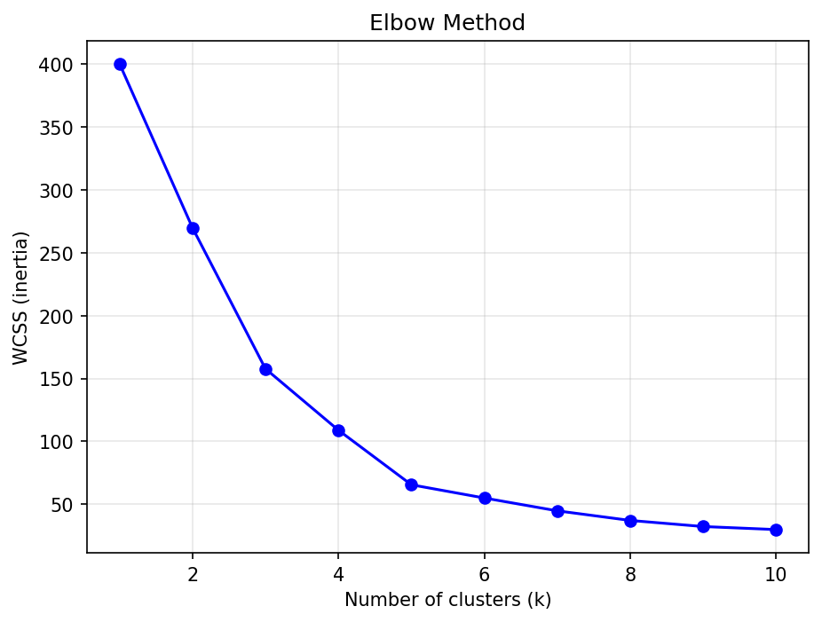
THE ELBOW METHOD
Step 2 — How Many Clusters? (1 of 3)
How it works
WCSS measures how spread out the points are inside their own cluster. Lower is tighter.
The catch
WCSS always falls as k rises. At k = 200 every customer is their own cluster and WCSS is zero — perfect, and completely useless.
So we look for the bend — the point where adding another cluster stops buying us much. Here the curve clearly flattens at k = 5.
Notes:
Explain the elbow honestly: it is a judgement call, not a formula. The curve always goes down, so the only thing we can look for is where it stops going down steeply. That subjectivity is exactly why we did not stop here and used two more methods.

Slide 9
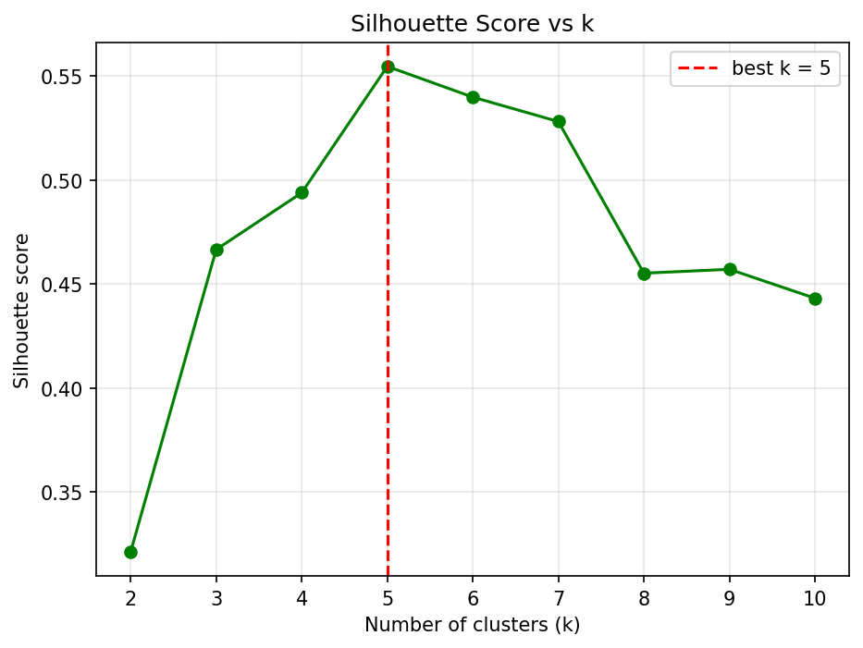
SILHOUETTE SCORE
Step 2 — How Many Clusters? (2 of 3)
How it works
For each customer it asks: am I closer to my own cluster, or to the nearest other one? It runs from −1 to 1, and unlike WCSS it does NOT automatically improve with more clusters — so it gives a real peak.
Highest score
0.5547
at k = 5
A clear peak, not a flat line — the data really does prefer five groups.
Notes:
The important contrast with the previous slide: WCSS can only ever go down, so it needs human interpretation. Silhouette can go up AND down, so its maximum is a genuine answer. Here it peaks at k=5 and then falls, which is much stronger evidence than the elbow alone. If someone asks what a good silhouette score is — above 0.5 is generally considered a reasonable, well-separated structure.

Slide 10
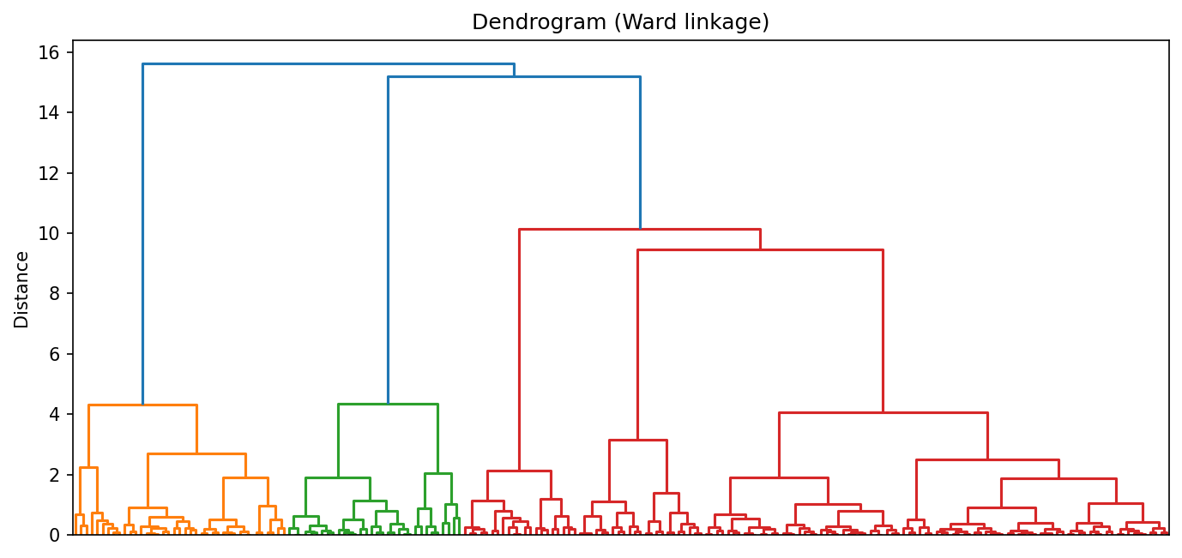
DENDROGRAM ANALYSIS
Step 2 — How Many Clusters? (3 of 3)
How to read it
Every customer starts at the bottom as their own cluster. Going up, the closest pairs merge. Height = how far apart the merged groups were.
A tall vertical line means two very different groups were forced together — so we cut below it.
All three methods independently agree on k = 5
Elbow (bend at 5) · Silhouette (peak at 5) · Dendrogram (longest gap cuts into 5) · And we saw 5 blobs by eye
Notes:
The dendrogram is the third and most visual method. The takeaway for the whole of Step 2 is the dark bar: four independent signals all point at five clusters. Any one of them alone could be argued with; all four agreeing is hard to dismiss. This is the moment we can commit to k=5 with confidence.

Slide 11
HOW IT WORKS
Step 3 — Algorithm 1: K-Means
1
Place k centroids
Why it fits this data
Drop 5 starting points into the data at random.
K-Means can only find round, similarly-sized clusters. Our EDA showed exactly that shape, so it is a good match here rather than a default choice.
2
Assign each customer
Every customer joins whichever centroid is nearest.
Move the centroids
One thing to watch
3
Step 1 is random, so different starting points can give slightly different answers. We set random_state = 42 and n_init = 10 so the result is repeatable.
Each centroid slides to the middle of the customers that joined it.
4
Repeat until settled
Keep going until nobody changes group. That is the final answer.
Notes:
Walk through the four steps slowly — this is the algorithm the professor most likely wants to hear explained. The randomness point is important: because the starting centroids are random, K-Means can land on different answers. n_init=10 means sklearn runs it ten times and keeps the best, and random_state=42 means we get the same result every run, which is what makes the project reproducible.

Slide 12
HOW IT WORKS
Step 3 — Algorithm 2: Hierarchical
1
Everyone alone
Why we chose this one
Start with 200 clusters — one per customer.
It works on a completely different principle from K-Means — merging from the bottom up instead of moving centroids around.
2
Merge the closest two
Find the two nearest clusters and join them into one.
That difference is the point: if two unrelated methods land on the same groups, the groups are probably real and not an artefact of one algorithm.
3
Repeat
Keep merging. 200 becomes 199, then 198, and so on.
4
Stop at k
It also produced the dendrogram we used on the previous slide.
Stop when 5 clusters remain. No randomness anywhere.
Notes:
The reason for picking hierarchical as the second algorithm is that it is genuinely different — bottom-up merging, no centroids, no randomness. If we had picked a near-identical algorithm, agreement between them would prove nothing. Also note 'Ward linkage' means we merge whichever pair increases the total spread the least.

Slide 13
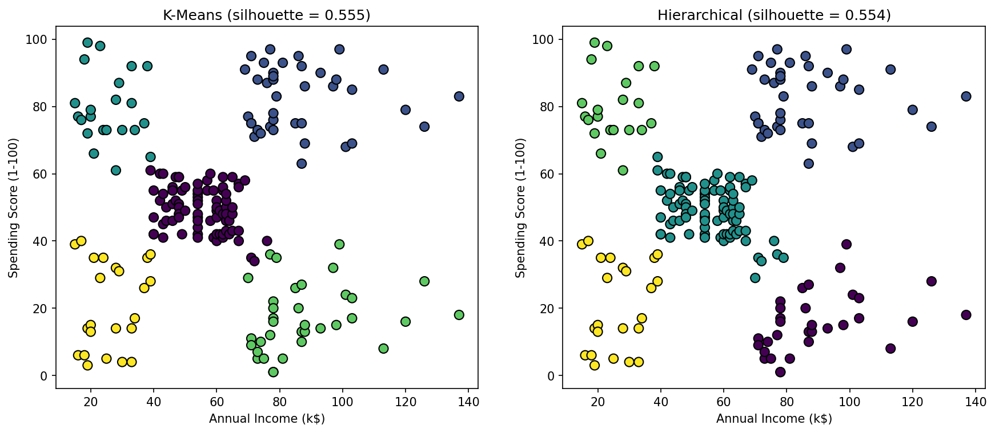
DO THEY AGREE?
Step 3 — Comparing the Two Algorithms
K-Means
Hierarchical
Nearly identical results
0.5547 silhouette
0.5538 silhouette
Cluster sizes 22/23/35/39/81 vs 21/23/32/39/85 — about 8 borderline customers placed differently.
Notes:
Point out that the two plots look almost the same. One technical detail worth mentioning if asked: we compared cluster SIZES, not cluster numbers. The numbers are arbitrary labels — what K-Means calls cluster 0, hierarchical might call cluster 3 — so comparing the numbers directly would be meaningless. About eight customers on the boundaries were placed differently, which is exactly what you would expect for points sitting between two groups.

Slide 14
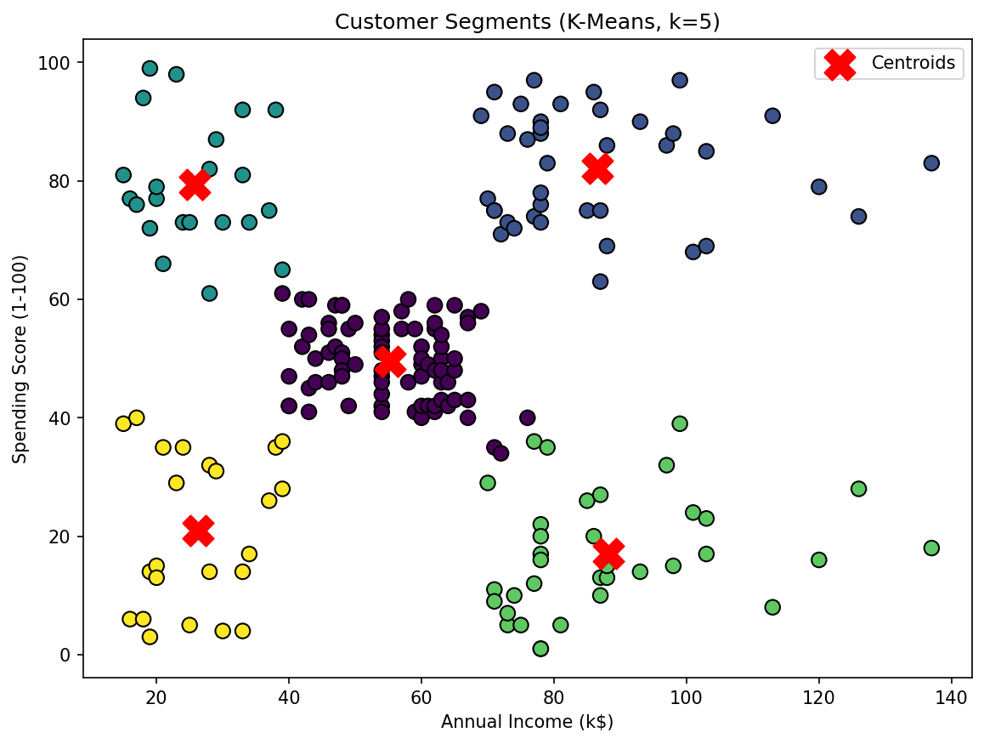
RESULTS
Step 4 — The Five Customer Segments
Who they are
Segment | N | Income | Spend
VIP / Target | 39 | $86k | 82
Untapped High Earners | 35 | $88k | 17
Young Big Spenders | 22 | $26k | 79
Budget Customers | 23 | $26k | 21
Average Customers | 81 | $55k | 50
Income = average annual income (k$). Spend = average spending score out of 100.
The four corners are the extremes; the middle group is the largest at 81 customers (40%).
Notes:
This is the payoff slide. Note how the five clusters map onto a simple grid: high/low income crossed with high/low spending, plus a large average group in the middle. The segment names were generated in code by comparing each cluster's averages to the dataset median, not typed in by hand — so if the data changed, the names would update too.

Slide 15
TURNING CLUSTERS INTO ACTION
Business Recommendations
VIP / Target Customers
Protect them. Premium loyalty tier, early access to new products, personal service. Highest return on retention spend.
39 customers · 20%
Untapped High Earners
Biggest growth opportunity — they can afford to buy but don't. Survey them, and use quality and prestige messaging rather than discounts.
35 customers · 18%
Young Big Spenders
Spend heavily on a small income. Flash sales, payment plans, student deals and social media campaigns.
22 customers · 11%
Average Customers
The largest group. Loyalty points and seasonal promotions to keep them, plus upsell tests to move some into VIP.
81 customers · 40%
Budget Customers
Low income, low spending. Cheap outreach only — email coupons and clearance. Don't spend premium ad budget here.
23 customers · 12%
The single most valuable finding: 35 customers earn the most in the dataset but spend almost nothing. That is where the growth is.
Notes:
This is the slide that answers 'so what?'. Clustering is only useful if it changes a decision. Highlight the Untapped High Earners — they have the highest average income in the entire dataset at $88k but a spending score of only 17. If the mall can work out why, that is the biggest revenue opportunity available. Also note the VIP group: 20% of customers who should get the majority of the retention budget.

Slide 16
BEING HONEST ABOUT THE METHODS
Evaluation — Strengths & Limitations
K-Means
Hierarchical
Strengths
Strengths
Fast and simple to run.
Gives centroids, so each segment has a clear description.
Scored highest here (0.5547).
No need to pick k — the dendrogram shows all options.
Completely deterministic: same answer every run.
The dendrogram is itself a useful diagnostic.
Limitations
Limitations
You must choose k yourself before running it.
Outliers drag the centroids around.
Only finds round clusters — it would fail on crescent shapes.
Random start means results can vary without a fixed seed.
Much slower — it does not scale to large customer bases.
A merge can never be undone, even if it was a mistake.
Results shift depending on which linkage rule you pick.
We report the K-Means result because its centroids make the segments easier to describe to a marketing team — not because it is the better algorithm in general.
Notes:
Be genuinely balanced here. The two silhouette scores are 0.5547 and 0.5538 — that gap is tiny and not a real quality difference. We chose K-Means for a practical reason: centroids give us a concrete 'average customer' for each segment, which is what makes the business slide possible. Hierarchical would have been the better choice if we had not known k in advance.

Slide 17
WHAT I LEARNED
Five Takeaways
1
Scaling is not optional
Clustering is built on distance, so a feature with bigger numbers wins by default. Standardizing changed which customers grouped together.
2
More features can hurt
Adding Age and Gender lowered the silhouette score. A feature with no pattern in it only adds noise to the distance calculation.
3
One metric is never enough
The elbow is a judgement call, so we backed it with silhouette and a dendrogram. Four signals agreeing on k = 5 is far stronger than one.
4
Cross-check with a second method
Two algorithms working on completely different principles found the same groups — that is what makes the result believable.
5
Cluster numbers are meaningless
Cluster 0 in one algorithm is not cluster 0 in another. I compared cluster sizes instead, after a direct comparison gave a nonsense answer.
Notes:
This is the reflection slide. Point five is worth telling as a story: I originally compared the two algorithms by checking how many customers got the same cluster number, and got 31% agreement, which looked terrible. The partitions were actually about 94% identical — the cluster numbers are just arbitrary labels. Catching that taught me to think about what a metric is actually measuring rather than trusting a number because it ran without an error.

Slide 18
CONCLUSION
Five segments, found three ways,
confirmed by two algorithms
5
0.5547
2
200
customer segments
silhouette score
algorithms agreed
customers labelled
The mall can now stop marketing to an average customer who doesn't exist, and start marketing to five groups that do — beginning with the 35 high earners who spend almost nothing.
Deliverables: customer_segmentation.py · customers_with_clusters.csv · 6 figures
Notes:
Close on the business point rather than the technical one. The phrase to land: the mall was marketing to an average customer who does not actually exist — 40% of customers are near the average, but the other 60% are at the extremes and need completely different treatment. Then invite questions.

