Slide 1

PROJECT OVERVIEW WINTER 2020 ECE 571
Design and Verification of AXI4-Lite protocol
Team 8:
Disha Shetty Likitha Atluru
Preetha Selvaraju
Rutuja Patil

Slide 2
Abstract
AMBA AXI4-Lite protocol is designed from scratch and implemented using SystemVerilog HDL.
Then the simulation is carried out for the functionality check using QuestaSim EDA tool.
A good verification strategy is executed using SystemVerilog verification constructs such as interfaces, assertions etc.
Here, the bus is verified for five different channels and finally system level testing is performed.

Slide 3
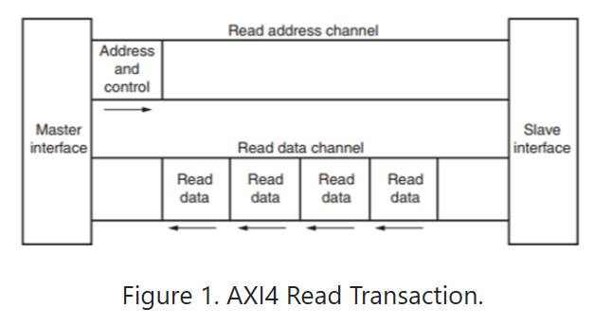
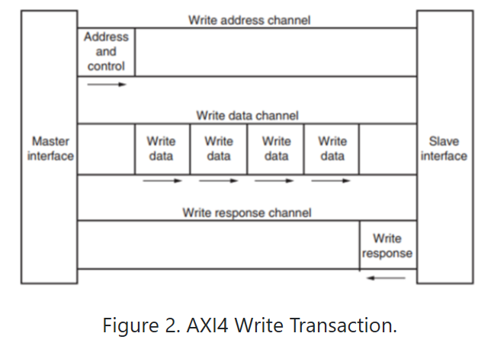
DESIGN APPROACH
Package, Interface, Master and Slave modules are designed.
Notes:
Read Transaction Phase:
Master puts address on read address channel and asserts ARVALID to indicate that address is valid and asserts RREADY to indicate that master is ready to accept data from slave.
When slave indicates that it is ready to accept address, handshake process takes place and slave will place data on read data channel and asserts RVALID to indicate data is valid.
Since both RREADY and RVALID are asserted, the transaction will be completed in next cycle and both the signals will be de-asserted.

Slide 4
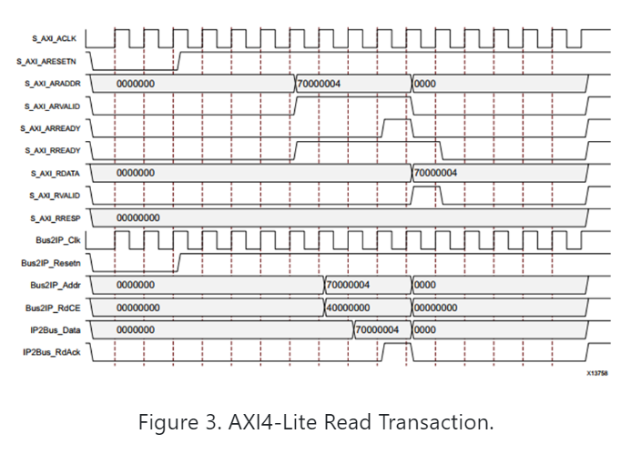

Slide 5
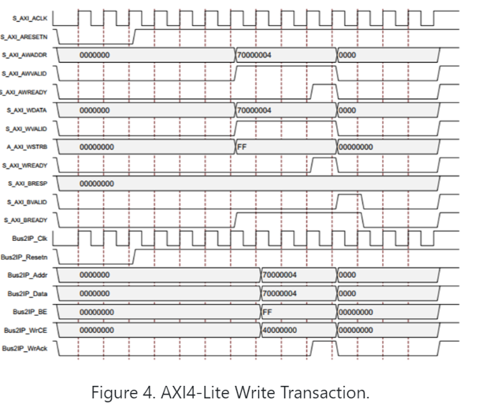

Slide 6
Verification Approach
Advanced Microcontroller Bus Architecture (AMBA) is analyzed and focused on the modules that are compatible with the AXI4-Lite protocol, which provides a simpler register style interface to the systems.
A set of signals in each channel are used to define a set of unit tests. Protocol functionality specifies the timing relationship between signals.
Mentor Graphics Questa Simulator is used for SystemVerilog simulation and there by expanding Verification capabilities to Assertion based verification.
Along with the unit tests, a set of assertions for each channel will be defined in a separate file and bound to the design.
Each independent channel will have its own separate testbench. For all these channels, there will be assertions that run along each testbench.
Also, a Makefile will be used for compiling and running each testbench.
Finally, this assertion-based verification environment will be used to verify our design implemented from scratch, in order to prove its effectiveness and implementation to find bugs.

Slide 7
Verification plan
Unit level and system level design verification will be implemented.
After reviewing and designing the AXI4-lite protocol functionality, we proceeded to consider each signal in different channels and implement different possibilities to define the following basic unit tests.
Unit Tests:
For unit level testing, we will be writing directed test cases to check the functionality of each channel.
Assertions will be used as checkers for unit level testing.

Slide 8
Read ADDRESS channel assertions
Assertions:
Assertion name | Description
ARADDR_STABLE_a | When ARVALID is asserted, address ARADDR remains stable until ARVALID and ARREADY become low
ARADDR_X_a | A value of ‘X’ on ARADDR is not permitted when ARVALID is high
ARVALID_RESET_a | When ARESETN goes low ARVALID should be low
ARREADY_RESET_a | When ARESETN goes low ARREADY should be low
ARVALID_STABLE_a | When ARVALID is asserted, then it must remain asserted until ARREADY is high
ARREADY_STABLE_a | ARREADY is asserted, then it remains asserted until ARVALID is high
ARVALID_X_a | A value of ‘X’ on ARVALID is not permitted when RESET is high(not in reset)
ARREADY_X_a | A value of ‘X’ on ARREADY is not permitted when ARESETN is high(not in reset)
READADDRESS_a | Check whether ARADDR has been received successfully by the slave

Slide 9
Read Data channel assertions
Assertions:
Assertion name | Description
READ_DATA_a | Check whether data RDATA has been read successfully by the master
RDATA_X_a | A value of X on RDATA valid byte lanes is not permitted when RVALID is HIGH
RVALID_RESET_a | when ARESETN goes low RVALID should be low
RREADY_RESET_a | When ARESETN goes low RREADY should be low
RVALID_STABLE_a | When RVALID is asserted, then it must remain asserted until RREADY is HIGH
RREADY_STABLE_a | When RREADY is asserted, then it must remain asserted until RVALID is HIGH
RVALID_X_a | A value of X on RVALID is not permitted when ARESETN is high(not in reset)
RREADY_X_a | A value of X on RREADY is not permitted when ARESETN is high(not in reset)
RDATA_STABLE_a | when RVALID is asserted, RDATA remains stable until RVALID and RREADY become low

Slide 10
WRITE ADDRESS channel assertions
Assertion name | Description
AWADDR_STABLE_X_a | when AWVALID is asserted, address AWADDR must remain stable until AWVALID and AWREADY become low
AWADDR_X_a | A value of ‘X’ on AWADDR is not permitted when AWVALID is HIGH
AWVALID_RESET_X_a | When ARESETn goes LOW AWVALID should be low
AWREADY_RESET | When ARESETn goes LOW AWREADY should be low
AWVALID_STABLE_X_a | When AWVALID is asserted, then it must remain asserted until AWREADY is HIGH
AWREADY_STABLE | When AWREADY is asserted, then it must remain asserted until AWVALID is HIGH
AWVALID_X_a | A value of ‘X’ on AWVALID is not permitted when ARESETN is high(not in reset).
AWREADY_X_a | A value of ‘X’ on AWREADY is not permitted when ARESETN is high(not in reset).
WRITEADDRESS_X_a | Check whether AWADDR has been received successfully by the slave

Slide 11
WRITE data channel assertions
Assertions:
Assertion name | Description
WDATA_STABLE_a | When WVALID is asserted, WDATA must remain stable until WVALID and WREADY become low.
WDATA_a | Check whether data WDATA has been read successfully by the slave.
WDATA_X_a | A value of X on WDATA valid byte lanes is not permitted when WVALID is HIGH.
WVALID_RESET_a | when ARESETn goes low WVALID should be low
WREADY_RESET_a | When ARESETn goes low WREADY should be low
WVALID_STABLE_a | When WVALID is asserted, then it must remain asserted until WREADY is HIGH.
WREADY_STABLE_a | When WREADY is asserted, then it must remain asserted until WVALID is HIGH.
WVALID_X_a | A value of X on WVALID is not permitted when ARESETN is high(not in reset).
WREADY_X_a | A value of X on WREADY is not permitted when ARESETN is high(not in reset).

Slide 12
WRITE response channel assertions
Assertion name | Description
BVALID_RESET_a | when ARESETn goes low, BVALID should be low.
BREADY_RESET_a | When ARESETn goes low BREADY should be low.
BVALID_X_a | A value of X on BVALID is not permitted when ARESETN is high(not in reset).
BREADY_X_a | A value of X on BREADY is not permitted when ARESETN is high(not in reset).
BVALID_STABLE_a | When BVALID is asserted, then it must remain asserted until BREADY is HIGH.
BREADY_STABLE_a | When BREADY is asserted, then it must remain asserted until BVALID is HIGH.

Slide 13
SYSTEM LEVEL TESTING
Verification strategy is that various combinations of write and read transactions are performed and then both the write and read data are verified if they match or not.
Assertions are added to check the proper transition of state from one to another in testbench.
Following are the things we checked in system level:
Default memory value check
Write to single location.
Read from single location.
Write and read at same time to different location.
Write and read at the same time to same location and check if read and write data matches.
Multiple write followed by multiple reads to consecutive locations and check if the write and read data matches
Multiple reads from the consecutive locations.

Slide 14
SYSTEM LEVEL TESTING
Multiple writes followed by multiple reads to random locations and check if the write and read data matches
Multiple writes followed by a single read to the same location and check if the last data written and read data matches
Single write followed by multiple reads to the same location and check if the read data matches the write data all the time
Reset in middle of write
reset in middle of read
Check for out of limit input write address
Check for out of limit input read address
Write and read to all locations and check if data matches

