Slide 1
Probabilistic Robotics:
Monte Carlo Localization
Sebastian Thrun & Alex Teichman
Slide credits: Wolfram Burgard, Dieter Fox, Cyrill Stachniss, Giorgio Grisetti, Maren Bennewitz, Christian Plagemann, Dirk Haehnel, Mike Montemerlo, Nick Roy, Kai Arras, Patrick Pfaff and others
_x0016__x001a__x001a__x001a__x001a_

Slide 2
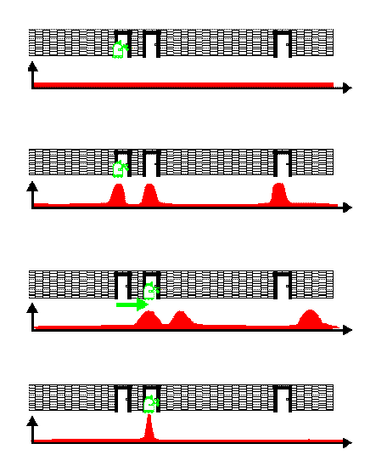
Bayes Filters in Localization

Slide 3
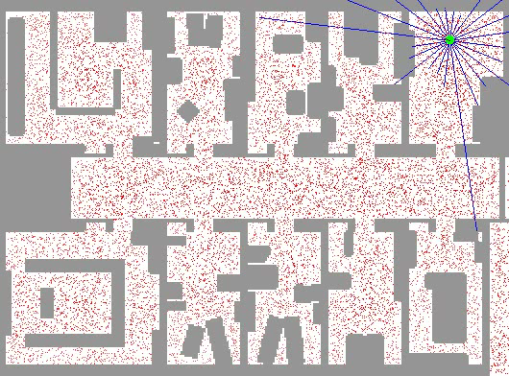
Sample-based Localization (sonar)

Slide 4
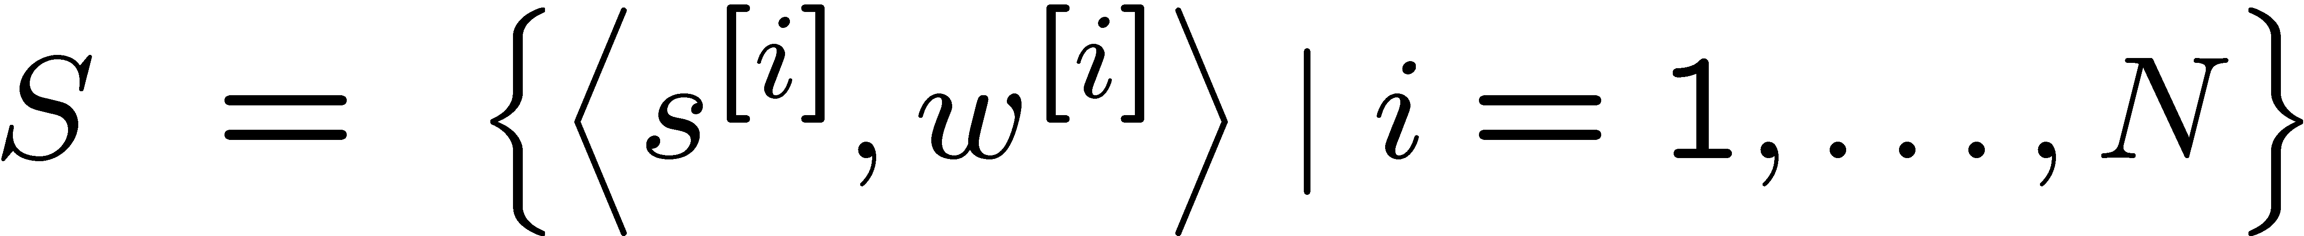
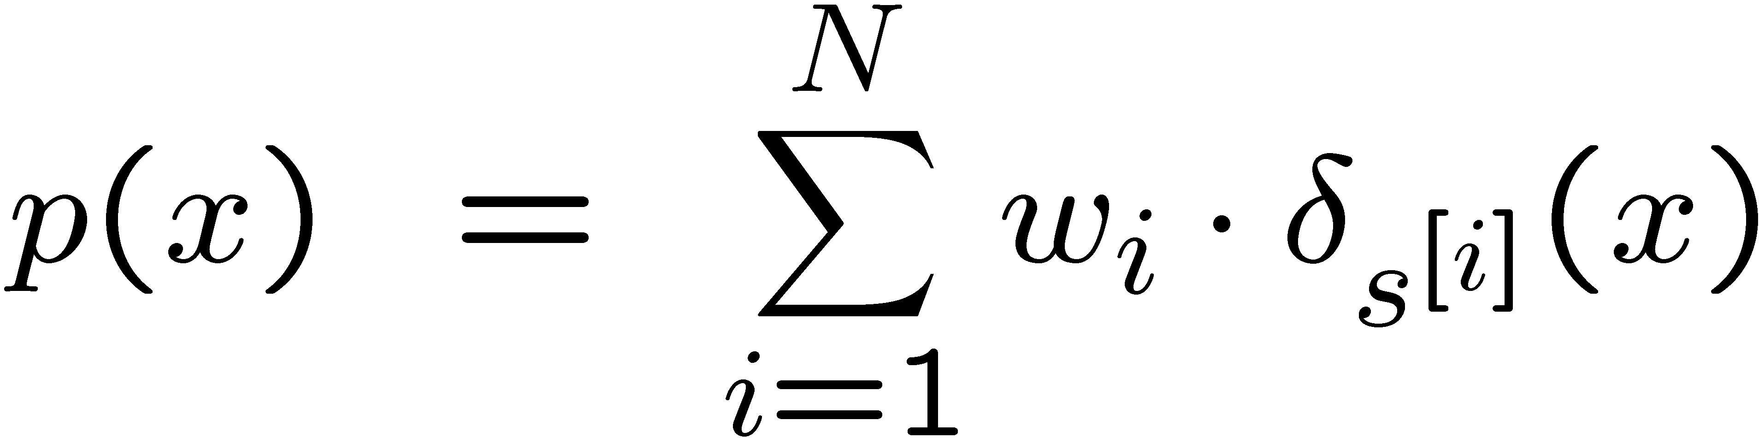
Mathematical Description
Set of weighted samples
State hypothesis
Importance weight
The samples represent the posterior

Slide 5
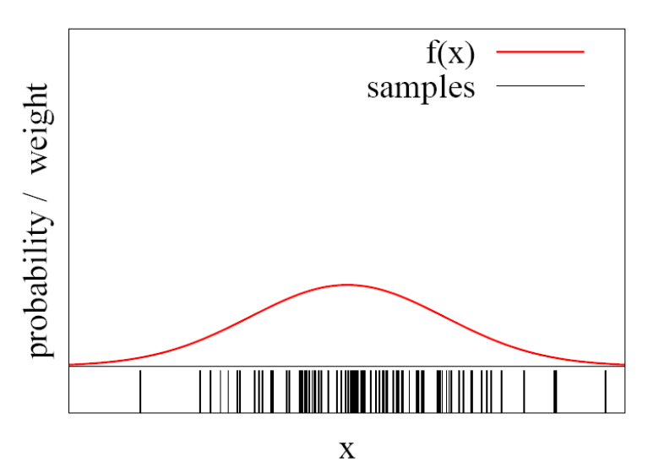
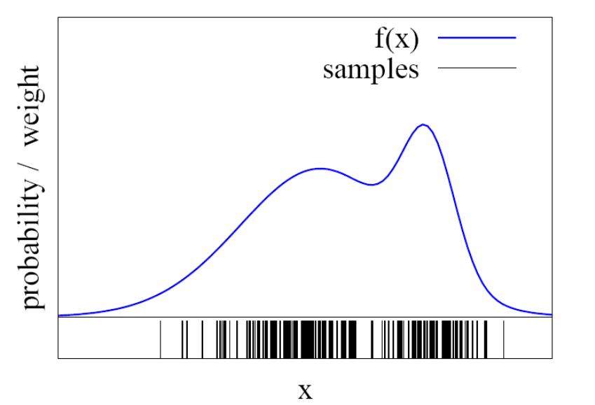
Function Approximation
Particle sets can be used to approximate functions
The more particles fall into an interval, the higher the probability of that interval
How to draw samples form a function/distribution?

Slide 6
Rejection Sampling
Let us assume that f(x)<1 for all x
Sample x from a uniform distribution
Sample c from [0,1]
if f(x) > c keep the sample
otherwise reject the sampe
f(x’)
c
c’
OK
f(x)
x
x’

Slide 7
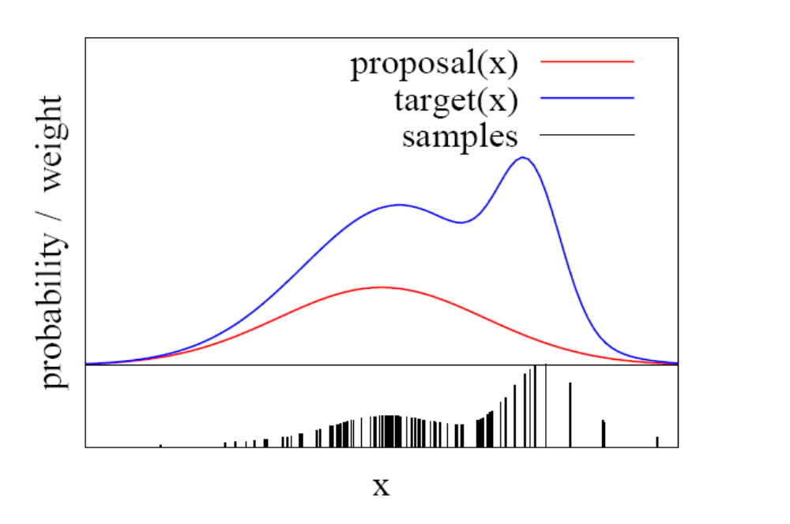
Importance Sampling Principle
We can even use a different distribution g to generate samples from f
By introducing an importance weight w, we can account for the “differences between g and f ”
w = f / g
f is often called
target
g is often called
proposal
Pre-condition:
f(x)>0 → g(x)>0

Slide 8
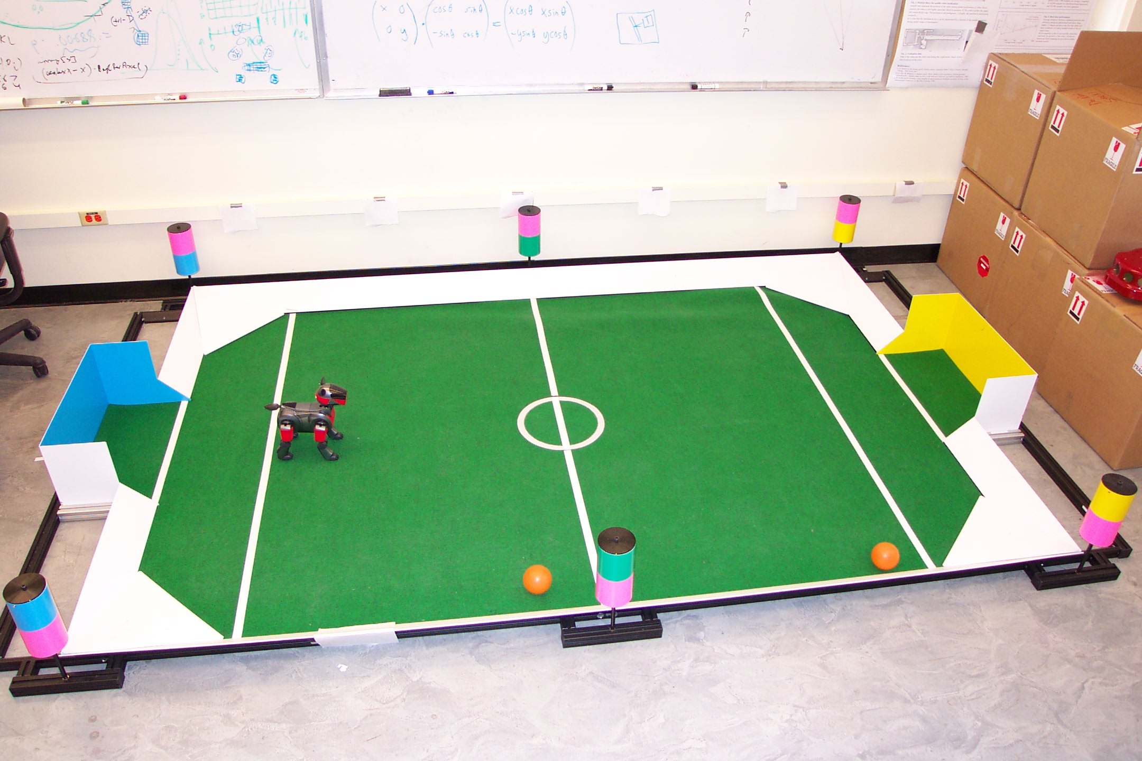
Importance Sampling with Resampling:
Landmark Detection Example

Slide 9
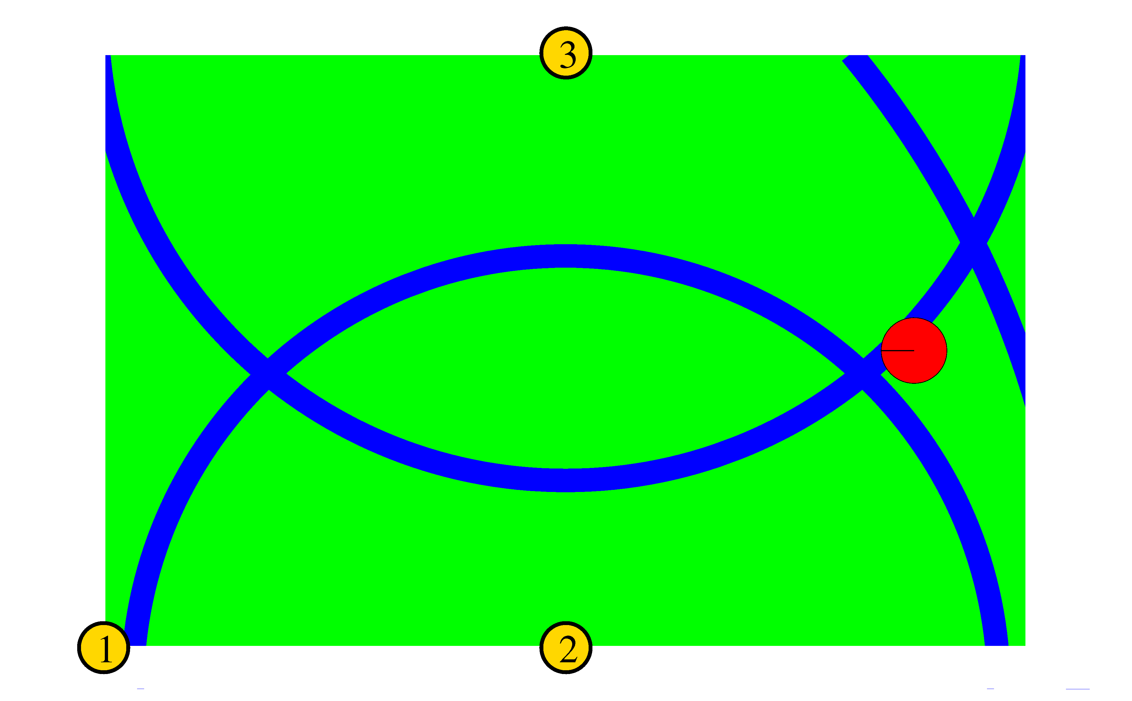

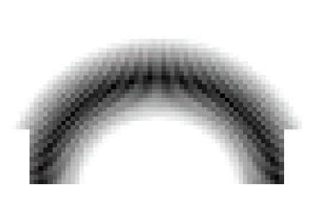
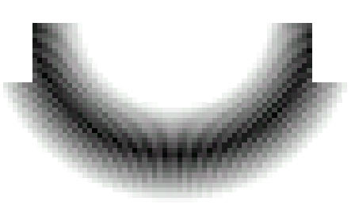
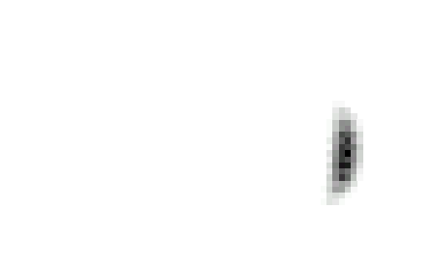
Distributions

Slide 10
Distributions
Wanted: samples distributed according to p(x| z₁, z₂, z₃)

Slide 11
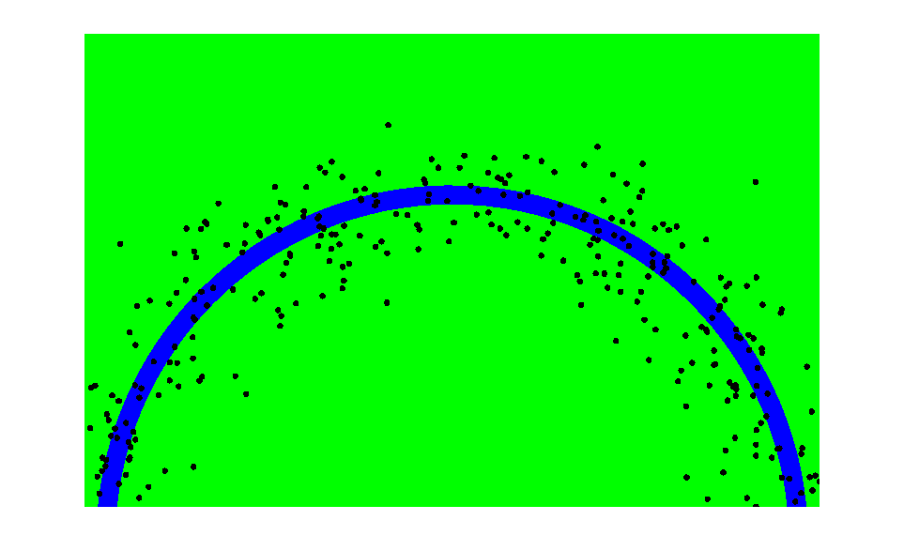
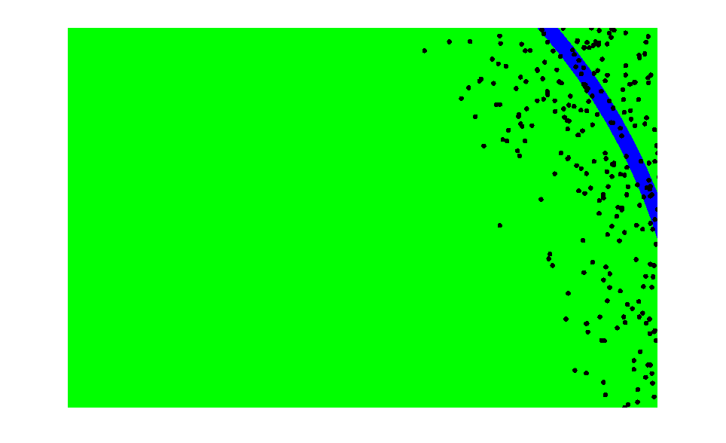
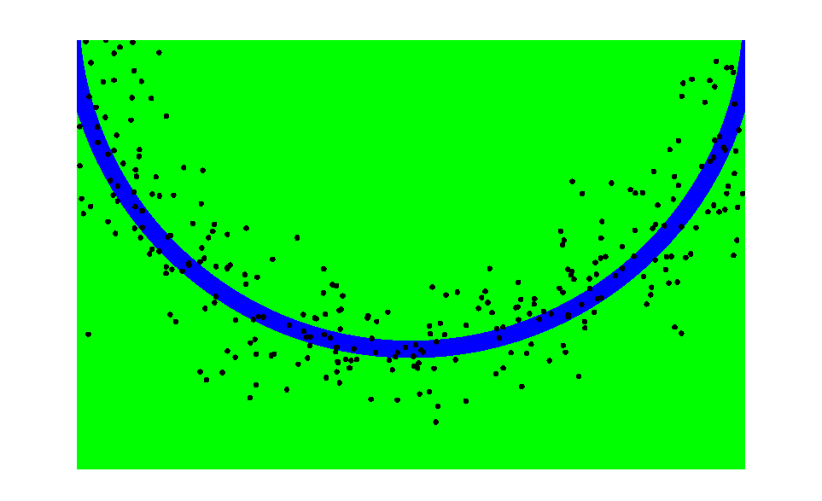
This is Easy!
We can draw samples from p(x|z_{l}) by adding noise to the detection parameters.

Slide 12
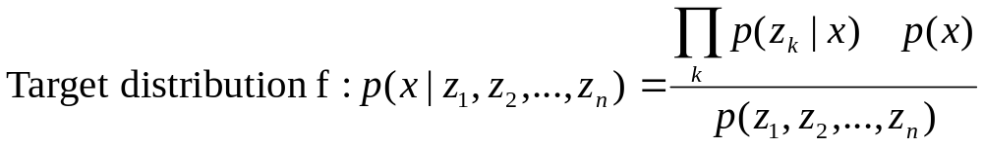
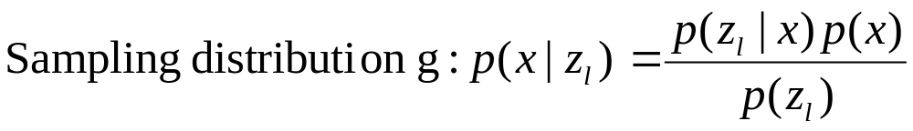
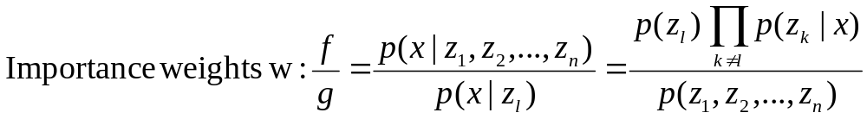
Importance Sampling

Slide 13
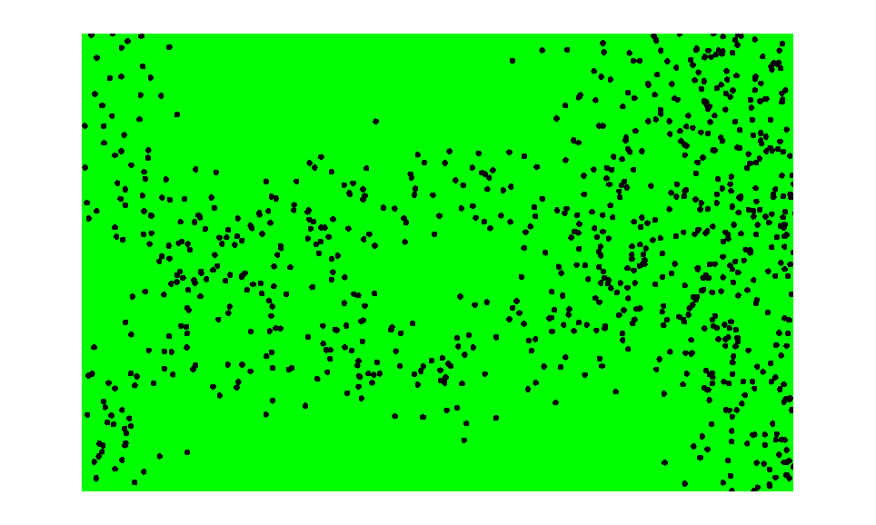
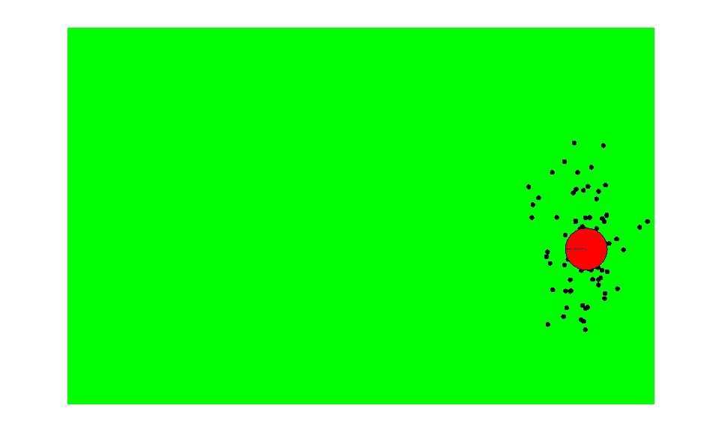
Importance Sampling with Resampling
Weighted samples
After resampling

Slide 14
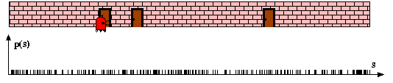
Particle Filters

Slide 15
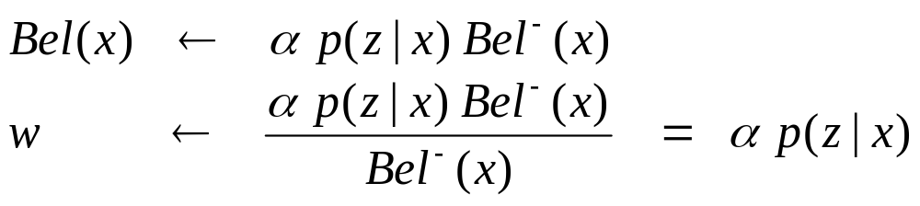
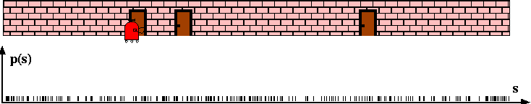
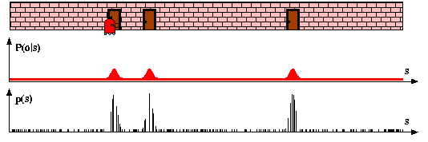
Sensor Information: Importance Sampling

Slide 16
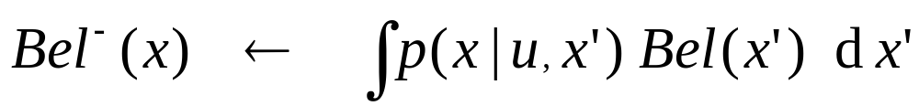
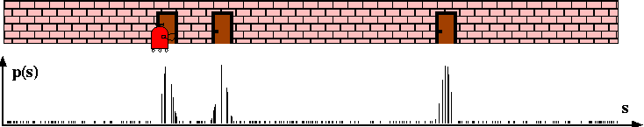
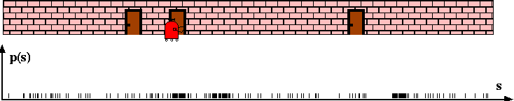
Robot Motion

Slide 17
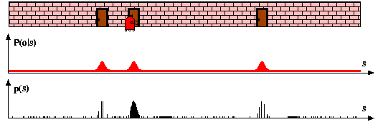
Sensor Information: Importance Sampling

Slide 18
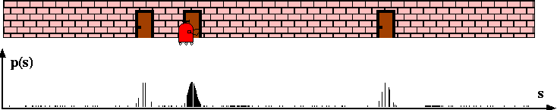
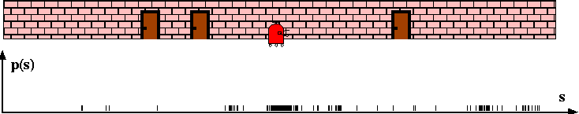
Robot Motion

Slide 19
Particle Filter Algorithm
Sample the next generation for particles using the proposal distribution
Compute the importance weights :
weight = target distribution / proposal distribution
Resampling: “Replace unlikely samples by more likely ones”
[Derivation of the MCL equations in book]

Slide 20










Particle Filter Algorithm
Algorithm particle_filter( S_{t-1}, u_{t-1} z_{t}):
For Generate new samples
Sample index j(i) from the discrete distribution given by w_{t-1}
Sample from using and
Compute importance weight
Update normalization factor
Insert
For
Normalize weights

Slide 21
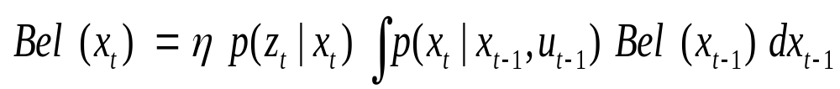
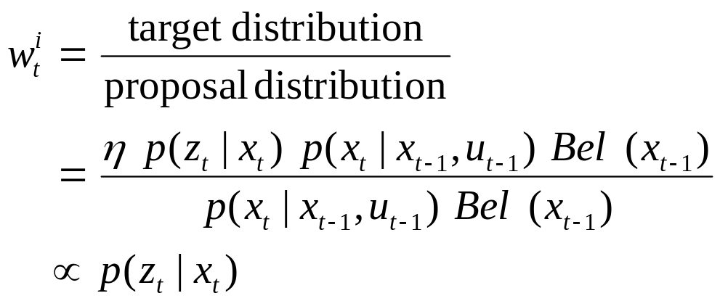
Particle Filter Algorithm
draw x^{i}_{t−1} from Bel(x_{t−1})
draw x^{i}_{t} from p(x_{t} | x^{i}_{t−1},u_{t−1})
Importance factor for x^{i}_{t}:

Slide 22
Resampling
Given: Set S of weighted samples.
Wanted : Random sample, where the probability of drawing x_{i} is given by w_{i}.
Typically done n times with replacement to generate new sample set S’.

Slide 23
Resampling
w_{n}
w₁
w_{n}
w₁
w₂
w₂
W_{n-1}
W_{n-1}
w₃
w₃
Stochastic universal sampling
Systematic resampling
Linear time complexity
Easy to implement, low variance
Roulette wheel
Binary search, n log n

Slide 24








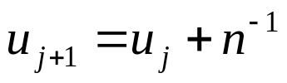
Resampling Algorithm
Algorithm systematic_resampling(S,n):
For Generate cdf
Initialize threshold
For Draw samples …
While ( ) Skip until next threshold reached
Insert
Increment threshold
Return S’
Also called stochastic universal sampling

Slide 25
Mobile Robot Localization
Each particle is a potential pose of the robot
Proposal distribution is the motion model of the robot (prediction step)
The observation model is used to compute the importance weight (correction step)
[For details, see PDF file on the lecture web page]

Slide 26
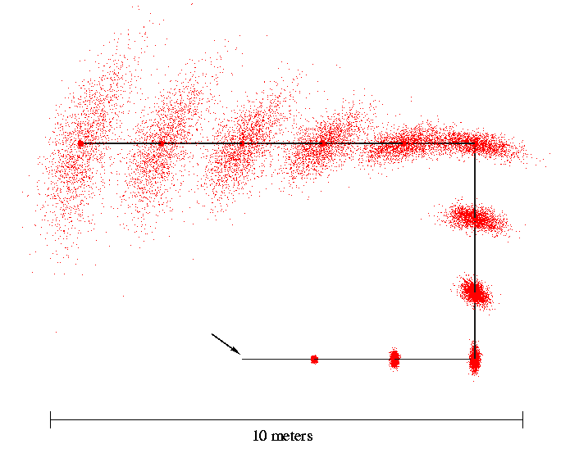
Motion Model
Start

Slide 27
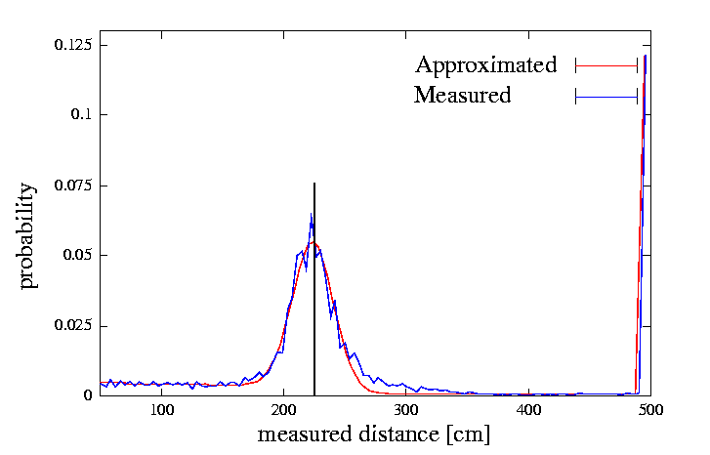
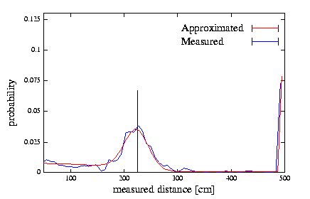
Proximity Sensor Model
Laser sensor
Sonar sensor

Slide 28
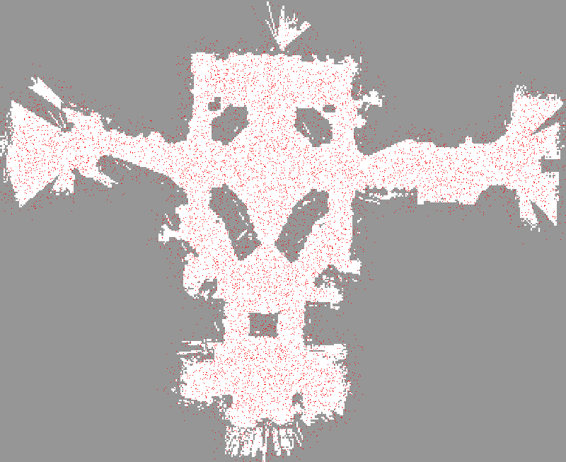

Slide 29
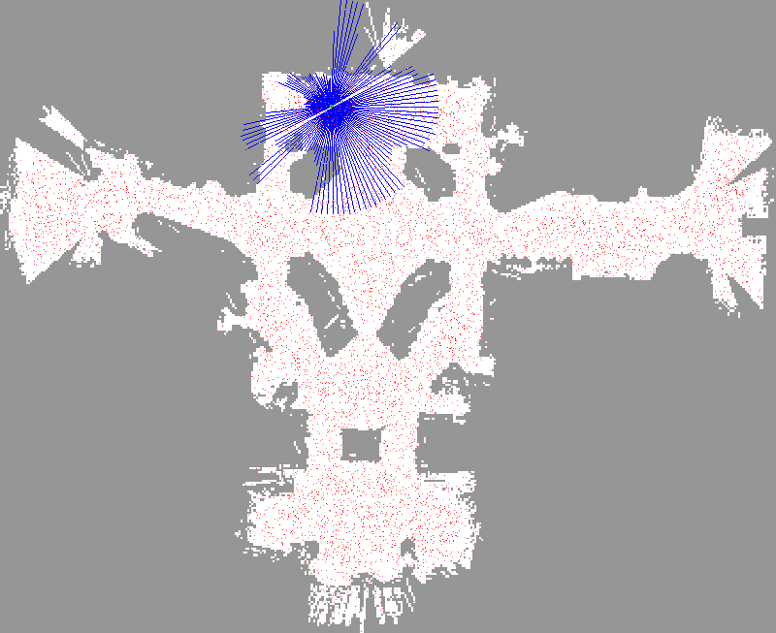

Slide 30
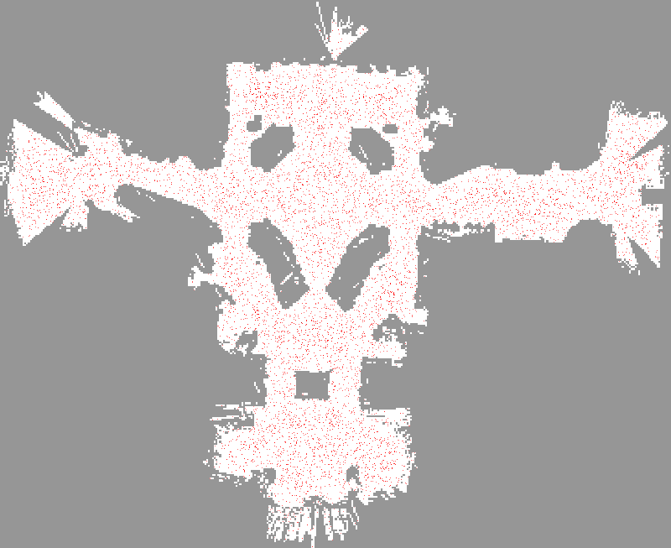

Slide 31
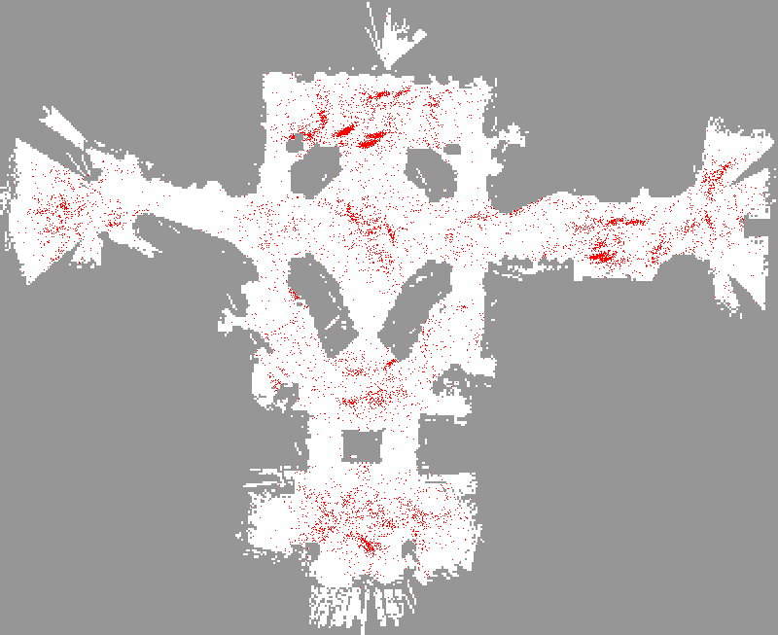

Slide 32
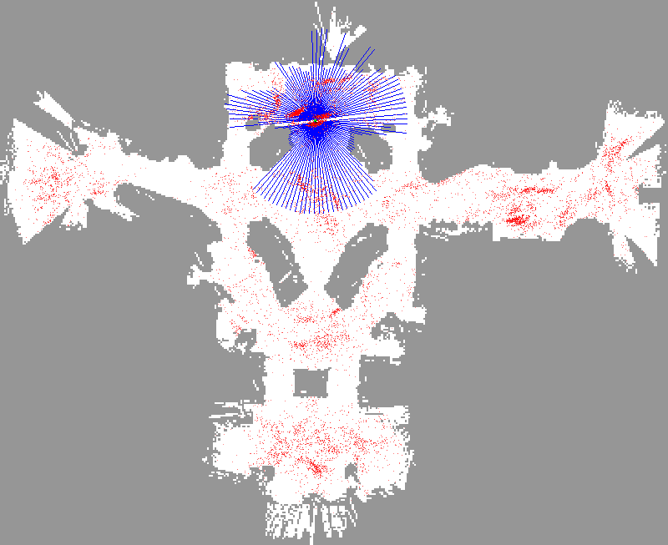

Slide 33
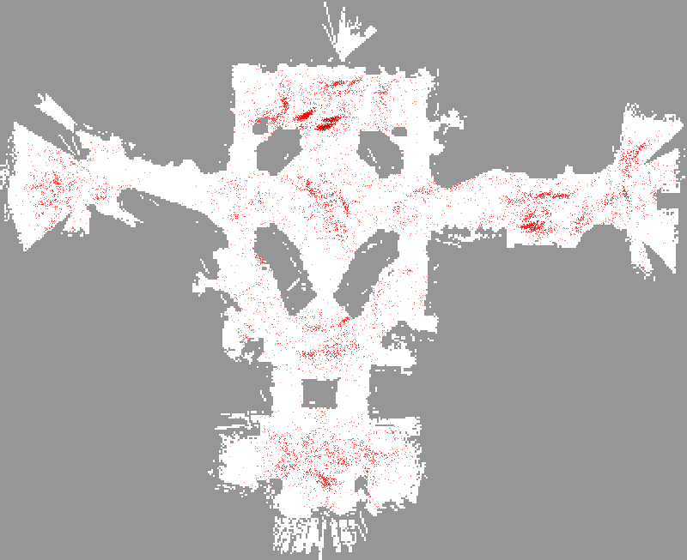

Slide 34
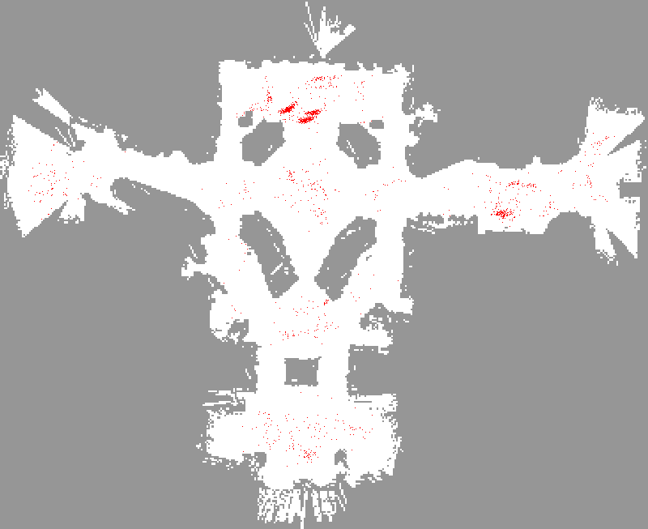

Slide 35
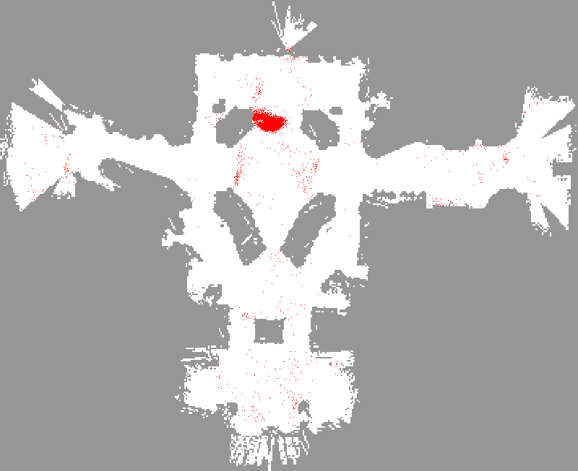

Slide 36
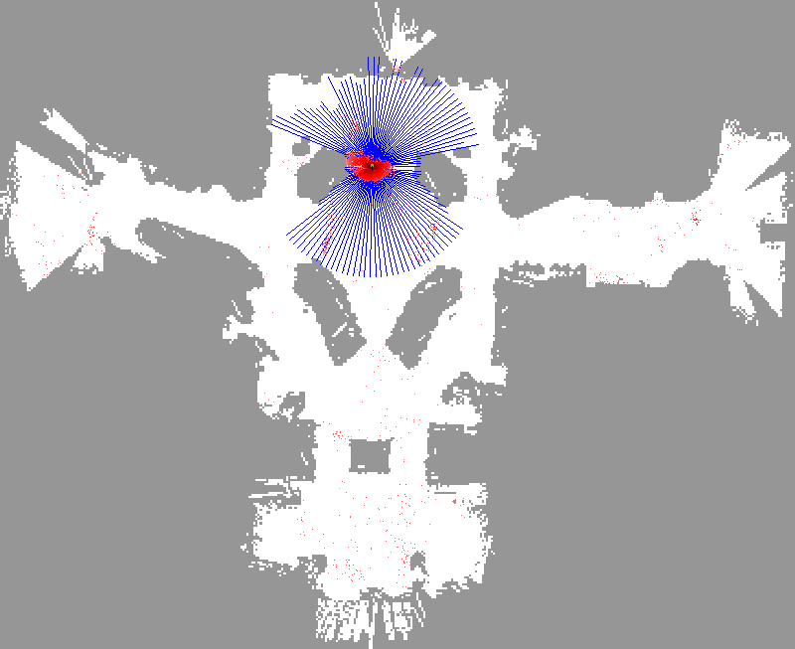

Slide 37


Slide 38
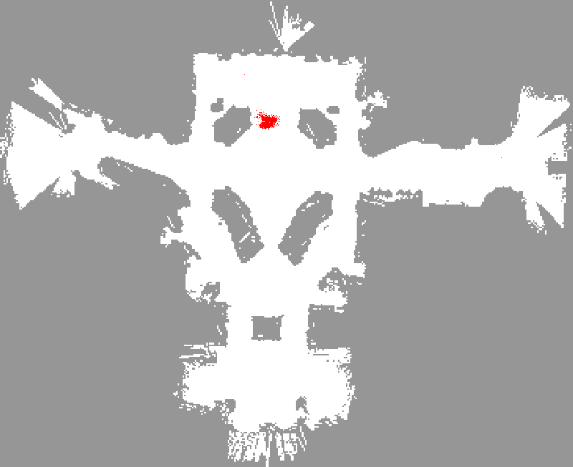

Slide 39
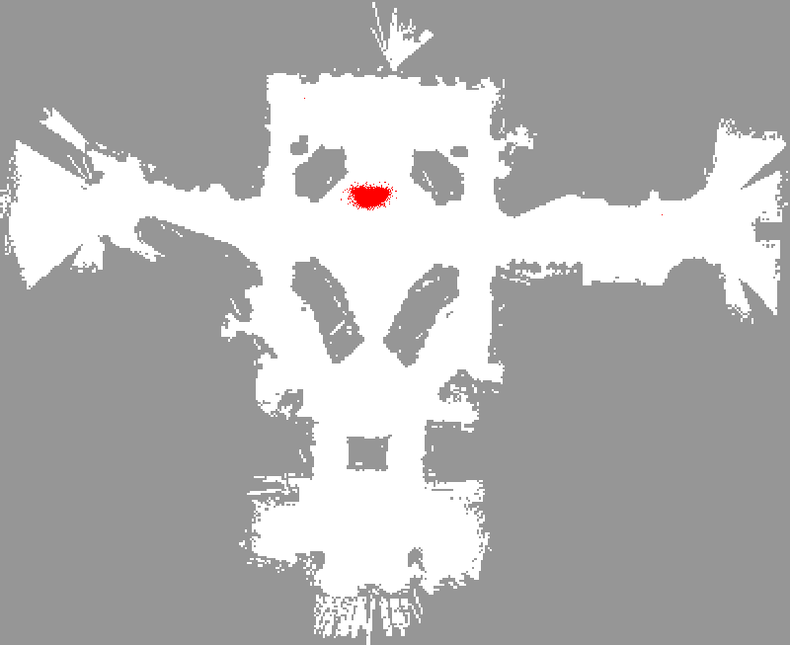

Slide 40
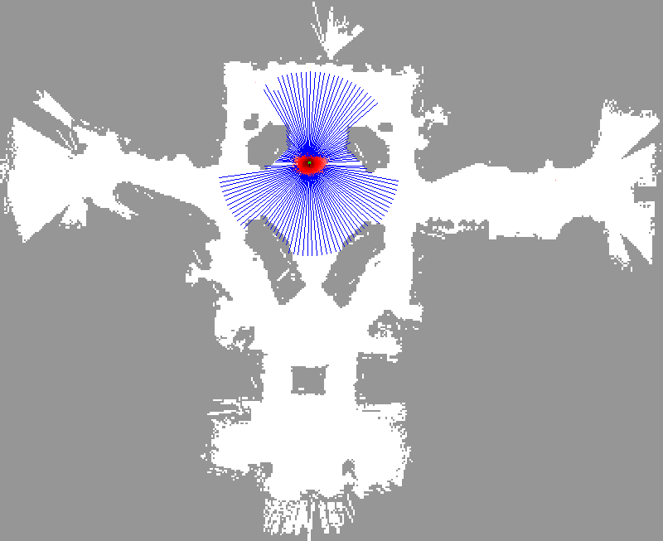

Slide 41
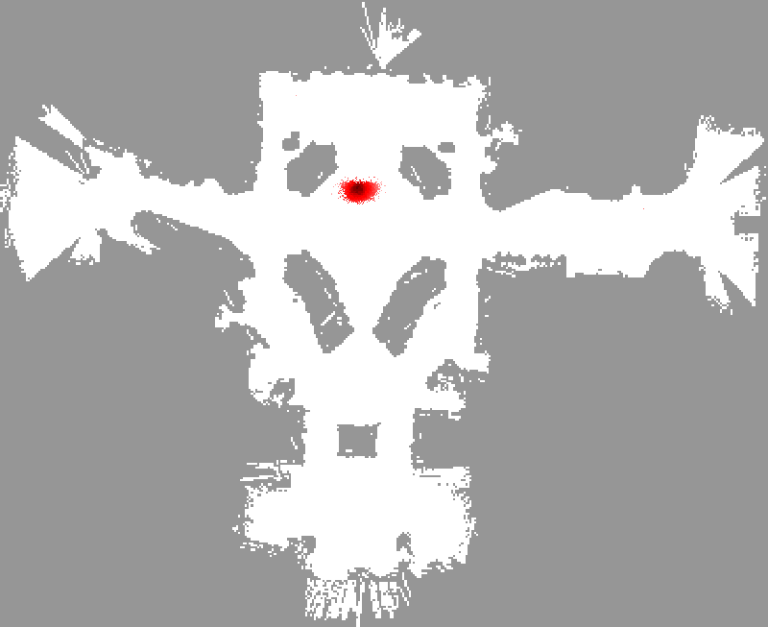

Slide 42
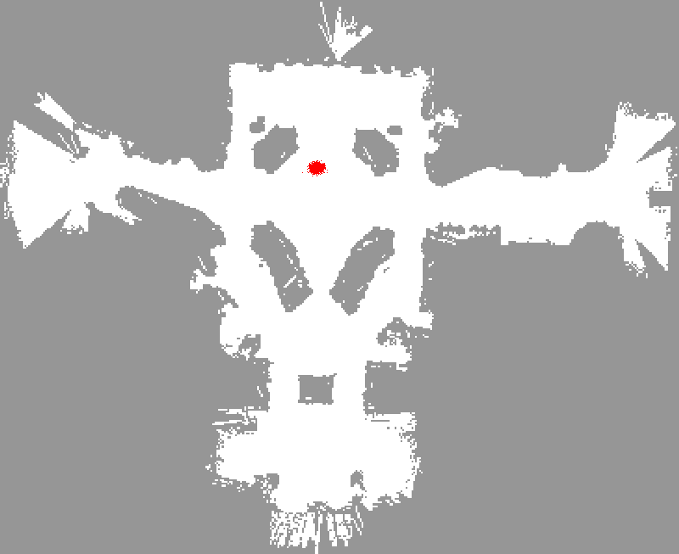

Slide 43


Slide 44


Slide 45


Slide 46
Sample-based Localization (sonar)

Slide 47

Initial Distribution

Slide 48

After Incorporating Ten Ultrasound Scans

Slide 49

After Incorporating 65 Ultrasound Scans

Slide 50

Estimated Path

Slide 51

Localization for AIBO robots

Slide 52


Using Ceiling Maps for Localization
[Dellaert et al. 99]

Slide 53

Vision-based Localization
P(z|x)
z
h(x)

Slide 54


Under a Light
Measurement z:
P(z|x):

Slide 55


Next to a Light
Measurement z:
P(z|x):

Slide 56


Elsewhere
Measurement z:
P(z|x):

Slide 57

Global Localization Using Vision

Slide 58
Limitations
The approach described so far is able to
  track the pose of a mobile robot and to
  globally localize the robot.
How can we deal with localization errors (i.e., the kidnapped robot problem)?

Slide 59
Kidnapping: Approaches
Randomly insert samples (the robot can be teleported at any point in time).
Insert random samples proportional to the average likelihood of the particles (the robot has been teleported with higher probability when the likelihood of its observations drops).

Slide 60
Summary – Particle Filters
Particle filters are an implementation of recursive Bayesian filtering
They represent the posterior by a set of weighted samples
They can model non-Gaussian distributions
Proposal to draw new samples
Weight to account for the differences between the proposal and the target
Monte Carlo filter, Survival of the fittest, Condensation, Bootstrap filter

Slide 61
Summary – Monte Carlo Localization
In the context of localization, the particles are propagated according to the motion model.
They are then weighted according to the likelihood of the observations.
In a re-sampling step, new particles are drawn with a probability proportional to the likelihood of the observation.

