Slide 1
This ppt shows me comparing a cluster-based permutation testing MatLab function that I wrote to BESA stats.
I noticed that my p-values for clusters were close to those of BESA, until the p-values start to get larger (e.g., >.4). Also, the p-values hit a “ceiling” at about 0.5. I realized that this has to do with the way we are calculating the p-value, see the later slide with an explanation.
On each slide, I show the p-value results from the p-value calculation method that Alex chose to use for the timeseries permutation toolbox compared to mine.
All of this data is the alpha encoding NIIs correlated with age.

Slide 2
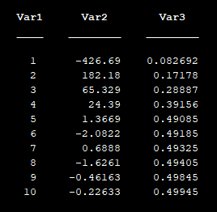
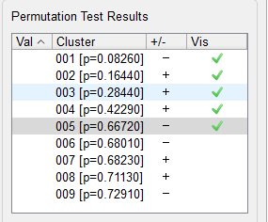
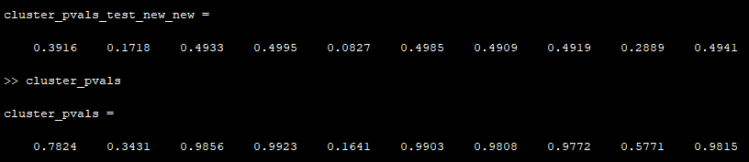
n4400-n4000 → 10,000 permutations

Slide 3
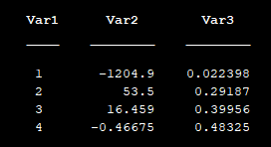
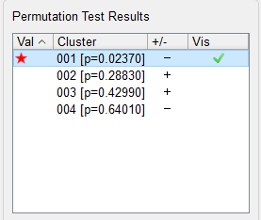
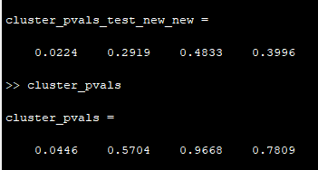
n4000-n3600 → 10,000 permutations

Slide 4
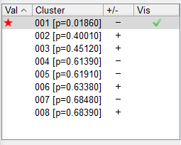
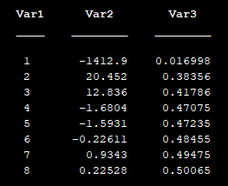
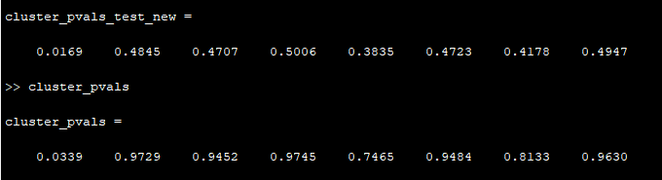
n3600-n3200 → 10,000 permutations

Slide 5
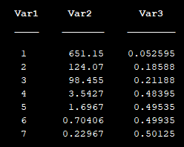
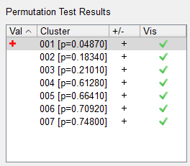
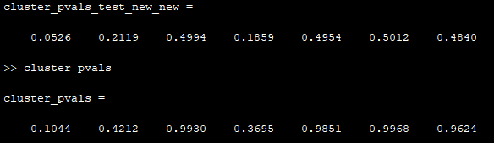
Theta n4200-n3800 → 10,000 permutations

Slide 6
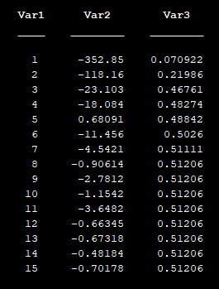
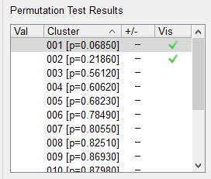
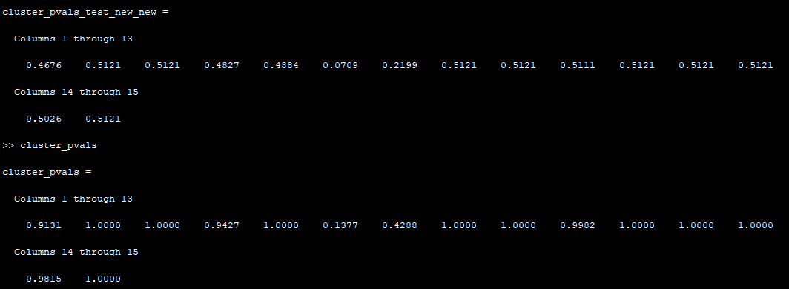
PESCAH OneDot 200-800ms 15Hz → 10,000 permutations
15 total clusters

Slide 7
Why there is the .5 ceiling
The way the p-value is calculated is by taking the number of values more extreme (i.e., further from 0) than the cluster of interest and dividing this number by the total number of values in the null distribution. This means that values near 0 will have about 50% of all other values on either side, resulting in a p-value of .5.

Slide 8
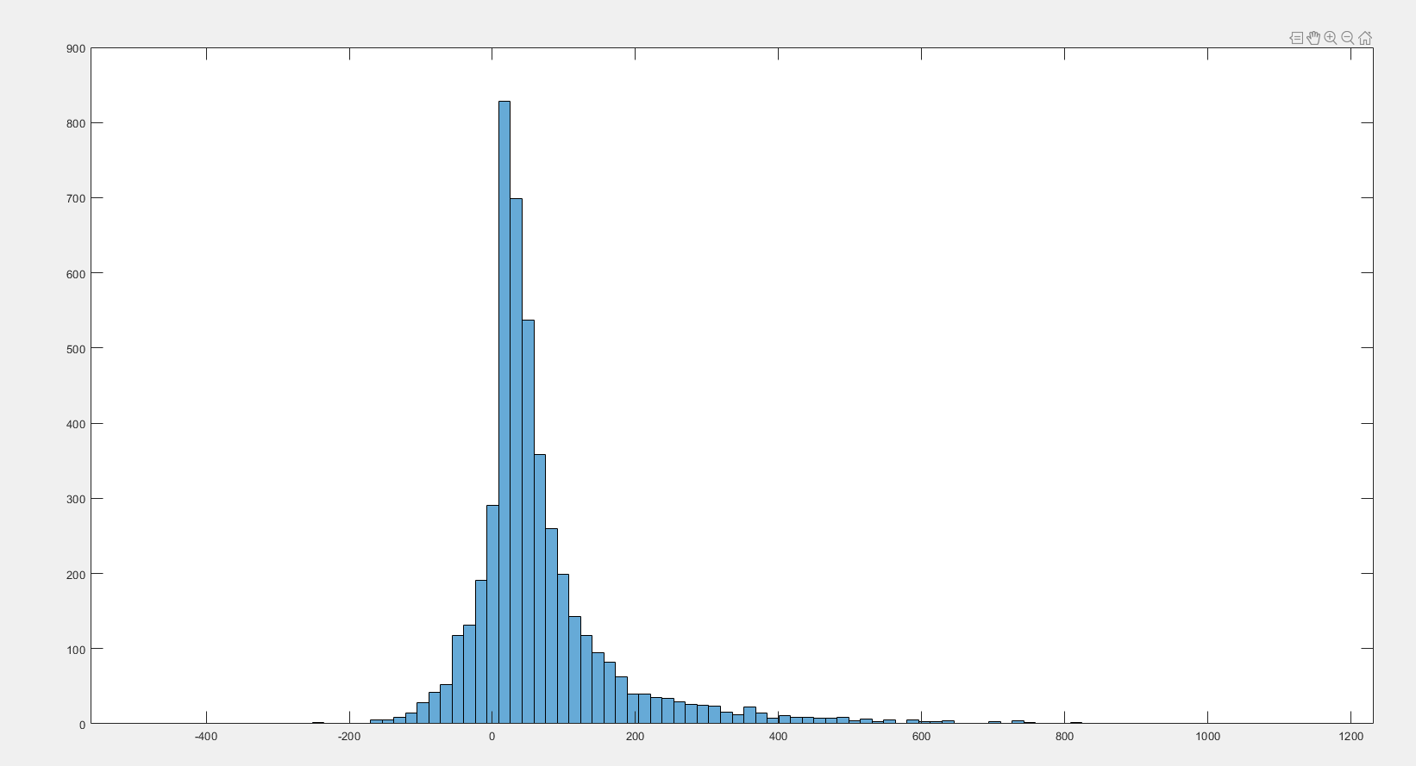
When I use the suprathreshold script, the distribution is off centered…

