Slide 1
ConfigNVPSim
GEM5 Based Configurable NVP Simulator
Gulsum Gudukbay Computer Science and Engineering Pennsylvania State University gxg5138@psu.edu | Sethu Jose Computer Science and Engineering Pennsylvania State University sxj487@psu.edu | Vineetha Govindaraj Computer Science and Engineering Pennsylvania State University vzg99@psu.edu

Slide 2
CONTENT
Motivation and Background
System Configuration
- Energy Harvester
- State Machine
- Atomic CPU
Experimentation
Results
Conclusion

Slide 3
Motivation
Energy harvesting applications
Using intermittent energy sources like solar or thermal energy to run the system.
Wide range of use cases
The system powered by clean renewable energy is very power efficient and could help run devices ranging from a smart watch to an IOT device.
Potential research area
Implementing an end to end system run by such a power source would mean developing software and hardware support which would run any application seamlessly.

Slide 4
BACKGROUND – NVP Architecture
The capability to maintain data and system states in the absence of input power is essential for an energy harvesting device
Non-Volatile Processors(NVPs) are designed to preserve the system state during power deficiencies.
NVPs hide data backup and restoration from the executing software to provide an execution mode that will eventually complete the current task i.e. forward progress.
The architectural design of NVP would involve accurate backup when the input energy goes beneath the threshold and a quick restore when the power comes back again.
Lots of ongoing efforts on reducing backup/restore overheads of NVP.

Slide 5
NVP Architecture - continued
One way to realize an NVP system is to implement different policies for backing up registers in NVPs.
There can also be architectures which use nonvolatile cache and nonvolatile on chip memories.
Major drawback for such a system is cost and power overhead.
We have simulated an NVP based system on GEM5, which can preserve the state of the system during power shortage and can perform forward progress .

Slide 6
GEM5 base system
GEM5 Base system limitations for NVP:
Assumes power is always available
No energy harvesting/energy consumption
System level power management module is absent
No concept of energy states in CPU and other HW modules
No mechanism to communicate energy consumption values between modules

Slide 7
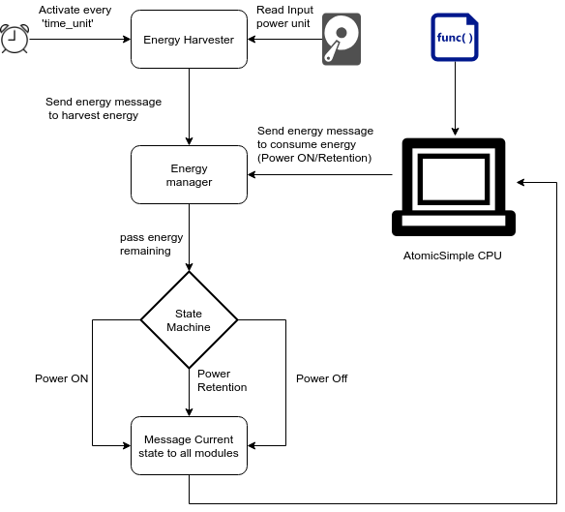
Energy Management Unit

Slide 8
Energy Harvester
Loads the discrete energy input from memory during initialization
Schedules an event to invoke itself every ‘energy_time_unit’ intervals of time
Sends energy harvest message with harvested value to energy manager module

Slide 9
Energy messages
Added energy port to every SimObject
All SimObjects uses energy port to send consumption messages to Energy Management Unit
Except energy harvester which sends harvest messages
These messages informs amount of energy harvested/ consumed
Energy Manager updates the ‘energy_remaining’ value

Slide 10
AtomicCPU
AtomicCPU is the GEM5 SimObject which simulates ARM CPU
AtomicCPU is configured to run a firmware which counts from 0 to 99
CPU consumes power in every tick
AtomicCPU is an energy consumer
It sends consume message to Energy Manager
Power consumption value per tick is configurable

Slide 11
State Machine
SM monitors ‘energy_remaining’
Updates System energy state to one of the following:
POWER ON
POWER RETENTION
POWER OFF
Uses configurable thresholds to switch between states:
thres_ret_to_on
thres_ret_to_off
thres_1_to_ret

Slide 12
Broadcast state
Based on SM state, send current state to all SimObjects
SimObjects may change their functionality based on this state change message
AtomicCPU changes status based on system energy state

Slide 13
AtomicCPU
Listens on incoming energy port for State change messages
Enters one of the following states:
CPU_STATE_OFF
CPU_STATE_RET
CPU_STATE_ON
Normal functionality in CPU_STATE_ON
Ticks are rescheduled in CPU_STATE_RET

Slide 14
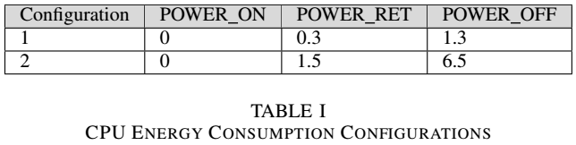
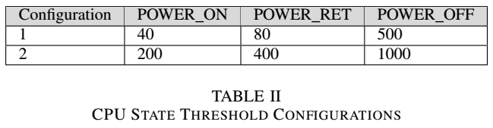
Experimentation

Slide 15
Results

Slide 16
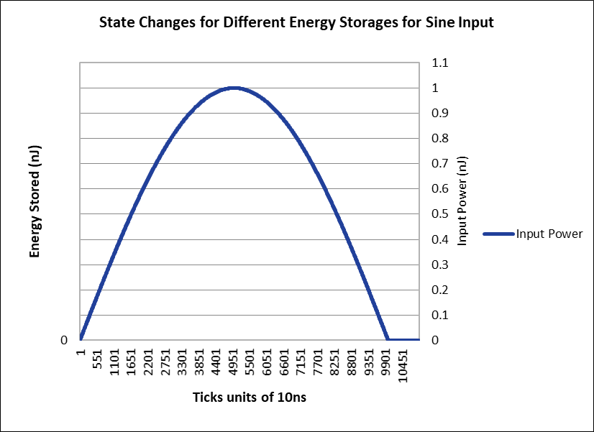
Fig. 1. Performance with sine input (threshold settings 1 and consumption settings 1)

Slide 17
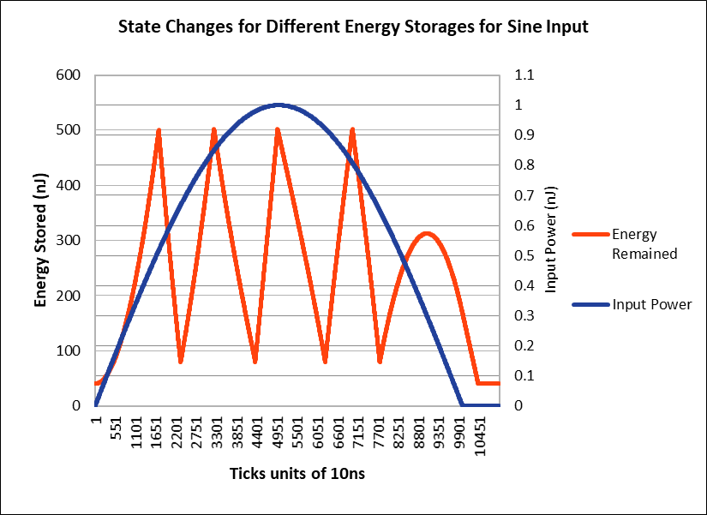
Fig. 2. Energy storages for performance with sine input (threshold settings 1 and consumption settings 1)

Slide 18
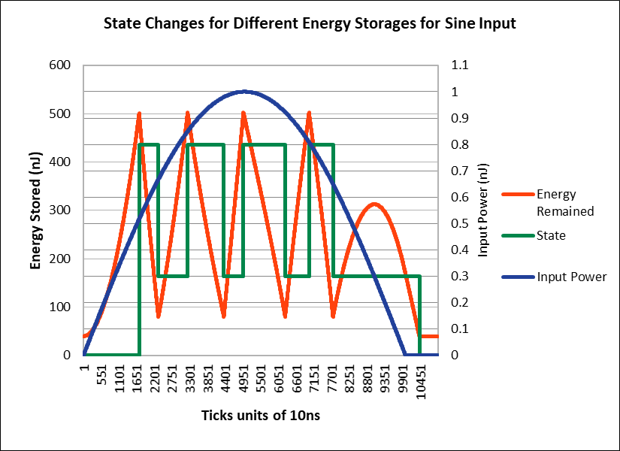
Fig. 3. State changes for different energy storages for performance with sine input (threshold settings 1 and consumption settings 1)

Slide 19
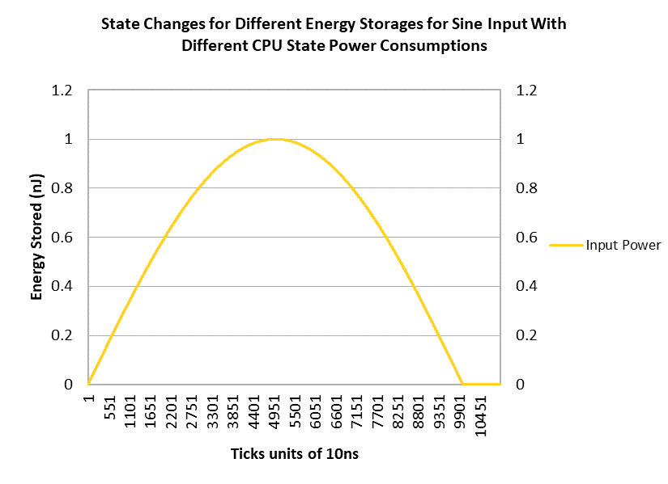
Fig. 4. Performance with sine input (threshold settings 1 and consumption settings 2)

Slide 20
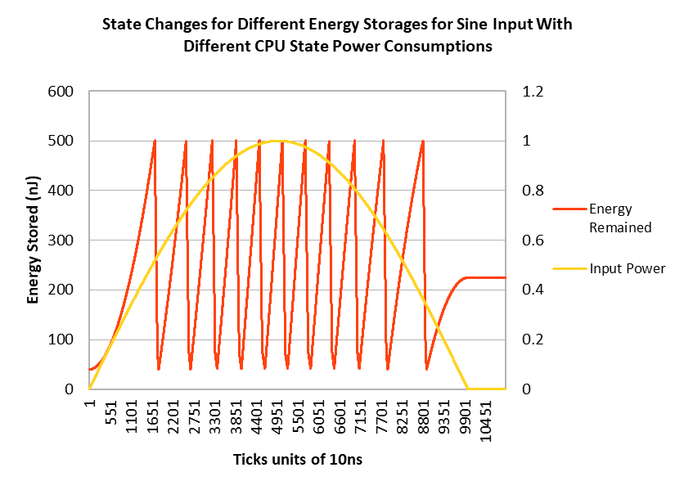
Fig. 5. Energy storages for performance with sine input (threshold settings 1 and consumption settings 2)

Slide 21
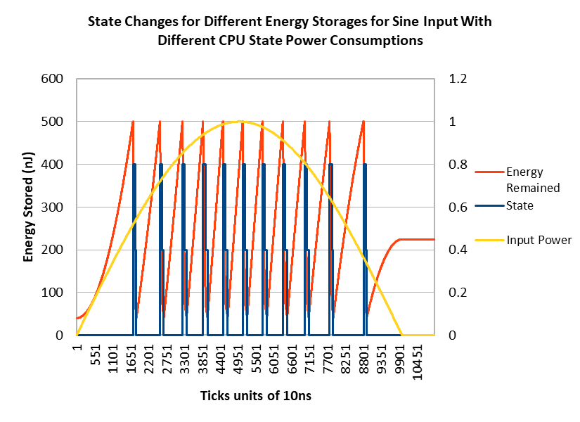
Fig. 6. State dhanges for different energy storages for performance with sine input (threshold settings 1 and consumption settings 2)

Slide 22
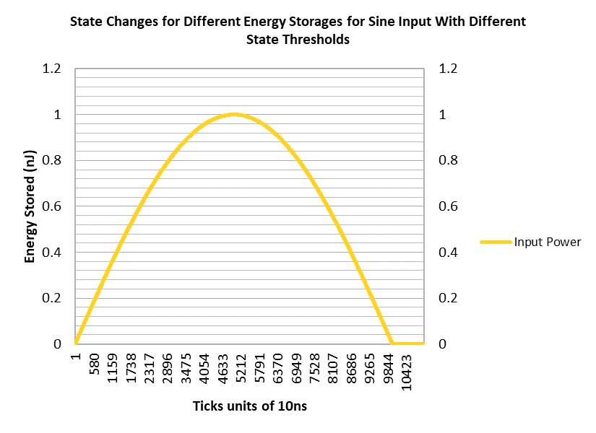
Fig. 7. Performance with sine input (threshold settings 2 and consumption settings 1)

Slide 23
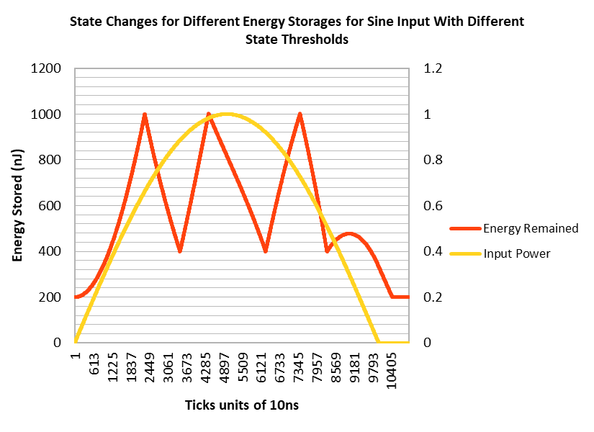
Fig. 8. Energy storages for performance with sine input (threshold settings 2 and consumption settings 1)

Slide 24
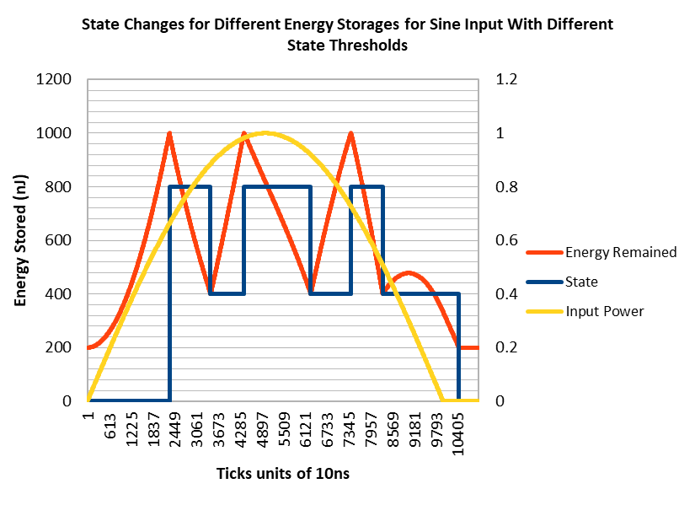
Fig. 9. State changes for different energy storages for performance with sine input (threshold settings 2 and consumption settings 1)

Slide 25
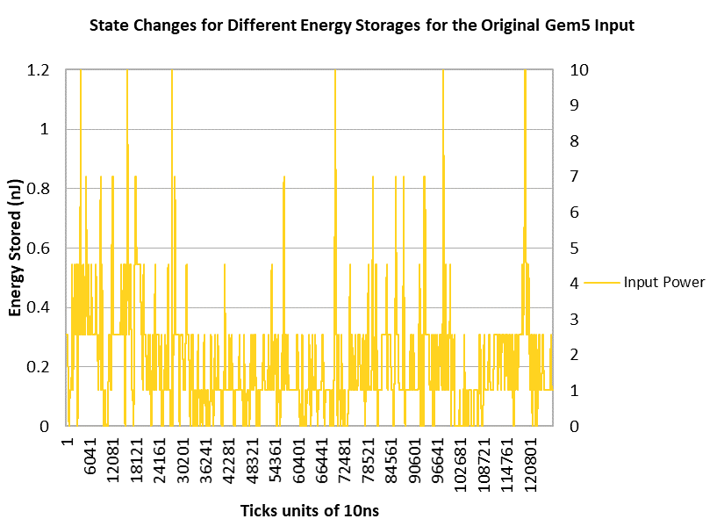
Fig. 10. ConfigNVPSim's response to real power input

Slide 26
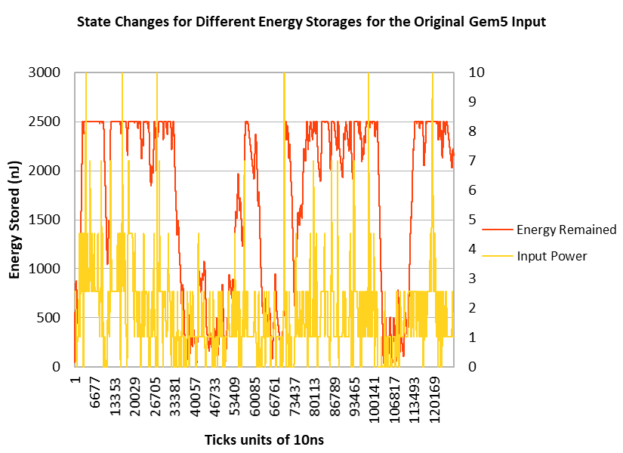
Fig. 11. Energy storages for ConfigNVPSim's response to real power input

Slide 27
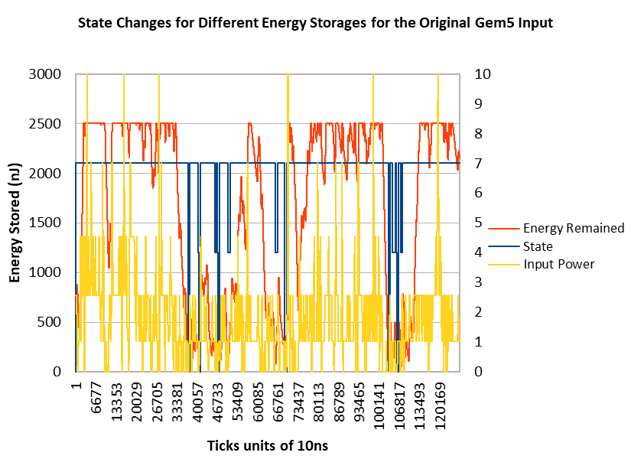
Fig. 12. State changes for ConfigNVPSim's response to real power input

Slide 28
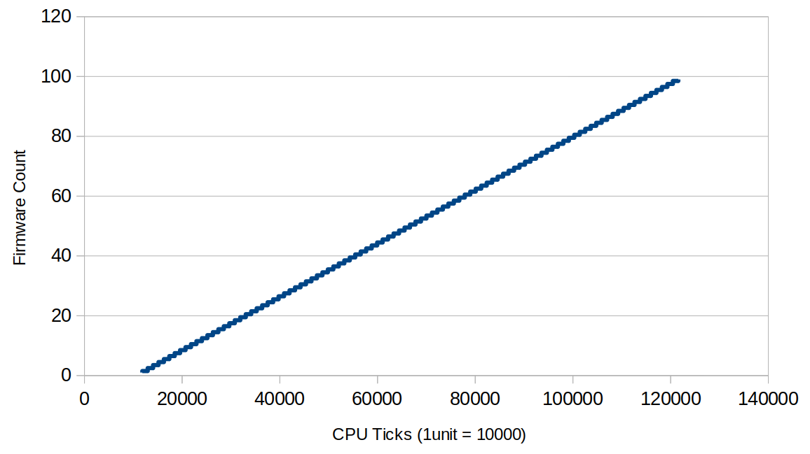
Fig. 13. FW Counter increase pattern in GEM5 system

Slide 29
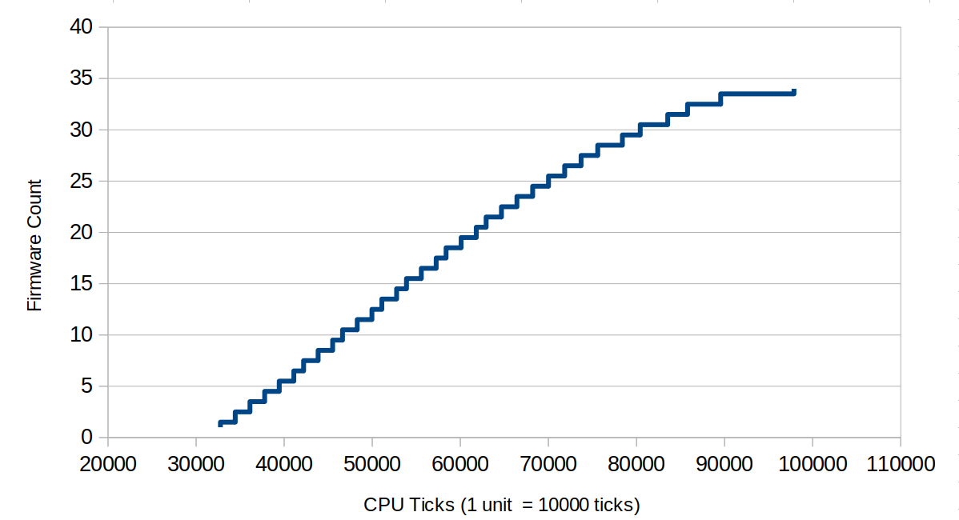
Fig. 14. FW Counter increase pattern in ConfigNVP system

Slide 30
Conclusion
In this work, an NVP system that can maintain forward progress at intermittent energy level was created.
The energy harvesting unit, a state machine that controls the instantaneous energy storage of the system and lastly an AtomicCPU unit that schedules the ticks and controls the CPU's power states were the heart of ConfigNVPSim.
Even though non-volatility was successfully implemented on top of the base implementation of GEM5 , the specific module for the backup of data was not implemented in this project, so that can be implemented along with different backup strategies in future work.
Since the demand for feature-rich mobile systems like smartphones and tablets has increased, NVP in such a system would provide an optimal power budget paired with increased performance. So as future work, a non-volatile simulator on an android platform would provide a promising solution to realize NVP based mobile systems.
A capacitance leakage model was not implemented in the energy management unit and should be implemented as future work, to make the simulations closer to real life situations.

Slide 31
References
Yizi Gu, Y. Liu, Y. Wang, H. Li, and H. Yang, "NVPsim: A simulator for architecture explorations of nonvolatile processors," 2016 21st Asia and South Pacific Design Automation Conference (ASP-DAC), Macau, 2016, pp. 147-152.
Nathan Binkert, Bradford Beckmann, Gabriel Black, Steven K. Reinhardt, Ali Saidi, Arkaprava Basu, Joel Hestness, Derek R. Hower, Tushar Krishna, Somayeh Sardashti, Rathijit Sen, Korey Sewell, Muhammad Shoaib, Nilay Vaish, Mark D. Hill, and David A. Wood. 2011. The gem5 simulator. SIGARCH Comput. Archit. News 39, 2 (August 2011), 1-7. DOI=http://dx.doi.org/10.1145/2024716.2024718
Jason Lowe-Power, Learning Gem 5, Retrieved from http://learning.gem5.org/
Kaisheng Ma, Yang Zheng, Shuangchen Li, Karthik Swaminathan, Xueqing Li, Yongpan Liu, Jack Sampson, Yuan Xie and Vijaykrishnan Narayanan "Architecture Exploration for Ambient Energy Harvesting Nonvolatile Processors" 2015 IEEE 21st International Symposium on High-Performance Computer Architecture.

