Slide 1
ConfigNVPSim
GEM5 Based Configurable NVP Simulator
Gulsum Gudukbay Computer Science and Engineering Pennsylvania State University gxg5138@psu.edu | Sethu Jose Computer Science and Engineering Pennsylvania State University sxj487@psu.edu | Vineetha Govindaraj Computer Science and Engineering Pennsylvania State University vzg99@psu.edu

Slide 2
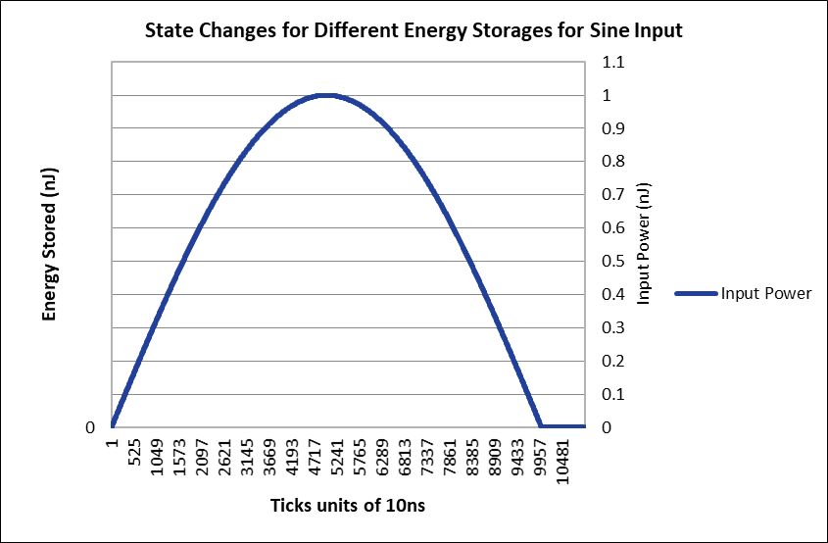

Slide 3
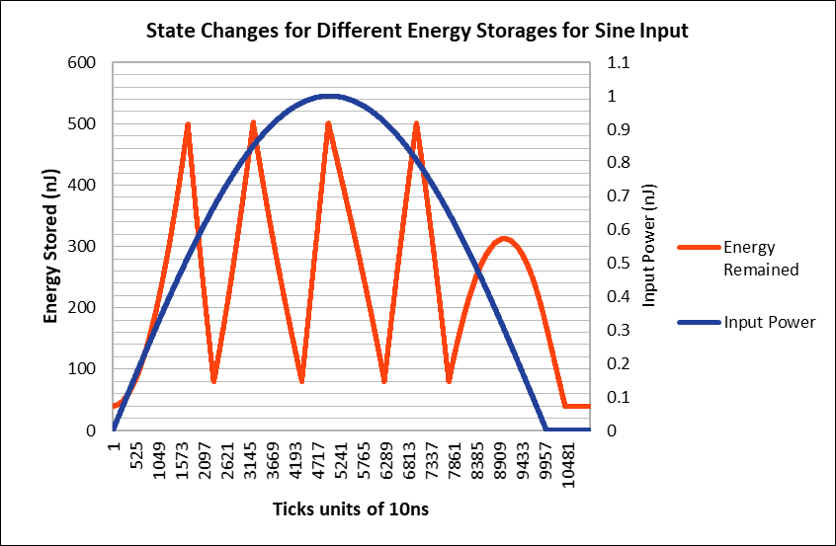

Slide 4
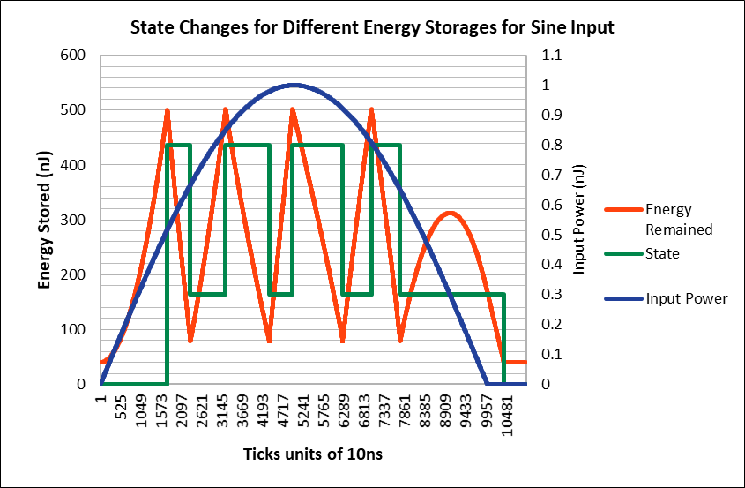

Slide 5
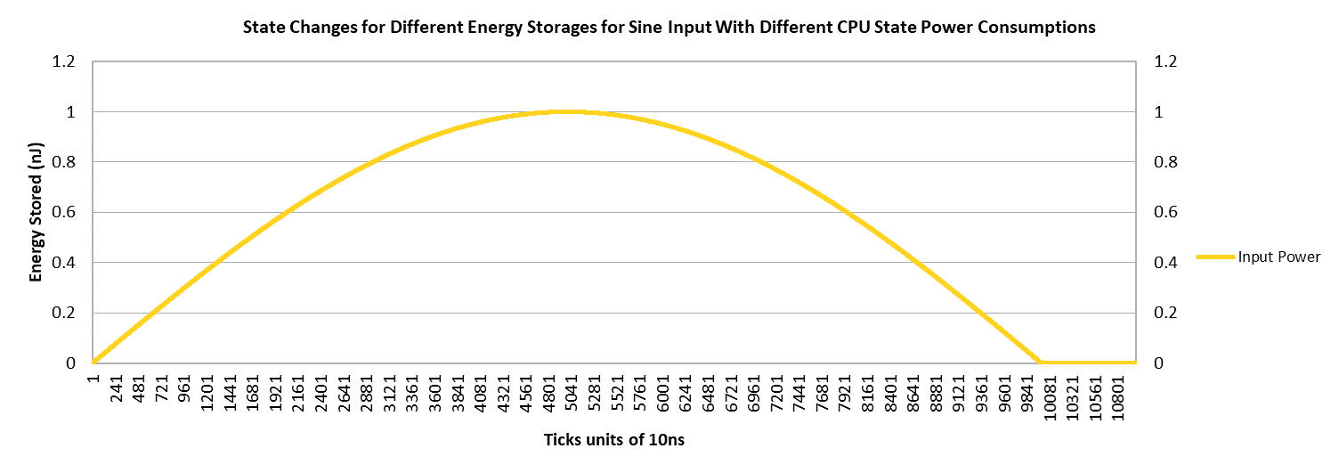

Slide 6
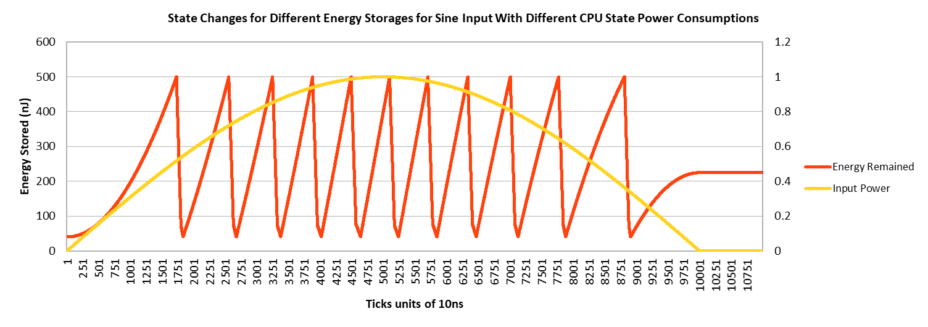

Slide 7
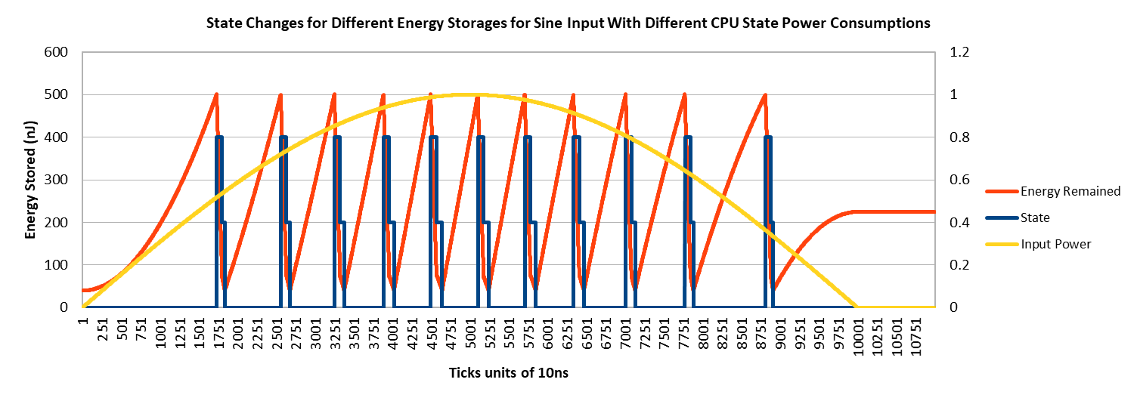

Slide 8
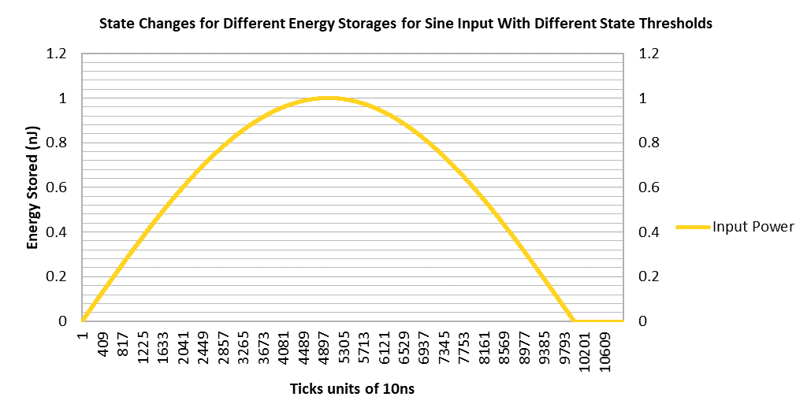

Slide 9
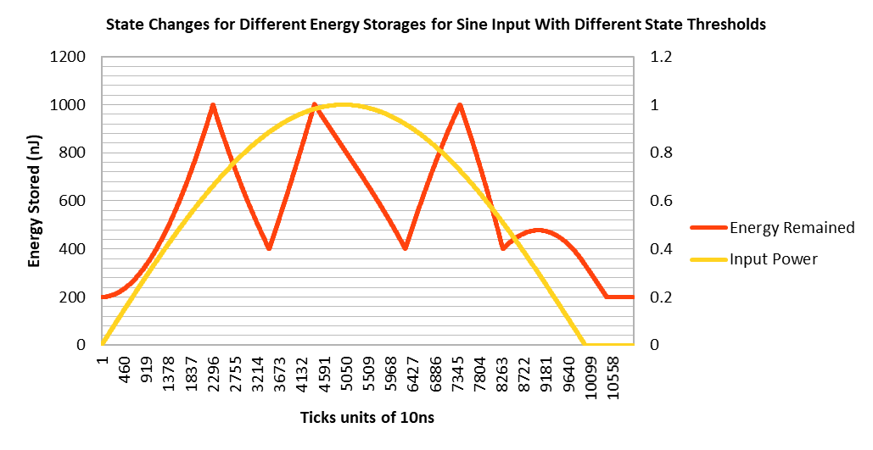

Slide 10
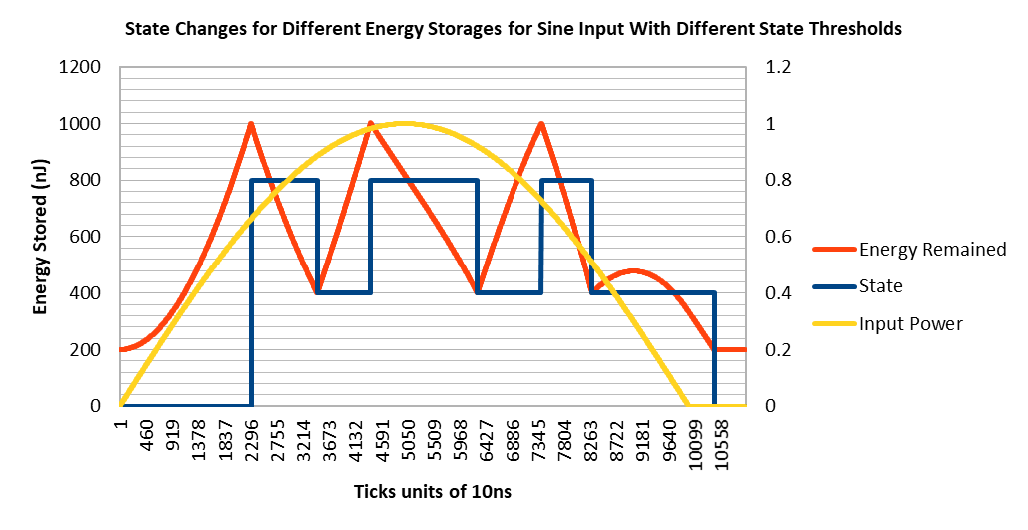

Slide 11
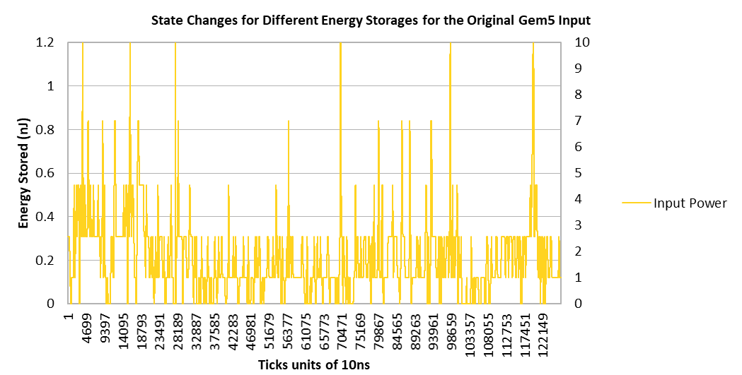

Slide 12
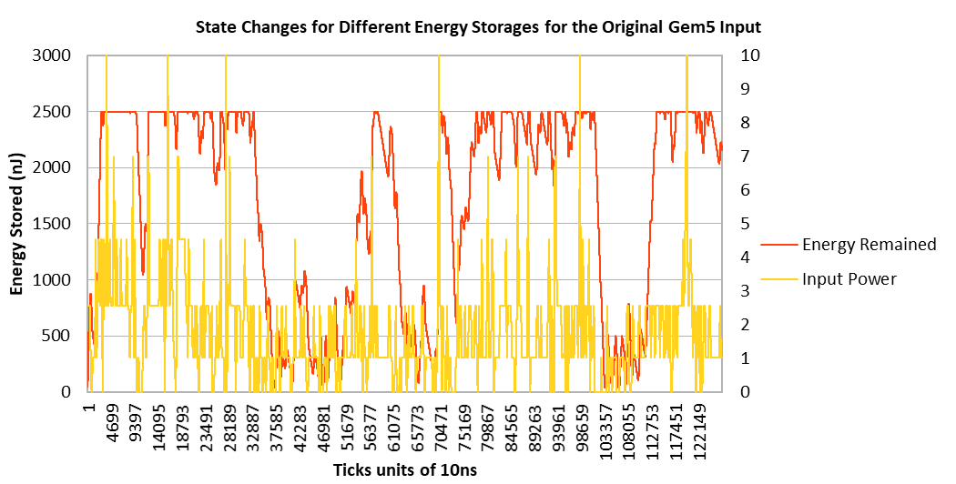

Slide 13
