Slide 1
ConfigNVPSim
GEM5 Based Configurable NVP Simulator
Gulsum Gudukbay Computer Science and Engineering Pennsylvania State University gxg5138@psu.edu | Sethu Jose Computer Science and Engineering Pennsylvania State University sxj487@psu.edu | Vineetha Govindaraj Computer Science and Engineering Pennsylvania State University vzg99@psu.edu

Slide 2
Abstract
As the demand for feature rich systems like smart phones and IOT has increased, Non-volatile processors (NVP) in such a system would provide an optimal power budget along with increased performance.
NVPsim, a non-volatile simulator on a gem5 platform provides a promising solution to realize NVP based systems.
The aim of the project is to realize an NVP system which can maintain forward progress at intermittent energy level.
The fundamental units encompassing the platform are energy harvesting unit, state machines to control the energy level of the system and an efficient store /restore unit to preserve data during intermittent power down.

Slide 3
Architecture

Slide 4
Energy Management System

Slide 5
State Machine

Slide 6
Atomic CPU

Slide 7
Results

Slide 8
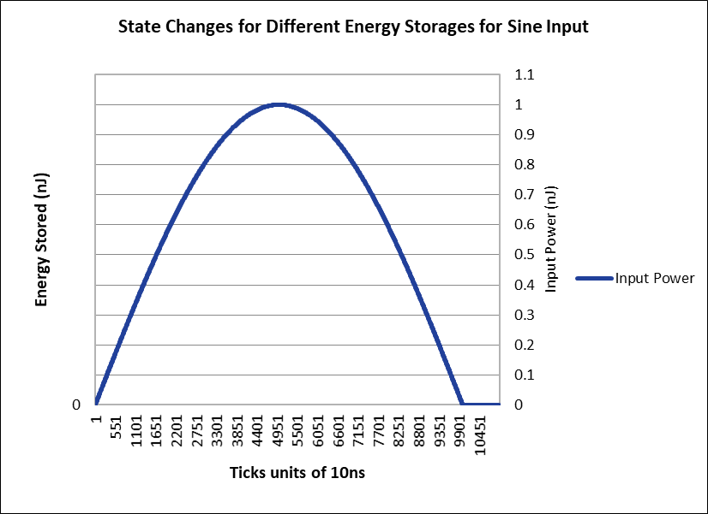
Fig. 1. Sine Input

Slide 9
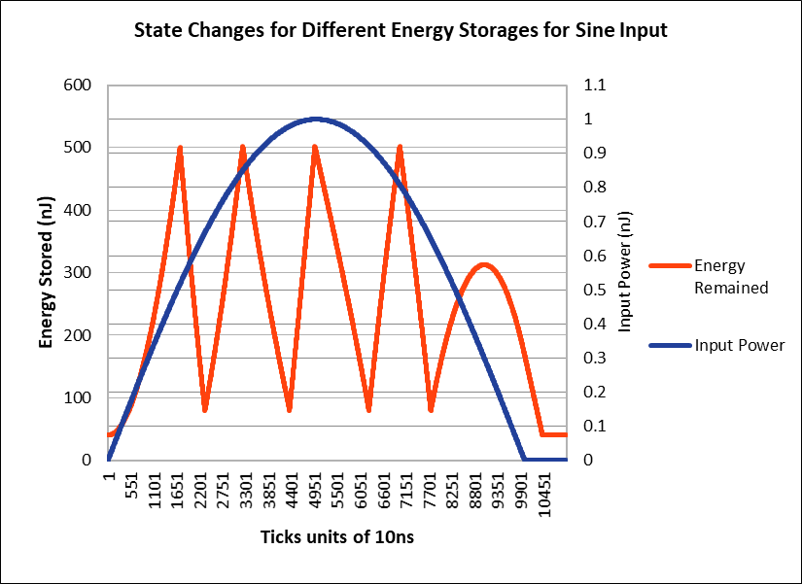
Fig. 2. Energy Storages for Sine Input

Slide 10
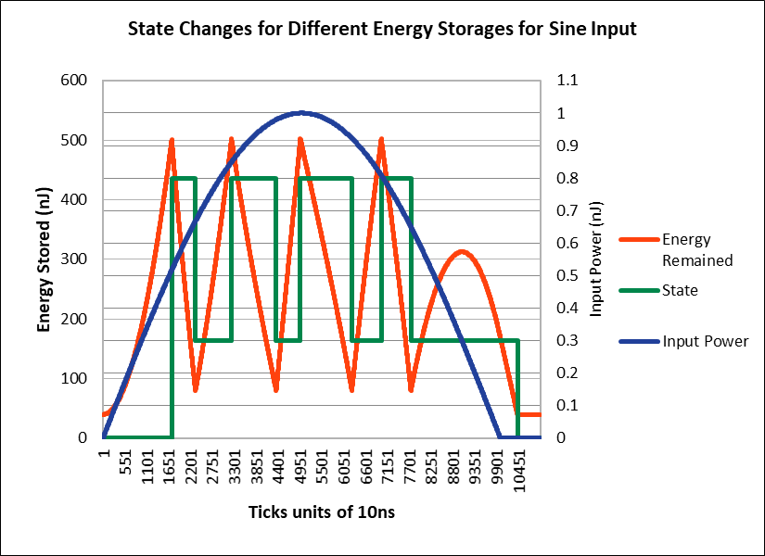
Fig. 3. State Changes for Different Energy Storages for Sine Input

Slide 11
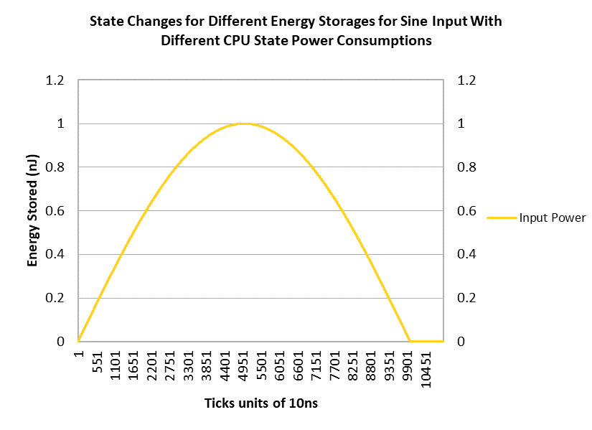
Fig. 4. Sine Input

Slide 12
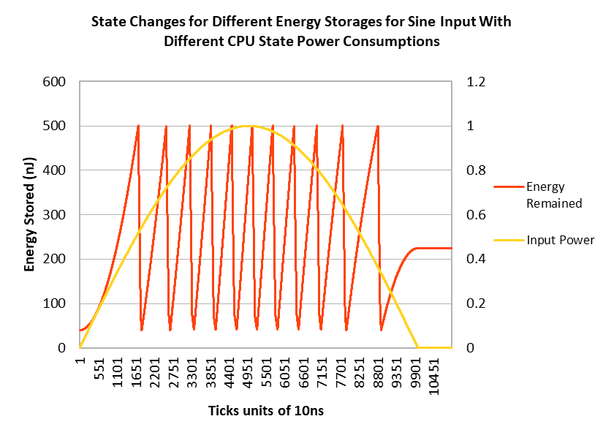
Fig. 5. Energy Storages for Sine Input With Different CPU State Power Consumptions

Slide 13
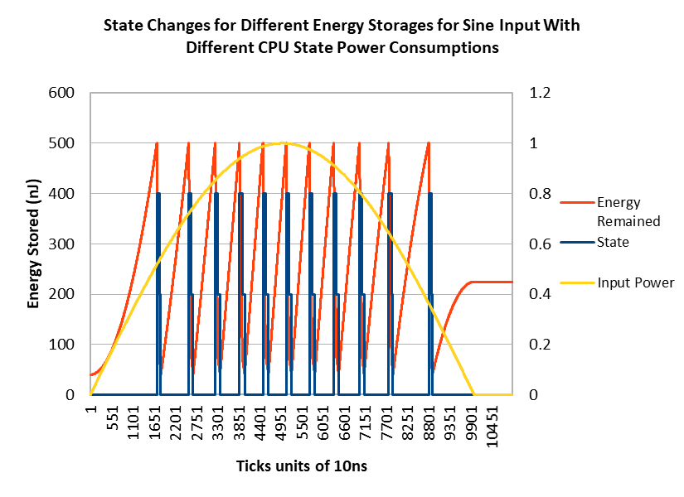
Fig. 6. State Changes for Different Energy Storages for Sine Input With Different CPU State Power Consumptions

Slide 14
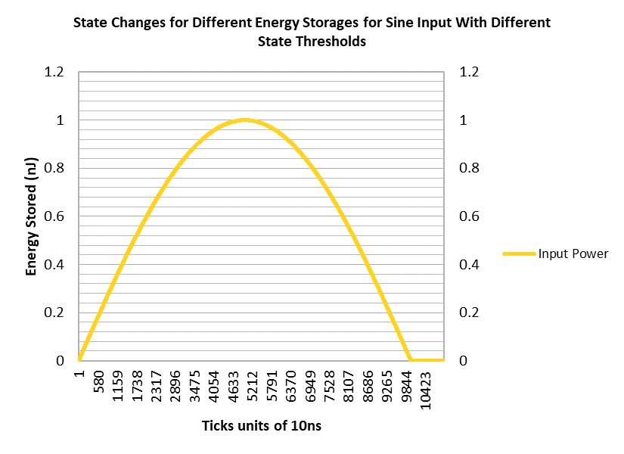
Fig. 7. Sine Input

Slide 15
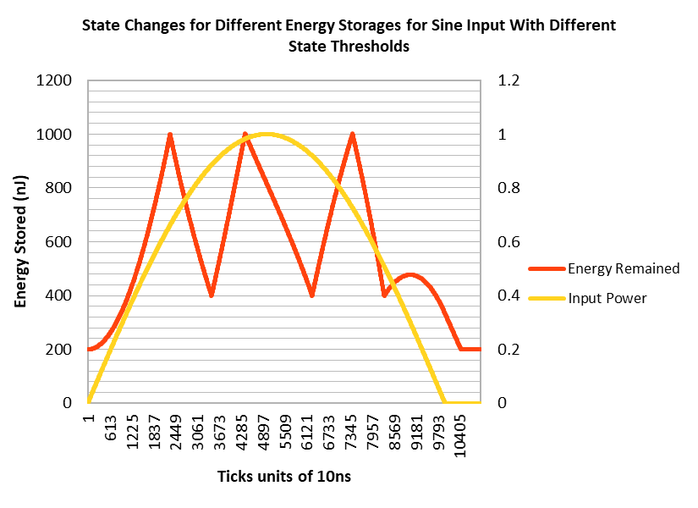
Fig. 8. Energy Storages for Sine Input With Different State Thresholds

Slide 16
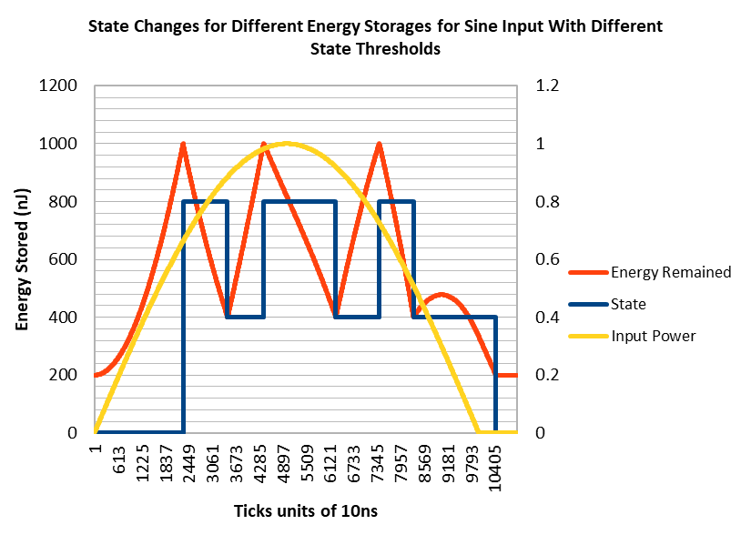
Fig. 9. State Changes for Different Energy Storages for Sine Input With Different State Thresholds

Slide 17
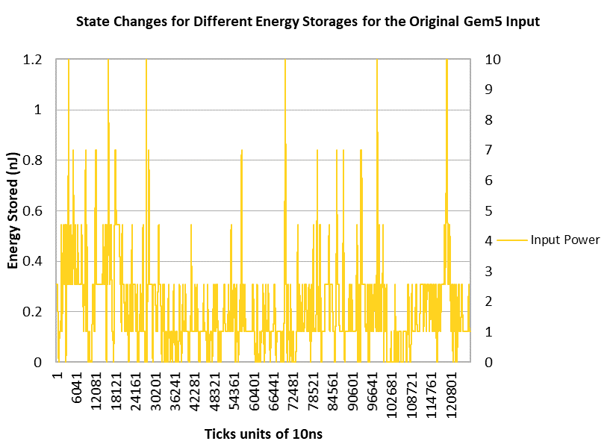
Fig. 10. Original Gem5 Input

Slide 18
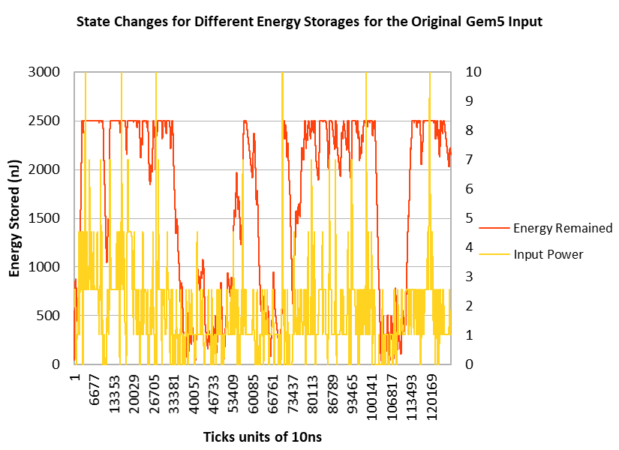
Fig. 11. Energy Storages for Original Gem5 Input

Slide 19
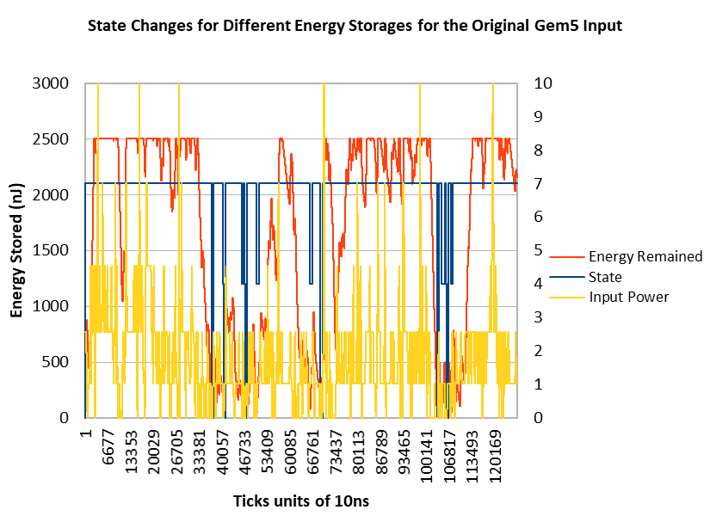
Fig. 12. State Changes for Different Energy Storages for Original Gem5 Input

Slide 20
Conclusion

Slide 21
References

