Slide 1
ConfigNVPSim
GEM5 Based Configurable NVP Simulator
Gulsum Gudukbay Computer Science and Engineering Pennsylvania State University gxg5138@psu.edu | Sethu Jose Computer Science and Engineering Pennsylvania State University sxj487@psu.edu | Vineetha Govindaraj Computer Science and Engineering Pennsylvania State University vzg99@psu.edu

Slide 2
Abstract
Non-volatile processors (NVP) provides an optimal power budget along with increased performance.
ConfigNVPSim, a non-volatile simulator on a gem5 platform, provides a solution to realizing a non-volatile simulator.
NVP systems ensure forward progress even at intermittent energy levels.
ConfigNVP aims at improving NVPSim system by adding configurability at all levels.
ConfigNVP implements new power levels to CPU based on the system energy level.
Energy management unit in ConfigNVPSim monitors the system energy.
The state machine implemented in the energy management unit ensures that the power levels are switched between off, on and power retention states based on preconfigured energy thresholds.
This implementation of ConfigNVPSim can be modified in future revisions to add backup and restore mechanisms to different system modules like DRAM and caches.

Slide 3
Architecture
There have been theoretical observations on a Non-Volatile Cache / Non-Volatile DRAM etc. But power and cost overhead is a major drawback.
Ma et.al.’s focus of design was to implement different policies for backing up registers in NVPs but, there exists a high write energy and latency overhead.
Cache design is a significant component is nonvolatile processors as the performance gap between cores and memories increases.
The NVPSim developed by Yizi Gu et. al is an efficient solution in implementing NVP simulators and ConfigNVPSim is based on this implementation.
The special focus of this project is on adding configurability to NVPSim implementation by Yizi Gu et. al.
This system considers the delay incurred by non-volatile components of the system and provides an approximate performance estimate.

Slide 4
Simulation Overview
Extra modules are implemented on a GEM5 base system to make the system capable of making forward progress with an intermittent power source.
This is achieved using discrete energy input which is fed at a preconfigured constant time interval to the system. Based on this, a system model which can handle such variations in power and analyze the performance was developed.
The main logic behind handling the intermittent energy source is the energy management unit. This unit lets the system know when to back up the data and when to restore. Energy management unit interacts with the system CPU to communicate the power level of the input. Based on that, CPU decides on how to process the instructions to avoid any data loss.
The two goals of this paper are: the architectural implementation of NVP on the GEM5 platform and the evaluation of different configurations that can be achieved using the existing architectural implementation.

Slide 5
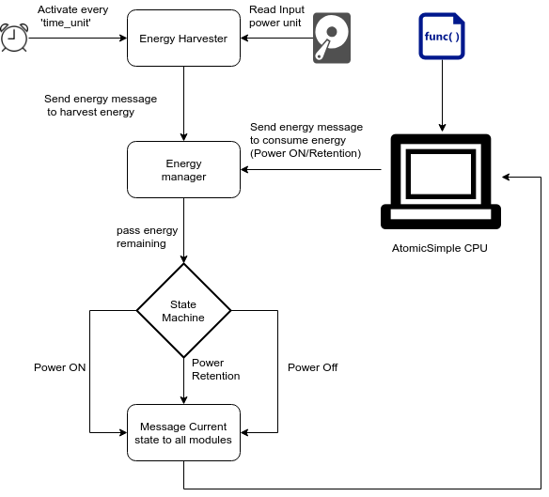
System Configuration

Slide 6
Energy Harvester
The concept of an intermittent power source is not inherent to the GEM5 system.
Input power levels are generated using tools like Octave or Matlab.
Upon system initialization, the energy harvester module reads and maintains a copy of the input power in the system. Then it schedules a periodic call to itself every energy_time_unit interval of time to update the system energy based on the input file.
Once the energy is read by the harvester, it updates the energy manager which maintains the current energy level of the system energy_remained.
Energy Manager receives energy messages from energy harvester as well as the other SimObjects which consumes energy in the system.
Energy harvester updates energy manager with an increase in the system energy.
Other SimObjects like AtomicSimpleCPU which are consumers of energy sends messages to energy manager informing the amount of energy consumed by that individual module.
Based on the source of these messages, the energy manager updates the system energy.
Once the energy_remained has been successfully updated by the energy manager, it invokes the state machine module which dictates how the power level of the system should be updated.

Slide 7
State Machine
The state machine used by the system has three states - STATE_POWER_OFF, STATE_POWER_RETENTION, and STATE_POWER_ON.
The state machine state is initialized to STATE_POWER_OFF.
Based on the energy level information received from the energy manager module, state machine updates the states to these modules.
When the system energy exceeds threshold thres_ret_to_1, the state machine switches the state to STATE_POWER_ON.
When the system energy falls below thres_1_to_ret. At this point, the state machine switches to STATE_POWER_RETENTION.
Once system energy falls below thres_ret_to_off, the state machine switches back to the STATE_POWER_OFF state.
The state change messages are broadcasted to all SimObjects so that they can change their power levels and functionality based on the current system energy level
To implement the messaging system, the SimObject definitions were augmented with an energy port for sending and receiving these messages.
In this implementation, only the AtomicCPU was modified to receive the energy messages broadcasted by the state machine. Moreover, AtomicCPU is the only module in ConfigNVPSim system which can consume power.
Extension of energy consumption to other modules like DRAM and cache has to be updated in the subsequent release versions of ConfigNVPSim.

Slide 8
Atomic CPU
AtomicCPU receives the energy messages from the state machine through the energy port.
GEM5 keeps the CPU running by scheduling and executing ticks at CPU clock periods. CPU ticks can be controlled to stop or to pause the CPU execution. This strategy is adopted in the NVP system to implement non-volatility.
When the AtomicCPU receives a state change message to POWER_OFF, the CPU enters the POWER_OFF state by de-scheduling the previously scheduled tick. This ensures that the CPU doesn't run anymore and that it is powered off.
When state machine switches the CPU state to POWER_RET state, the CPU ticks are rescheduled to the subsequent tick period which prevents the CPU execution. The tick rescheduling continues until the next state change. When the POWER_ON state is entered, the rescheduled and turned off tick is restored and CPU starts execution.
When the state change is from POWER_RET to POWER_ON, the system remembers the previous state and tick is restored from the last backed up tick.

Slide 9
Experimentation
ConfigNVPSim's performance with an ideal sine input was evaluated in order to examine the state changes.
Two parameters were variable: state change thresholds and energy consumptions in each state.
Four experiments were done: the first one was with threshold settings 1 and consumption settings 1, the second one was threshold settings 2 and consumption settings 1, the third one was threshold settings 1 and consumption settings 2 and the last one was ConfigNVPSim's response to real power input that was fed into the base Gem5 implementation.

Slide 10
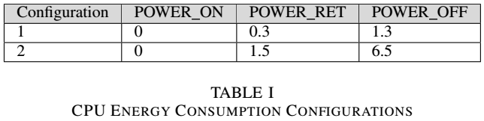
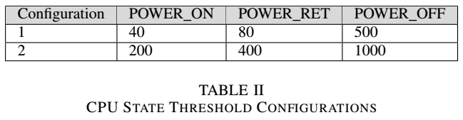
Experimentation

Slide 11
Results

Slide 12
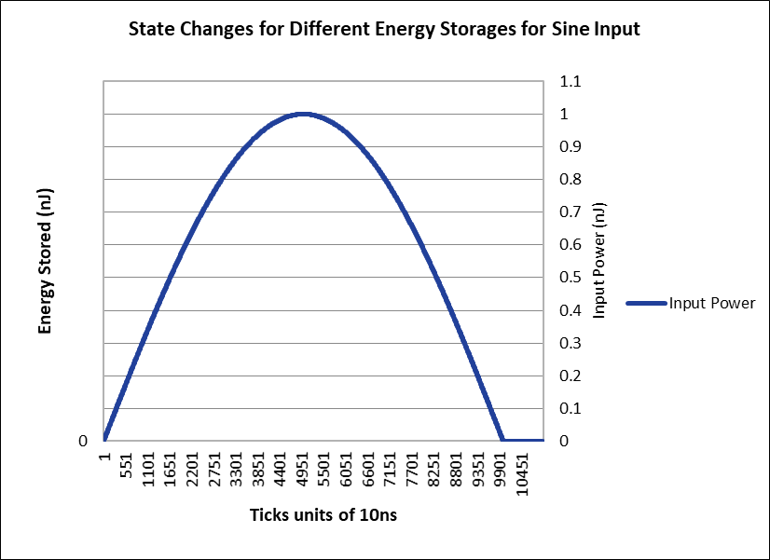
Fig. 1. Performance with sine input (threshold settings 1 and consumption settings 1)

Slide 13
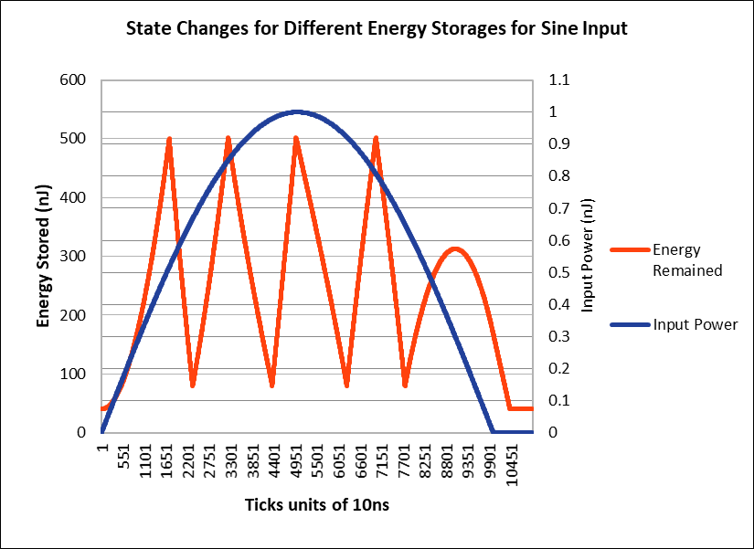
Fig. 2. Energy Storages for Performance With Sine Input (threshold settings 1 and consumption settings 1)

Slide 14
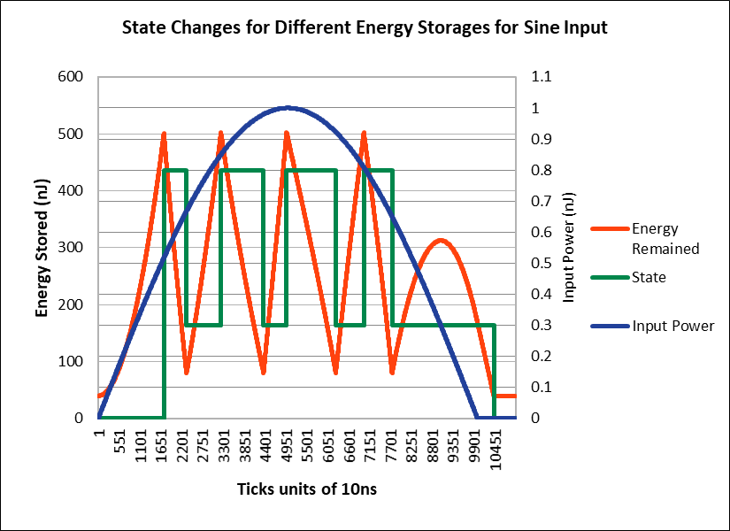
Fig. 3. State Changes for Different Energy Storages for Performance with sine input (threshold settings 1 and consumption settings 1)

Slide 15
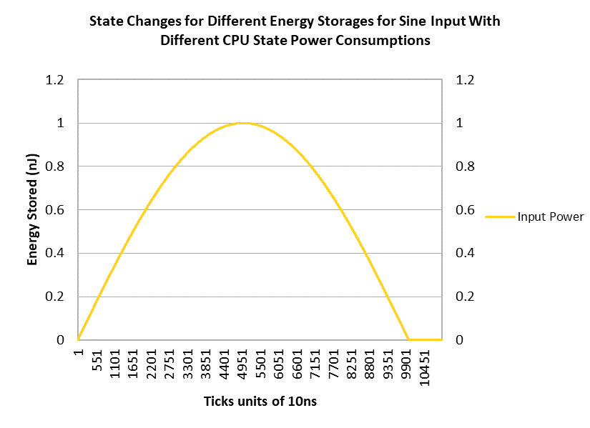
Fig. 4. Performance with sine input (threshold settings 1 and consumption settings 2)

Slide 16
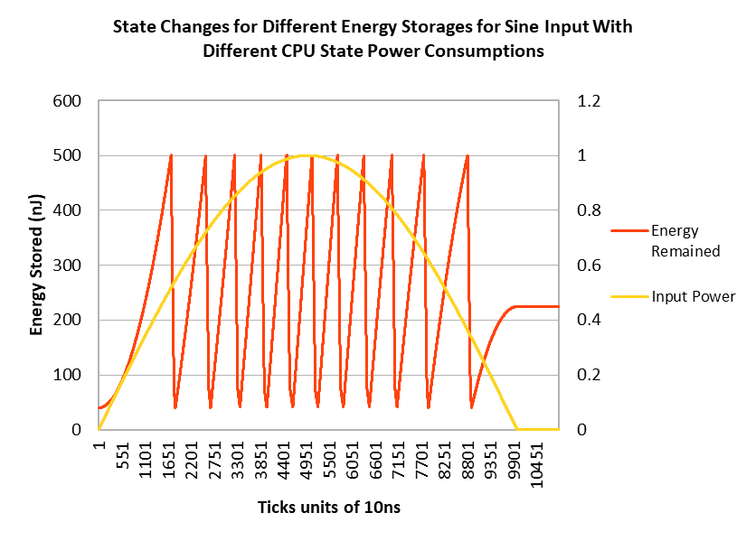
Fig. 5. Energy Storages for Performance with sine input (threshold settings 1 and consumption settings 2)

Slide 17
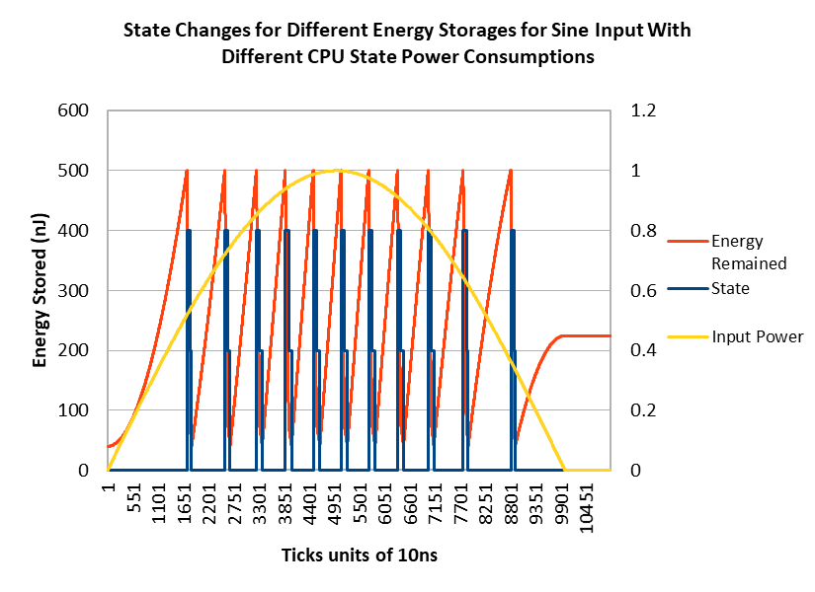
Fig. 6. State Changes for Different Energy Storages for Performance with sine input (threshold settings 1 and consumption settings 2)

Slide 18
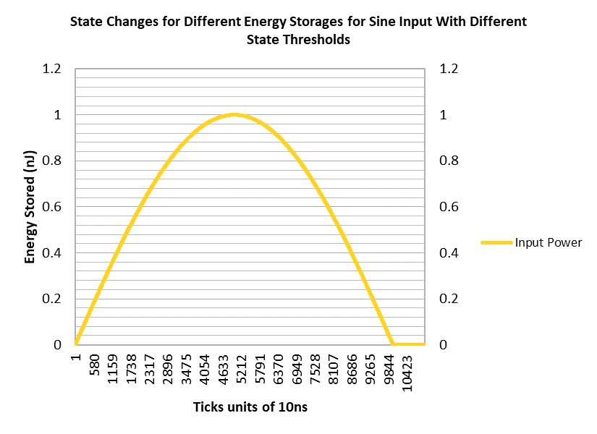
Fig. 7. Performance with sine input (threshold settings 2 and consumption settings 1)

Slide 19
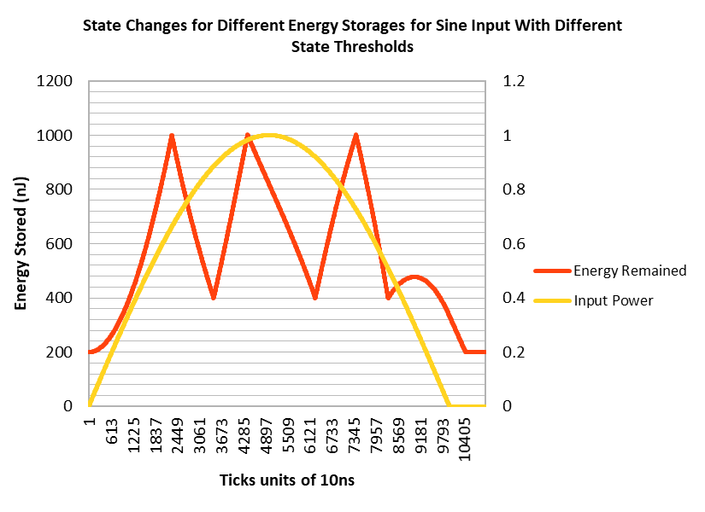
Fig. 8. Energy Storages for Performance with sine input (threshold settings 2 and consumption settings 1)

Slide 20
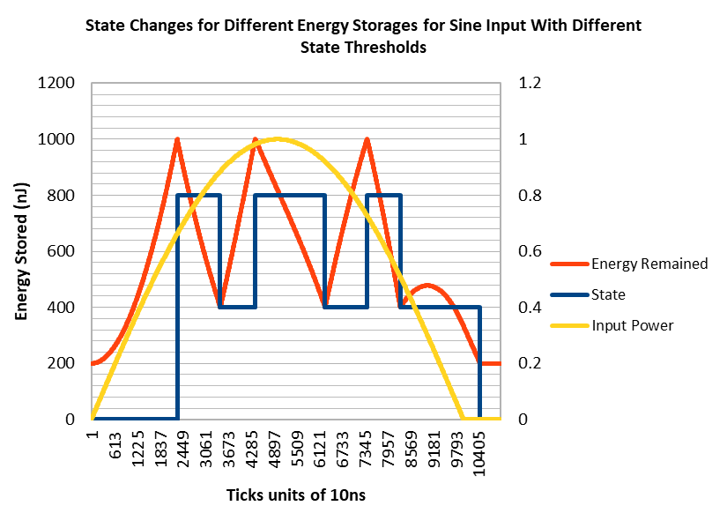
Fig. 9. State Changes for Different Energy Storages for Performance with sine input (threshold settings 2 and consumption settings 1)

Slide 21
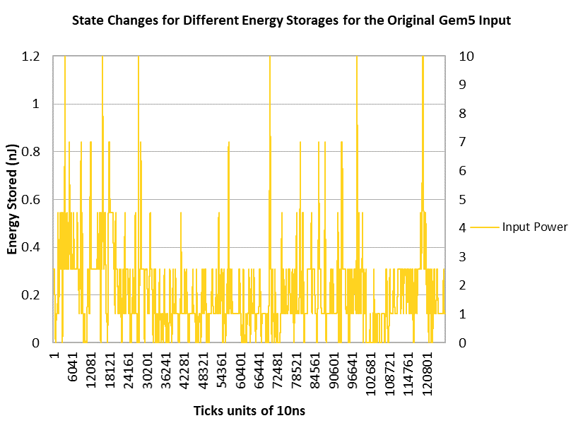
Fig. 10. Original Gem5 Input

Slide 22
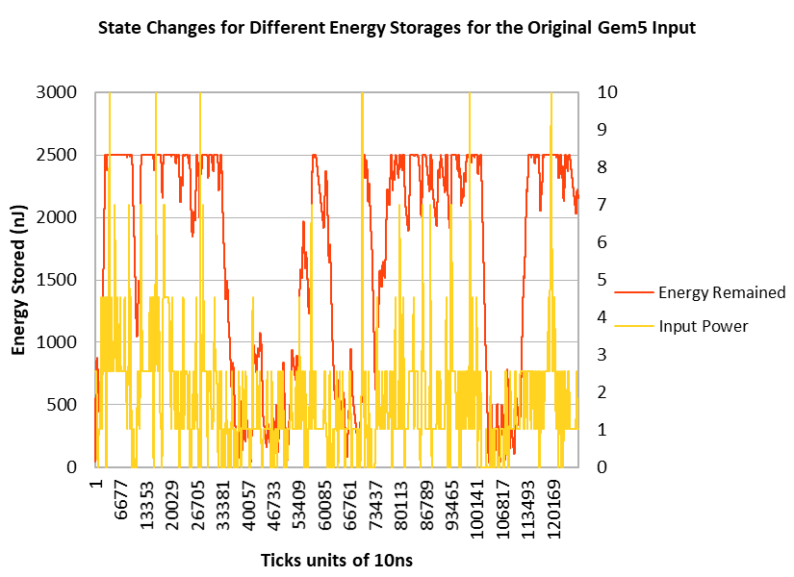
Fig. 11. Energy Storages for ConfigNVPSim's response to real power input

Slide 23
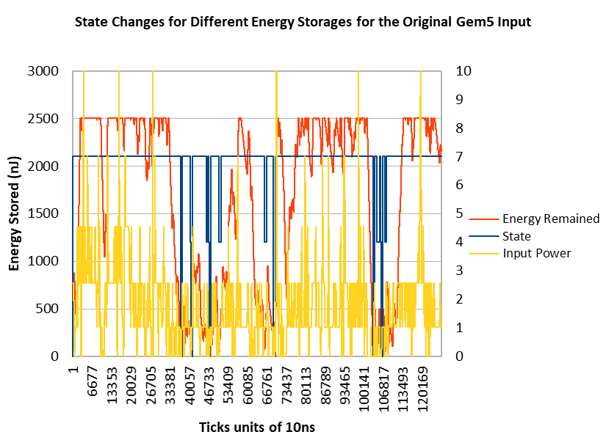
Fig. 12. State Changes for ConfigNVPSim's response to real power input

Slide 24
Conclusion
By presenting the idea of ConfigNVPSim, the goals of implementing NVP on the GEM5 platform in terms of architecture and the evaluation of various configurations that can be created utilizing the currently existing architectural implementation were proposed. In this work, an NVP system that can maintain forward progress at intermittent energy level was created. The energy harvesting unit, a state machine that controls the instantaneous energy storage of the system and lastly an AtomicCPU unit that schedules the ticks and controls the CPU's power states were the heart of ConfigNVPSim. Four experiments were done to evaluate the performance of ConfigNVPSim using different energy consumption and CPU state threshold settings.
Even though non-volatility was successfully implemented on top of the base implementation of GEM5 in terms of energy harvesting module and a state machine that controls the CPU states, the specific module for the backup of data was not implemented in this project, so that can be implemented along with different backup strategies in future work.
Since the demand for feature-rich mobile systems like smartphones and tablets has increased, NVP in such a system would provide an optimal power budget paired with increased performance. So as future work, a non-volatile simulator on an android platform would provide a promising solution to realize NVP based mobile systems.
A capacitance leakage model was not implemented in the energy management unit and should be implemented as future work, to make the simulations closer to real life situations.

Slide 25
References
Yizi Gu, Y. Liu, Y. Wang, H. Li, and H. Yang, "NVPsim: A simulator for architecture explorations of nonvolatile processors," 2016 21st Asia and South Pacific Design Automation Conference (ASP-DAC), Macau, 2016, pp. 147-152.
Nathan Binkert, Bradford Beckmann, Gabriel Black, Steven K. Reinhardt, Ali Saidi, Arkaprava Basu, Joel Hestness, Derek R. Hower, Tushar Krishna, Somayeh Sardashti, Rathijit Sen, Korey Sewell, Muhammad Shoaib, Nilay Vaish, Mark D. Hill, and David A. Wood. 2011. The gem5 simulator. SIGARCH Comput. Archit. News 39, 2 (August 2011), 1-7. DOI=http://dx.doi.org/10.1145/2024716.2024718
Jason Lowe-Power, Learning Gem 5, Retrieved from http://learning.gem5.org/
Kaisheng Ma, Yang Zheng, Shuangchen Li, Karthik Swaminathan, Xueqing Li, Yongpan Liu, Jack Sampson, Yuan Xie and Vijaykrishnan Narayanan "Architecture Exploration for Ambient Energy Harvesting Nonvolatile Processors" 2015 IEEE 21st International Symposium on High-Performance Computer Architecture.

