Slide 1


Slide 3
Specific Requirements
Functional Requirements:
- Accept temp, rain, humidity inputs -> return prediction.
- Catalog search for localized needs.
Non-Functional Requirement:
- Scalable to 1000+ crops, fast load speed.
External Interfaces:
- Particle.js backgrounds, FontAwesome.
Performance:
- ML execution avoids memory overflow; Lookups < 500ms.

Slide 4
Action Plan (Gantt Overview)
T1 [Week 1]: Requirement Analysis & Domain Research
T2 [Week 2-3]: UI/UX Design & Frontend Implementation
T3 [Week 4]: Dataset Generation (Synthetic Modeling)
T4 [Week 5]: ML Model Training & Optimization
T5 [Week 6]: System Integration & Delivery Testing

Slide 5
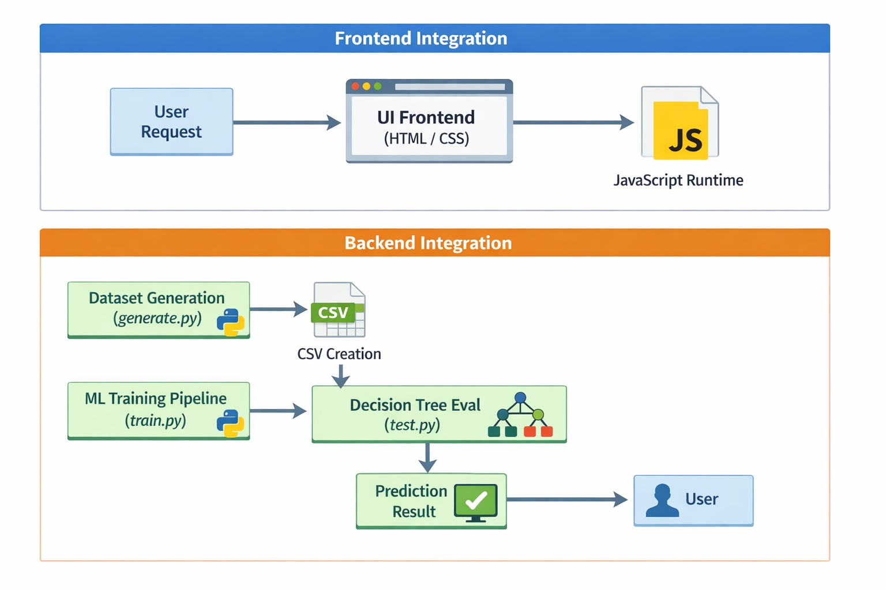
System Flowchart & Architecture

Slide 6
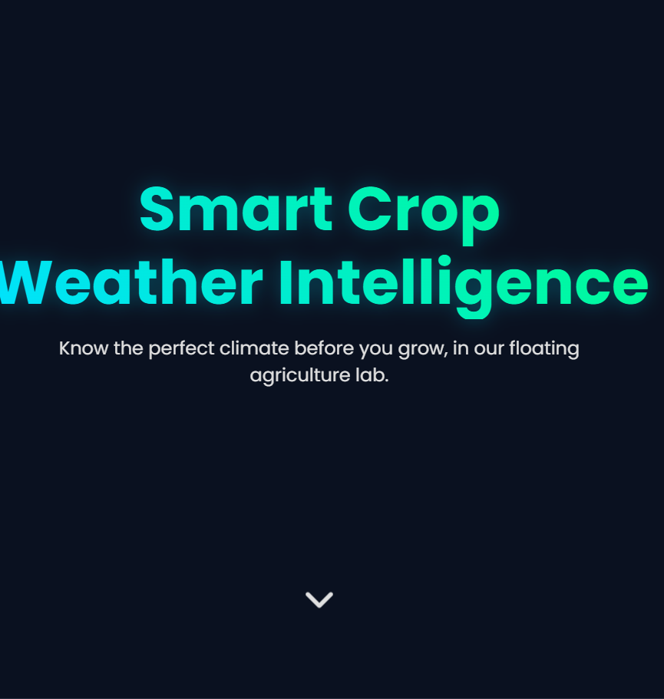
Website Interface Preview
This is first page of the website.
Smart Crop Weather Intelligence

Slide 7
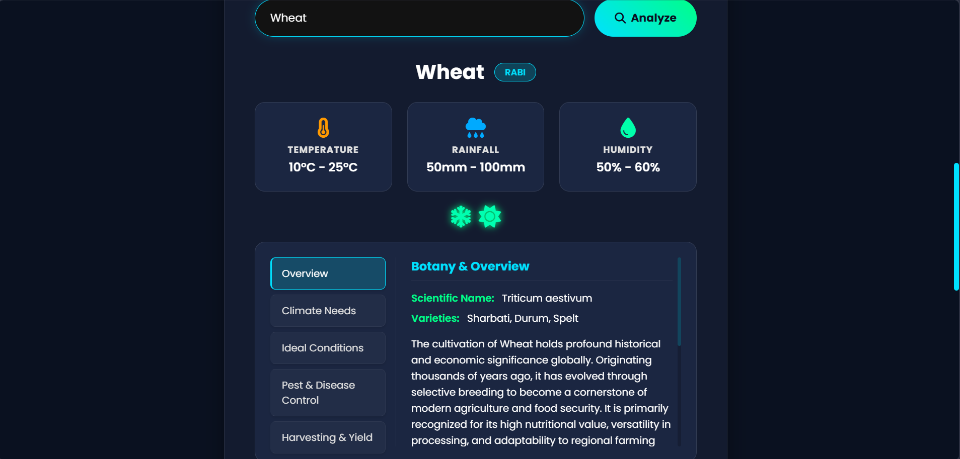

Slide 8
Method of Solution (SRS)
Input Process:
- Precise climate metrics (Temp/Rain/Humidity).
Output:
- Model predicts class label (Crop Name) + rich metadata.
Data Storage:
- Local formats (.csv for ML, .js for Catalog) -> scalable.
Menu Design:
- Hero Menu, Analysis Tool, Tabulated Results Pane.

Slide 9
Programming Code Details
Standardization:
- ES6 JavaScript, Modular Python imports, HTML5 layout.
Comments & Documentation:
- Math operations & dataset generations thoroughly commented.
Error Handling:
- Try/Except in Python.
- MemoryError catching for 32-bit limits.
- UI fallback (Crop Not Found).

Slide 10
Testing Details
Test Plan:
- Validate dateset integrity, ML accuracy, and workflows.
Test Cases Executed:
- Warm/Wet: Temp 28.5C, Rain 210mm -> Rice (PASS)
- Cool/Dry: Temp 18.0C, Rain 80mm -> Wheat (PASS)
Testing Methodologies:
- Black Box Testing (ML predictions)
- Integration Testing (raw .csv to Pandas Dataframe)

Slide 11
Thank You

Slide 12
Smart Crop Weather Intelligence
(Weather-Based Crop Prediction)
Domain: Machine Learning & Agricultural Data Analytics
Abstract: Analyzing climate inputs to recommend optimal crops using Decision Trees and bridging meteorology with agriculture.

Slide 13
Introduction
Scope & Objectives:
- Provide accessible, reliable crop recommendations.
- Maximize yield and mitigate financial risks.
System Description:
- Full-stack app with dynamic web GUI mapped to robust Python ML backend.
Proposed System:
- Responsive search portal with automated pipeline generating 1000+ crops.

Slide 14
Overall Description
Hardware Requirements:
- Core CPU, 2GB+ RAM, 500MB+ Storage
Software Requirements:
- Windows/Linux/macOS
- Python, Web Browser
- Pandas, Scikit-Learn, HTML/JS/CSS
Characteristics:
- Responsive UI, scalable DB
- Cross-browser compatible

