Slide 1
Introduction to Data Analysis and with Python

Slide 2
Numerical Python (NumPy)
NumPy is the most foundational package for numerical computing in Python.
If you are going to work on data analysis or machine learning projects, then having a solid understanding of NumPy is nearly mandatory.
Indeed, many other libraries, such as pandas and scikit-learn, use NumPy’s array objects as the lingua franca for data exchange.
One of the reasons as to why NumPy is so important for numerical computations is because it is designed for efficiency with large arrays of data. The reasons for this include:
- It stores data internally in a continuous block of memory, independent of other in-built Python objects.
- It performs complex computations on entire arrays without the need for for loops.

Slide 3
Ndarray vs. lists
By now, you are familiar with Python lists and how incredibly useful they are.
So, you may be asking yourself: “I can store numbers and other objects in a Python list and do all sorts of computations and manipulations through list comprehensions, for-loops etc. What do I need a NumPy array for?”
There are very significant advantages of using NumPy arrays overs lists.

Slide 4


Creating a NumPy array
To understand these advantages, lets create an array.
One of the most common, of the many, ways to create a NumPy array is to create one from a list by passing it to the np.array() function.
In:
Out:

Slide 5
Differences between lists and ndarrays
The key difference between an array and a list is that arrays are designed to handle vectorised operations while a python lists are not.
That means, if you apply a function, it is performed on every item in the array, rather than on the whole array object.

Slide 6




Let’s suppose you want to add the number 2 to every item in the list. The intuitive way to do this is something like this:
In:
Out:
That was not possible with a list, but you can do that on an array:
In:
Out:

Slide 7
It should be noted here that, once a Numpy array is created, you cannot increase its size.
To do so, you will have to create a new array.

Slide 8


Create a 2d array from a list of list
You can pass a list of lists to create a matrix-like a 2d array.
In:
Out:

Slide 9


The dtype argument
You can specify the data-type by setting the dtype() argument.
Some of the most commonly used NumPy dtypes are: float, int, bool, str, and object.
In:
Out:

Slide 10
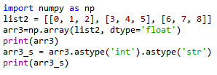
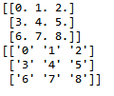
The astype argument
You can also convert it to a different data-type using the astype method.
In:
Out:
Remember that, unlike lists, all items in an array have to be of the same type.

Slide 11

dtype=‘object’
However, if you are uncertain about what data type your array will hold, or if you want to hold characters and numbers in the same array, you can set the dtype as 'object'.
In:
Out:

Slide 12

The tolist() function
You can always convert an array into a list using the tolist() command.
In:
Out:

Slide 13
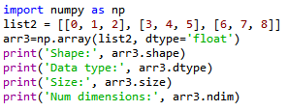

Inspecting a NumPy array
There are a range of functions built into NumPy that allow you to inspect different aspects of an array:
In:
Out:

Slide 14


Extracting specific items from an array
You can extract portions of the array using indices, much like when you’re working with lists.
Unlike lists, however, arrays can optionally accept as many parameters in the square brackets as there are number of dimensions
In:
Out:

Slide 15
Pandas
Pandas, like NumPy, is one of the most popular Python libraries for data analysis.
It is a high-level abstraction over low-level NumPy, which is written in pure C.
Pandas provides high-performance, easy-to-use data structures and data analysis tools.
There are two main structures used by pandas; data frames and series.

Slide 16


Indices in a pandas series
A pandas series is similar to a list, but differs in the fact that a series associates a label with each element. This makes it look like a dictionary.
If an index is not explicitly provided by the user, pandas creates a RangeIndex ranging from 0 to N-1.
Each series object also has a data type.
In:
Out:

Slide 17
Pandas data frame
Simplistically, a data frame is a table, with rows and columns.
Each column in a data frame is a series object.
Rows consist of elements inside series.
Case ID | Variable one | Variable two | Variable 3
1 | 123 | ABC | 10
2 | 456 | DEF | 20
3 | 789 | XYZ | 30

Slide 18
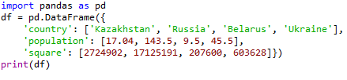

Creating a Pandas data frame
Pandas data frames can be constructed using Python dictionaries.
In:
Out:

Slide 19
Thank You

