Slide 1
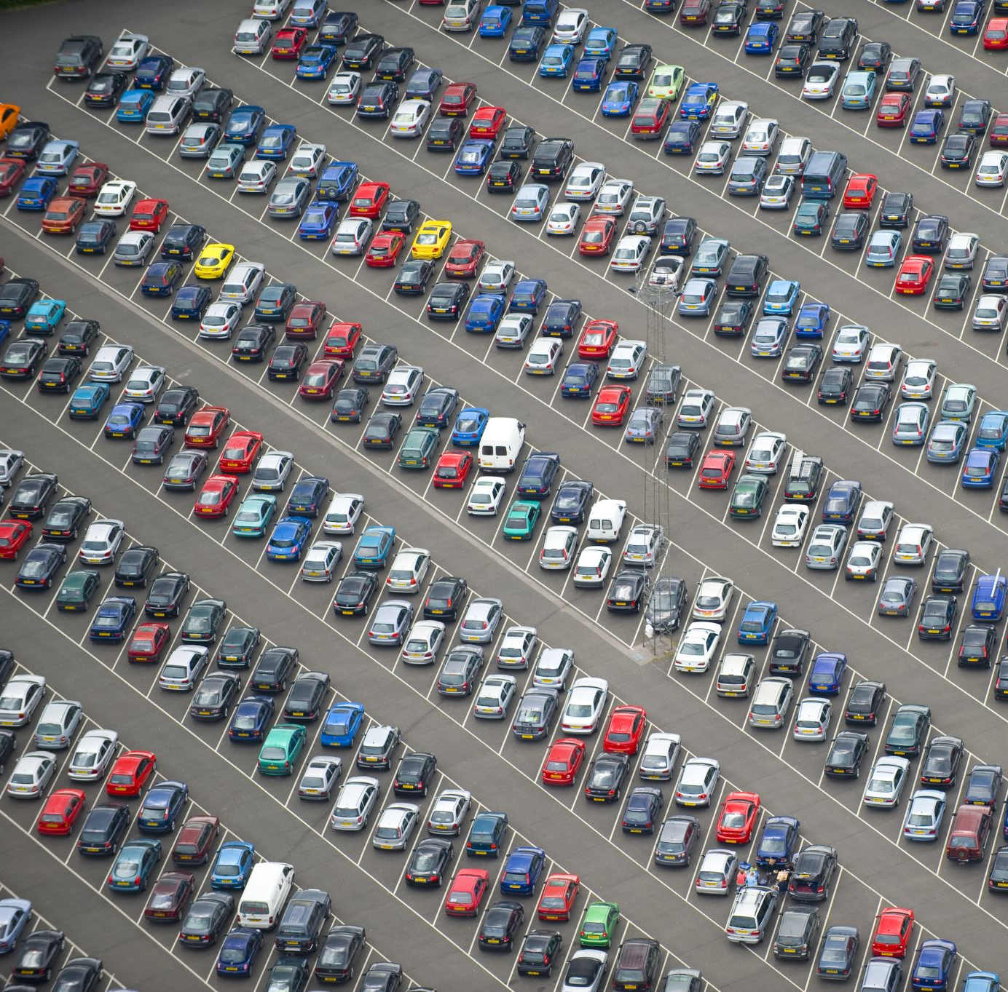
VEHICLE MANAGEMENT SYSTEM
• Deep Anand Vaidya – 001099996 • Noordeep Gill – 002194664 • Sai Swarna Raghuraman – 002191782 • Sethu Surya Teja Pagolu – 002122149 • Vivek Mannava – 002921511 • Yash Jain – 001521876

Slide 2
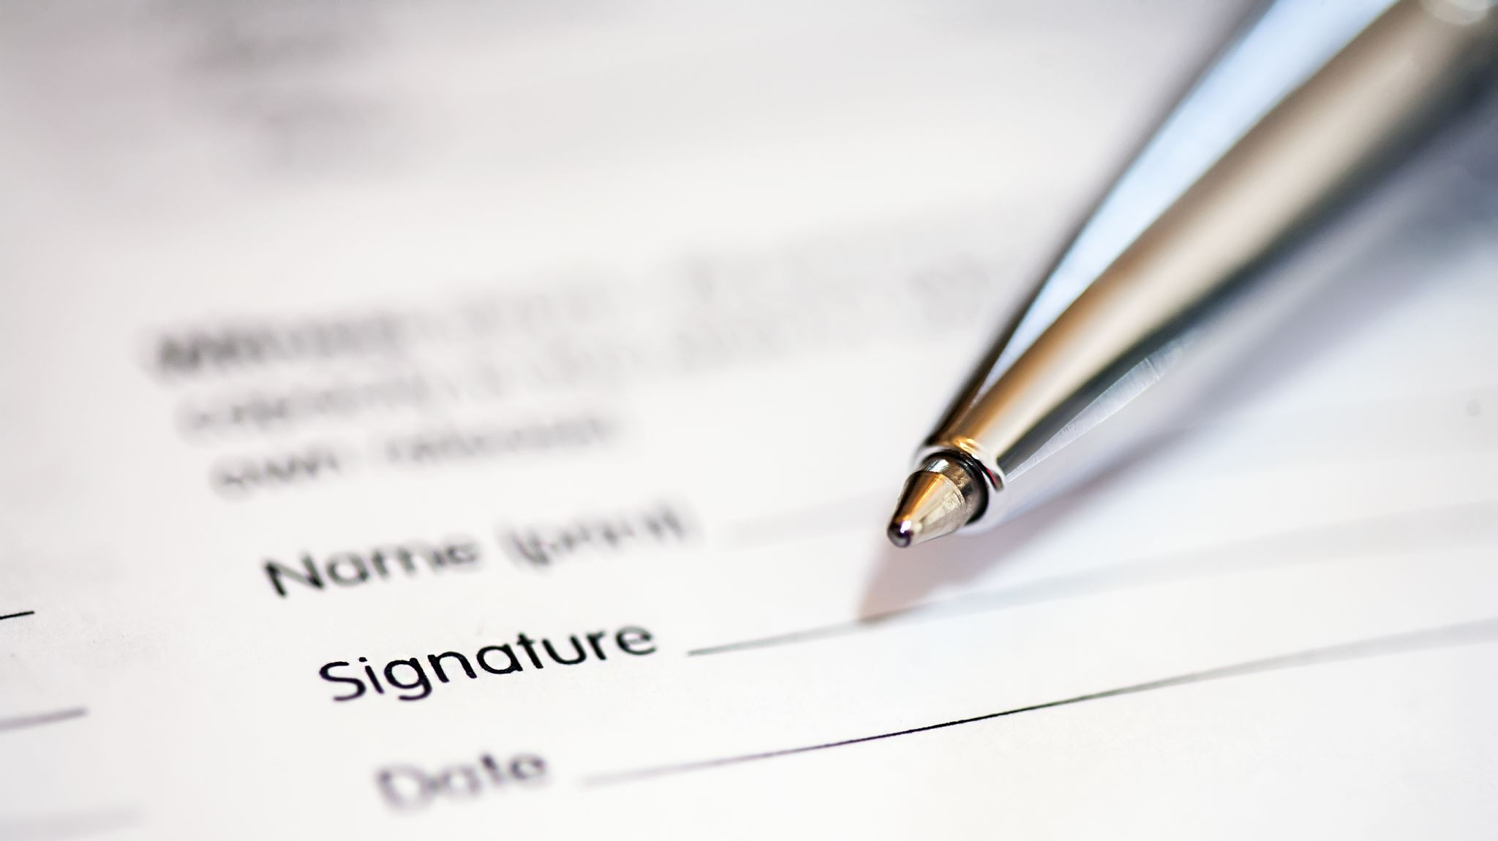
PROBLEM STATEMENT

Slide 3
Multiple users sign in with the same username and it’s difficult to manually search them for existing users. This causes data inconsistencies.
It’s important to track whether a vehicle has been dropped to its destination by the allotted time. This is useful since it can avoid any last-minute confusion when the vehicle is assigned to a new customer. Manage the locations where the cars can be parked and manage the parking spaces allocated at each location.
This data can be used to increase/decrease the parking capacity in the future.
Demand of car in each city or location. Total amount of money earned, and which area is profitable and highest demand to increase the service.

Slide 4

Solution

Slide 5
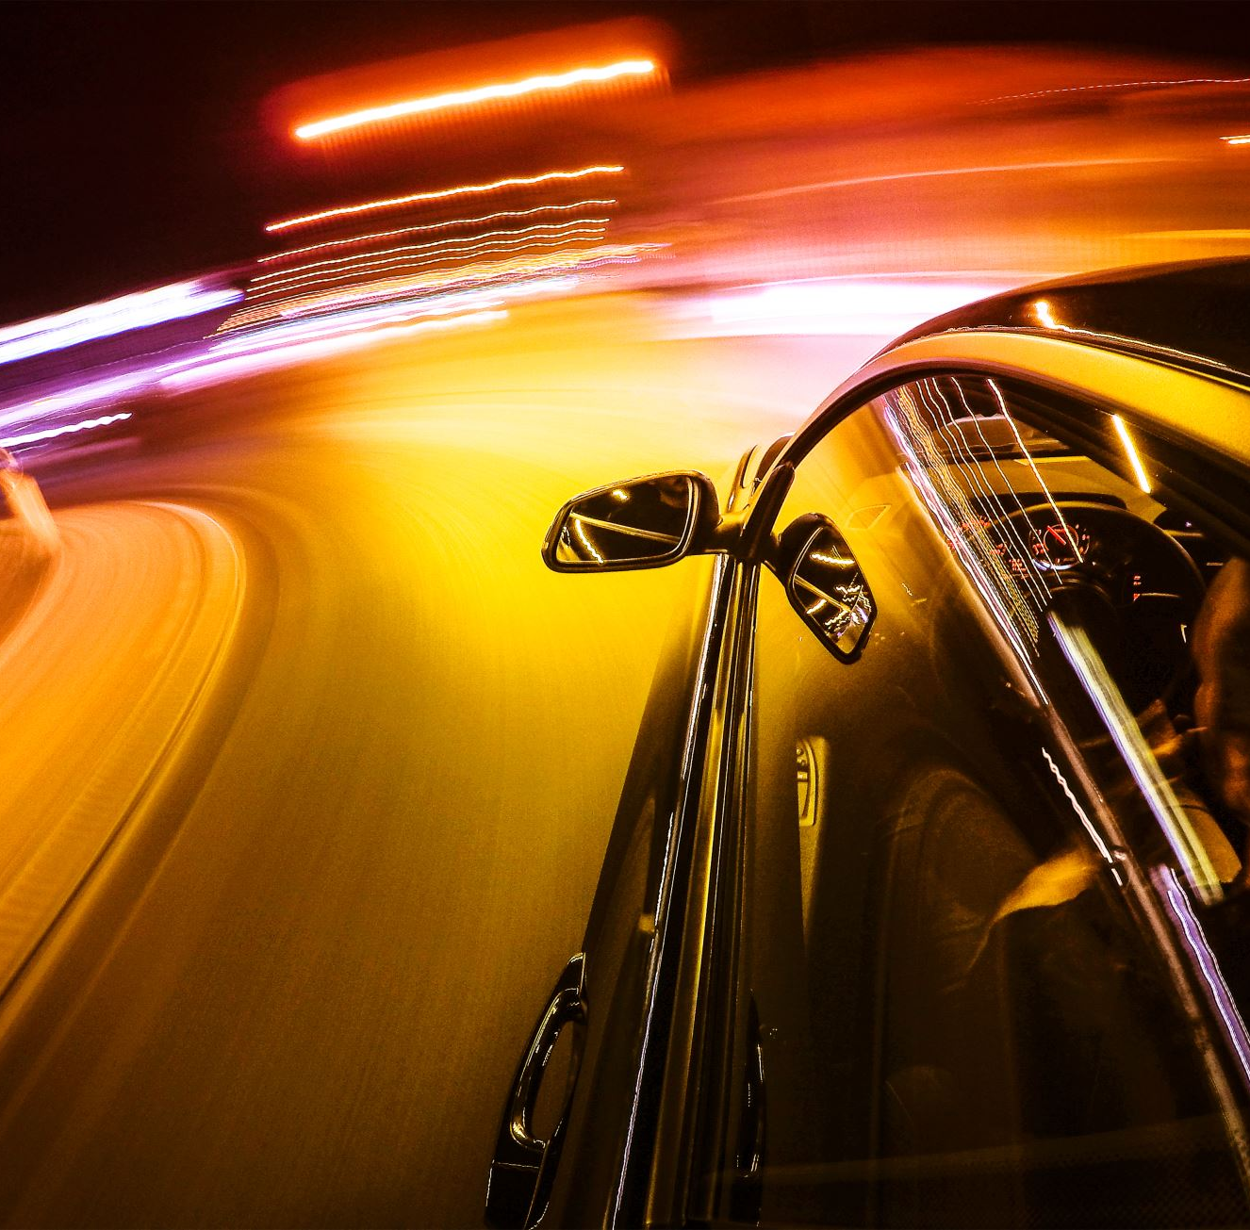
Users should be able to view cars listing.
Users should be able to filter out cars based on the user needs.
Users should be able to book the car.
User should be able to cancel the booking
Analyst is able to view the previous booking details to analyze it to enhancing the services in the future.

Slide 6
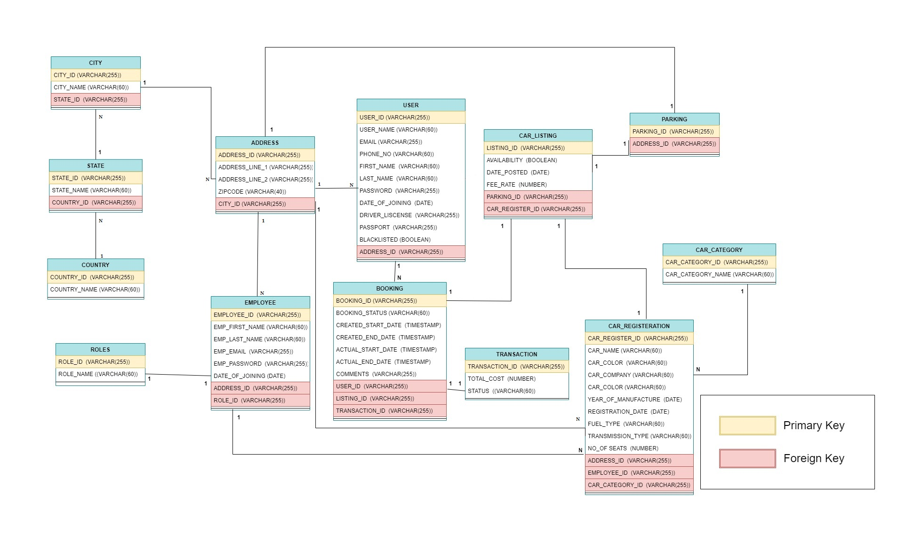

Slide 7
Contributions
Deep Anand Vaidya worked on Booking and Address tables, triggers and Indexes
Noordeep Singh Gill worked on Country, State , City, User and role tables, reports
Vivek worked on User table and PPT.
Yash Jain worked on Transaction and car registration tables and reports and Indexes
Sethu worked on Car listing, Parking, Car Category, Employee tables and Indexes
Swarna worked on views and Employee table

Slide 8

THANK YOU

