Slide 1

Heaps in data structure
Ethan, seth & Jaci
11.05.2020

Slide 2

Heap definition:
What is a heap?
Define me ^_^

Slide 3

Real world applications
What are some ways outside of class that heaps are used?
Why are we learning this?

Slide 4
I really like this slide and want to incorporate it

Slide 5

Let’s look at some code!

Slide 6
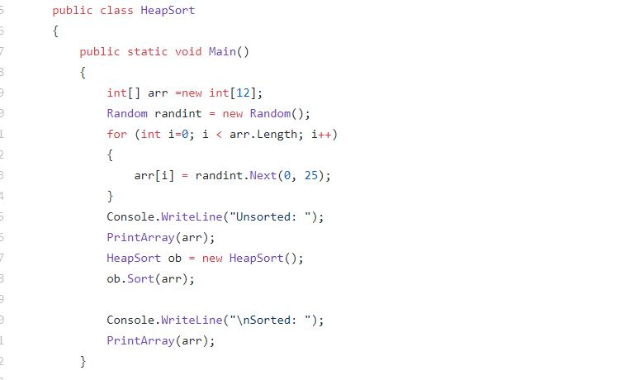
Main
What does this main do?

Slide 7
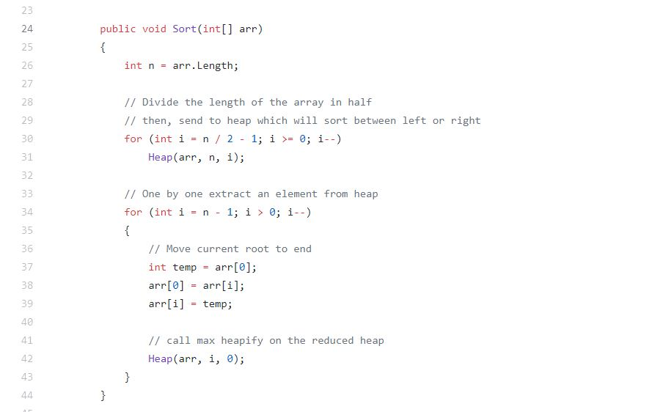
Stuff about class, loops ints
sort

Slide 8
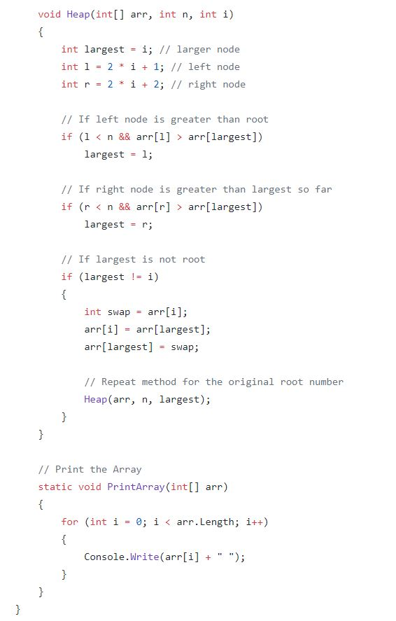
heap
Lets talk about heap, int, loops, and print array! Yay ^_^

Slide 9
THANK YOU
victoria@fabrikam.com

