Slide 1
Week 08 Assignment
Chapter 8: How to work with data types

Slide 2
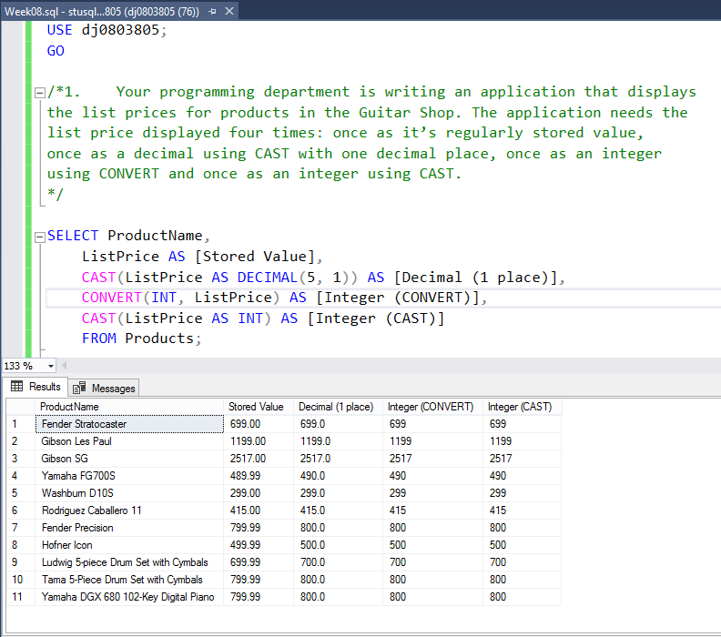
Question 1
This query retrieves each product’s List Price, and uses CAST and CONVERT to return the appropriate amount in several useful ways for the developer. Fairly straight forward.

Slide 3
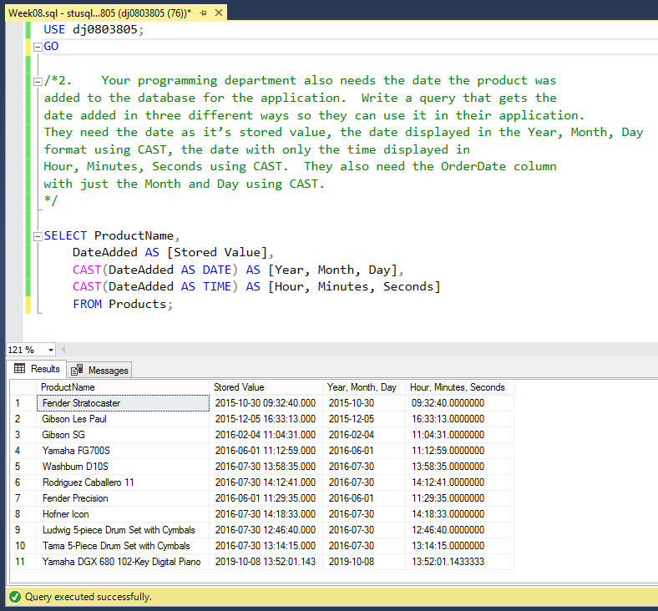
Question 2
This query returns several Date/Time values for when each product was first added to the database.
The part outlined in red is confusing, however. It’s not entirely clear what this part of the request means, and it seems a little out of place given that the Products table doesn’t have an “OrderDate” column.
My best guess is that a joined query, returning the date when each product has ever been ordered, makes sense. However, such a query seems outside of the scope of the assignment. Clarification is required to complete this part.

Slide 4
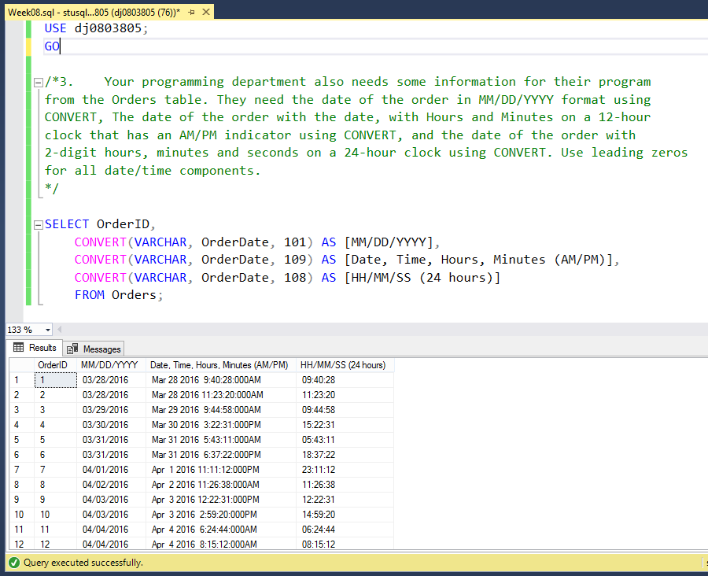
Question 3
This query returns further Date/Time information, this time as strings formatted in several different ways.
The “red part” outlined in the previous question seems like it would fit better here – however, since it is in Question 2, it is unclear if it was simply misplaced, or just needs further explanation.

Slide 5
Sources Used
W3 Schools Links:
CAST()
https://www.w3schools.com/sql/func_sqlserver_cast.asp
CONVERT()
https://www.w3schools.com/sql/func_sqlserver_convert.asp
Data Types
https://www.w3schools.com/sql/sql_datatypes.asp

