Slide 1
GROUP G4 / UNIVERSITY OF PASSAU
ML-based
Python Source Code
Vulnerabilities
> train word2vec --corpus python
SEC
17
models
TOKENS
Security Insider Lab II / Task 1
Ghazal Pouresfandiyar Borojeni
Seth Whenton
29.04.2026
White-mode terminal aesthetic / clean evidence / minimal live-read slides

Slide 2
WHAT THIS DECK PROVES
SECURITY INSIDER LAB II
Security knowledge becomes a code-embedding pipeline
Task 1 connects vulnerability patterns with a practical Word2Vec workflow for Python source code.
7
5
17
web vulnerability classes documented
pipeline stages from corpus to model
Word2Vec model files delivered
The model is not a detector yet. It creates token vectors that can support later vulnerability classifiers.
02

Slide 3
EXERCISE 1
SECURITY INSIDER LAB II
Most web vulnerabilities start at a trust boundary
The seven required classes were grouped by how attacker-controlled input moves through the system.
Injection
Client side
Information & access
Critical impact
SQL Injection
Command Injection
XSS
CSRF / XSRF
Path Disclosure
Open Redirect
Remote Code Execution
Prevention pattern: validate input, encode output, avoid unsafe execution, and reveal less internal detail.
03

Slide 4
EXERCISE 2
SECURITY INSIDER LAB II
The lab pipeline turns raw repositories into trainable token sequences
Each stage had a concrete output and a compatibility repair before the models could be trained.
01
02
03
04
05
Corpus
Clean
Tokenize
Merge
Train
8 GitHub repositories
165 MB Python source
UTF-8 handling
Python 3 syntax repair
34.6M tokens
35 part files
124 MB training file
withString mode
16 new configs
required model included
> output: word2vec_withString10-200-300.model
04

Slide 5
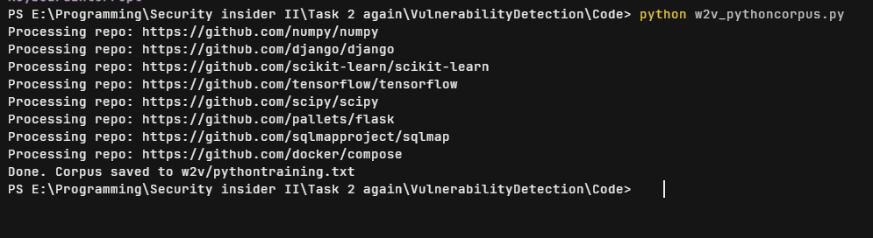
CORPUS CREATION AND CLEANING
SECURITY INSIDER LAB II
The dataset came from major Python projects, then had to be normalized
165 MB
raw and cleaned Python corpus
8
repositories mined with pydriller
Django / NumPy / TensorFlow / Scikit-learn / Flask / SciPy / sqlmap / Docker Compose
Compatibility fixes: pydriller API update, UTF-8 file handling, and safer per-repository error handling.
05

Slide 6
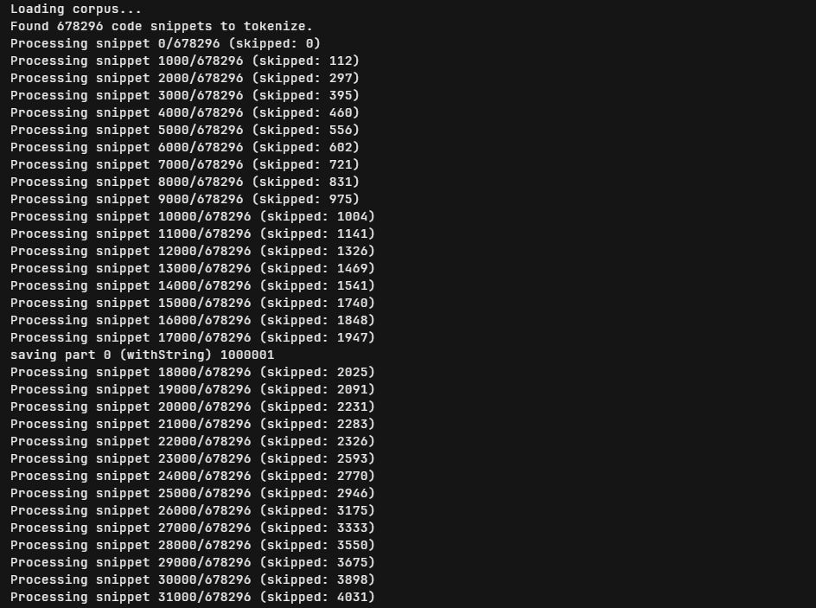
TOKENIZER REWRITE
SECURITY INSIDER LAB II
The tokenizer stopped crashing once broken snippets were isolated
The raw corpus is many files joined together, not one valid Python program, so the tokenizer had to fail softly.
34.6M
678k
85.9k
tokens processed
snippets attempted
bad snippets skipped
Old behavior: one indentation error could stop the whole run.
New behavior: tokenize each snippet, catch errors, keep the usable corpus.
> Python tokenize.tokenize(f.readline) + per-snippet try/except
06

Slide 7
MODEL TRAINING
SECURITY INSIDER LAB II
A targeted training matrix replaced an unrealistic 378-combination run
The selected models varied min_count, epochs, and vector_size while preserving the required configuration.
min_count
epochs
vector_size
10 / 30 / 50 / 100
50 / 100 / 200
5 to 300
controls vocabulary size
controls training passes
controls embedding detail
> required: min_count=10 epochs=200 vector_size=300
Training ran on a Hetzner Ubuntu VPS; a 4 GB swap file was added after an out-of-memory kill.
07

Slide 8
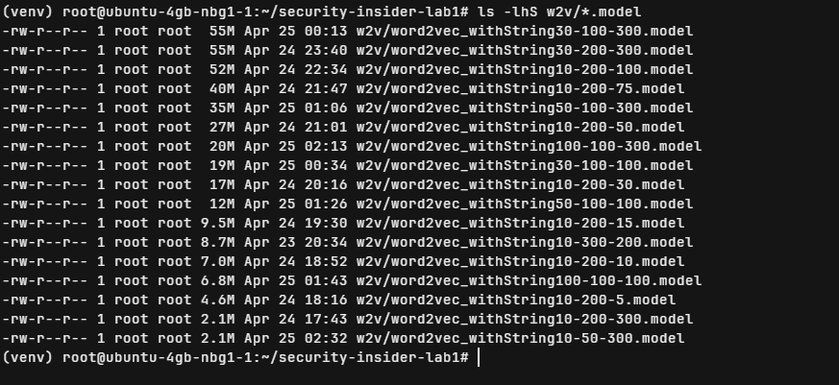
RESULTS
SECURITY INSIDER LAB II
The submission package contains the required model and more than 15 total models
17
model files present
597 MB
final model archive
~152 MB
The small .model file is only metadata; the trained vector arrays live in companion .npy files.
real size of required model with .npy vectors
08

Slide 9
VERIFICATION
SECURITY INSIDER LAB II
The required model learned meaningful Python control-flow relationships
A simple similarity probe checked whether the embedding space made intuitive sense.
most_similar("if")
$ verify word2vec_withString10-200-300.model
nearest tokens
elif
elif
0.7564
assert
0.5855
0.7564 similarity
while
0.5106
raise
0.3777
else
0.3692
Other nearby tokens included assert, while, raise, else, and break.
Control-flow tokens cluster together.
This validates the embedding pipeline, not a finished vulnerability detector.
09

Slide 10
LESSONS LEARNED
SECURITY INSIDER LAB II
The hardest work was modernizing the old pipeline, not calling Word2Vec
The fixes are also the story: every failure mode became a more robust data-preparation step.
API drift
pydriller and gensim calls changed
Encoding
Windows defaults could not read every corpus character
Tokenizer crashes
bad indentation had to be skipped locally
Hardware limits
VPS memory needed swap before training could finish
Security part: know the dangerous patterns. ML part: represent code tokens so a future detector can learn those patterns.
10

Slide 11
SECURITY INSIDER LAB II
LAB 5 PROJECT IDEA
HERMSEC
> scan https://github.com/org/repo
[1/5] Reading repository structure
[2/5] Running Bandit and Semgrep
A CVE-aware AI security agent for repositories
[3/5] Checking dependency CVEs
[4/5] Asking selected model to explain
[5/5] Writing Markdown report
Bring-your-own-model: OpenRouter, Ollama, LM Studio, or another compatible API.
Scanners and CVE databases produce evidence; the model explains and prioritizes it.
The tool stays defensive: scan, explain, suggest fixes, and avoid inventing CVEs.
11

Slide 12
HERMESSEC WORKFLOW
SECURITY INSIDER LAB II
Repository evidence flows through scanners before the model explains it
The AI layer is useful because it translates confirmed scanner output into developer-friendly action.
GitHub URL
or local path
Bandit
Semgrep
pip-audit
OSV-Scanner
BYOM AI
explanation
Security report
severity / CVE / fix
Suggested demo command
Questions?
> hermsec scan ./examples/vulnerable-python-app
Group G4 / Security Insider Lab II
12

