Slide 1
Elgamal Cryptography System
Team 3
Abdul Body
Haya Alruqi
Josh Kelley
Seth Wilson

Slide 2
General Elements and Key Generation
Public key cryptosystem developed by Taher Elgamal in 1984
Requirements for public key pairs described by Diffie and Hellman
Key generation based on prime q and alpha, a primitive root of q
Security based on difficulty of computing discrete logarithms
Notes:
The Elgamal Cryptographic System is a public key cryptosystem that was published in 1985 by Taher Elgamal in a paper titled, “"A Public-Key Cryptosystem and a Signature Scheme Based on Discrete Logarithms.”1 Public key encryption systems use asymmetric encryption algorithms that rely on one key that is publicly distributed, commonly called a public key, and a different but related key that is kept secret, commonly called a private key.2
Whitfield Diffie and Martin Hellman described a number of requirements for public key cryptographic algorithms. The two requirements they identified for the key pair are that it is computationally easy to generate a key pair and that it is computationally infeasible for an adversary to determine the private key from knowledge of the public key.3
The key pair in the Elgamal Cryptographic System is based on the choice of a prime number q and a number alpha, a primitive root of q.4 A private key value is chosen and the public key value is the remainder modulus q of alpha raised to the power of the private key. To obtain the private key value from the public key, an adversary would have to solve the difficult problem of computing a discrete logarithm, which is thought to be computationally infeasible for values of q that are at least 300 decimal digits in length.5

Slide 3
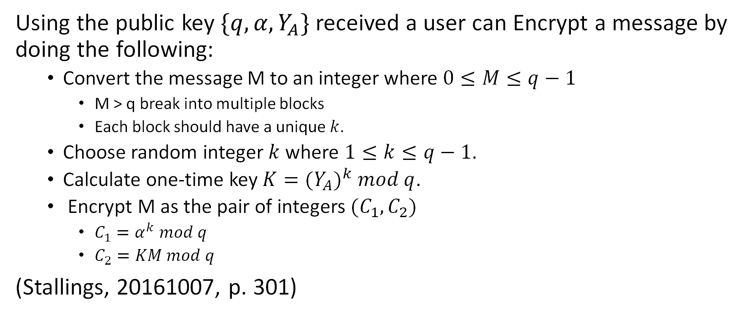
Encryption
Using the public key $\{q, α, Y_{A}\}$received a user can Encrypt a message by doing the following:
Convert the message M to an integer where $0≤M≤q−1$
M > q break into multiple blocks
Each block should have a unique $k$.
Choose random integer $k$ where $1≤k≤q−1$.
Calculate one-time key $K={(Y_{A})}^{k} mod q$.
Encrypt M as the pair of integers $(C_{1},C_{2})$
$C_{1}=α^{k} mod q$
$C_{2}=KM mod q$
(Stallings, 20161007, p. 301)
Notes:
Any user B that has access to A’s public key $\{q, α, Y_{A}\}$ can encrypt a message as follows:
Represent the message as an integer M in the range 0≤M≤q−1. Longer messages are sent as a sequence of blocks, with each block being an integer less than q.
Choose a random integer k such that 1≤k≤q−1.
Compute a one-time key $K={(Y_{A})}^{k} mod q$. ($Y_{A} and q$ are values from received public key)
Encrypt M as the pair of integers $(C_{1},C_{2})$where
$C_{1}=α^{k} mod q$
$C_{2}=KM mod q$
(Stallings, 20161007, p. 301)
Stallings, W. (20161007). Cryptography and Network Security, 7th Edition [VitalSource Bookshelf version]. Retrieved from vbk://9780134444635

Slide 4
Decryption
For decryption we have the following steps
Receive cipher text C1 and C2
Calculate K=C^(xa) mod q
For decrypting plain text we used the following formula
M=(C2)K^-1 mod q
Notes:
For decryption we have the following steps
Receive cipher text C1 and C2 in these we have the ciphertext that we get when we done the encryption
Calculate K=C^(xa) mod q. by using this formula we will calculate the value of K
For decrypting plain text we used the following formula
M=(C2)K^-1 mod q
In the M we will get the decrypted plain text

Slide 5
Applications- Electronic Signatures
Can be used for creating signatures, verifying, and preventing forgery
Electronic signatures = signing protocol + authentication process
Setup the same as encryption
Sign the message
Verify the signature
Notes:
Beyond encryption and decryption, an application of the ElGamal Cryptography System is electronic signatures. Digital signatures need to be secure since they serve the same purpose as traditional signatures. Electronic Signatures are tied to documents using mathematics so that they cannot be replaced by something else or copied and pasted into another document. Elgamal is one successful method of creating, verifying, and protecting signatures from forgery.
An electronic signatures consists of the signing protocol plus the authentication process. Public key cryptosystems like Elgamal are useful for e-signatures because the signature is created with private information but verified with public information. The signing protocol consists of the set up, signing the message, and verification. The set up is similar to the encryption process. The user selects a large prime number and secret integer. When signing the message, the random integer k is selected and the public key is computed. Users should avoid repeating the integer for k to ensure security. During verification, the message is decrypted using public information to determine the signature’s validity. Elgamal is preferred for signatures because it is difficult to for hackers to know the secret integer or be able to find a suitable "s" in the discrete logarithm.

Slide 6
References
1. https://en.wikipedia.org/wiki/ElGamal_encryption#cite_note-1. Accessed 12/1/2019.
2. Stallings, Cryptography and Network Security, p. 274.
3. Ibid.
4. Id., p. 301.
5. Id., p. 303.
6. Cryptography and Network Security Practice and Principles section 10.2
7. http://cs.indstate.edu/~jgrewal/steps.pdf
8. https://www.commonlounge.com/discussion/35a1c2baa00b447f9275e8f71b02ef29

