Slide 1
Lecture 5 The Theory of Consumer Choice
October 4, 2004
Budget Constraints
Indifference Curves
Consumer Optimization
Income and Substitution Effects
From Consumer Choice to Demand Curves
An irregular economical oddity: Giffen goods
Consumption-saving decisions
Do people really think this way?
(The work-leisure decision)

Slide 2
The Idea of Competition
How is (perfect) competition different in economics from its ordinary, everyday meaning?
  In the everyday sense of the term, the competitor is active in the marketplace, indeed, aggressive in trying to beat out other competitors, as in sports or games.
  In economics, the perfect competitor has no need to be aggressive. Rather she is absolutely passive, accepting the ruling price and demanding or supplying whatever she wishes at that price. As a consumer in the supermarket, or a farmer who grows a standard variety of wheat.

Slide 3
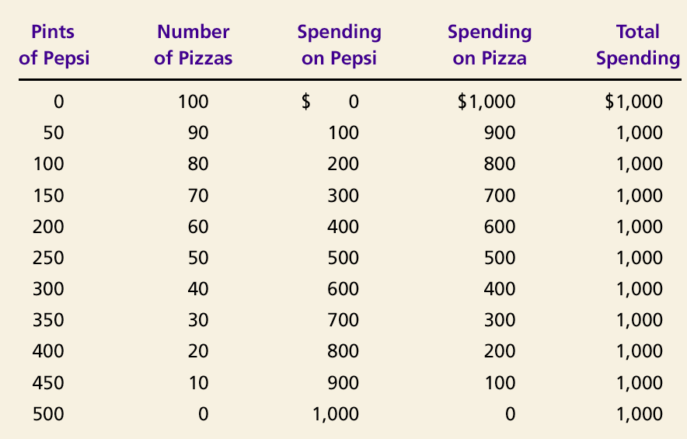

I
Table 1 The Consumer’s Budget Constraint
Copyright©2004 South
-
Western

Slide 4
Figure 1 The Consumer’s Budget Constraint
Quantity
of Cola
The (negative of the) slope of the budget constraint is the ratio of the price of pizza to the price of cola; in this case, p_{pizza} / p_{cola} = 5
B
500
C
250
Consumer’s
budget constraint
A
0
50
100
Quantity
of Pizza
Copyright©2004 South
-
Western

Slide 5
Figure 2a The Consumer’s Preferences
Quantity
of Cola
D
C

E
B
A
0
Quantity
of Pizza
Copyright©2004 South
-
Western

Slide 6
Figure 2b The Consumer’s Preferences
Quantity
If D is superior to B and E is inferior, then there must be some point on the line linking D and E which is just equivalent to B. Suppose this point is F.
of Cola
D
F
C

E
B
A
0
Quantity
of Pizza
Copyright©2004 South
-
Western

Slide 7
Figure 2c The Consumer’s Preferences
If D is superior to B and E is inferior, then there must be some point on the line linking D and E which is just equivalent to B. Suppose this point is F.
Similarly for the new line segment connecting E and D. Suppose G is just equivalent to B.
Quantity
of Cola
G 
D
 F
C

E
B
A
0
Quantity
of Pizza
Copyright©2004 South
-
Western

Slide 8
Figure 2d The Consumer’s Preferences
If D is superior to B and E is inferior, then there must be some point on the line linking D and E which is just equivalent to B. Suppose this point is F.
Similarly for the new line segment connecting E and D. Suppose G is just equivalent to B.
The blue curve represents the locus of all points equivalent to B. A locus of all points equivalent to each other is called an indifference curve because the consumer is indifferent between these combinations of goods.
Quantity
of cola

G 
D
 F
C

E
B
Indifference
Curve
A
0
Quantity
of Pizza
Copyright©2004 South
-
Western

Slide 9
Figure 2e The Consumer’s Preferences: Higher and Lower Levels of Preference Fulfillment
Quantity
of Cola
C
B
D
I
2
A
Indifference
curve,
I
1
0
Quantity
of Pizza
Copyright©2004 South
-
Western

Slide 10
Figure 3 The Impossibility of Intersecting Indifference Curves
Quantity
of Cola
C
A
B
0
Quantity
of Pizza
Copyright©2004 South-Western

Slide 11
Figure 4 The Marginal Rate of Substitution
Quantity
of Cola
14
MRS
= 6
8
A
1
4
MRS
= 1
B
3
1
Indifference
curve
0
2
3
6
7
Quantity
of Pizza
Copyright©2004 South-Western

Slide 12
Marginal Rates of Substitution and Marginal Utilities
The marginal rate of substitution (MRS) of cola for pizza is the ratio of the marginal utility of pizza (MU_{pizza}) to the marginal utility of cola (MU_{cola}): I can substitute 6 cans of cola for 1 pizza and maintain the same level of satisfaction if (and only if) 1 pizza gives me 6 times as much satisfaction (utility) at the margin as does a single can of cola.
In algebraic terms, MRS = MU_{pizza} / MU_{cola}

Slide 13
Marginal Rates of Substitution and Marginal Utilities, cont’d
Observe that for present purposes it doesn’t matter how much utility is associated with a particular indifference curve, only that the level of utility increases as we move away from the origin. What matters is the ratio of marginal utilities, not the absolute levels.

Slide 14
Figure 2f The Consumer’s Preferences
The numbering of indifference curves doesn’t matter for purposes of the theory of consumer
Quantity
of Cola
C
200
(85)
100
B
D
(75)
I
2
A
Indifference
curve,
I
1
0
Quantity
of Pizza
Copyright©2004 South
-
Western

Slide 15
Figure 5a Perfect Substitutes and Perfect Complements
(a) Perfect Substitutes
Nickels
6
4
2
I₁
I₂
I₃
0
1
2
3
Dimes
Copyright©2004 South-Western

Slide 16
Figure 5b Perfect Substitutes and Perfect Complements
(b) Perfect Complements
Left
Shoes
I₂
7
5
I₁
0
5
7
Right Shoes
Copyright©2004 South-Western

Slide 17
Figure 6 The Consumer’s Optimum
Quantity
of Cola
Optimum
B
A
I₃
I₂
I₁
Budget constraint
0
Quantity
of Pizza
Copyright©2004 South-Western

Slide 18
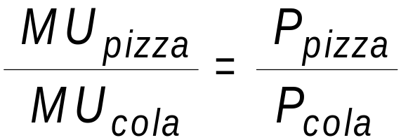
Algebraic Characterization of the Consumer’s Optimum
The slope of the budget constraint and the highest indifference curve attainable are equal at the optimum. So
MRS = P_{pizza} / P_{cola}
or

Slide 19
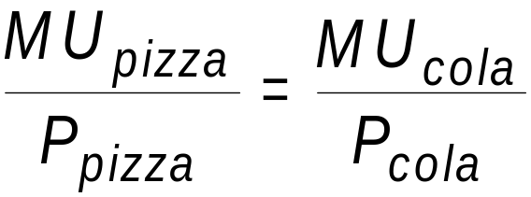
Algebraic Characterization of the Consumer’s Optimum, cont’d
We can rearrange the characterization in terms of ratios of marginal utilities and prices to read

Slide 20
Algebraic Characterization of the Consumer’s Optimum, cont’d
This means that the marginal utility per dollar spent on pizza is equal to the marginal utility per dollar spent on cola. This is a necessary condition of optimality, for if it were not fulfilled the consumer could do better by re-arranging her expenditure between the two items.

Slide 21
Figure 7 An Increase in Income
Quantity
of Cola
New budget constraint
1. An increase in income shifts the
budget constraint outward . . .
New optimum
3. . . . and
cola
Initial
consumption.
optimum
I₂
Initial
budget
I₁
constraint
0
Quantity
2. . . . raising pizza consumption . . .
of Pizza
Copyright©2004 South-Western

Slide 22
Figure 8 An Increase in Income Reduces Demand for an “Inferior” Good
Quantity
of Cola
New budget constraint
Is inferiority a property of goods or people’s preferences?
1. When an increase in income shifts the
3. . . . but
Initial
budget constraint outward . . .
cola
optimum
consumption
falls, making
New optimum
cola an
inferior good.
Initial
budget
I₁
I₂
constraint
0
Quantity
2. . . . pizza consumption rises, making pizza a normal good . . .
of Pizza
Copyright©2004 South-Western

Slide 23
Figure 9 A Change in Price
Quantity
of Cola
1,000
D
New budget constraint
New optimum
500
B
1. A change (up or down?) in the price
of cola rotates the budget constraint. . .
3. . . . and
raising cola
Initial optimum
consumption.
Initial
I₂
budget
I₁
constraint
A
0
100
Quantity
2. . . . reducing pizza consumption . . .
of Pizza
Copyright©2004 South-Western

Slide 24
Figure 10 Deriving the Demand Curve From Consumer Optimization
(a) The Consumer
’
s Optimum
(b) The Demand Curve for Cola
Quantity
Price of
of Cola
New budget constraint
Cola
1000
750
B
$2
A
500
I₂
B
A
1
250
Demand
I₁
0
Initial budget
Quantity
0
250
750
Quantity
constraint
of Pizza
of Cola
Copyright©2004 South-Western

Slide 25
Do We Need the Apparatus of Consumer Choice?
We could start with demand curves if all we were interested in was description (positive economics like “A minimum wage will lead to unemployment”).
But as soon as we enter the realm of welfare economics (like “A market system is optimal”), we rely on the optimizing consumer.

Slide 26
Figure 11 Income and Substitution Effects
Quantity
of Cola
New budget constraint
C
New optimum
Income
effect
B
Initial optimum
Substitution
Initial
effect
budget
constraint
A
I₂
I₁
0
Quantity
Substitution effect
of Pizza
Income effect
Copyright©2004 South-Western

Slide 27
Figure 12 A Giffen Good
Quantity of
Potatoes
Initial budget constraint
B
Optimum with high
price of potatoes
Optimum with low
D
price of potatoes
E
C
New budget
I₂
I₁
constraint
0
A
Quantity
of Meat
Copyright©2004 South-Western

Slide 28
Figure 13a Deriving the Demand Curve From Consumer Optimization: A Giffen Good
(a) The Consumer’s Optimum
Quantity of
Potatoes
Initial budget constraint
(a) The Consumer
’
s Optimum
(b) The Demand Curve for Potatoes
B
Price of
Potatoes
Optimum with high
price of potatoes
D
Optimum with low
Which way does the demand curve for a Giffen Good slope?
price of potatoes
E
C
New budget
I₂
I₁
constraint
0
A
Quantity
0
Quantity
of Meat
of Potatoes
Copyright©2004 South-Western

Slide 29
Figure 13b Deriving the Demand Curve From Consumer Optimization: A Giffen Good
(a) The Consumer’s Optimum
Quantity of
Potatoes
Initial budget constraint
(a) The Consumer
’
s Optimum
(b) The Demand Curve for Potatoes
B
Price of
Potatoes
Optimum with high
price of potatoes
D
Optimum with low
P₂
price of potatoes
E
C
P₁
New budget
I₂
I₁
constraint
0
A
Quantity
0
Quantity
of Meat
Q₁
Q₂
of Potatoes
Copyright©2004 South-Western

Slide 30
Figure 14 The Consumption-Saving Decision
Consumption
Budget
when Old
constraint
and Retired
$110,000
55,000
Optimum
I₃
I₂
I₁
0
$50,000
100,000
Consumption
when Young
and Working
Copyright©2004 South-Western

Slide 31
Figure 15 An Increase in the Interest Rate
(a) Higher Interest Rate Raises Saving
(b) Higher Interest Rate Lowers Saving
Consumption
Consumption
when Old
BC₂
when Old
BC₂
1. A higher interest rate rotates
1. A higher interest rate rotates
the budget constraint outward . . .
the budget constraint outward . . .
BC₁
BC₁
I₂
I₁
I₂
I₁
0
Consumption
0
Consumption
2. . . . resulting in lower
when Young
2. . . . resulting in higher
when Young
consumption when young
consumption when young
and, thus, higher saving.
and, thus, lower saving.
Copyright©2004 South-Western

Slide 32
Figure 15 An Increase in the Interest Rate
(a) Higher Interest Rate Raises Saving
(b) Higher Interest Rate Lowers Saving
Consumption
Consumption
when Old
BC₂
when Old
BC₂
1. A higher interest rate rotates
1. A higher interest rate rotates
the budget constraint outward . . .
the budget constraint outward . . .
BC₁
BC₁
I₂
I₁
I₂
I₁
0
Consumption
0
Consumption
2. . . . resulting in lower
when Young
2. . . . resulting in higher
when Young
consumption when young
consumption when young
and, thus, higher saving.
and, thus, lower saving.
Is this a case of a Giffen Good?
Copyright©2004 South-Western

Slide 33
Do People Really Think This Way? (Mankiw, pp 475-476)
[Y]ou might be tempted to treat the theory of consumer choice with some skepticism. After all, you are a consumer. You decide what to buy every time you walk into a store. And you know that you do not decide by writing down budget constraints and indifference curves. Doesn’t this knowledge about your own decisionmaking provide evidence against the theory?
The answer is no. The theory of consumer choice does not try to present a literal account of how people make decisions. It is a model. And, as we first discussed in Chapter 2, models are not intended to be completely realistic.
The best way to view the theory of consumer choice is as a metaphor for how consumers make decisions. No consumer (except an occasional economist) goes through the explicit optimization envisioned in the theory. Yet consumers are aware

Slide 34
Do People Really Think This Way? (Cont’d)
that their choices are constrained by their financial resources. And, given those constraints, they do the best they can to achieve the highest level of satisfaction. The theory of consumer choice tries to describe this implicit, psychological process in a way that permits explicit, economic analysis.
The proof of the pudding is in the eating. And the test of the theory is in the applications. In the last section of this chapter we applied the theory of consumer choice to three practical issues about the economy. If you take more advanced courses in economics, you will see that this theory provides the framework for much additional analysis. [Emphasis added]

Slide 35
Mankiw on models, Principles of Economics, 3rd Edition, ch 2, pp 22-23
Economists [like biology teachers] use models to learn about the world, but instead of being made of plastic, they are most often composed of diagrams and equations. Like a biology teacher's plastic model, economic models omit many details to allow us to see what is truly important. Just as the biology teacher’s model does not include all of the body’s muscles and capillaries, an economist's model does not include every feature of the economy.
As we use models to examine various economic issues throughout this book, you will see that all the models are built with assumptions. Just as a physicist begins the analysis of a falling marble by assuming away the existence of friction, economists assume away many of the details of the economy that are irrelevant for studying the question at hand. All models—in physics, biology, or economics—simplify reality in order to improve our understanding of it.

Slide 36
Consumption vs Saving as Pizza vs Cola
Where do preferences come from?
What is the budget constraint?
Different strokes for different folks: a theory of saving in terms of the theory of consumer choice is just what one might expect of a middle-aged college professor. Why?
Who saves and why?

Slide 37
Figure 16 The Work-Leisure Decision
Consumption
$5,000
Optimum
I₃
2,000
I₂
I₁
0
60
100
Hours of Leisure
Copyright©2004 South-Western

Slide 38
Figure 17 An Increase in the Wage
(a) For a person with these preferences
. . .
. . . the labor supply curve slopes upward.
Consumption
Wage
Labor
supply
1. When the wage rises . . .
BC₁
BC₂
I₂
I₁
0
Hours of
0
Hours of Labor
2. . . . hours of leisure decrease . . .
Leisure
3. . . . and hours of labor increase.
Supplied
Copyright©2004 South-Western

Slide 39
Figure 18 An Increase in the Wage
(b) For a person with these preferences
. . .
. . .
the labor supply curve slopes backward.
Consumption
Wage
BC₂
1. When the wage rises . . .
Labor
BC₁
supply
I₂
I₁
0
Hours of
0
Hours of Labor
2. . . . hours of leisure increase . . .
Leisure
3. . . . and hours of labor decrease.
Supplied
Copyright©2004 South-Western

