Slide 1
GEEK ROOM GLOBAL AI HACKATHON 2026
DiscoveryBrief
Walk into a discovery meeting with evidence, not a blank page.
A research-assisted briefing for enterprise sales and solution teams.
Local application + reproducible synthetic demos • Independent human quality review pending
DISCOVERYBRIEF • REVIEW • 01

Slide 2
PROBLEM
The preparation gap
• Research is scattered across news, company pages and meeting notes.
• Teams must separate public evidence from assumptions and customer-provided context.
• RFP details are easy to paraphrase beyond what the customer actually said.
The result should help a team ask better questions, with traceable evidence.
DISCOVERYBRIEF • REVIEW • 02

Slide 3
PRODUCT
From context to a bounded brief
1 Enter the company, meeting context and optional RFP.
2 Research recent public developments and review each proposed claim.
3 Generate a one-page brief, source evidence and grounded questions.
4 Export and revisit a clearly labeled result.
When evidence is insufficient, the brief explicitly says so.
DISCOVERYBRIEF • REVIEW • 03

Slide 4
SPONSOR INTEGRATIONS
Tavily + Bifrost in the workflow
Tavily Search + Extract → public source discovery and article text.
Bifrost → the single gateway for structured Planner, Analyst, Verifier, Composer and Auditor calls.
Deterministic checks → exact quotes, dates, source references, RFP offsets and bounded outputs.
No direct model-provider calls from the application.
DISCOVERYBRIEF • REVIEW • 04

Slide 5
EVIDENCE AND UNCERTAINTY
Trust is designed into the flow
• Public facts are displayed only after verification and reference checks.
• User-provided RFP and participant context retain their attribution.
• Ambiguous identity can require clarification; empty evidence remains context-only.
• Fixed-evidence and replay modes are labeled separately from live research.
The verifier is a safeguard, not a guarantee of factual accuracy.
DISCOVERYBRIEF • REVIEW • 05

Slide 6
DEVELOPMENT TEST • 9 NOVEMBER 2026
What has been observed
A public-company / synthetic-RFP API run completed with quality limited.
It returned two referenced claims, two requirements and two questions.
Synthetic fixed-evidence E01 returned ready with three distinct developments.
One development run is not an accuracy benchmark.
DISCOVERYBRIEF • REVIEW • 06

Slide 7
MEASURED OPERATIONS; HUMAN QUALITY REVIEW PENDING
Evaluation and limitations
• Ten fixed-evidence cases produced 20 baseline/candidate outputs.
• 10/10 expected candidate outcomes matched; this is not factual accuracy.
• Model calls: baseline 10 vs candidate 48.
• Median latency: baseline 8.7s vs candidate 36.9s.
• Precision, recall and question ratings remain unjudged; model cost unknown.
Results and failures must be disclosed before submission.
DISCOVERYBRIEF • REVIEW • 07

Slide 8
SUBMISSION READINESS
Next steps
Complete independent human judgments using the supplied review form.
Inspect this deck and the three synthetic replay demonstrations.
Confirm public repository and submission links under the owner's authorization.
Limits: single worker, model semantic errors, approximate event clustering, no verified fallback.
Evidence-first discovery preparation, with uncertainty made visible.
DISCOVERYBRIEF • REVIEW • 08

Slide 9
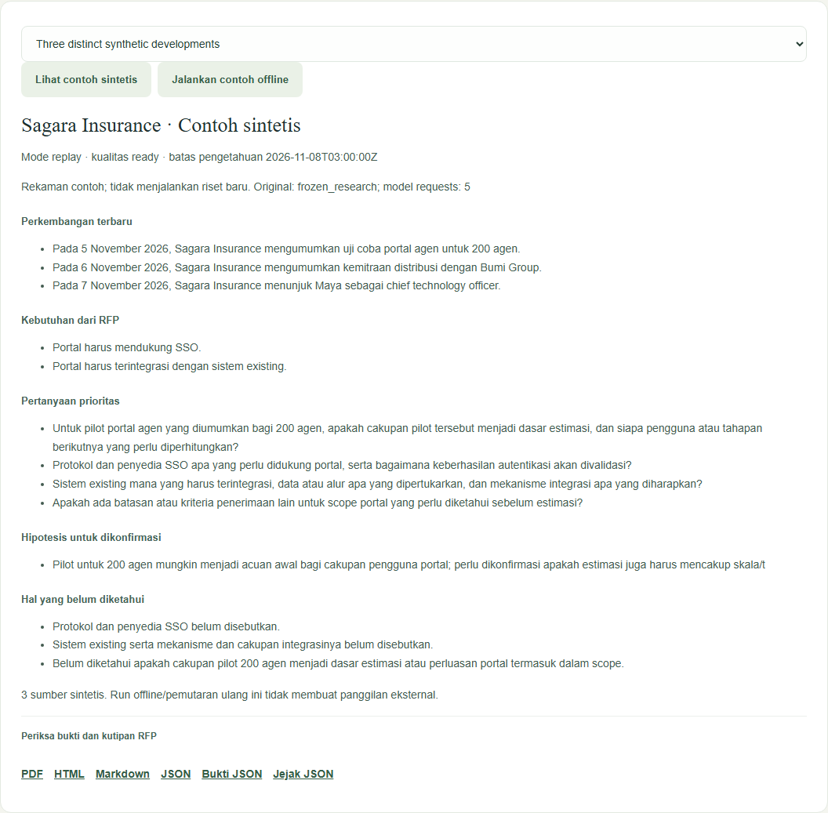
A brief with inspectable evidence
Synthetic ready example
Three separate developments.
Literal RFP requirements.
Questions and labeled hypotheses.
Replay performs no new research; original fixed-evidence/model metrics remain separate.

Slide 10
Run and review
Source package: discoverybrief/README.md
Architecture: docs/architecture.md
Evaluation: eval/results.md and eval/review-gapfix.html
Demo reports: submission/demo/
Public GitHub URL: not published in this session.
No deployment or submission receipt is claimed.

