Slide 1
GEEK ROOM GLOBAL AI HACKATHON 2026
DiscoveryBrief
Walk into a discovery meeting with evidence, not a blank page.
A research-assisted briefing for enterprise sales and solution teams.
Local application + reproducible synthetic demos • Independent human quality review pending
DISCOVERYBRIEF • 01

Slide 2
PROBLEM
The preparation gap
• Research is scattered across news, company pages and meeting notes.
• Teams must separate public evidence from assumptions and customer-provided context.
• RFP details are easy to paraphrase beyond what the customer actually said.
The result should help a team ask better questions, with traceable evidence.
DISCOVERYBRIEF • 02

Slide 3
PRODUCT
From context to a bounded brief
1 Enter the company, meeting context and optional RFP.
2 Research recent public developments and review each proposed claim.
3 Generate a one-page brief, source evidence and grounded questions.
4 Export and revisit a clearly labeled result.
When evidence is insufficient, the brief explicitly says so.
DISCOVERYBRIEF • 03

Slide 4
SPONSOR INTEGRATIONS
Tavily + Bifrost in the workflow
Tavily Search + Extract → public source discovery and article text.
Bifrost → the single gateway for structured Planner, Analyst, Verifier, Composer and Auditor calls.
Deterministic checks → exact quotes, dates, source references, RFP offsets and bounded outputs.
No direct model-provider calls from the application.
DISCOVERYBRIEF • 04

Slide 5
EVIDENCE AND UNCERTAINTY
Trust is designed into the flow
• Public facts are displayed only after verification and reference checks.
• User-provided RFP and participant context retain their attribution.
• Ambiguous identity can require clarification; empty evidence remains context-only.
• Fixed-evidence and replay modes are labeled separately from live research.
The verifier is a safeguard, not a guarantee of factual accuracy.
DISCOVERYBRIEF • 05

Slide 6
LIVE DEMONSTRATION - 10 NOVEMBER 2026
What has been observed
A public-company live run with synthetic meeting/RFP context completed ready.
Four selected findings, two requirements and two discovery questions.
Five Tavily searches, two extractions and five model requests; approximately 79 seconds.
Separate container/replay/PDF/restart and model-fallback routing checks passed.
Regression checks: 87 Python tests and four frontend tests passed.
One development run is not an accuracy benchmark.
DISCOVERYBRIEF • 06

Slide 7
MEASURED OPERATIONS; HUMAN QUALITY REVIEW PENDING
Evaluation and limitations
• Ten fixed-evidence cases produced 20 baseline/candidate outputs.
• 10/10 expected candidate outcomes matched; this is not factual accuracy.
• Model calls: baseline 10 vs candidate 48.
• Median latency: baseline 8.7s vs candidate 36.9s.
• Precision, recall and question ratings remain unjudged; model cost unknown.
Results and failures must be disclosed before submission.
DISCOVERYBRIEF • 07

Slide 8
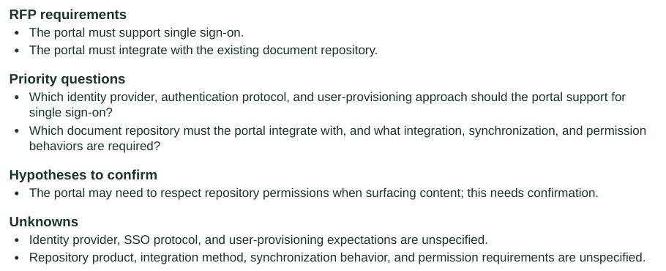
A brief with inspectable evidence
RFP requirements, questions and explicit unknowns
Recorded live result
Synthetic meeting context
OpenAI - ready coverage
Four selected findings
Two explicit requirements
Two discovery questions
The research wait is omitted in the demo video. This is not an accuracy benchmark.
Detail cropped from the actual one-page English PDF.
The complete brief and evidence are available in the demonstration.

Slide 9
Run and review
Source and setup: https://github.com/setiani/DiscoveryBrief
Demo video: https://www.youtube.com/watch?v=lTUKSxRqjq4
Setup: README.md
Architecture: docs/architecture.md
Evaluation: eval/results.md and human review form
No public deployment or submission receipt is claimed.

