Slide 1
Secure data hiding in images using stegnography
CAPSTONE PROJECT
Presented By:Setigam Adilakshmi Amrutha
Student Name : Setigam Adilakshmi Amrutha
College Name & Department : Sri Sivani College Of Engineering & Computer Science and Engineering

Slide 2
OUTLINE
Problem Statement
Technology used
Wow factor
End users
Result
Conclusion
Git-hub Link

Slide 3
Problem Statement
Develop a Python program that implements a simple steganography technique to hide a secret text message inside an image by modifying pixel values. The program should also allow authorized users to retrieve the hidden message using a passcode.p a Python program that implements a simple steganography technique to hide a secret text message inside an image by modifying pixel values. The program should also allow authorized users to retrieve the hidden message using a passcode. D

Slide 4
Technology used
Functional Requirements:
Message Embedding:
The user inputs a secret message and a passcode.
The program embeds the message into an image by encoding ASCII values into the pixel values.
The encoded image is saved as a new file.
Message Extraction:
The program prompts the user for a passcode to retrieve the hidden message.
If the passcode matches the one used during encoding, the program extracts and displays the hidden message.
If the passcode is incorrect, access is denied.
Error Handling:
The program should check whether the image file exists.
Ensure that the message fits within the image dimensions.
Handle edge cases such as out-of-bounds errors while encoding or decoding.

Slide 5
REQUIREMENTS
Constraints:
The message length should not exceed the available pixel capacity of the image.
Only alphanumeric and basic ASCII characters (0-255) can be embedded.
The encoding method should modify pixel values in a way that is not easily noticeable.
Passcode-based authentication should be implemented to prevent unauthorized decryption.

Slide 6
Expected outcome
The program successfully hides a secret message in an image.
A user with the correct passcode can retrieve the original message.
The image does not visually degrade significantly due to the embedding process.

Slide 7
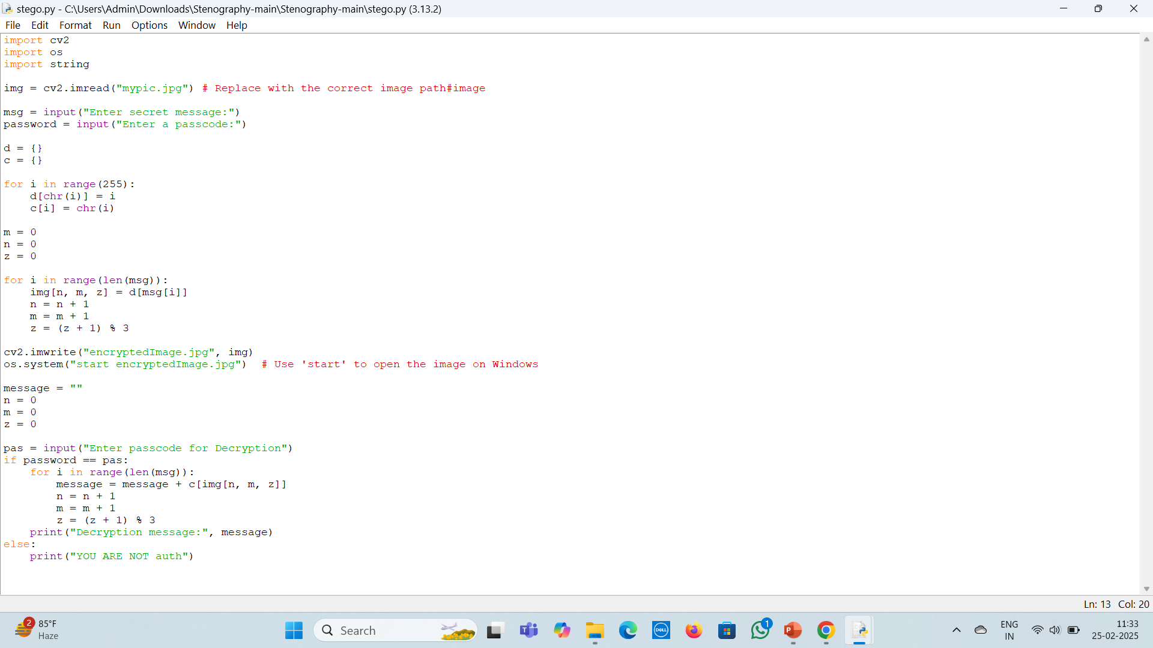
Results

Slide 8
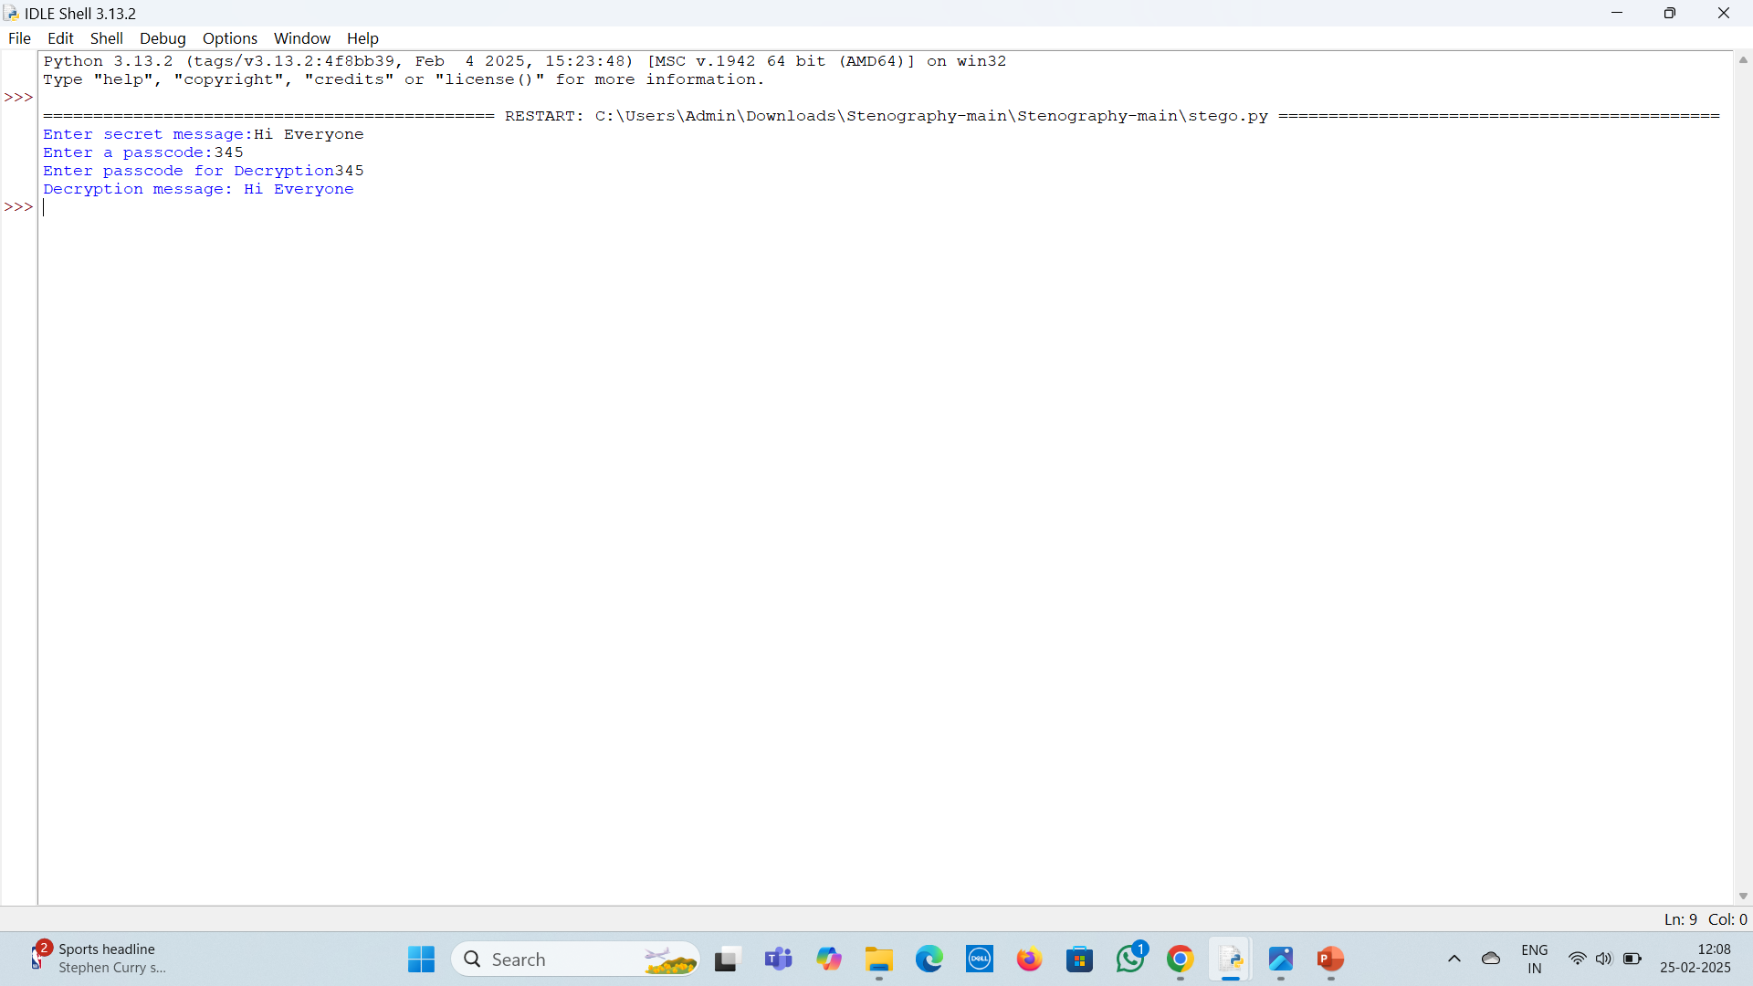
RESULTS

Slide 9

Sample

Slide 10
Conclusion
This project effectively implements image-based steganography to securely hide text within an image, retrievable only with a passcode. It ensures secure communication by modifying pixel values, making the message undetectable. With potential enhancements like encryption and improved pixel distribution, it can be further strengthened for cybersecurity and privacy protection.

Slide 11
GitHub Link
https://github.com/setigam-adilakshmi-amrutha/stegnography/upload

Slide 12
THANK YOU

