Slide 1
Agile Analysis Pipeline
Andy Brown
New Pipeline Development
Notes:
Intro myself
Here to talk about the agile development process of the analysis pipeline I developed

Slide 2

Who Are We?
Notes:
We are the Welcome Trust Sanger Institute. Here is a picture of our campius which is south of Cambridge in Hinxton

Slide 3
Who Are We?
One of the world's largest DNA Sequencing Centres
Second largest compute centre after CERN in Europe
Notes:
We are one of the worlds largest DNA sequencing centres. Until fairly recently, the largest, but we have been overtaken in the last few years by some centres in America, and then the Chnese have blown all the competition away.
We also have the largest compute centre in Europe after CERN. Biology has very much moved into the informatics domain, and unlike many other disciplines such as Physics, which have had the time to develop their compute infrastructure over the 15+yrs it takes to design the rest of the experiments, Biology has jumped such that we are sometimes lucky to get 1.5 motnhs.

Slide 4
What Do We Do?
Human, Mouse, Zebrafish and Pathogen Genome Projects
Post sequencing analysis, annotation and maintenance
(It's never truly finished!)
Notes:
Originally set up to sequence 1 third of the Human Genome, we also worked on the Mouse Genome. We have also sequenced other organisms and Pathgens ourselves.
We are also involved in the Post sequencing analysis, annotation and sequence maintenance.
Contrary to popular belief, the sequences are never truly finished.

Slide 5
Who Am I?
Tracking systems and analysis pipeline for Next Generation Sequencing Technologies
Perl, Web Technologies, Moose
Notes:
I'm a software developer in a group responsible for producing the tracking systems and running the primary analysis pipeline for the Next Generation Sequencing Instruments.
I mostly develop using Perl, Web Technologies and Moose

Slide 6
Next Generation Sequencing?
Massively Parallel DNA Sequencing
Producing Millions of Reads per run
~38 instruments
~5Tb of data a day
Managing quick turnaround on Staging of 320Tb data a month
Notes:
What is Next Generation Sequencing.
The Human Genome cost millions of dollars, and took around 15 years to complete. Very costly, as it used a sequencing techinique which just did a few strands of DNA at a time.
NGS is Massively Parallel Sequencing of strads, sequenicng millions at a time.
However, with approx 38 instruments, producing around 5Tb of data a day, that is a lot forus to deal with. We have a quick turnaround of 320Tb of data a month.

Slide 7
Analysis
Convert Images to Bases
Obtain quality values
Recalibrate quality
Separate up DNA sequences from different projects
Do this in parallel
Be able to extend this
Notes:
Here is an outline of the primary amalysis requirements, which needs to be done within 2 weeks of the run completing on an instrument.

Slide 8
Analysis
Current analysis running script was unable to cope with changing demands
Notes:
Our current analysis pipeline running script was unable to cope with the changing demands.

Slide 9
What Did I Have?

Slide 10

Notes:
Time – I had a little bit of time to look at how to approach this, and the best way to structure it

Slide 11
A Brief
Notes:
A suggestion of what the whole pipeline would be needed to do

Slide 12
Run
Completes
Bustard
CIF
Qseq, Sig2
Control Refs
Adaptor
Removal
Control Refs
Index: rejects
Index: rejects
Split
by Tag
Split
by Tag
Split
by Tag
Split
by Tag
Split
by Tag
Create Cal
Table
Index: + tags
Index: + tags
Cal Table
Initial Product
Creation
Initial Product
Creation
Gray boxes may
be pass-through
Calibrate
Scores
Calibrate
Scores
Cal-Qseq
Cal-Qseq
Consent
Align
Consent
Align
Index: + consent
Index: + consent
K-mer Error
Correction
K-mer Error
Correction
Create SRF
K-mer Error
Correction
K-mer Error
Correction
Index: + rejects
Index: + rejects
K-mer Error
Correction
K-mer Error
Correction
K-mer Error
Correction
K-mer Error
Correction
K-mer Error
Correction
K-mer Error
Correction
K-mer Error
Correction
Create Fastq
Next
Page!
Fastq
K-mer Error
Correction
K-mer Error
Correction
K-mer Error
Correction
Sample Refs
Align to
Ref
BAM

Slide 13
Control Refs
Sig2
Index
fastq
BAM
Run Summary (Summary.htm stuff)
IVC Plots
Q20 Counts
Fastqcheck
Insert Size Histogram
Error rates and QQ-Plots
Heatmaps
SNP Finder
... And Anything Else You Can Think Of
Human QC
Fuse
Archive
SRF
QC and Archival

Slide 14

Notes:
Vision, Ideas and Enthusiasm

Slide 15
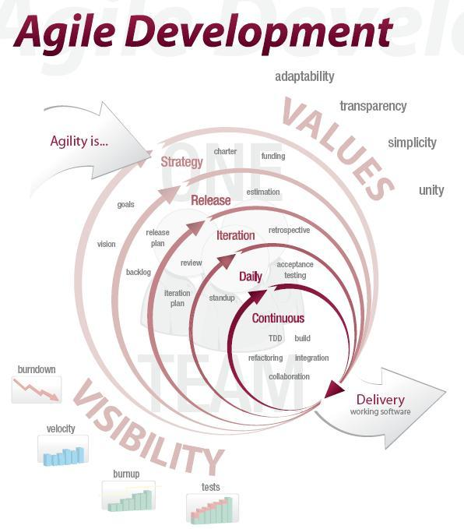
Notes:
Desire to develop in a more agile way, even if the rest of my teams focus wasn't quite along with that

Slide 16
Working in a Agile Manner
Current manner – still close to Cascade, some idea of iterations
I wanted more agility – defined iterations
Got close
Notes:
We had always had visions of working in an agile manner, but in reality it was still quite close to cascade. We had tried to apply some idea of iterations, but it mostly meant I've done a feature, if no-one has objections, I'll release it.
I wanted more than that, I wanted Agility ad the idea of defined iterations.
I got close with this.

Slide 17
First Iteration - It1
Chop down the brief into stories
Spoke with creator of the brief, my boss & team about what was needed
Pluggable, Automatic, Auto QC
Notes:
For my first iteration, I decided to look at the brief, chop it down into manageable chunks or stories, and decide look at what we wanted, then prototype it
I spoke with the creater of the brief (who had been running the previous script up until now), my boss and got some ideas from my team.
We wanted something that was pluggable, automatic, and would be able to produce some QC.

Slide 18
It1: First bit of Coding
Read old code – anything I can steal – yes!
Write some 'in principle' tests to get an idea of the way to go.
Write some code for those tests.
Notes:
So, in my first bout of coding, I started by reading the old, and now convoluted, script. Mostly looking for anything I could steal for a prototype.
I wrote some tests of how I wanted it to work.
I then worte my prototype

Slide 19
It1: Prototype
Notes:
I had heard of someone elses pipeline which involved a daemon running constantly, polling for finished jobs beofre launching the next. We had already decicded that this was not that feasible for us, since it would involve too much overhead of a daemon per run, approx 5 new daemons per day.
I hit upon an idea of a script which would
Know the order to launch jobs
Know which job had just been launched – via a command line parameter
Launch the next job
Launch itself, with the state, and a dependency on the previous job, to feed through to launch the next, or just finish

Slide 20
It1: Fail
Test Principle – Worked
Reality – Too Unwieldy
Notes:
In principle, it worked. However, in reality it was an epic fail, It got too unwieldywith more that parts, and that was before we wanted to parallise jobs

Slide 21
It1: Evaluation
Too much wrapping
Too much could go wrong with lots of parts
Out the Window!
Notes:
Also it had too much wrapping code, dealing with processing what had gone before it.
We decided that just too much could go wrong with it.
So we threw it out of the window.

Slide 22
Second Iteration - It2
So, I'm Agile. I don't see this as a set back.
Opportunity to try a different approach.
I sketch it out.
Notes:
Part of being agile is not to worry. I had only spent a week on this, so don't see it as a set back. It was a prototype, and a first attempt. I learmt from it.
This surprised my boss, since I'm normally quite particlular about my work, and I don't like things going wrong. Well, unless I deliberately plan it that way. I spent 3 weeks trying to prove that for us, message queues miight be unreliable, and finally did.
I took this as a chance to try a different approach.
I sketched it out.

Slide 23
Flag Waver
Function a
Function b
Function c
Function d
Function e
Object to
Launch Ca
Object to
Launch Cb
Object to
Launch Cc
Object to
Launch Cd
Object to
Launch Ce
Component
a
Component
b
Component
c
Component
d
Component
e
Notes:
This approach got termed the flag waver. A central function would launch in turn smaller functions which would call out to objects. Those objects would know how to launch other programs from the pipeline, and would only feedback the minimal amount of information required to launch the next one.
Using lsf, this would only need to be the job ids of the launched programs, which would then be used as job requirements for the next launched job.
This fitted nicely with the idea of it being pluggable, as the different functions should be loosely coupled. The order might be important a before b, but it might not matter if c got put in between them.

Slide 24
It2: Second lot of Coding
Again, start off with in principle tests
Write some code to pass those tests
Select a bit of real world to apply it to
Notes:
With this idea, I got back on coding.
I write some in principle test, and some code to pass those tests.
I then try it on some real world to see it it still is ok, as before.

Slide 25
It2: Pass
This real world bit works
All jobs are launched as expected
Replace the old section with this bit
It still works :) A perfect replacement
Notes:
This time the real world works! All my jobs launch and go through an example as expected.
I replace the old section I had taken (some post analysis analysis) and actually install it.
WooHoo, it is a perfect replacement.

Slide 26
It2: Evaluation
Success :)
The Flag Waver model - functions that know what to do, but no knowledge of other functions
This should make it pluggable
Notes:
Evaluating again – success!
I now have a model which is loosely coupled enough to make it pluggable – I hope.
I'm also happy enough with this as a prototype to move it into a production scale framework

Slide 27
It2: Evaluation
Bulky data getting generated multiple times over – Needs more DRYness
Notes:
However, I notice something about the way the functions are getting called. Some data is in the form of bulky hashrefs, and geneated multiple times over

Slide 28
It3: Some new requests
It would be easier to code if we didn't have users of the applications!
The first new request comes in for some automated QC
Just launch them at the correct time

Slide 29
It3: Scrum
So, I scrum.
The objective: Work out priorities for this iteration.
There are many 'stories', I decide on the following.

Slide 30
It3: Scrum
Write something to make data construction and passing more DRY
Write another replacement pipeline section
Try to incorporate 1 QC into previous pipeline section

Slide 31
It3: Tests
I write some tests to assess launching the analysis pipeline
I write some tests to incorporate a QC launch into the post analysis pipeline
I run the tests, which fail

Slide 32
It3: Code
I decide first to add the QC launch
My boss wants to start getting the data
I get a quick view of how pluggable the system actually is
It is good :)

Slide 33
It3: Code
The analysis guys want their pipeline to start showing up
Good reason - a new version of the scripts have appeared, and they don't want to patch the old
This takes the rest of the iteration

Slide 34
It3: Release
The most important release so far
Completely replace old code with new
Took about 2 days, with bug fixing

Slide 35
It3: Evaluation
Bugs on Release - tests don't always prove everything!
No time to DRY out the code
Successful product into production
Old code has gone to 'silicon heaven'

Slide 36
It4: Scrum
I again scrum
So far, iterations have been quite quick
In order for some time to pass for the pipeline, I decide to do refactoring this time

Slide 37
It4: Scrum
Utilising more Inheritance (using Moose Roles)
Create external role to translate attributes without building hashes each time

Slide 38
It4: In Brief
After 2 weeks
  a nicely refactored pipeline
  external role to DRY out data (released to CPAN)
  time to have monitored how the pipeline was running
Release and go

Slide 39
The next few iterations
Iterations continue, releasing every 2-3 weeks :)
Until it all broke :(

Slide 40
The Broken Pipeline Iteration
Up until now, the pipeline had been behaving itself.
New analysis code came from our supplier, our R&D team would test, then I would throw the switch and release.

Slide 41
The Broken Pipeline Iteration
However, they changed something we didn't find in testing.
Runs with multiplexed lanes broke, as they have an extra 'barcode' read

Slide 42
The Broken Pipeline Iteration
Luckily, here is where being agile really helped.
Whilst I had just 'scrummed' to decide my priorities, I just dropped them
New Priority – Fix the Pipeline

Slide 43
The Broken Pipeline Iteration
Pluggable, so could a function or two be moved to help?
Yes! 1 function move would halve the problem.
Run on example – expected outcome

Slide 44
The Broken Pipeline Iteration
Now to fix the 3 read / 2 read problem
Again, write tests, test, code, test, run on example, write tests for bugs, test, code, test, run on example ....
End of this iteration, able to release a fully fixed pipeline

Slide 45
The Broken Pipeline Iteration
Evaluation:
Being Agile, both in project management and design, helped here.
How?

Slide 46
The Broken Pipeline Iteration
Design:
Plugin design of the pipeline - half the problem was solved just by moving something.
The other part just by writing a new module.
It just worked!

Slide 47
The Broken Pipeline Iteration
Project Management:
Changing an iterations priorities so that the urgently required fix could be done...
...barely disrupting the flow of work on feature requests

Slide 48
What has happened since?
Development has settled into a 2-3 week release cycle
Team knows development position
Made it easier for them to cover me

Slide 49
What else happened since?

Slide 50

Notes:
My boss and other team members have read some of my books

Slide 51
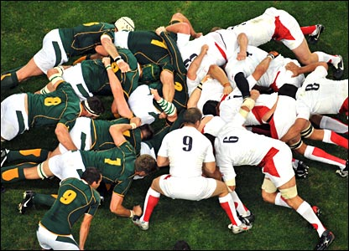
Notes:
We scrum daily

Slide 52
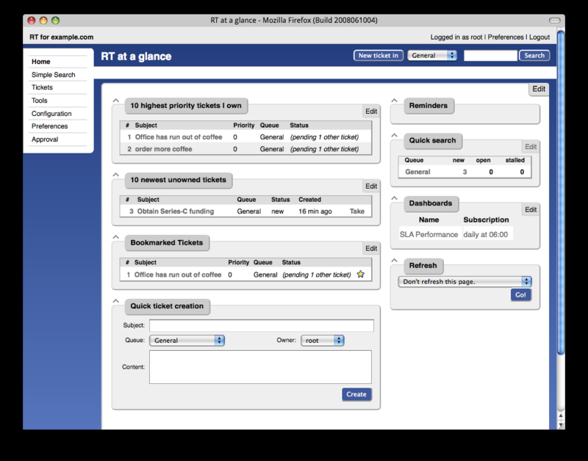
Notes:
Sprints and feature requests are tracked using RT

Slide 53

Notes:
Our productivity has increased

Slide 54
Acknowledgements
David Jackson
Guoying Qi
John O'Brien
Marina Gourtovaia
Sri Deevi
Tom Skelly
Irina Abnizova
Steve Leonard
Tony Cox
You

Slide 55
Contact Me!
http://software-east.net/profile/AndyBrown
setitesuk@gmail.com
http://vampiresoftware.blogspot.com
http://twitter.com/setitesuk
http://www.slideshare.net/setitesuk
http://github.com/setitesuk

