Slide 1
Agile Analysis Pipeline
Andy Brown
New Pipeline Development

Slide 2

Who Are We?

Slide 3
Who Are We?
Responsible for Human, Mouse and Zebrafish Genome Projects, along with other organisms and Pathogens
Post sequencing analysis, annotation and maintenance
(It's never truly finished!)

Slide 4
Who Am I?
Responsible for tracking systems and analysis pipeline for Next Generation Sequencing Technologies
Perl, Web Technologies, Moose

Slide 5
Next Generation Sequencing?
Massively Parallel DNA strand Sequencing
Producing Millions of Reads per run
~38 instruments
~5Tb of data a day
Managing quick turnaround on Staging of 320Tb data a month

Slide 6
Analysis
Convert Images to Bases
Obtain quality values
Recalibrate quality
Separate up DNA sequences from different projects
Do this in parallel
Be able to extend this
Notes:
This is the basic analysis that is needed, with the requirement to parallise where possible and allow it to be extended.

Slide 7
Need to be AGILE
Basically, the current analysis running script was unable to cope with changing demands
To be fair, it was knocked up very quickly to solve an immediate problem

Slide 8
What Did I Have?

Slide 9
A Brief
Notes:
A suggestion of what the whole pipeline would be needed to do

Slide 10
Run
Completes
Bustard
CIF
Qseq, Sig2
Control Refs
Adaptor
Removal
Control Refs
Index: rejects
Index: rejects
Split
by Tag
Split
by Tag
Split
by Tag
Split
by Tag
Split
by Tag
Create Cal
Table
Index: + tags
Index: + tags
Cal Table
Initial Product
Creation
Initial Product
Creation
Gray boxes may
be pass-through
Calibrate
Scores
Calibrate
Scores
Cal-Qseq
Cal-Qseq
Consent
Align
Consent
Align
Index: + consent
Index: + consent
K-mer Error
Correction
K-mer Error
Correction
Create SRF
K-mer Error
Correction
K-mer Error
Correction
Index: + rejects
Index: + rejects
K-mer Error
Correction
K-mer Error
Correction
K-mer Error
Correction
K-mer Error
Correction
K-mer Error
Correction
K-mer Error
Correction
K-mer Error
Correction
Create Fastq
Next
Page!
Fastq
K-mer Error
Correction
K-mer Error
Correction
K-mer Error
Correction
Sample Refs
Align to
Ref
BAM

Slide 11
Control Refs
Sig2
Index
fastq
BAM
Run Summary (Summary.htm stuff)
IVC Plots
Q20 Counts
Fastqcheck
Insert Size Histogram
Error rates and QQ-Plots
Heatmaps
SNP Finder
... And Anything Else You Can Think Of
Human QC
Fuse
Archive
SRF
QC and Archival

Slide 12
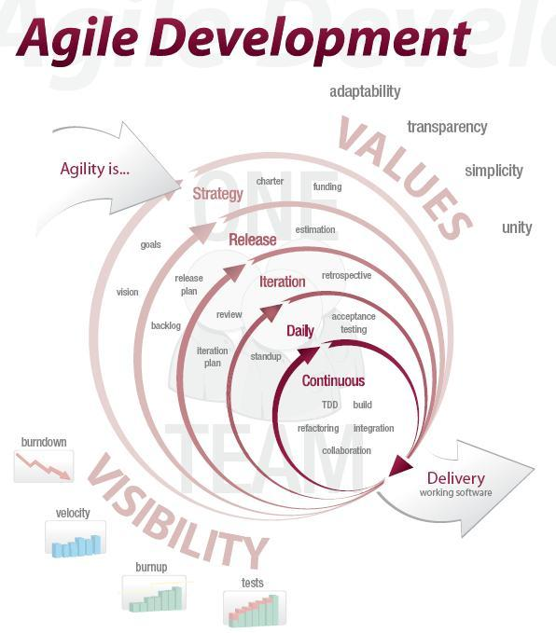
Notes:
Desire to develop in a more agile way, even if the rest of my teams focus wasn't quite along with that

Slide 13
Working in a Agile Manner
Current manner – still close to Cascade, some idea of iterations
I wanted more agility – defined iterations
Got close

Slide 14
First Iteration - It1
Chop down the brief into stories
Spoke with creator of the brief, my boss, team about what was needed
Pluggable, Automatic, Auto QC

Slide 15
It1: First bit of Coding
Read old code – anything I can steal – yes!
Write some 'in principle' tests to get an idea of the way to go.
Write some code for those tests.

Slide 16
It1: First Idea

Slide 17
It1: Fail
Test Principle – Worked
Reality – Too Unwieldly, trying to relaunch and maintain state

Slide 18
It1: Evaluation
My Boss took a look at the Failure
Too much wrapping
Too much could go wrong with lots of parts
Out the Window!

Slide 19
Second Iteration - It2
So, I'm Agile. I don't see this as a set back.
This is an opportunity to try a different approach.
I sketch it out.

Slide 20
Flag Waver
Function a
Function b
Function c
Function d
Function e
Object to
Launch Ca
Object to
Launch Cb
Object to
Launch Cc
Object to
Launch Cd
Object to
Launch Ce
Component
a
Component
b
Component
c
Component
d
Component
e

Slide 21
The next few iterations
I continued down this agile development path, for a few more iterations, slowly building and releasing extra features every 2 weeks.

Slide 22
What has happened since?
I have continued to work on the pipeline development in an agile way
Continued feature releases, and the ability to add in new plugins have made it easier for my colleagues to add and patch when needed

Slide 23
What else happened since?

Slide 24

Notes:
My boss and other team members have read some of my books

Slide 25
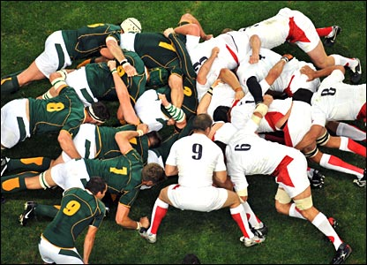
Notes:
We scrum daily

Slide 26
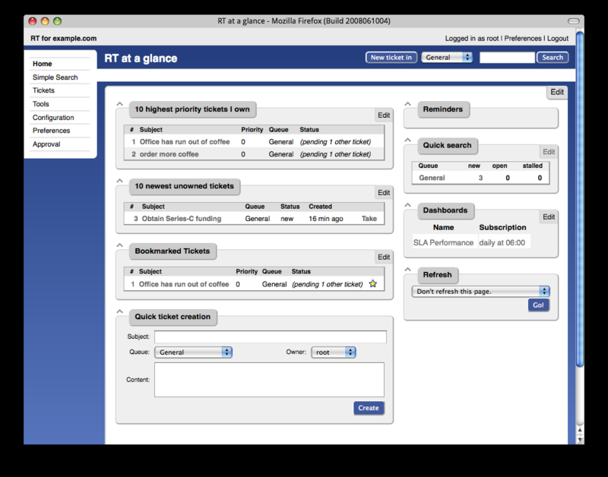
Notes:
Sprints and feature requests are tracked using RT

Slide 27

Notes:
Our productivity has increased

Slide 28
Acknowledgements
David Jackson
Guoying Qi
John O'Brien
Marina Gourtovaia
Sri Deevi
Tom Skelly
Irina Abnizova
Steve Leonard
Tony Cox
You

Slide 29
Contact Me!
http://software-east.net/profile/AndyBrown
setitesuk@gmail.com
http://vampiresoftware.blogspot.com
http://twitter.com/setitesuk
http://www.slideshare.net/setitesuk
http://github.com/setitesuk

