Slide 1
How I Turned to the Dark Side.
Formats of Data Transfer

Slide 2
What file types are there?
The 4/5 most popular are:
  CSV, TSV
  XML
  JSON
  YAML

Slide 3
CSV / TSV
Comma or Tab Separated Values
Easy to dump into a spreadsheet
Parsable using a library that uses SQL
Little space
CSV is not very human readable, and if large amounts TSV can get confusing

Slide 4
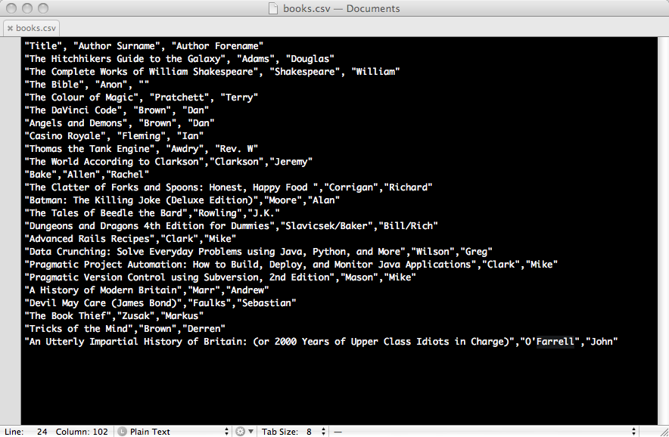

Slide 5
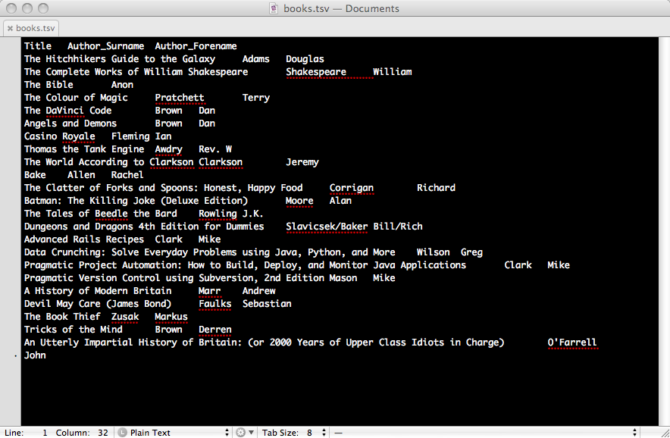

Slide 6
YAML
YAML Aint Markup Language
Very Human Readable Data structures
Very useful for config and fixture files
Easy for machines to read
Whitespace dependent, so can produce very long files.
Forced to be a particular structure

Slide 7
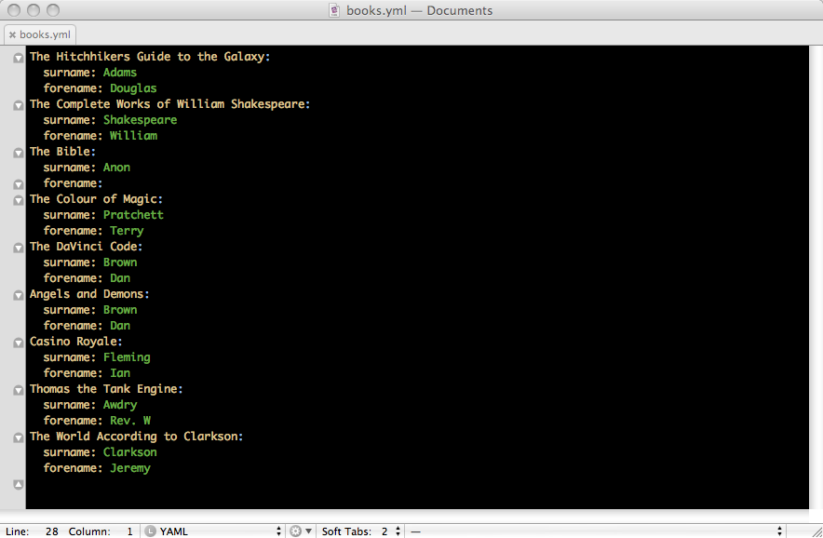

Slide 8
XML
eXtensible Mark up Language
If well-formed, can be read by a number of libraries
Very common
Whitespace independent
Layout of data very much up to the individual - but needs documenting!

Slide 9
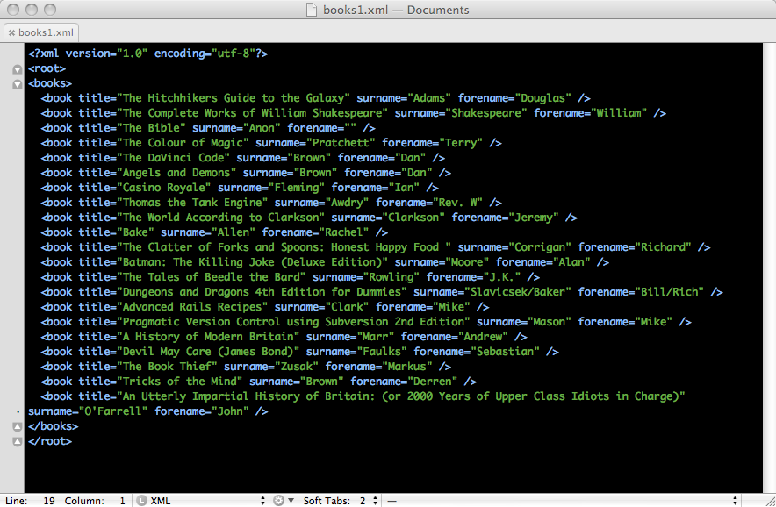

Slide 10
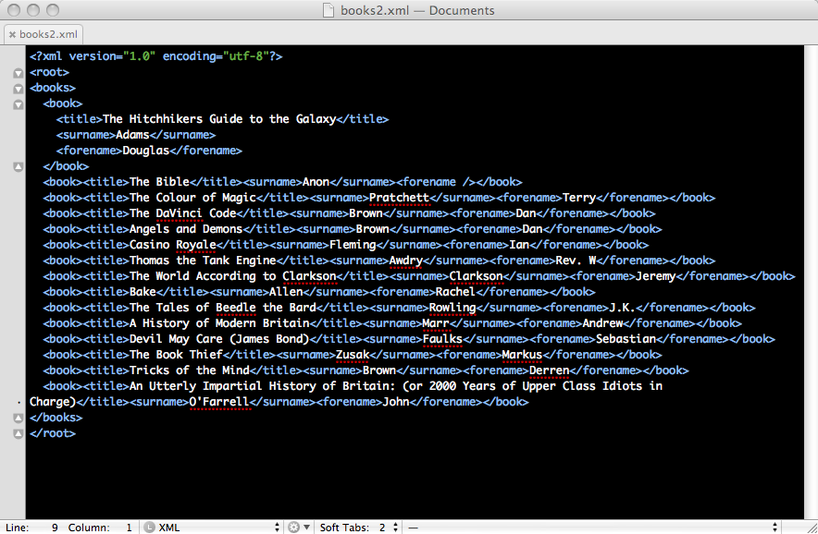

Slide 11
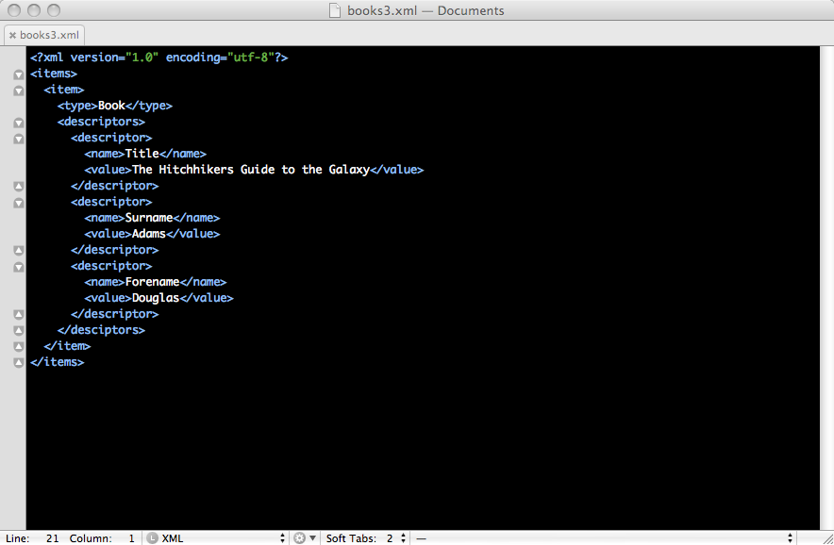

Slide 12
JSON
JavaScript Object Notation
Forced to be a particular structure
Potentially Dangerous in JavaScript if just evalled
Little memory space
Data structure is obvious to a human reader if spaced out, although whitespace independent

Slide 13
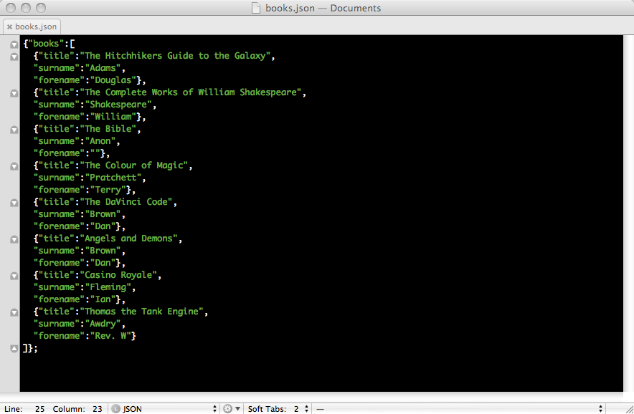

Slide 14
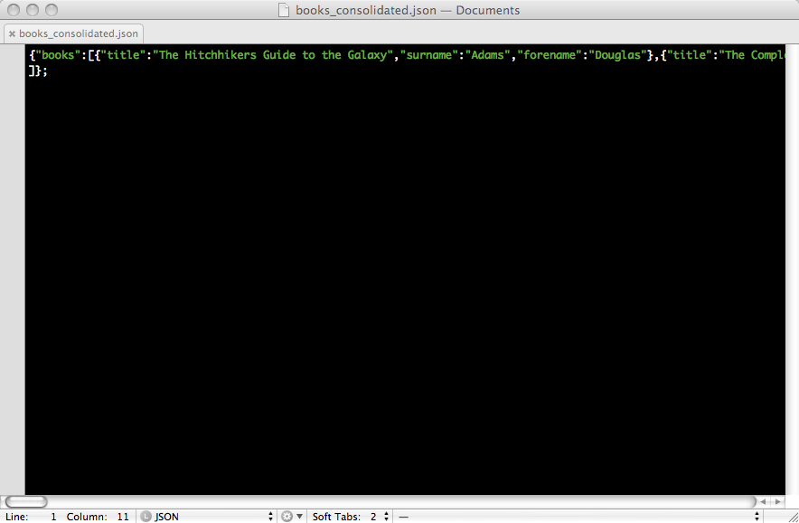

Slide 15
What’s the best?
Pros
  CSV/TSV good for sending to Spreadsheets and Databases
  YAML is great when it needs to be human modifiable, such as fixture data/config files
  XML is very versatile in how to markup data
  JSON is very compact and easily parsed into objects

Slide 16
What’s the best?
Cons
  CSV/TSV can be difficult to work with in apps, as no variable names necessarily associated.
  YAML can be very long files, and needs to adhere to the whitespacing

Slide 17
What’s the best?
Cons
  XML can be confusing if not well documented, and can be longwinded to obtain the information
  JSON can be less human readable if you are aiming for reducing bandwith by stripping whitespace

Slide 18
What is my Choice?
Depends on the application, but:
  I want the data to be both Human and Machine readable
  I want the format to be well defined
  I want it to be convenient to parse
  I want it to be supported long term

Slide 19
What is my choice?
Was XML, Fast becoming JSON
Easy to parse
Follows rigid structure
If laid out it can be
  Easily eyeballed for the data
  Easily hand-modified

