Slide 1
New Pipeline Development
New Sequencing R & D
Andy Brown

Slide 2
Overview
Who we are
What’s new in NPG Software
New Sequencing R & D - Life cycle of a run folder

Slide 3
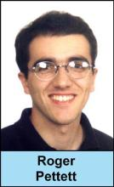

New Pipeline Development
Roger Pettett - Group Leader
Andy Brown - Senior Software Developer
Responsible for in-house pipeline software development

Slide 4



New Sequencing R & D
Clive Brown - Group Leader
Tom Skelly
Nava Whiteford
Optimisation of New Sequencing Technology Software
Nava Whiteford
Tom Skelly

Slide 5
What’s New in NPG Software
We are aiming for fortnightly releases of features.
2 releases since the new year (7 & 8)
Release 6 just before Christmas

Slide 6
Release 7 - 15/01/2008
Sample Data in email alerts
Loaders group
Fetch run lanes associated with a CAS project
Instrument Utilisation for past 30 days
Run and Sample summaries pick up recently mirrored

Slide 7
Release 8 - Yesterday!
Instrument Utilisation now in graphical form
Graphs on run/x and instrument/x pages to show prephasing, phasing, signal and noise for last 10 cycles
Good/bad lanes now on run lane summary - and don’t show anything if it cannot be determined
Text search facility

Slide 8
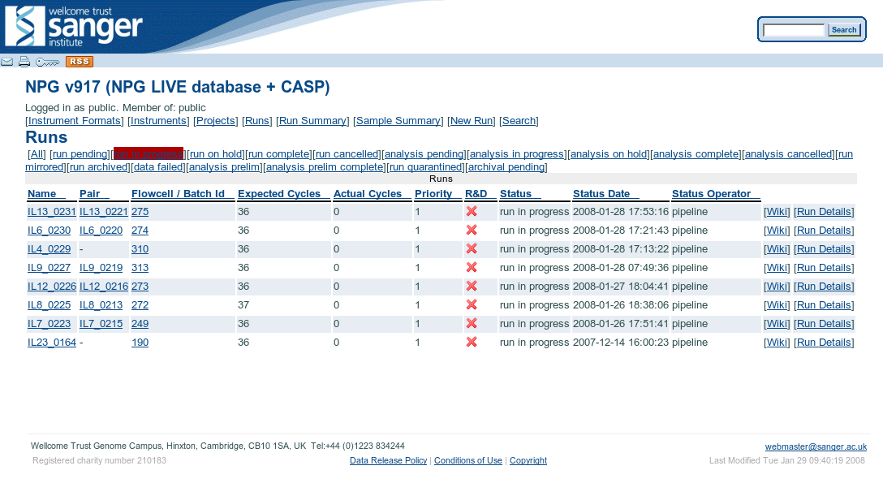

Slide 9
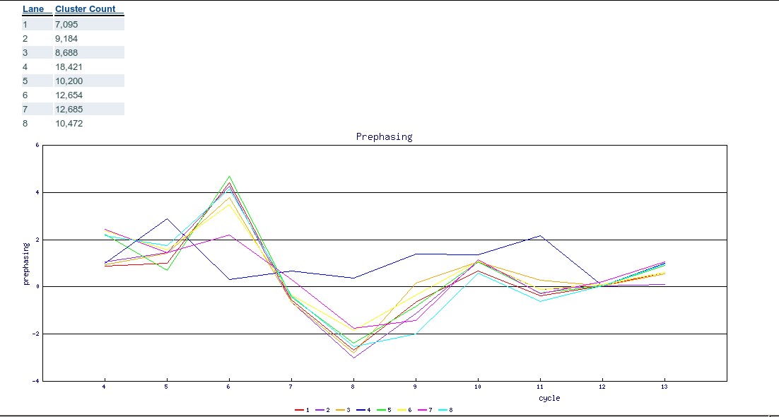

Slide 10
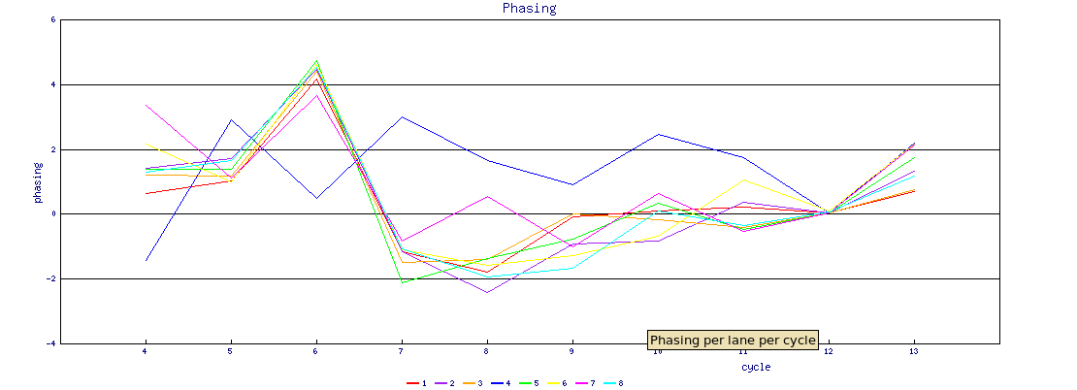

Slide 11
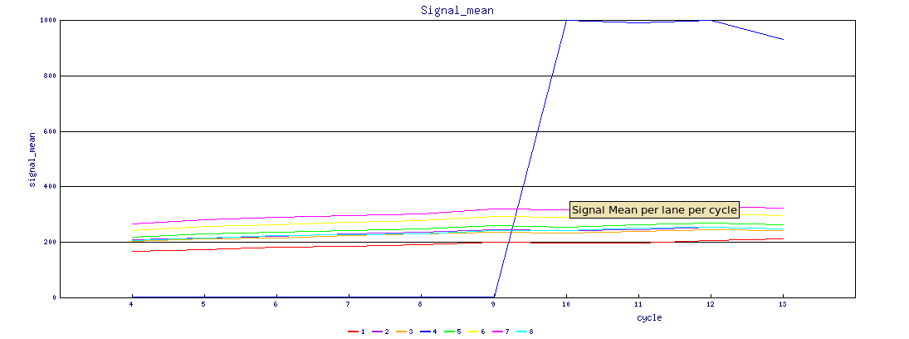

Slide 12
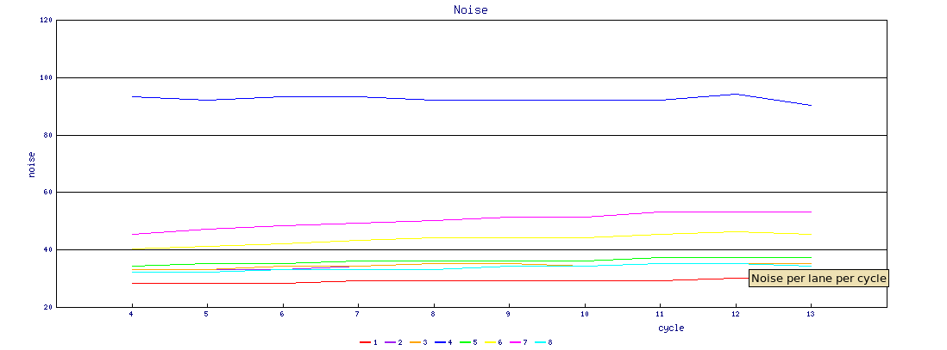

Slide 13
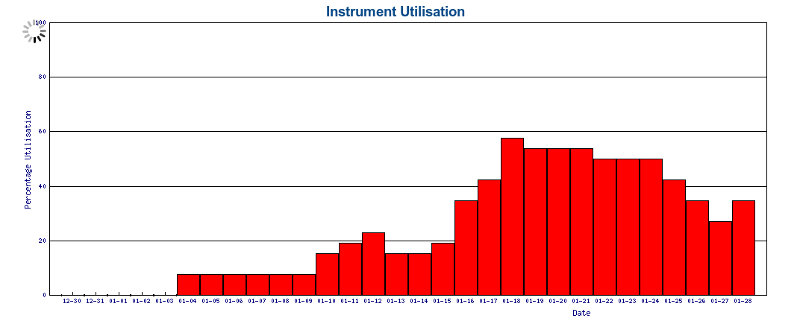

Slide 14
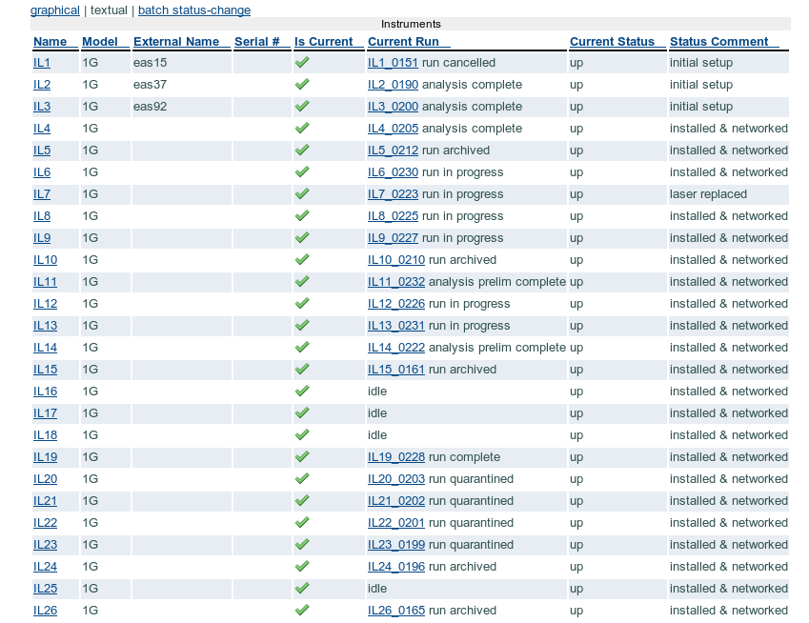

Slide 15
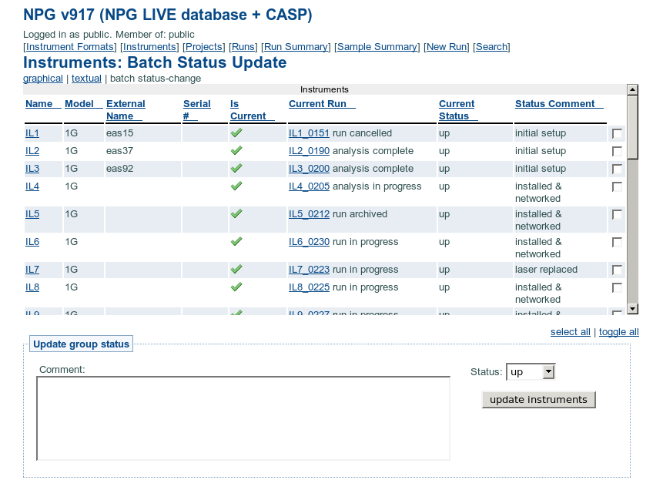

Slide 16
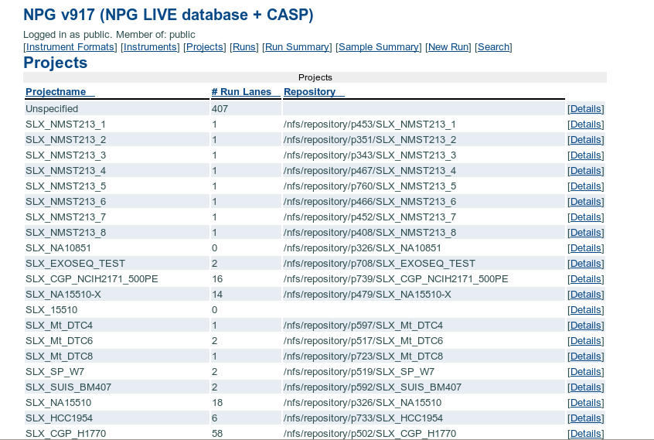

Slide 17
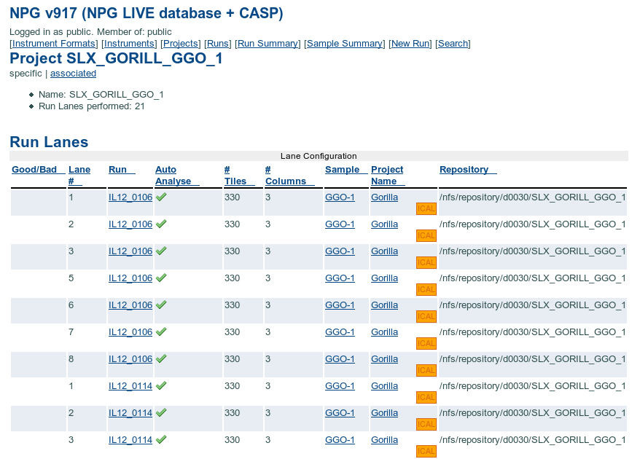

Slide 18
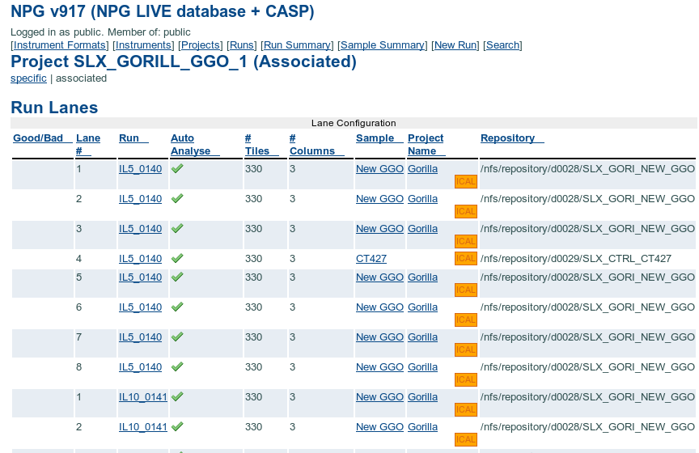

Slide 19
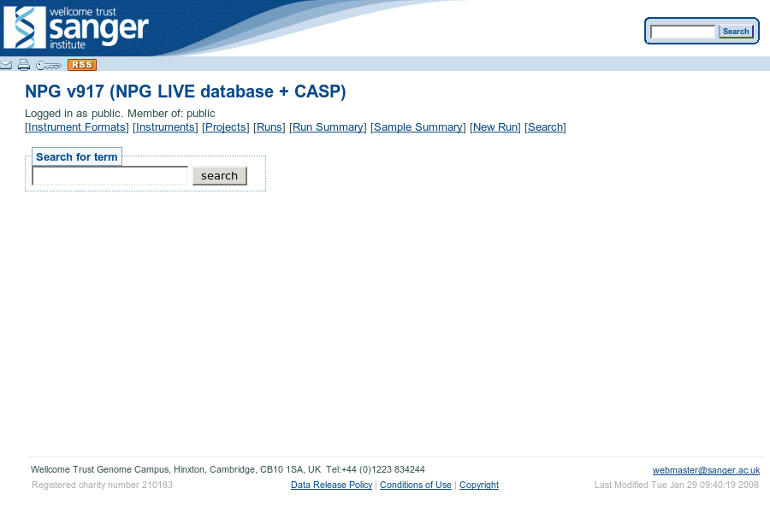

Slide 20
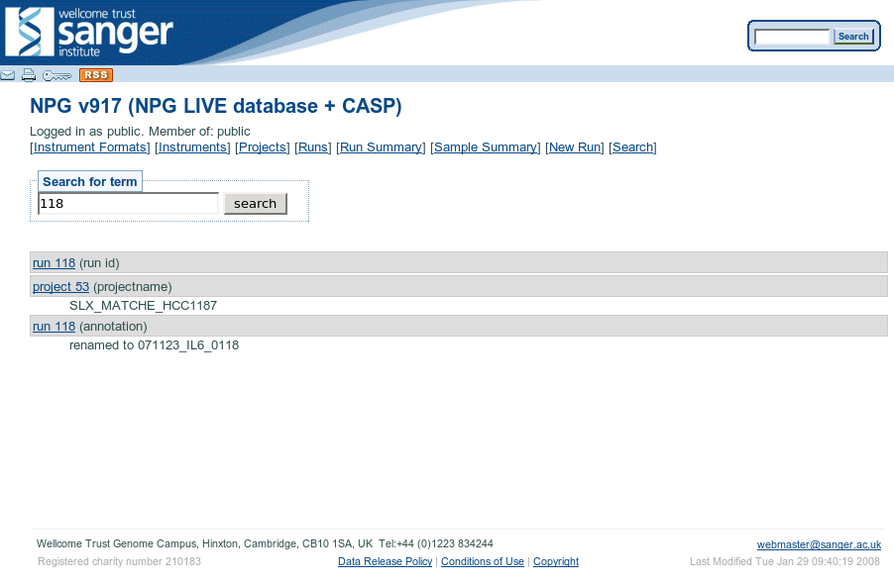

Slide 21
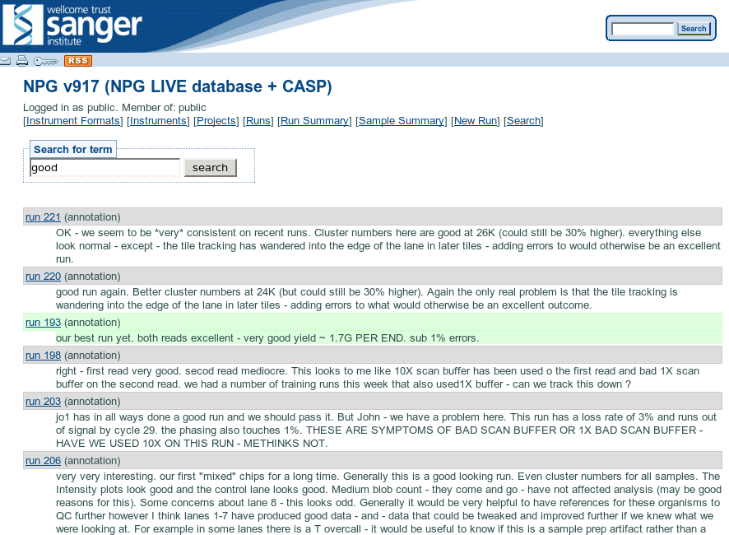

Slide 22
Life Cycle of a Run Folder

Slide 23
enter in db
2nd/only read complete
run
pending
analysis
in progress
start run
pipeline complete
run in
progress
analysis
complete
run quar-
antined
run finished
human QC
run
complete
archival
pending
data mirrored
copy to archive
analysis
pending
run
archived
first read?
Runfolder
Life-Cycle
analysis
prelim
complete (1/20 tiles)
prelim
complete

Slide 24
Things to note
There's a "prelim" run done on 1 of 20 tiles of a first read. It uses phageAlign.
"Latest Analysis" link is created at Analysis-Complete stage.
Data is copied to archive only after human QC (soon to be automated tick-off)
Failed runs, test runs, etc are quarantined, not archived.

Slide 25
Thanks

