Slide 1












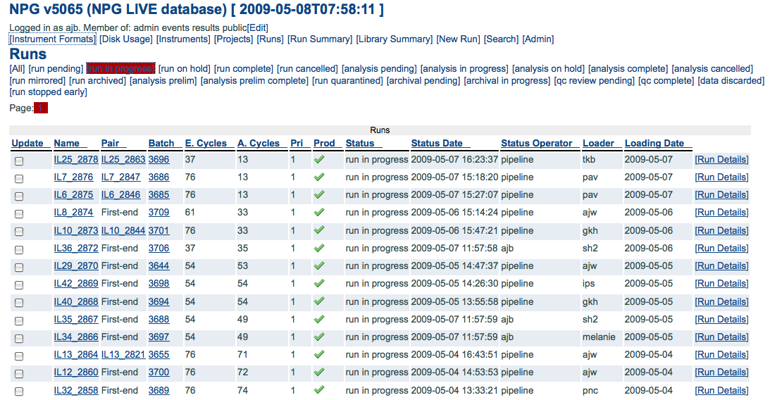
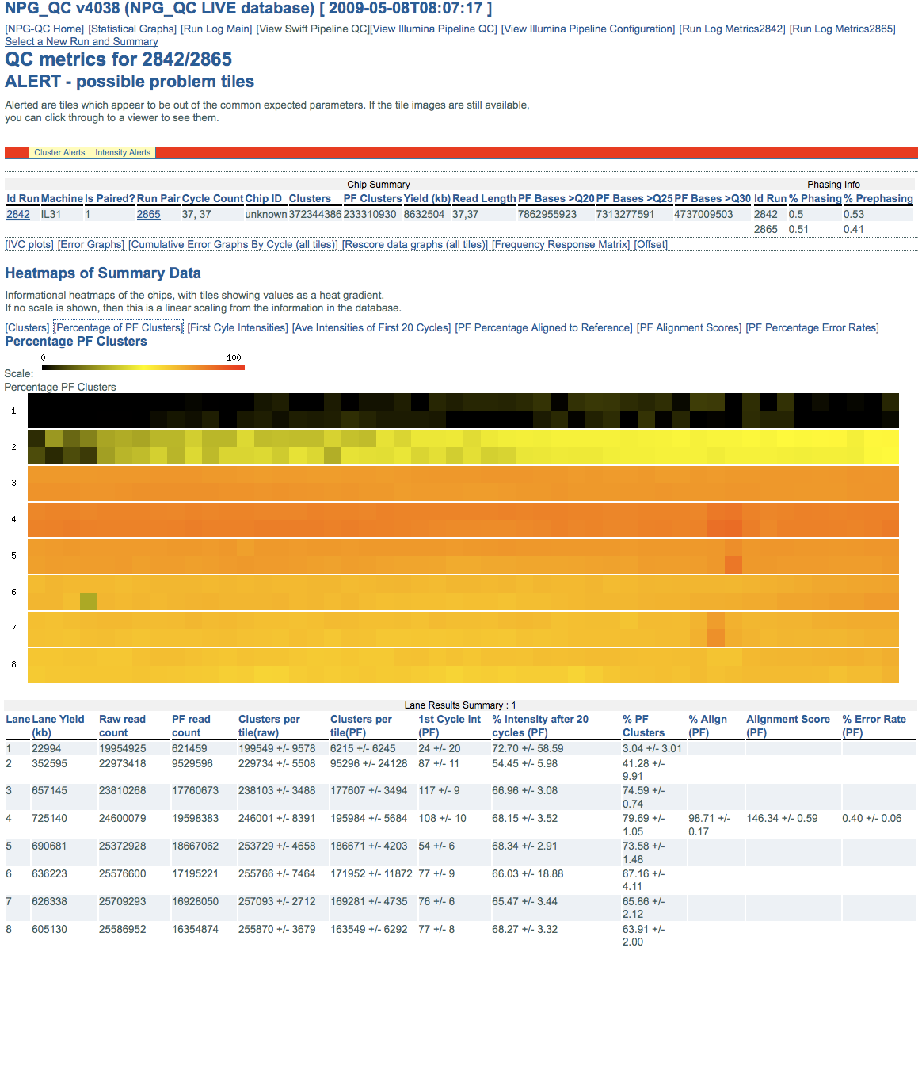
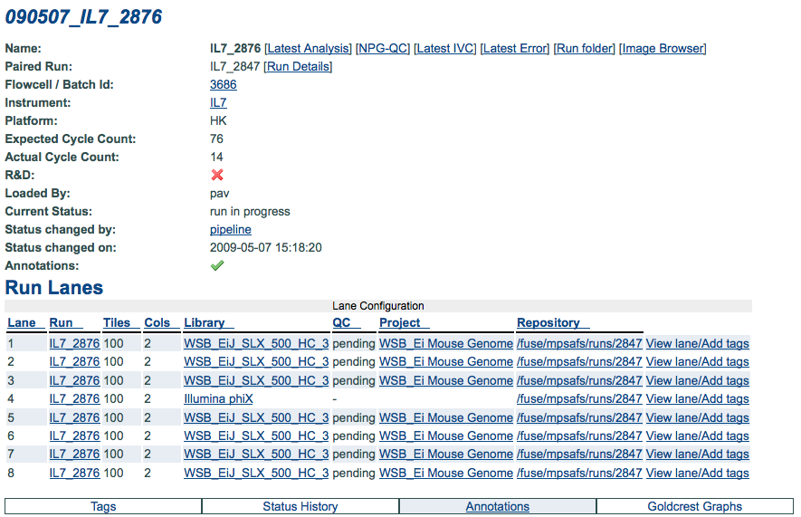
New Pipeline Development Group
Andrew Brown, Sri Deevi, Marina Gourtovaia, David Jackson, John O’Brien, Gouying Qi
Aim: Through production and maintenance of software packages and pipelines, provide
support to the institute’s users of New Sequencing Technologies
Chainlink QC services
Long term storage
NPG QC
pipeline QC
archive
MPSA
sequence
storage
SRF, fastq
Sequence-
Scape
project and
pipeline LIMs
NPG Tracking
for sequencing runs
and instruments
Run Tracking
Analysis QC Viewer
Alignment Pipeline
SequenceScape:
Project Management
Library Prep LIMS
(Externally managed)‏
Data Staging
Long Term Data Storage
NPG
Analysis
user
requested
alignments
Illumina
Genome
Analysers
You?
Mirroring &
Raw data
management
Sanger/Illumina
hybrid pipeline
Data Mirroring off Instruments
Analysis Pipeline
Manual QC of Runs
New Pipeline
Development
ERA
Staging storage
Data exposed via Web interfaces, XML/JSON services and Perl API modules.
Primary user interfaces are through the Run Tracking, Analysis QC Viewer and Alignment Pipeline applications, either through web interfaces or through XML/JSON services and Perl API modules.
NPG Tracking
Run tracking and instrument management.
NPG QC
Displaying the Illumina output of run analysis in a variety of formats including tile heatmaps of the run flowcell, graphs.

