Slide 1
How many tests does it take to change a lightbulb?
Andy Brown

Slide 2
Overview
What is the benefit of testing?
How to test?
Test-driven Development
Continuous Integration

Slide 3
What is the benefit of testing?
Testing allows you to be confident that your code will do what you want it to.
And more chance that it won’t do anything you don’t expect.
Allows the end user to be confident that the software will do the job.
Much easier to debug as the software develops.

Slide 4
How to test?
Simply: Give bits of code some data, and ask what the outcome is?
Develop into a test suite.
Run all tests after any feature is added, removed or code is refactored.
Debug.
Re-run tests.

Slide 5
Test-driven Development
Write a test to get an outcome.
Run the test - it should fail.
Write some code to make the test pass.
Run the test - does it pass?
Run the test suite to ensure nothing is now broken.

Slide 6
Example
Developing a room for a lightbulb to light.

Slide 7
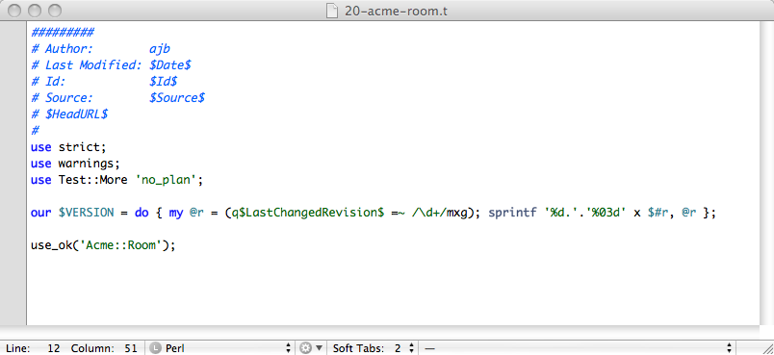

Slide 8
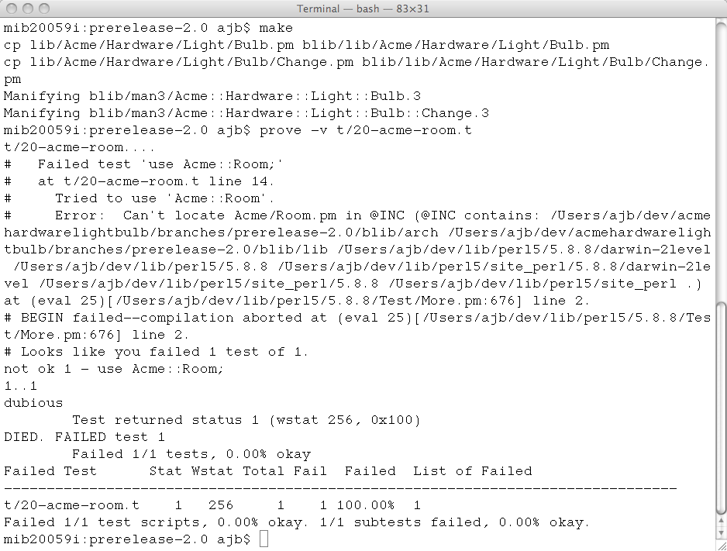

Slide 9
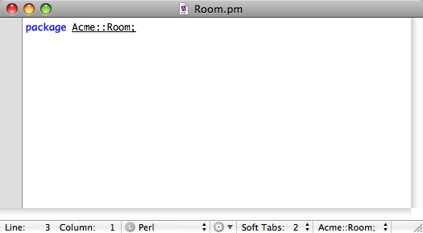

Slide 10
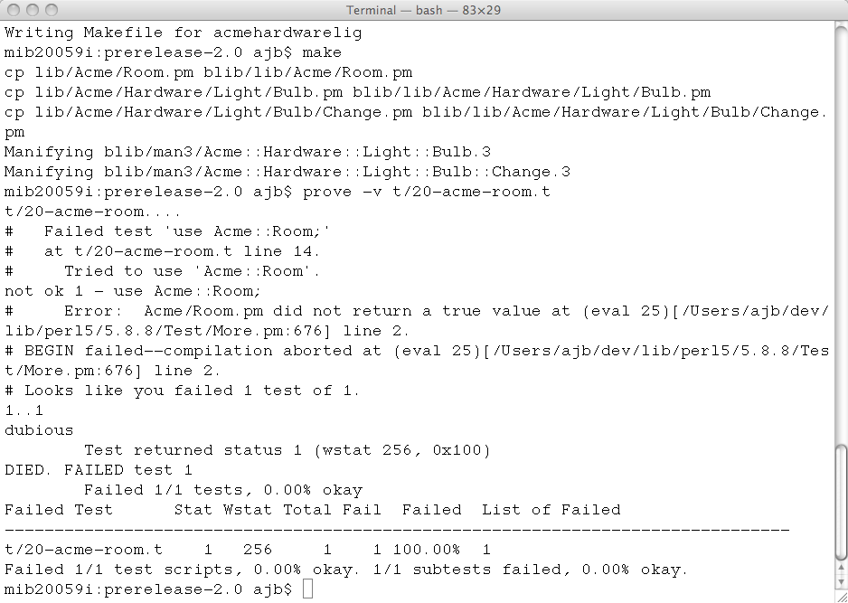

Slide 11
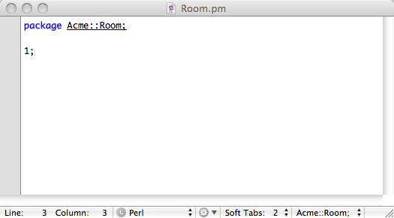

Slide 12
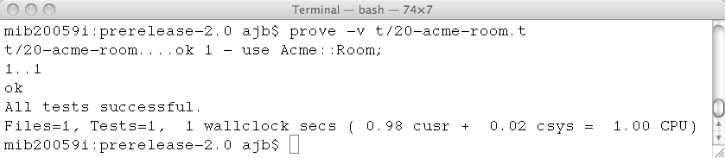

Slide 13
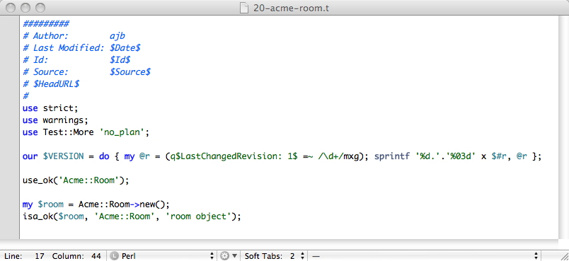

Slide 14
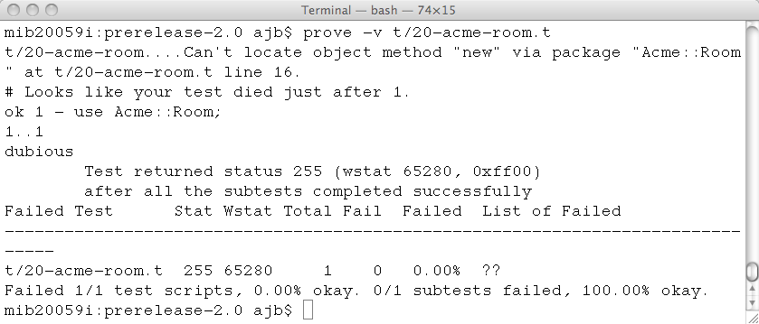

Slide 15
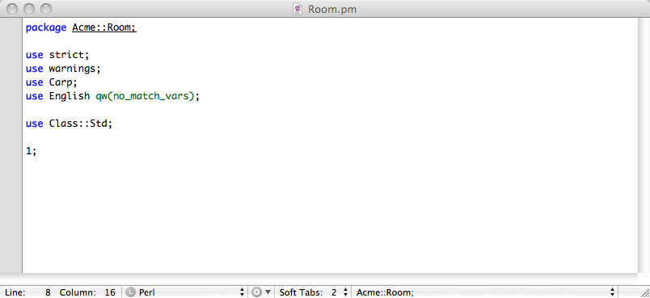

Slide 16
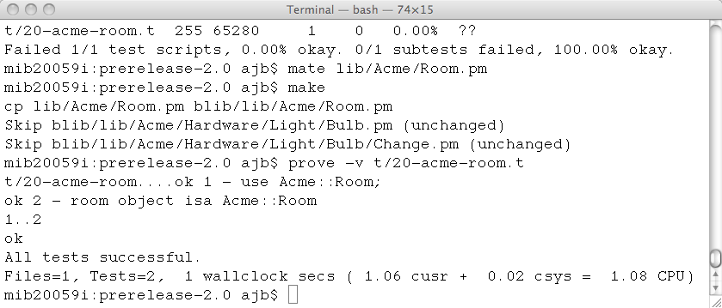

Slide 17
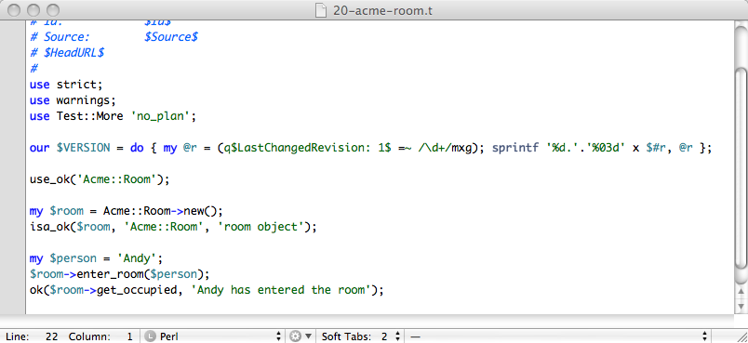

Slide 18
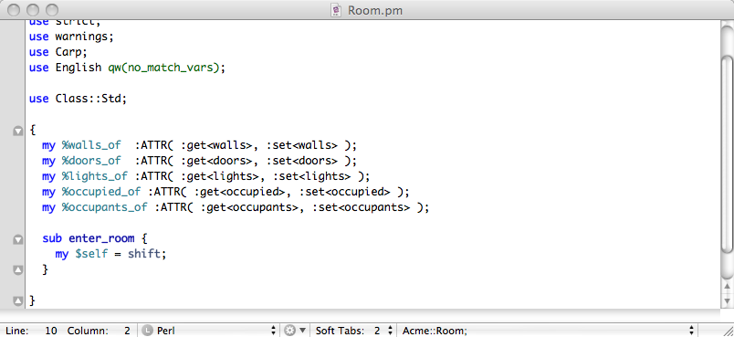

Slide 19
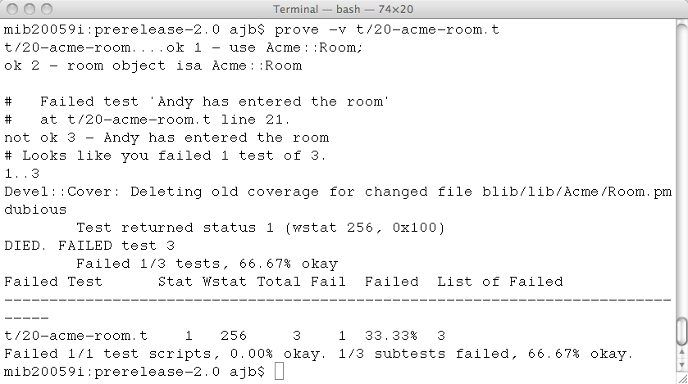

Slide 20
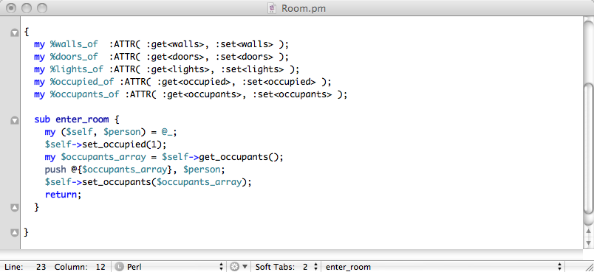

Slide 21
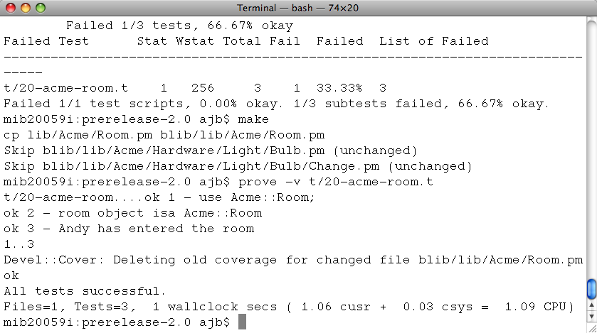

Slide 22
Conditionals

Slide 23
The forgotten bit
You need to test every single possible path throughout
Both: if/elsif/else
and: if (this and that) or (!the_other)
This could multiply the number of tests x-fold!

Slide 24
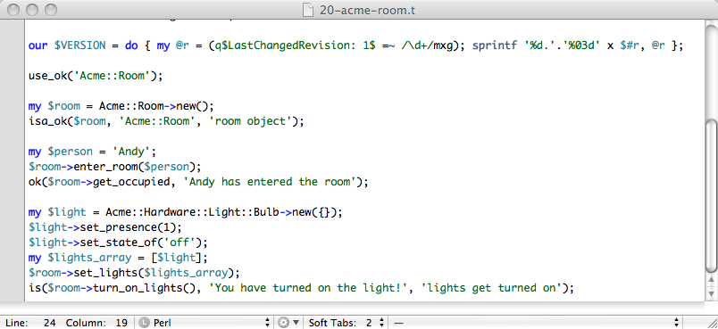

Slide 25
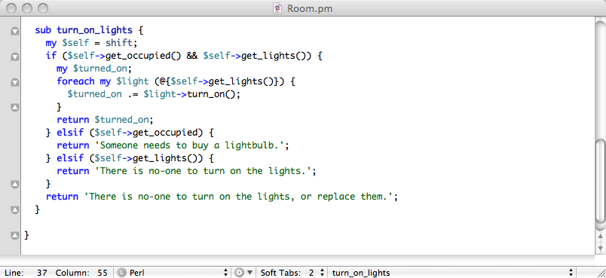

Slide 26
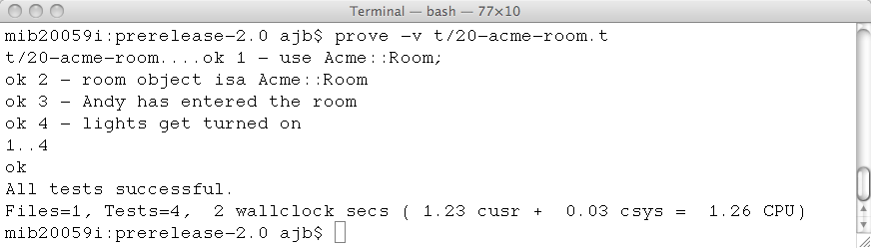

Slide 27
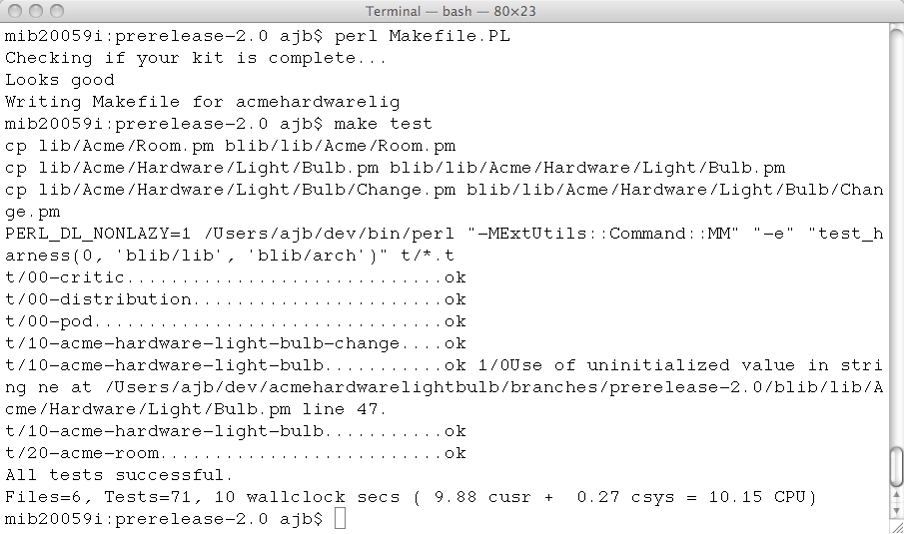

Slide 28
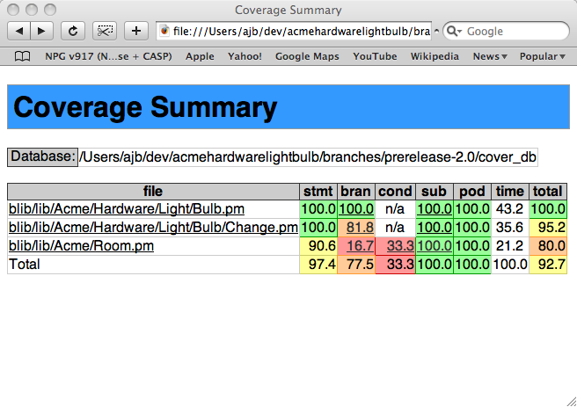

Slide 29
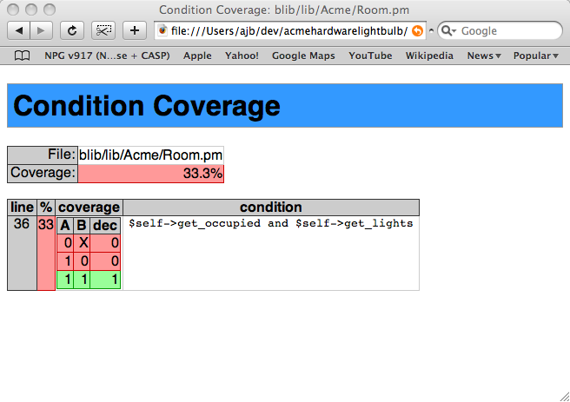

Slide 30
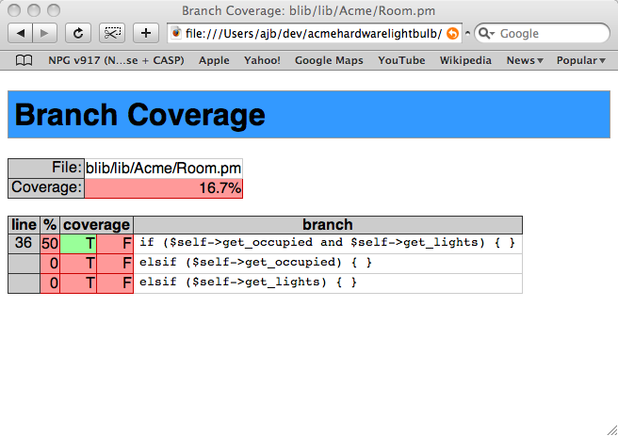

Slide 31
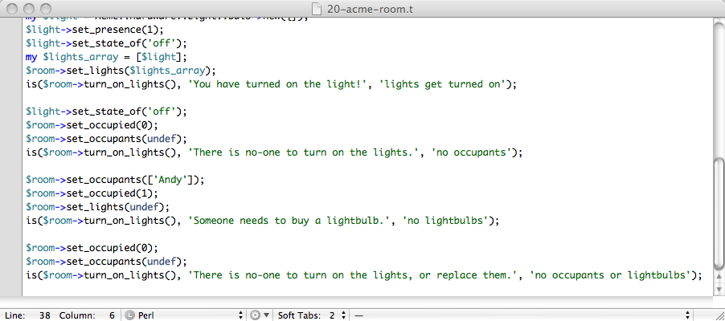

Slide 32
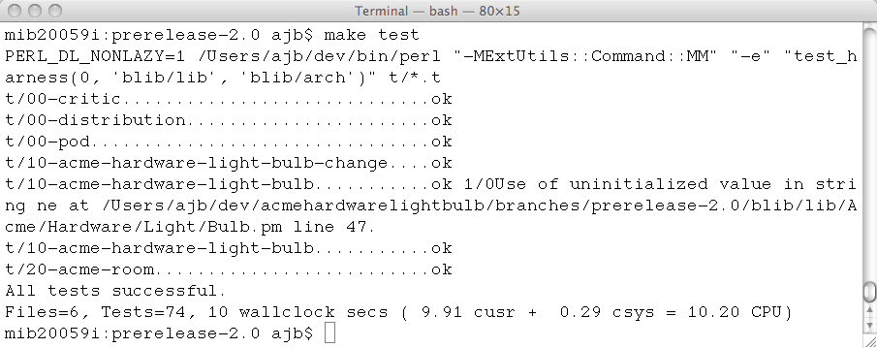

Slide 33
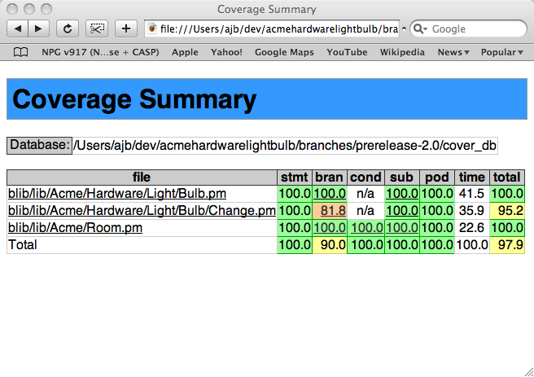

Slide 34
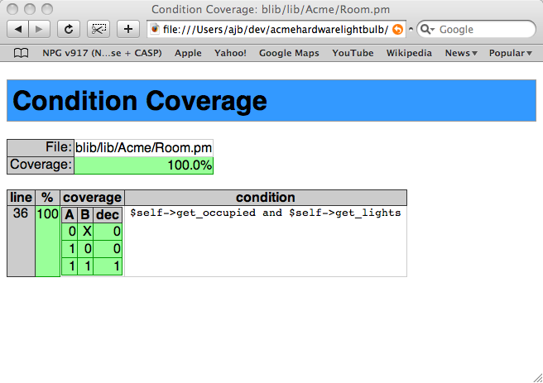

Slide 35
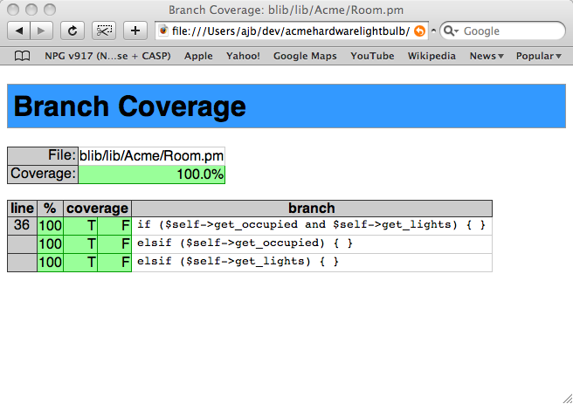

Slide 36
What does that mean?
Because you have been through every conditional, you can be very confident that the code is robust.
If I changed something in the Acme::Hardware::Light::Bulb module, all those conditionals in Acme::Room will get tested, and show breakages better.

Slide 37
That was PERL!
Perl - Test::More and Devel::Cover
Java - Junit
Ruby - Test::Unit
Rails - Tests baked right in
Haskell - Hunit
C/C++ - Boost
Just Google around!
You can always write tests, and if you can’t find a suitable framework, then develop your own.

Slide 38
Shared Development
Someone changes something
You update
Run the tests
If the tests pass - great!
If the tests fail - you find out what they broke!
They do the same to you!

Slide 39
Continuous Integration
Continuous Integration servers allow code to be constantly kept in check
Can update the version control and released software to constantly release
Test suites are vital!

Slide 40
Summary
Write tests - preferably before the code is written
But write them anyway if not
Develop into a suite
Run often
Even use_ok(my::module) will ensure code at least compiles

Slide 41
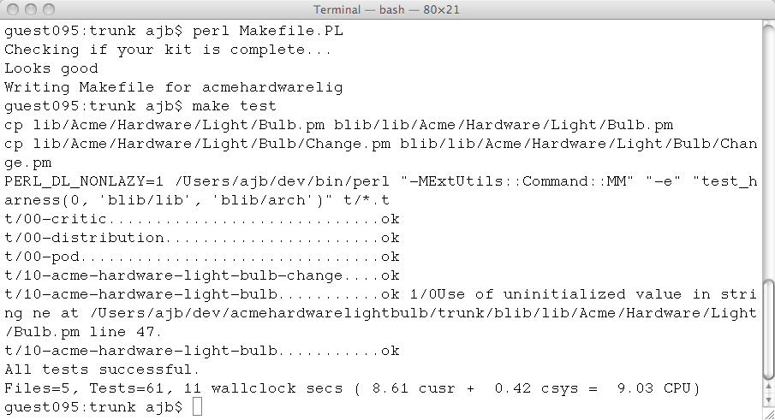
How many tests does it take to change a lightbulb?
61

Slide 42
http://vampiresoftware.blogspot.com/
http://sourceforge.net/projects/acmehardwarelig

